Slide 1
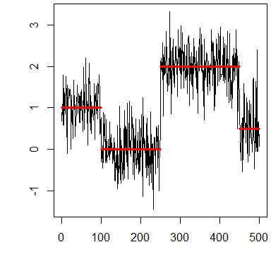
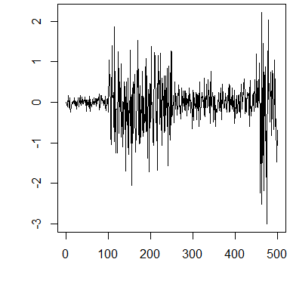
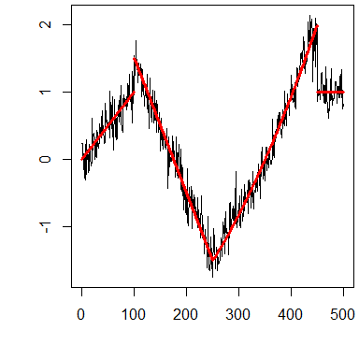
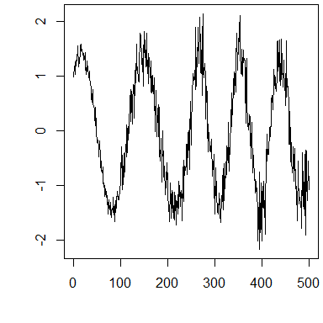
Further Changepoint Analysis

Slide 2
References
Video Tutorials:
NHS-R Community Conference 2020. Introduction to changepoint analysis
https://www.youtube.com/watch?v=WelmlZK5G2Y
NHS-R Community Conference 2020. Further Changepoint Analysis
https://www.youtube.com/watch?v=GP5O3_iko1M
useR! International R User 2017 Conference Introduction to optimal changepoint detection algorithms
https://www.youtube.com/watch?v=I7jUBro78RM
Git-Repos for the tutorials
https://github.com/tdhock/change-tutorial
https://github.com/rkillick/intro-changepoint-course
https://github.com/rkillick/further-changepoints-course

Slide 3

Recall: changepoints
For data $y_{1},…,y_{n}$, if a changepoint exists at $τ$, then $y_{1},…,y_{τ}$ differ from $y_{τ+1},…,y_{n}$ in some way.
There are many different types of change.

Slide 4
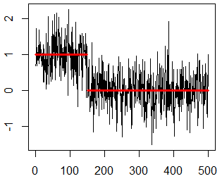
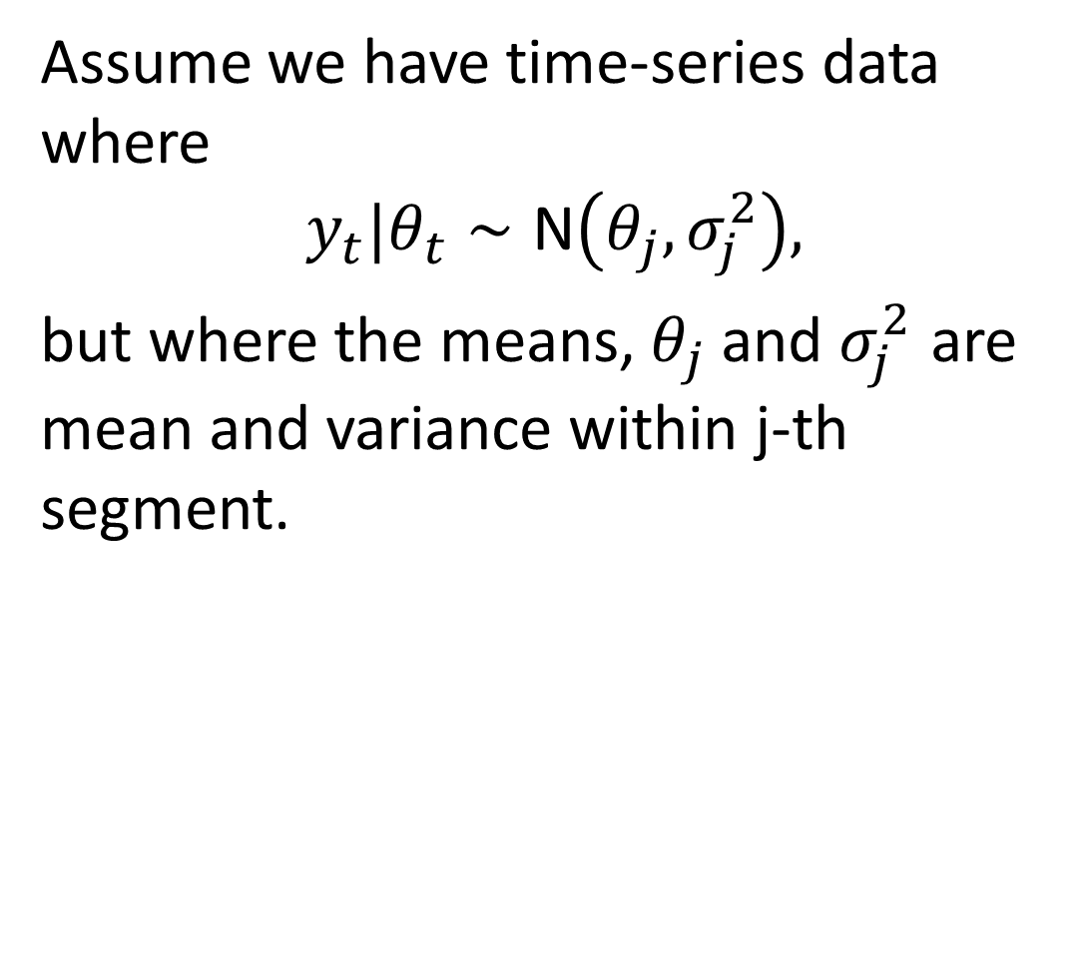
Single Changepoint
Assume we have time-series data where
$$y_{t}|θ_{t}∼\text{N}\left(θ_{j},σ_{j}^{2}\right),$$
but where the means, $θ_{j}$and $σ_{j}^{2}$ are mean and variance within j-th segment.

Slide 5
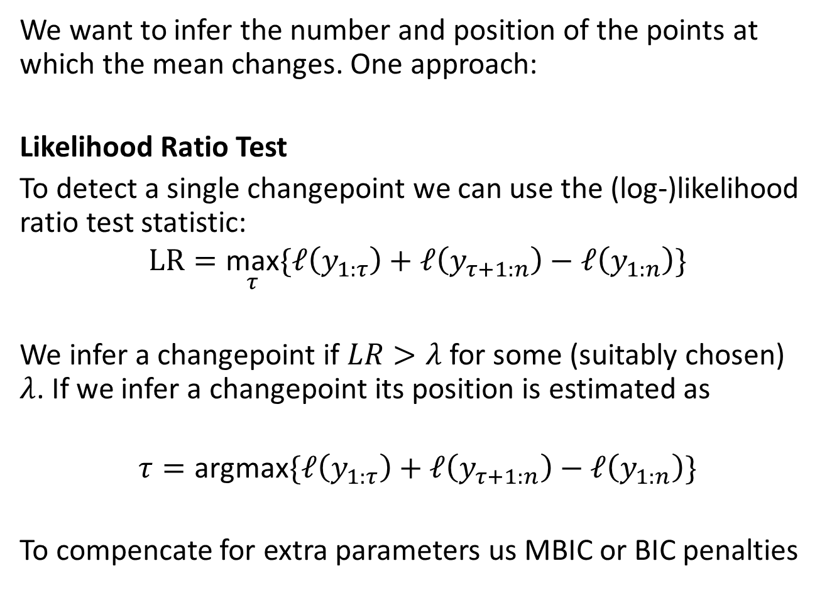
Single Changepoint
We want to infer the number and position of the points at which the mean changes. One approach:
Likelihood Ratio Test
To detect a single changepoint we can use the (log-)likelihood ratio test statistic:
$$LR=\underset{τ}{\text{max}}\{ℓ\left(y_{1:τ}\right)+ℓ\left(y_{τ+1:n}\right)−ℓ\left(y_{1:n}\right)\}$$
We infer a changepoint if $LR>λ$ for some (suitably chosen) $λ$. If we infer a changepoint its position is estimated as
$$τ=\text{argmax}\{ℓ\left(y_{1:τ}\right)+ℓ\left(y_{τ+1:n}\right)−ℓ\left(y_{1:n}\right)\}$$
To compencate for extra parameters us MBIC or BIC penalties

Slide 6
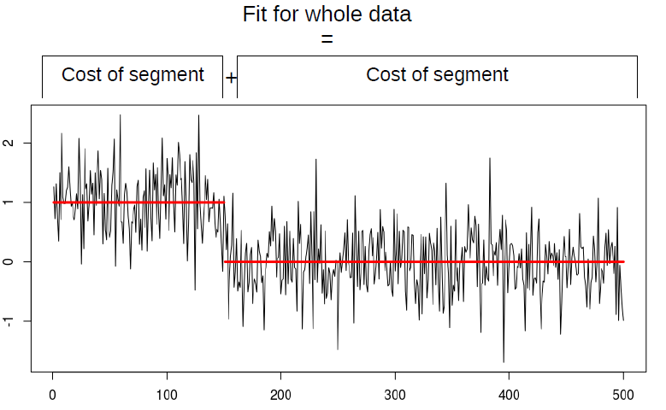
Single Changepoint
(optional)
- Cost of Whole

Slide 7
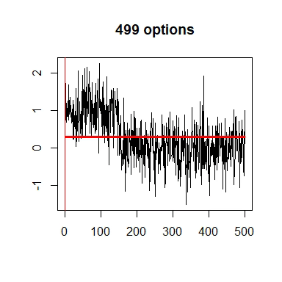
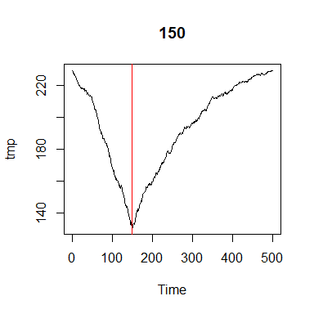
Finding a single change
Fit

Slide 8
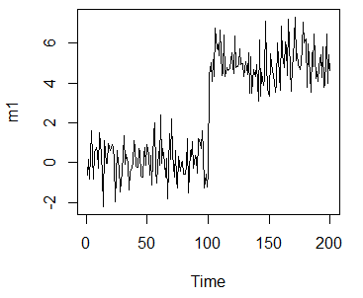
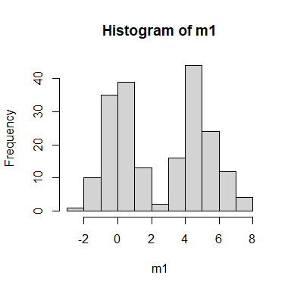
Checking Assumptions
The main assumptions for a Normal likelihood ratio test for a change in mean are:
Independent data points;
Normal distributed points pre and post change;
Constant variance across the data.
How can we check these?

Slide 9
How to check
Check the residuals
set.seed(1) m1=c(rnorm(100,0,1),rnorm(100,5,1)) m1.amoc=cpt.mean(m1) means=param.est(m1.amoc)$mean m1.resid=m1-rep(means,seg.len(m1.amoc)) shapiro.test(m1.resid)
## ## Shapiro-Wilk normality test ## ## data: m1.resid ## W = 0.99228, p-value = 0.3721

Slide 10
Residual Check
ks.test(m1.resid,pnorm,
mean=mean(m1.resid),
sd=sd(m1.resid))
## ## One-sample Kolmogorov-Smirnov test ## ## data: m1.resid ## D = 0.045812, p-value = 0.7953 ## alternative hypothesis: two-sided

Slide 11
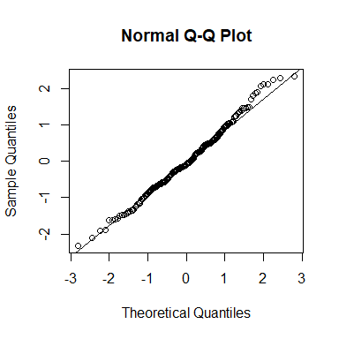
Residual Check
qqnorm(m1.resid) qqline(m1.resid)

Slide 12
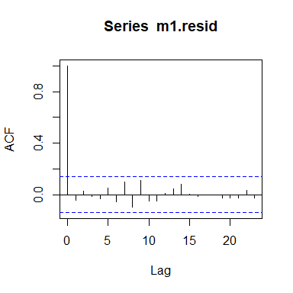
Residual Check
acf(m1.resid)

Slide 13
Outline
Recap of changepoints
Checking assumptions
Autocorrelation
Multivariate changepoints
Influence

Slide 14
Packages
Today we will use the following packages
library(changepoint)
library(EnvCpt)
library(changepoint.influence)
library(changepoint.geo)
Other notable R packages are available for changepoint analysis including
ecp - for univariate and multivariate energy test statistics
InspectChangepoint - for multivariate Inspect projection direction mean only change
hdbinseg - for multivariate double CUSUM test statistic
BayesProject - for multivariate changepoints

Slide 15
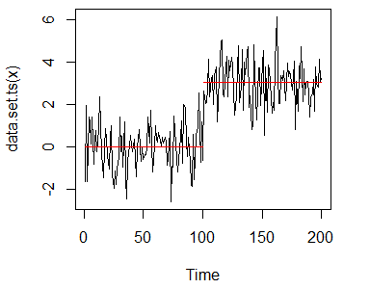
Autocorrelation
What effect does autocorrelation have on our analysis?
set.seed(879123) x=c(rnorm(100),rnorm(100,3)) plot(cpt.meanvar(x,method='PELT'))

Slide 16
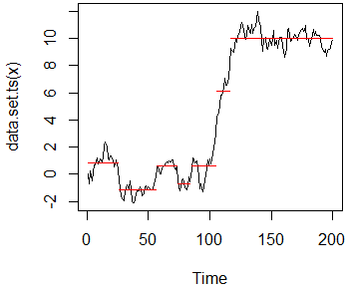





Autocorrelation +ve
What effect does autocorrelation have on our analysis?
source('sim.cpt.AR1.R') set.seed(879123) x=sim.cpt.AR1(cpts=c(0,100,200),
X=cbind(rep(1,200)),init=0, beta=rbind(c(0,0.9),c(1,0.9)),
sig2=(1-0.9^2),nsim=1) plot(cpt.meanvar(x,method='PELT'))
AR(1) model:

Slide 17
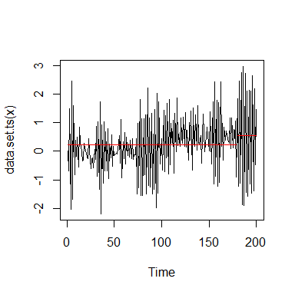
Autocorrelation -ve
What effect does autocorrelation have on our analysis?
set.seed(879123) x=sim.cpt.AR1(cpts=c(0,100,200),
X=cbind(rep(1,200)),init=0, beta=rbind(c(0,-0.9),c(1,-0.9)),
sig2=(1-0.9^2),nsim=1) plot(cpt.meanvar(x,method='PELT'))

Slide 18
Exercise
Take a look at the “Lai2005fig4” data in the changepoint package. Fit changes in mean as below, then check the residuals.
Are the assumptions of our model reasonable?
data("Lai2005fig4") out=cpt.mean(Lai2005fig4$GBM29,method='PELT')
Don’t forget to look at the data!

Slide 19
EnvCpt
EnvCpt automatically fits 12 different models to your data:
Flat mean (+AR1, +AR2, +Change, +AR1+Change, +AR2+Change)
Trend mean (+AR1, +AR2, +Change, +AR1+Change, +AR2+Change)
AR1= autoregressive of order 1 = current data point is strongly related to the last data point.
BONUS: Can see which model is best
PITFALL: Might be best to use another model which isn’t checked - always look at the fit!

Slide 20
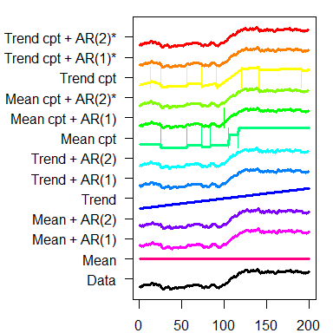
EnvCpt: Example
set.seed(879123) x=sim.cpt.AR1(cpts=c(0,100,200),
X=cbind(rep(1,200)),init=0, beta=rbind(c(0,0.9),c(1,0.9)),
sig2=(1-0.9^2),nsim=1) out=envcpt(x)
## Fitting 12 models
which.min(BIC(out))
## meanar1cpt ## 5
plot(out)

Slide 21
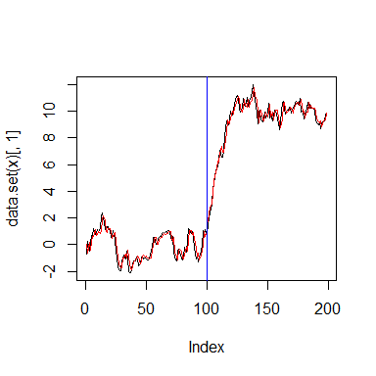
EnvCpt: Example
cpts(out$meanar1cpt)
## [1] 100
plot(out[[which.min(BIC(out))+1]]) abline(v=cpts(out$meanar1cpt),
col='blue')

Slide 22
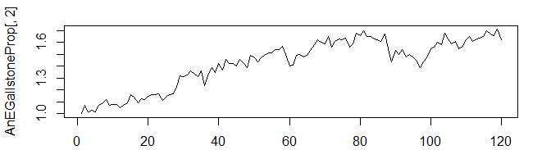
EnvCpt: A&E Gallstone
HES Data on monthly proportion of A&E admissions for gallstone disease from Jan 2010 - Dec 2019.
load('AnEGallstoneProp.Rdata') plot(AnEGallstoneProp[,2],type='l')
Use EnvCpt to see if there is evidence for changes in the monthly proportion of A&E admissions for gallstone disease.

Slide 23
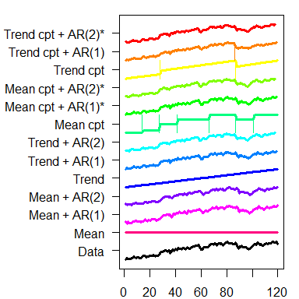
Gallstone Solution
out=envcpt(AnEGallstoneProp[,2])
## Fitting 12 models
which.min(BIC(out))
## trendar1cpt ## 11
plot(out)

Slide 24
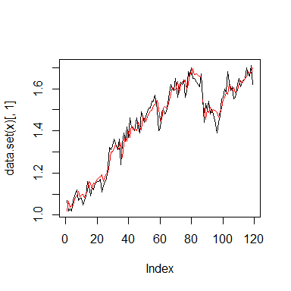
Gallstone Solution
AnEGallstoneProp$Date[cpts(out$trendar1cpt)]
## [1] "0001-02-17"
plot(out$trendar1cpt)

Slide 25
Exercise
Go back to the “Lai2005fig4” data. Use envcpt() to identify the best model. Does this fit with what we observed previously?

Slide 26
Multivariate changes
In moving to the multivariate setting a number of different scenarios could arise.
The process in each channel could be unconnected to the rest (i.e. repeated use of univariate cpt methods might be appropriate);
There may be some shared structure across channels. For example
Changes occur at the same time in all channels;
Changes occur in a subset of channels at the same time.
The nature of the change could vary from one channel to another;
and doubtless many more scenarios!

Slide 27
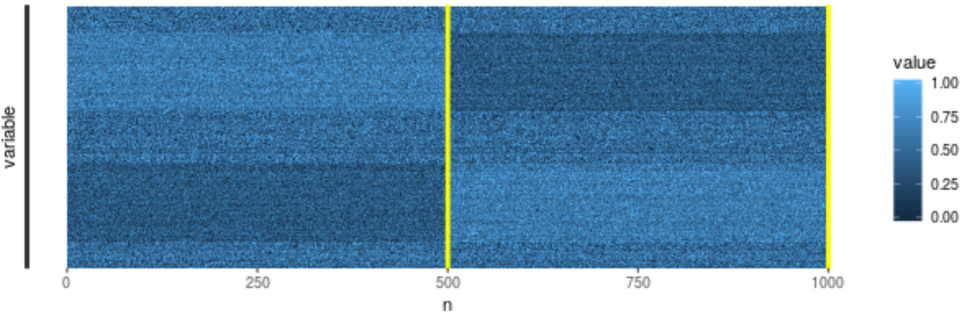
Multivariate changes
In the multivariate setting we encounter new challenges:
Computational expense.
Sparsity of changepoints.
Incorporating multivariate power.

Slide 28
Many methods
Some well known multivariate changepoint approaches include:
ecp: James, Matteson (2015)
Inspect: Wang, Samworth (2017)
DoubleCUSUM: Cho (2016)

Slide 29
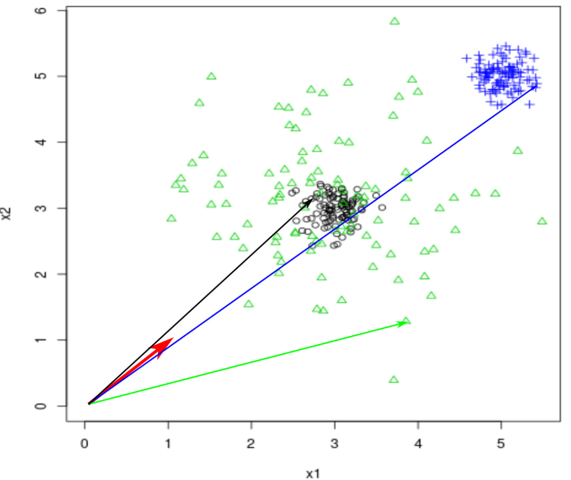
GeomCP Intuition

Slide 30
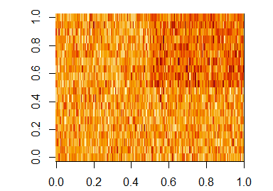
GeomCP Mean Ex
set.seed(1) Y=rbind(matrix(rnorm(100*20),ncol=20),cbind(matrix(rnorm(100*10), ncol=10),matrix(rnorm(100*10,1),ncol=10))) image(Y)

Slide 31
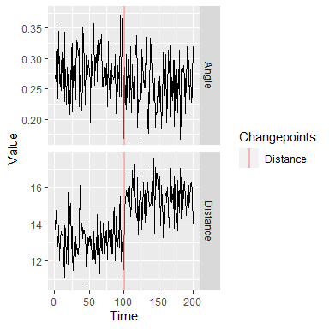
GeomCP: Mean Ex
res <- geomcp(Y) plot(res)

Slide 32
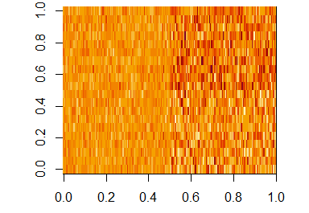
GeomCP MeanVar Ex
set.seed(1) Y=rbind(matrix(rnorm(100*20),ncol=20),cbind(matrix(rnorm(100*10,0,2), ncol=10),matrix(rnorm(100*10,1,2),ncol=10))) image(Y)

Slide 33
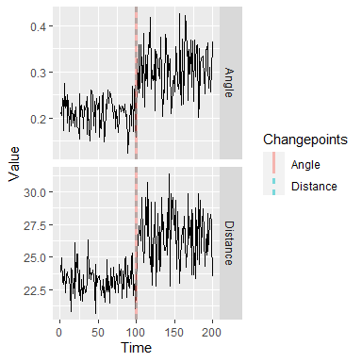
GeomCP: MeanVar Ex
res <- geomcp(Y) plot(res)

Slide 34
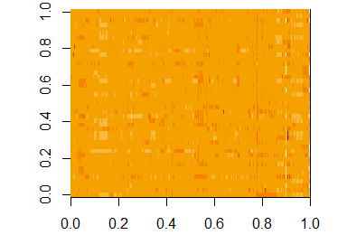
Task: Genetics
Analyse the ACGH Bladder Tumor data from the ecp package. It is 2215x43 with 43 patients. How many changes do you find?
data(ACGH) image(ACGH$data)

Slide 35
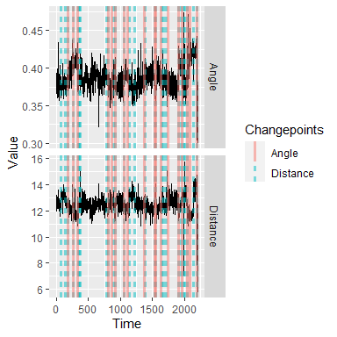
Solution: Genetics
outACGH <- geomcp(ACGH$data) plot(outACGH)

Slide 36
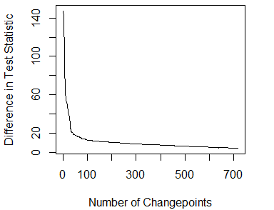
Solution: Genetics
Can also take the distance and angle vectors and analyse using CROPS
outACGH.dist=cpt.meanvar(distance(outACGH),method='PELT', penalty='CROPS',pen.value=c(5,500)) plot(outACGH.dist,diagnostic=TRUE)

Slide 37
Influence
Which data points are influential for obtaining the segmentation?
Changepoints versus Outliers
How to measure influence?
How stable is the obtained segmentation?

Slide 38
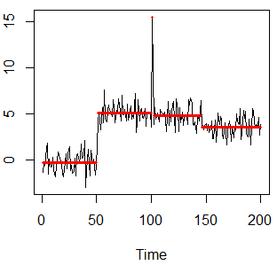
Influence: Example
set.seed(30) x=c(rnorm(50),rnorm(50,mean=5),
rnorm(1,mean=15), rnorm(49,mean=5),
rnorm(50,mean=4)) xcpt=cpt.mean(x,method='PELT') plot(xcpt,cpt.width=3,ylab='')

Slide 39
How to measure?
Sources of Inspiration:
Regression Analysis: Measures of Influence (e.g., Cook’s distance)
Robust Statistics: Influence Functions
Two routes:
Modifying an observation
Leaving out an observation

Slide 40
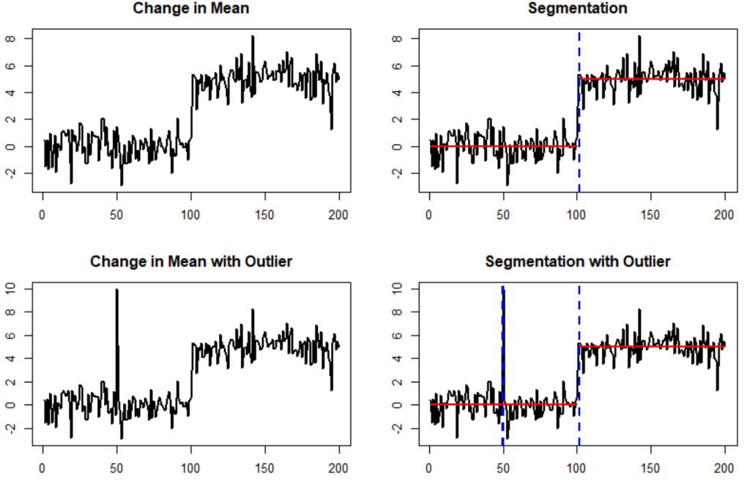
Modify

Slide 41
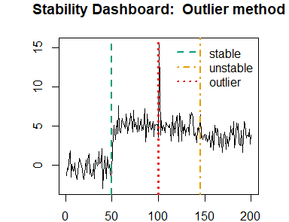
Stability Dashboard: Out
x.inf.out=influence(xcpt,method='outlier') out.Stability=StabilityOverview(x,cpts(xcpt),x.inf.out, legend.args=list(display=TRUE,x="topright",y=NULL,cex=1, horiz=FALSE,xpd=FALSE,bty='n'))

Slide 42
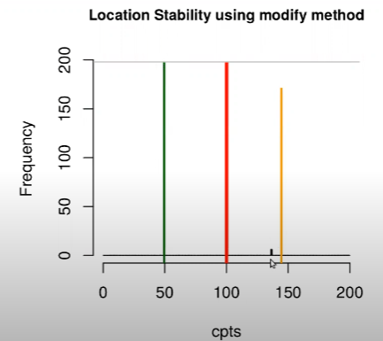
Location Stability: Mod
out.location=LocationStability(cpts(xcpt),x.inf, cex.main=0.9)

Slide 43
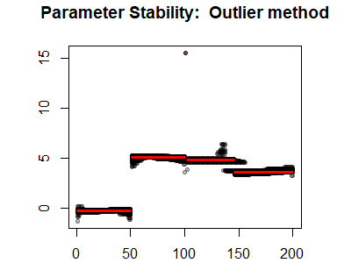
Parameter Stability: Out
ParameterStability(x.inf.out,original.mean=rep( param.est(xcpt)$mean,times=diff(c(0,xcpt@cpts))))

Slide 44
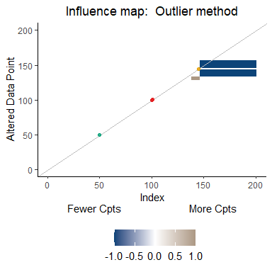
Influence Map: Out
out.map=InfluenceMap(cpts(xcpt),x.inf.out)

Slide 45

Stability Dashboard: Del
x.inf.del=influence(xcpt,method='delete') del.Stability=StabilityOverview(x,cpts(xcpt),x.inf.del, legend.args=list(display=TRUE,x="topright",y=NULL,cex=1, horiz=FALSE,xpd=FALSE,bty='n'))

Slide 46
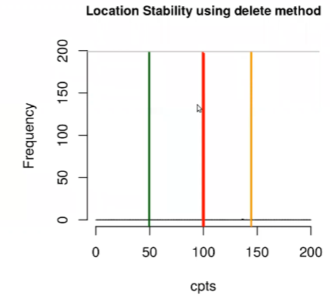
Location Stability: Del
del.location=LocationStability(cpts(xcpt),x.inf.del

Slide 47
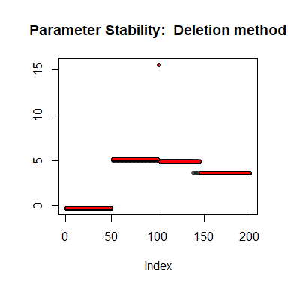
Parameter Stability: Del
ParameterStability(x.inf.del,original.mean=rep( param.est(xcpt)$mean,times=diff(c(0,xcpt@cpts))))

Slide 48
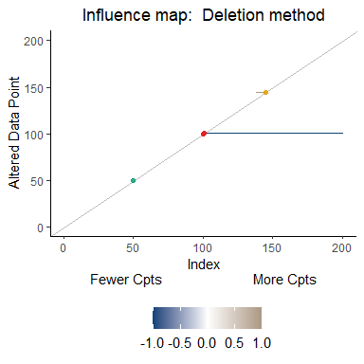
Influence Map: Del
del.map=InfluenceMap(cpts(xcpt),x.inf.del)

Slide 49
Summary
Multivariate is interesting but still lots of challenges in the univariate space
Lots of interesting research in the changepoint space
Always looking for interesting problems to work on
Reach out if you want help / guidance

Slide 50
References
PELT: Killick, Fearnhead, Eckley (2012)
EnvCpt: Beaulieu, Killick (2018)
geomCP: Grundy, Killick (2020)
Influence: Wilms, Killick, Matteson (2021+)

