Slide 1




PORTFOLIO • 2026
Putri Rizqi
Khairunnisa
Mobile Application Developer
Flutter
Android (Kotlin)
REST API
AI / ML Integration
Indonesia
khairunnisaaptr@gmail.com
github.com/nisarizqi
linkedin.com/in/putririzqik

Slide 2
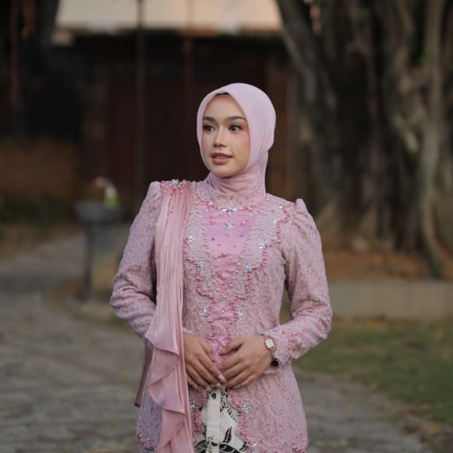

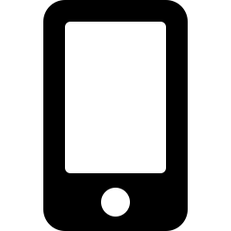
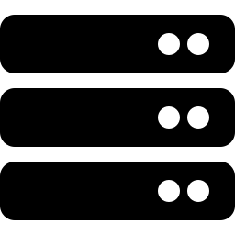

ABOUT ME
Building mobile experiences
with heart & precision
Production-Ready Mobile Apps
Your Photo Here
Mobile Application Developer with experience building production-ready mobile applications using Flutter and Android technologies.
1:1 photo, min 500×500px
Enterprise Systems & APIs
Experienced in developing enterprise internal systems, RESTful APIs, and integrating AI-based features such as biometric authentication, facial recognition, and location-based services.
User-Centered Craft
Passionate about building scalable, efficient, and user-centered mobile solutions.
Putri Rizqi Khairunnisa • Mobile Application Developer
02

Slide 3


CORE SKILLS
What I Work With
Mobile Development
Backend & API
Flutter • Kotlin • Jetpack Compose
Laravel • RESTful API • MySQL
AI / Machine Learning
Tools & Workflow
Google ML Kit • PyTorch • Image Processing
Git • Postman • Android Studio • Figma • VS Code
Putri Rizqi Khairunnisa • Mobile Application Developer
03

Slide 4


PROJECTS
Featured Mobile Projects
MAIN PROJECT
TOP 50 CAPSTONE
SoloHRIS
Bersih.Kan
Internal Attendance System — production mobile app for employee attendance.
Waste Management Platform — capstone project for Bangkit Academy.
Built using Flutter from scratch
Developed REST API using Laravel
Integrated biometric login, face recognition, GPS attendance
Used for internal employee operations
Android app using Jetpack Compose
Integrated ML-based waste classification
UI/UX with 10+ screens
Recognized among Top 50 Capstone Projects
Flutter • Laravel • ML Kit • MySQL
Kotlin • Jetpack Compose • ML API
Putri Rizqi Khairunnisa • Mobile Application Developer
04

Slide 5


PROJECTS
Machine Learning & Research Projects
THESIS
ML RESEARCH
White Blood Cell
Segmentation
Plant Recommendation
System
Medical image segmentation using deep learning.
Machine learning classification system for plant recommendation.
U-Net with ResNet34 backbone
Hybrid Gated Attention + SE Block
Achieved 96.06% Dice Score
SVM classification model
Optimized using Artificial Bee Colony algorithm
Improved accuracy over baseline
Python • PyTorch • Deep Learning
Python • Scikit-learn
Putri Rizqi Khairunnisa • Mobile Application Developer
05

Slide 6





CASE STUDY
SoloHRIS — Project Deep Dive
Internal attendance system mobile application for employees.
Problem
Solution
Previous system was web-based and inefficient; manual attendance caused delays and inconsistencies.
Developed a mobile-first attendance system with biometric + facial recognition + GPS validation.
Architecture
Contribution
Flutter (Mobile App) • Laravel (Backend API) • Google ML Kit (Face Recognition) • MySQL (Database)
End-to-end mobile development, API integration, and feature development for biometric, GPS, and authentication.
Impact: Improved internal attendance workflow efficiency and reduced manual processing dependency.
Putri Rizqi Khairunnisa • Mobile Application Developer
06

Slide 7



EXPERIENCE
Work Experience
PT BPR Bank Solo (Perseroda)
Nov 2025 – Present
Information Technology Staff
Developed SoloHRIS, internal Flutter-based attendance system
Built REST APIs using Laravel
Integrated biometric login, facial verification, GPS attendance
Provided IT support and system maintenance
DTIK UNS
Oct 2023 – Dec 2024
Software Developer Intern
Documented technical specifications for academic systems
Collaborated to improve usability and workflow
Universitas Sebelas Maret
Feb 2024 – Jun 2024
Teaching Assistant — Android Development
Mentored 50+ students in Android development
Reviewed 150+ assignments and projects
Putri Rizqi Khairunnisa • Mobile Application Developer
07

Slide 8


CERTIFICATIONS
Certifications
Continuous learning across mobile, cloud, and programming fundamentals.
Dev Certification for Android (DCA)
Bangkit Academy
Python Coding Bootcamp
Dicoding
Google, GoTo, Traveloka
Progate
Putri Rizqi Khairunnisa • Mobile Application Developer
08

Slide 9
LET'S CONNECT
Let's build impactful
mobile solutions together.
Email
LinkedIn
GitHub
khairunnisaaptr@gmail.com
linkedin.com/in/putririzqik
github.com/nisarizqi
Thank you!

