Slide 1
Airbnb Analysis – Texas
Team Members:
Nisa Bukhari
Nick Smith
Todd Grubbs
Nader Elkhatib

Slide 2
Outline
Airbnb Findings: Listings and Cost
Factors Impacting Airbnb variables:
Walk Scores
Population/Census Data
Restaurants Rating & List

Slide 3
Airbnb Findings
Listings and Cost

Slide 4
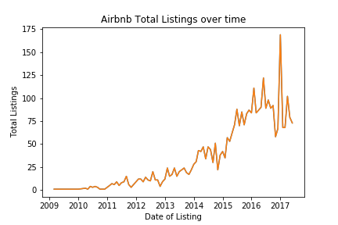
Airbnb Findings: Total Listings

Slide 5
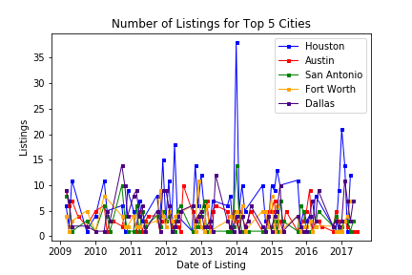
Airbnb Findings: Top 5 Cities Listings

Slide 6
Airbnb Findings: Listings
Total Airbnb Listings vs five most popular cities:
It appears that the overall number of listings trends noticeably upward but the popular cities don't increase to account for the change.
This means the increase in listings is due to more listings in a variety of cities.

Slide 7
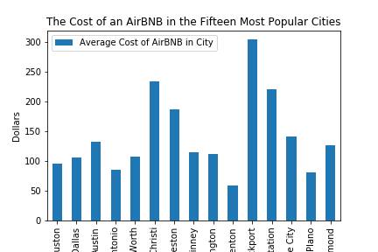
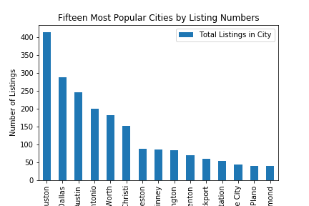
Airbnb Findings: Top 15 Cities Cost

Slide 8
Airbnb Findings: Top 15 Cities Cost
Average Cost in Top 15 Cities:
Vacation spots will cost more money.
The anomaly here is College Station, it seems that Aggies are willing to pay more in order to stay near their alma mater.

Slide 9
Walk Scores
Walks Scores vs Airbnb Listings & Ave Price

Slide 10
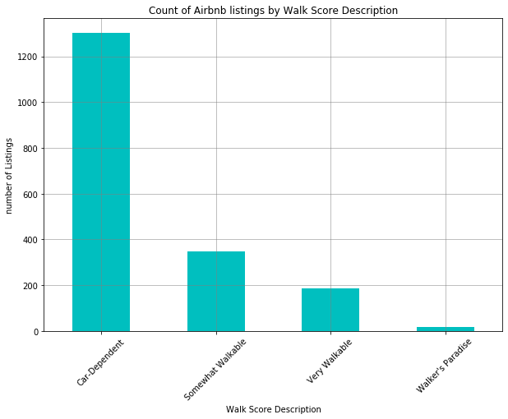
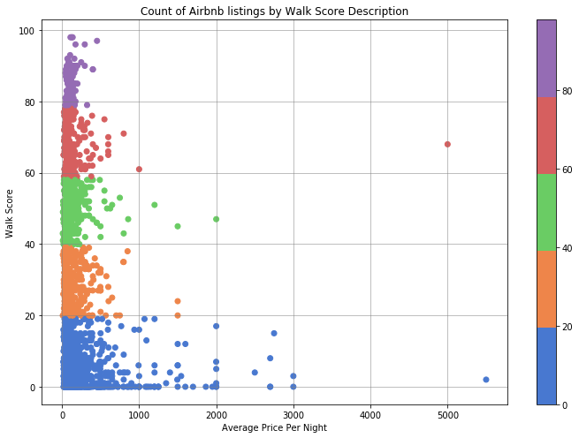
Walks Scores vs Airbnb Listings & Ave Price

Slide 11
Walks Scores vs Airbnb Listings & Ave Price
Question: Do Walk Scores have an effect on Airbnb Listings count and Average Price per Night?
Analysis
When comparing walk score to the Airbnb listings, the dominate amount of Airbnb listings in Texas are considered “Car-Dependent”
When comparing the average price of Airbnb listings, it does not show any strong correlations with the walk score rating.

Slide 12
Population/Census Data
Population Data vs Airbnb Ave Rates

Slide 13
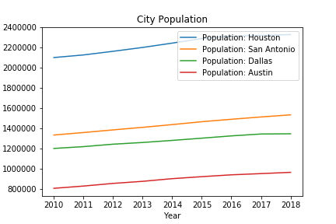
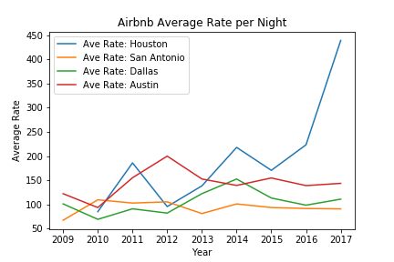
Airbnb Average Rates vs Cities’ Population

Slide 14
Airbnb Average Rates vs Cities’ Population
Question: Is there a correlation between Airbnb average rate changes and population changes on a city level?
Analysis:
Population per city increases over time.
Airbnb rates seem to fluctuate in small intervals
Cannot conclude there is a correlation between the two variables

Slide 15
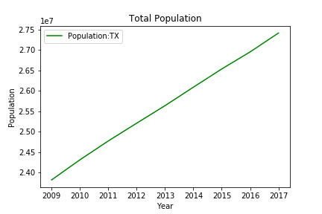
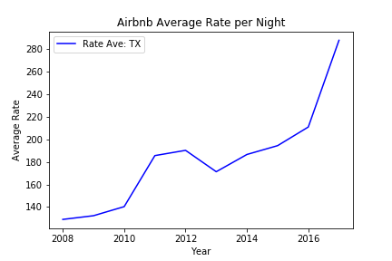
Airbnb Average Rate vs State Population

Slide 16
Airbnb Average Rate vs State Population
Question: Is there a correlation between Airbnb average rates and Texas’ population change?
Analysis:
Population and average rates on a state level both increase with time.
Potential positive correlation between the two variables.

Slide 17
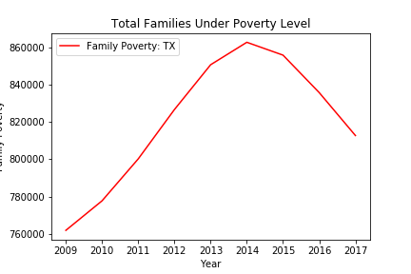
Airbnb Average Rate vs Poverty Levels

Slide 18
Airbnb Average Rate vs Poverty Levels
Question: Is there a correlation between Airbnb average rate and family count under poverty level in Texas?
Analysis:
Poverty level increase over time but starts to decrease 2014 and afterwards
Potential negative correlation post 2014 as renting out spaces may’ve become an additional source of income families under poverty levels utilized.

Slide 19
Restaurants Rating & List

Slide 20
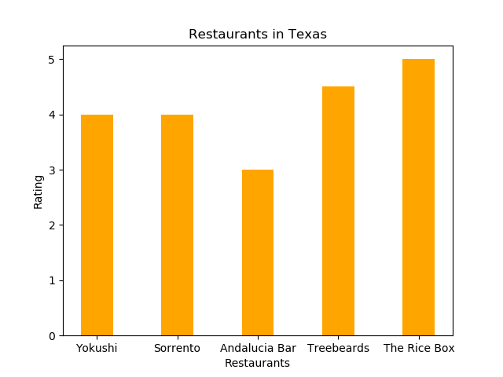
Restaurants Rating & List

Slide 21
Restaurants Rating & List for Airbnb
With YELP API the restaurants information that includes business names, phone numbers, addresses, distances, & rating.
YELP Fusion API allows an individual to review millions of businesses across 32 countries.
It is much easier to locate the top rating restaurants in Texas with the YELP API.
The rating and the restaurants list at your fingertip.

Slide 22
References
Kaggle CSV Airbnb Data Set:
https://www.kaggle.com/PromptCloudHQ/airbnb-
property-data-from-texas
API’s: Yelp, Zillow, USA Census Berueu.

