Slide 1
BOOTSTRAP PRATICE
Your project must comply with following requirements

Slide 2
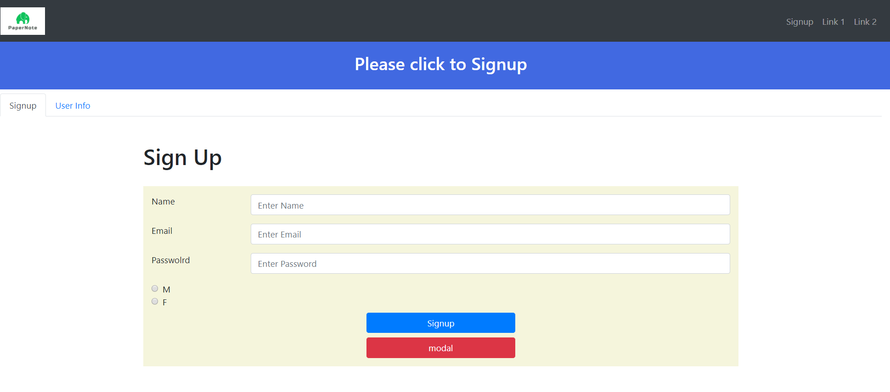
1, in the center of vertical and horizontal block and white text
2. You shall display
tabs
3
This button shall be displayed like this

Slide 3
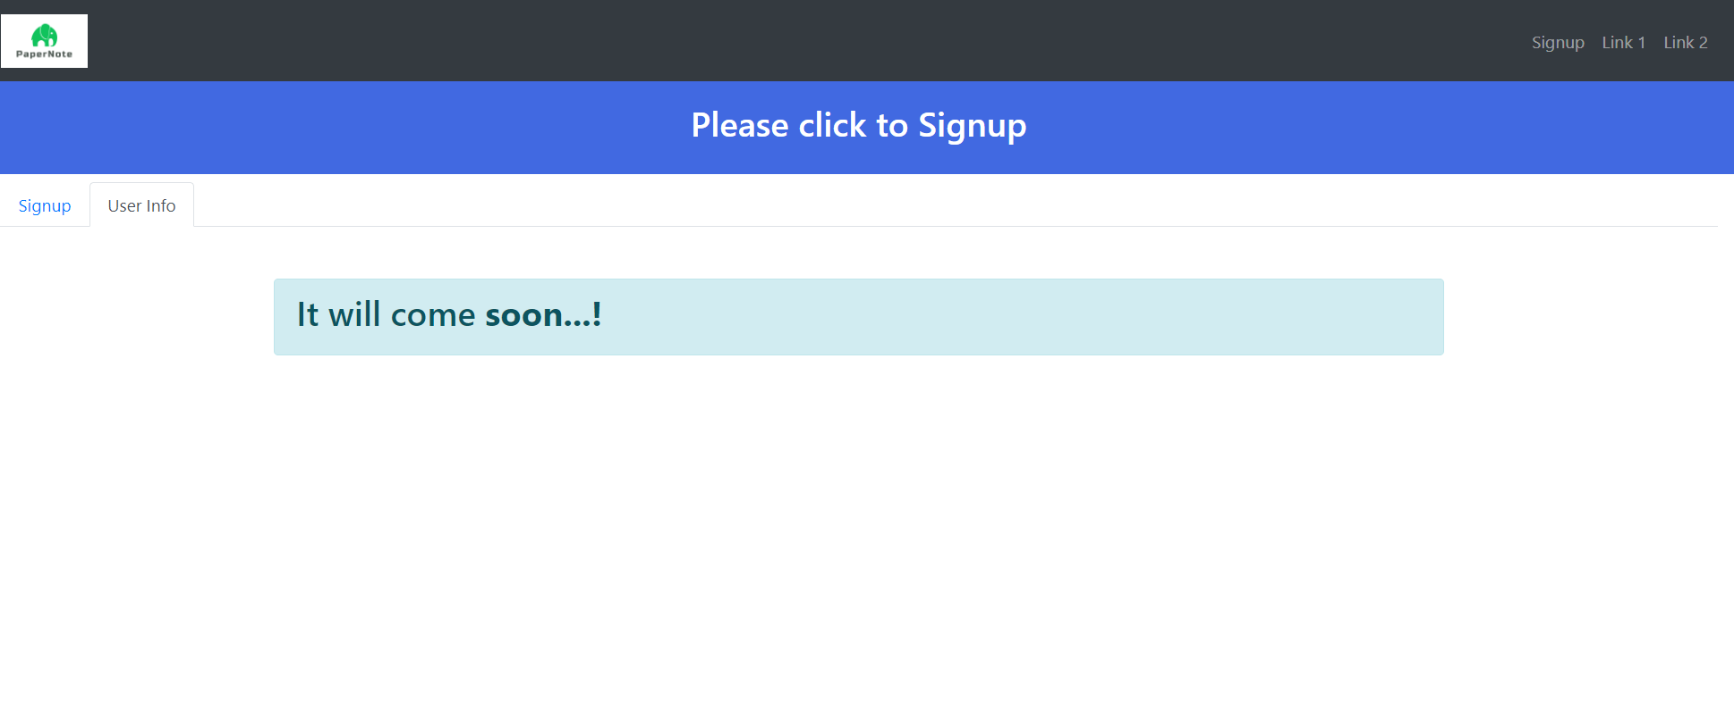
4. After click on ‘User info’
The tab shall display this

Slide 4
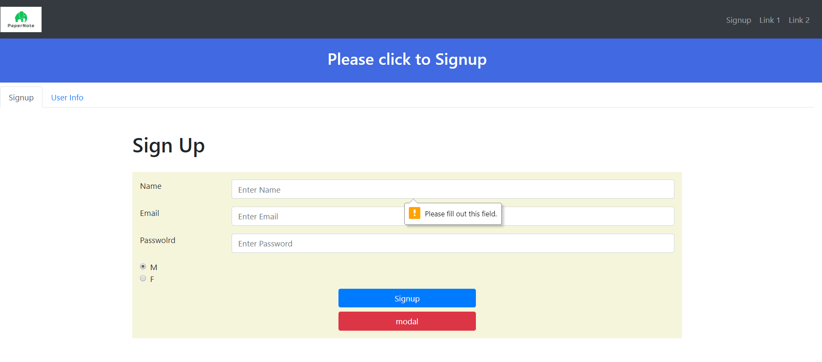
All fields are required
This shall be a email
5. After click on SIGNUP, validation errors are displayed

Slide 5
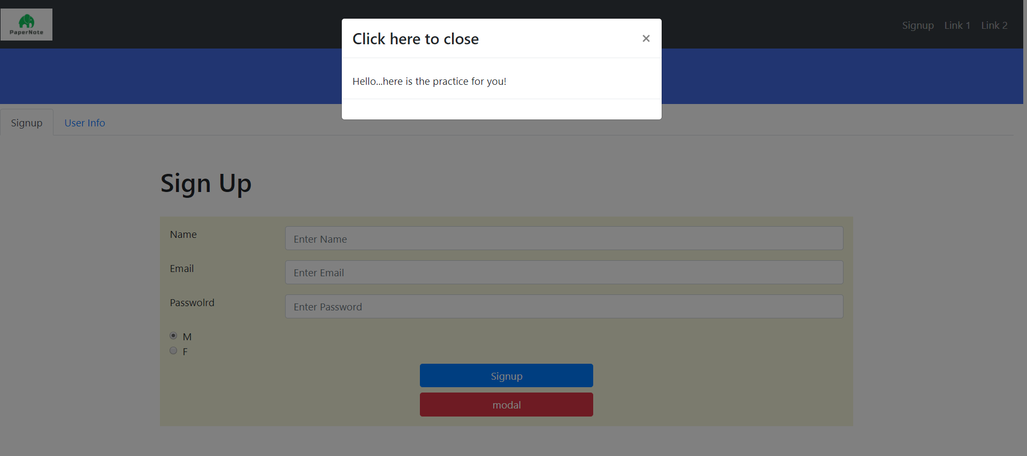
6. After click on MODAL , a model dialog is displayed

Slide 6
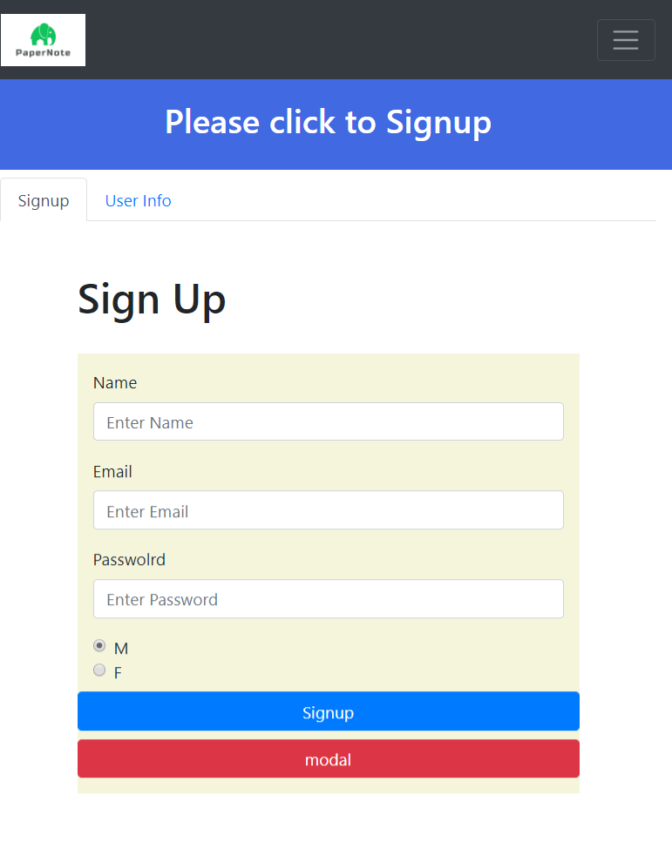
7. If your reduce the width, a hamburger is displayed instead of menu

Slide 7
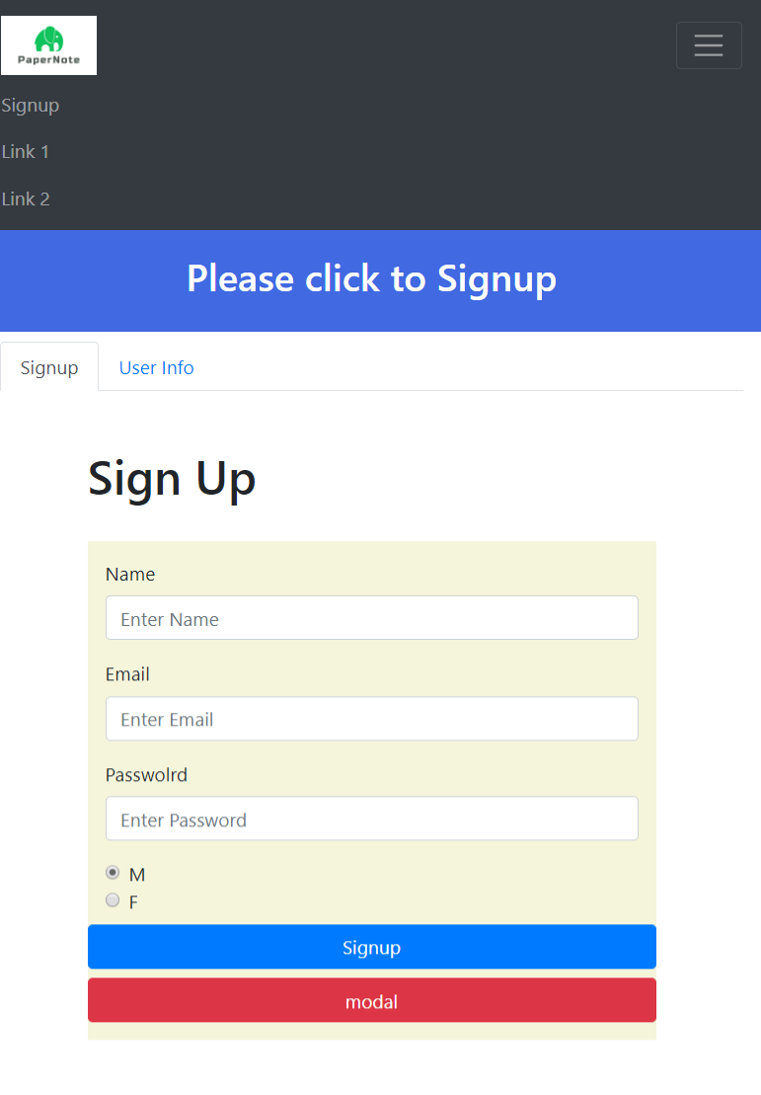
8. If you click on Hamburger the menu is displayed

