Slide 1
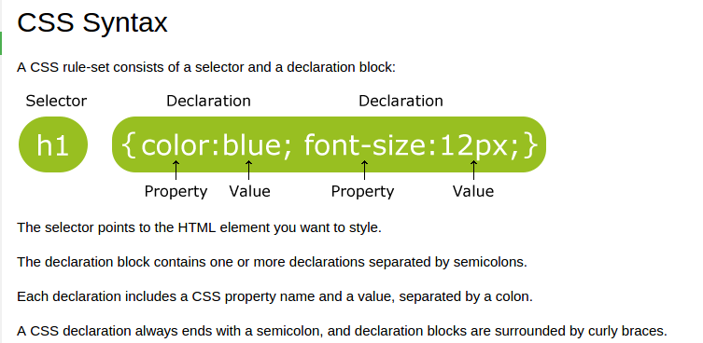
CSS (Cascading Style Sheets)
CSS is a language that describes the style of an HTML document.

Slide 2
The id Selector
The id selector uses the id attribute of an HTML element to select a specific element.
The id of an element should be unique within a page, so the id selector is used to select one unique element!
To select an element with a specific id, write a hash (#) character, followed by the id of the element.

Slide 3
There are three ways of inserting a style sheet:
1.External style sheet
2.Internal style sheet
3.Inline style
External Style Sheet
With an external style sheet, you can change the look of an entire website by changing just one file!
Each page must include a reference to the external style sheet file inside the <link> element. The <link> element goes inside the <head> section

Slide 4
An external style sheet can be written in any text editor. The file should not contain any html tags. The style sheet file must be saved with a .css extension.
Internal Style Sheet
An internal style sheet may be used if one single page has a unique style.
Internal styles are defined within the <style> element, inside the <head> section of an HTML page

Slide 5
Inline Styles
An inline style may be used to apply a unique style for a single element.
To use inline styles, add the style attribute to the relevant element. The style attribute can contain any CSS property.
Colors in CSS are most often specified by:
a valid color name - like "red"
an RGB value - like "rgb(255, 0, 0)"
a HEX value - like "#ff0000"

Slide 6
Types Of Selectors
1. ID -> “ # ”
  ID is a type of selector which is used to style one single tag
  2. Class -> “ . ”
  Class is a type of selector which is used to style
  More than one tag of the similar type.
  3. Universal -> “ * ”
  Universal as the word says is universal to all the tags . You style each and every tag.

Slide 7
Borders
The CSS border properties allow you to specify the style, width, and color of an element's border.
CSS Margins
The CSS margin properties are used to generate space around elements.
The margin properties set the size of the white space outside the border.
With CSS, you have full control over the margins. There are CSS properties for setting the margin for each side of an element (top, right, bottom, and left).

Slide 8
CSS has properties for specifying the margin for each side of an element:
margin-top
margin-right
margin-bottom
Margin-left
Padding - Individual Sides
CSS has properties for specifying the padding for each side of an element:
padding-top
padding-right
padding-bottom
padding-left

Slide 9
Setting height and width
The height and width properties are used to set the height and width of an element.
Links
The four links states are:
a:link - a normal, unvisited link
a:visited - a link the user has visited
a:hover - a link when the user mouses over it
a:active - a link the moment it is clicked

Slide 10
CSS Tables
Table Borders
To specify table borders in CSS, use the border property.
Collapse Table Borders
The border-collapse property sets whether the table borders should be collapsed into a single border
And many more ...

Slide 11
Honorary Mentions
1.Background-image
2.CSS box model
3.CSS and Bootstrap Icons
4.Max-width
5.CSS forms
6.CSS Animations ... etc

