Slide 1
CRYPTOGRAPHY
AT
NSOC 04
3rd June 2017 @ NIE Mysuru

Slide 2
INTRODUCTION
Cryptography -
* art of writing and solving codes
* The scientific study of techniques for securing digital information,transactions and distributed computations
* The art and science of concealing the messages to introduce secrecy in information
security is recognized as cryptography.

Slide 3
Components of a Cryptosystem
Plain Text
Encryption Algorithm
Cipher Text
Decryption Algorithm
Encryption Key
Decryption Key

Slide 4
Kerckoff's Principle
The cipher method must not be required to be secret, and it must be able to fall into the hands of the enemy without inconvenience.

Slide 5
Classical Ciphers
Caesar Cipher
Mono – alphabetic substitution cipher
Play fair cipher
Vigenere cipher,etc

Slide 6
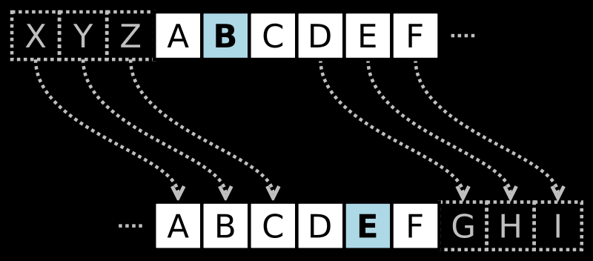
Caesar Cipher
Generally referred to as shift cipher
Concept of substitution of letters in the alphabet by shifting each letter by a fixed number.
Sender and Receiver need to agree on a fixed key
Caesar cipher is a specific term when shift is 3
Not a secure system

Slide 7
Pick Your Brains!!!
Guess what this Pakistani player told the media before the most awaited match -
ymj gtdx bnqq uqfd ajwd bjqq
Key = 5

Slide 8
Mono – alphabetic Substitution
The shift cipher maps each plaintext character to a different ciphertext character, but the mapping in each case is given by the same shift
The 26 letters in the English alphabet can be arranged in 26! ways, there by increasing the key space of the cipher.
Slightly more secure than the caesar cipher.
Cracking the cipher is possible, if only the message intercepted is long enough.

Slide 9
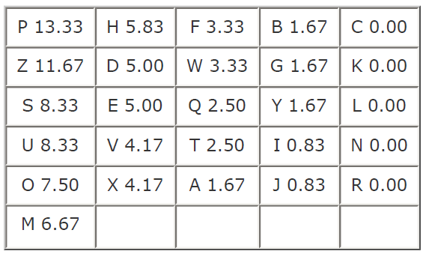
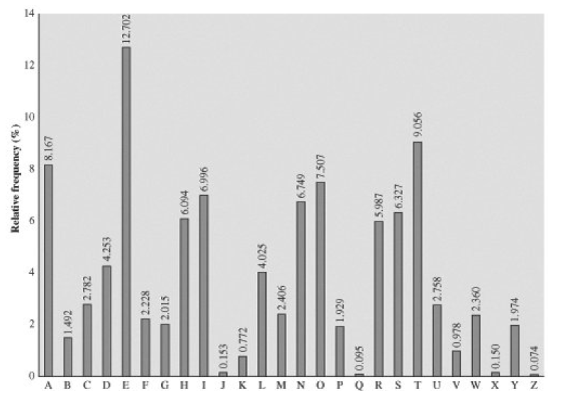
Break the code given below -
UZQSOVUOHXMOPVGPOZPEVSGZWSZOPFPESXUDBMETSXAIZ
VUEPHZHMDZSHZOWSFPAPPDTSVPQUZWYMXUZUHSX
EPYEPOPDZSZUFPOMBZWPFUPZHMDJUDTMOHMQ

Slide 10
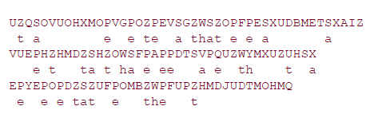


Slide 11
Solve it.!
Decrypt this -
ZRJ AMGKF QOSNU ESC TMDIP SXJO ZRJ YLBV WSH
Key - LQKWJEHRGTFYDUSIAOPZMXNCVB

Slide 12
Playfair Cipher
One of the best multiple-letter encryption cipher
Encryption is based on operating on diagrams
Solved with the help of a 5 X 5 matrix and a keyword
Illustration with the keyword as REMOTE
R | E | M | O | T
A | B | C | D | F
G | H | I/J | K | L
N | P | Q | S | U
V | W | X | Y | Z

Slide 13
R | E | M | O | T
A | B | C | D | F
G | H | I/J | K | L
N | P | Q | S | U
V | W | X | Y | Z
Both letters are in the same column -
EH => BP ZL => TU SO => YD
Both letters are in the same row -
AC => BD UQ => NS YW => ZX
Neither in the same column nor the same row
RS => ON TW => EZ LS => KU

Slide 14
If the diagram consists of the same letters, like
GG then it is split into -
GX and G
If in the end there is no letter left to pair up with one letter that is left we pad it with a Z.
NIE => NI EZ

Slide 15
Pick Your Brain!!
When the PT-109 American patrol boat, under the command of Lieutenant John F.Kennedy, was sunk by a Japanese destroyer, a message was received at an Australian wireless station in Playfair code:
KXJEY UREBE ZWEHE WRYTU HEYFS
KREHE GOYFI WTTTU OLKSY CAJPO
BOTEI ZONTX BYBNT GONEY CUZWR
GDSON SXBOU YWRHE BAAHY USEDQ
The key used was ROYAL NEW ZEALAND NAVY. Decrypt the message.

Slide 16
Vigenère Cipher
A string is used as a keyword
An advancement of the Caesar cipher, but the shifts are varying for each letter depending on the key.
Here each letter of the key is converted to its respective numerical value,
eg :- MOBILE
M->12 0->14 B->1 I->7 L->11 E->4

Slide 17
Plain text : w a t c h o u t f o r t o m
Key : m o b i l e m o b i l e m o
Cipher : i o u k s s g h g w c x a a
Plain text : attack from south east
Key : pointp oint point poin
Cipher :

Slide 18
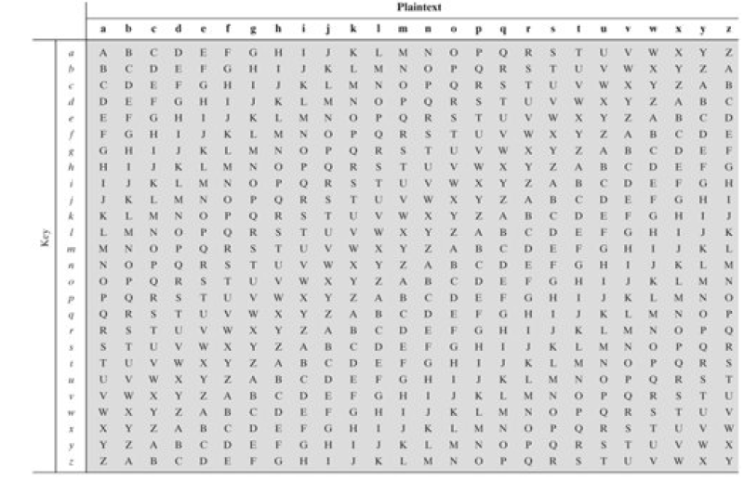

Slide 19
You can't see me!!!
Awut Wmyoo Iazywae Tmag
Key - Ring

Slide 20
Transposition techNIEks
Here the plain text is encrypted by performing permutations on it
Majorly used two techNIEks are -
a) Rail fence
b) Write the message in a rectangle, row by row, and read the message column by column, but permute the order of columns

Slide 21
Rail Fence Technique
Plain Text : Enjoy your holidays
Arrangement : E j y o r o i a s
  n o y u h l d y
  Cipher Text : Ejyoroiasnoyuhldy

Slide 22
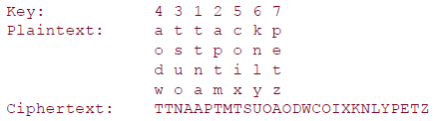
Writing the message in a rectangle
Plain Text : Attack postponed until two am xyz

Slide 23
Modern Ciphers(Symmetric Key Encryption)
Modern digital world deals data in binary forms
The majorly distinguished schemes of data encryption are -
1)Block Ciphers – operates on a block of n bits to produce a cipher text of n bits
  DES has 64 bit blocks & AES has 128 bit blocks
2)Stream Ciphers – operates on the data in bit-wise fashion.
  Technically stream ciphers are block ciphers with block size 1 bit

Slide 24
Block Cipher
Take a n-bit data, operates on it and the resultant is also a n-bit data
The size of the block(n bits) is dependent on the scheme and is fixed for that scheme
The strength of the cipher does not depend on the size of the block but the size of the key.
The size of bits is usually preferred to be a multiple of 8, as most computers process data in the same format

Slide 25
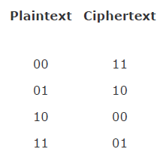
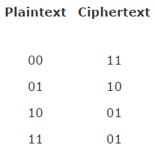
A block cipher operates on a plaintext block of n bits to produce a ciphertext block of n bits.
There are 2^{n} possible different plaintext blocks and, for the encryption to be reversible (i.e., for decryption to be possible), each must produce a unique ciphertext block. Such a transformation is called reversible, or nonsingular.

Slide 26
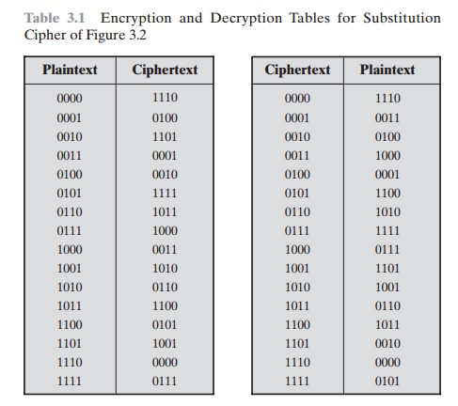

Slide 27
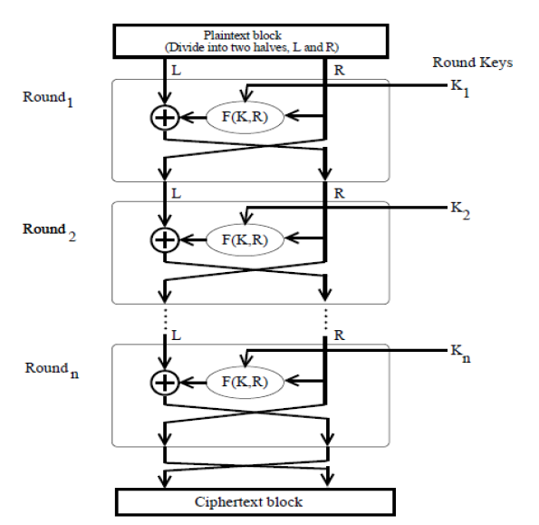
Fistel Block Cipher

Slide 28
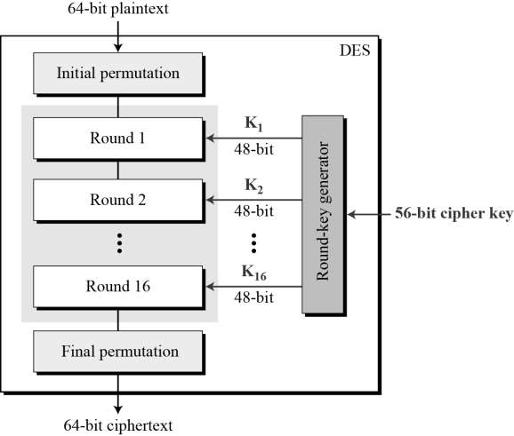
DES
A Symmetric key block cipher
Implementation of Fiestel Block Cipher
Consists of 16 rounds
Block size is 64 bits
Key size is 58 bits

Slide 29
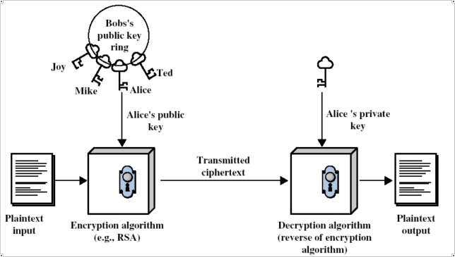
Public Key Encryption System
Encryption Schemes-
  RSA
  ElGamal
  Elyptic Curve

