Slide 1
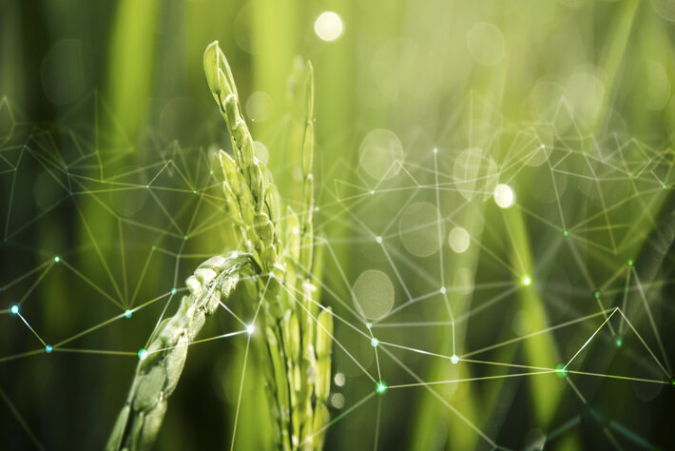
Smart agriculture monitoring system Using iot
By:-
Nischal jain h s

Slide 2
Contents
1. Introduction
2. Components
3. Methodology
3.1 Sensing
3.2 Data Transmission
3.3 Decision Logic
4. Hardware Setup
5. Protocols
6. Programming
7.Application
8. Future Scope

Slide 3
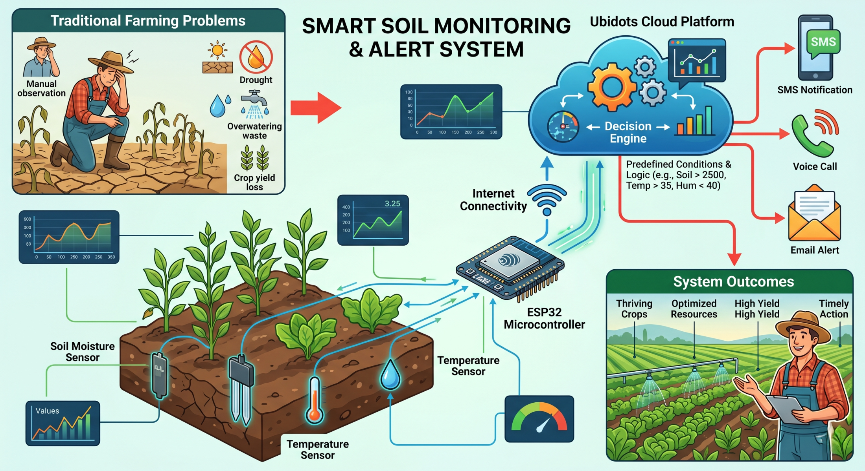
1.Introduction
Manual irrigation leads to water wastage and inefficient crop management.
Monitors soil moisture, temperature, and humidity using sensors.
Sends real-time data to the cloud via ESP32.
Provides smart decisions and alerts for efficient irrigation and crop health.

Slide 4
2.Components
HARDWARE REQUIRED
Esp32 Microcontroller
Soil Moisture Sensor
DHT Sensor
Breadboard & Jumper Wires
SOFTWARE REQUIRED
ESP-IDF
Ubidots

Slide 5
3.Methodology
3.1 Sensing
Soil Moisture Sensor
Soil
Soil Moisture Sensor
Analog Value
Ubidots
Esp32 Microcontroller
Alert

Slide 6
DHT22 Sensor
.
DHT Sensor
Esp32 Microcontroller
Ubidots
Alert

Slide 7
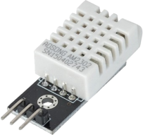
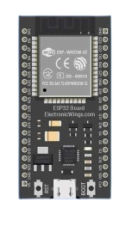
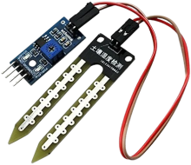
3.2 Data Transmission
Sensors
Esp32
Sensors generate analog/digital data
ESP32 reads using ADC / GPIO
Data converted into usable values

Slide 8

3.2 Data Transmission
Esp32
WiFi module of ESP32 enables internet connectivity.
HTTP protocol is used to send sensor data from ESP32 to Ubidots cloud
Cloud stores and processes data

Slide 9

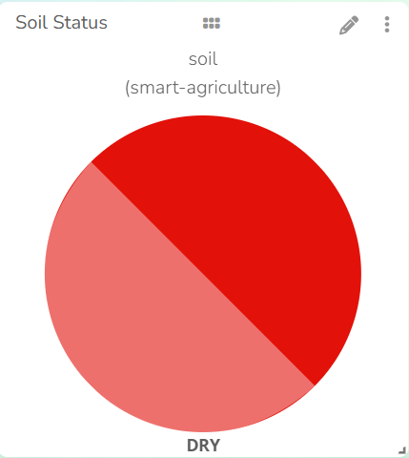
3.3 Decision Logic
Event 1: Dry Soil
Condition: Soil Moisture > 2500
Inference: Soil is dry
Triggers SMS, Call, Email alerts
⚠️ Soil is DRY!
Current Value:
Please irrigate the field.

Slide 10
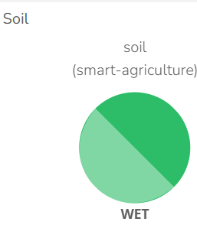
3.3 Decision Logic
Event 2: Wet Soil / High Humidity
Condition: Soil < 1500 OR Humidity > 80%
Inference: Overwatering risk
Triggers SMS, Call alerts
Overwatering risk !!!
Stop irrigation

Slide 11
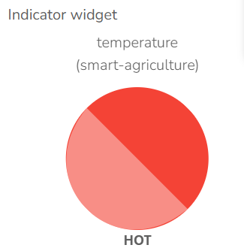
3.3 Decision Logic
Event 3: Extreme Condition
Condition: Soil > 2500 AND Humidity < 40% AND Temp > 35°C
Inference: Extreme condition
Triggers SMS, Call alerts
CRITICAL CONDITION
Irrigation is Necessary

Slide 12
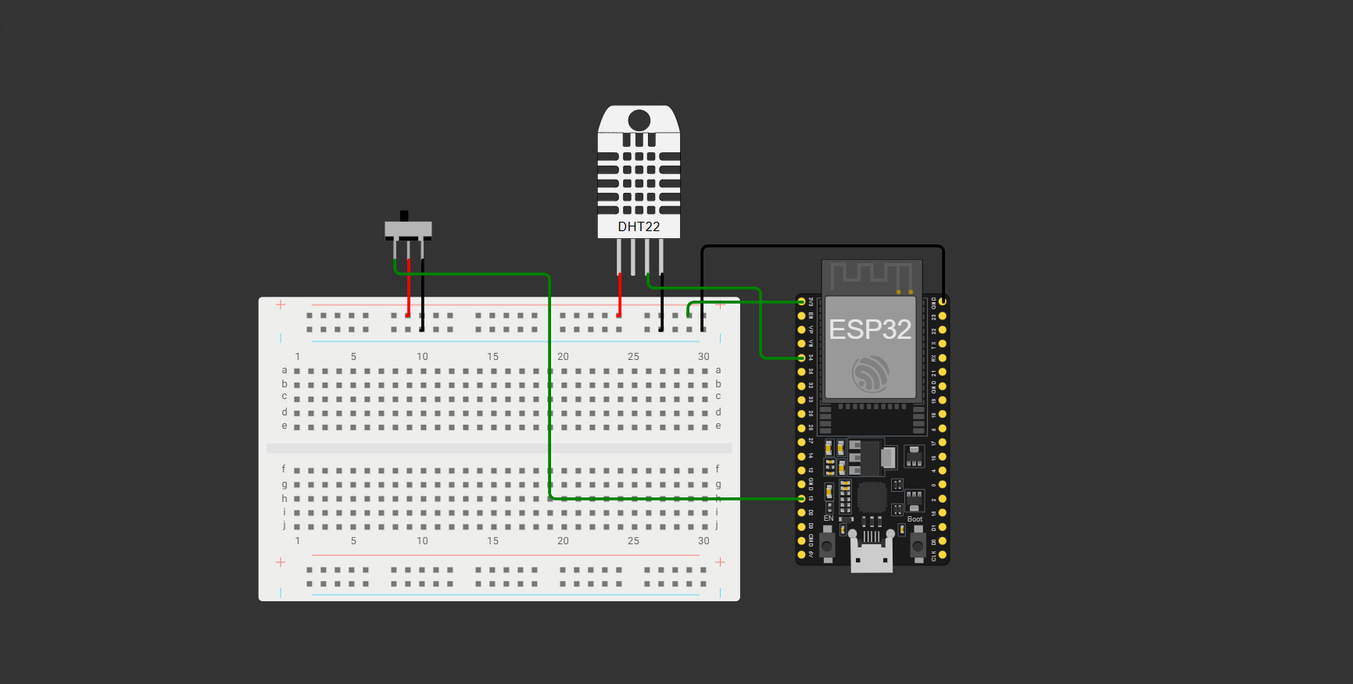
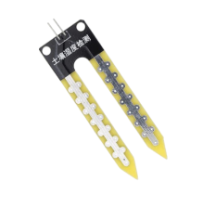
4.Hardware Setup
Soil moisture sensor ->GPIO34
DHT22 sensor -> GPIO5

Slide 13
5.Protocols
Single-wire protocol:
Serial communication interfaces.
Sensors uses single-wire communication protocol for data transmission.
HTTP protocol:
HTTP protocol is used to send sensor data from ESP32 to Ubidots cloud.
ESP32 acts as a client and sends data using REST API over WiFi.
Ubidots stores and visualizes data in real-time dashboard.

Slide 14

6.Programming
ESP IDF
ESP-IDF is the development framework.
It is used to program the ESP32 microcontroller.
Modular code structure:
- soil.c → Soil sensor reading
- dht_sensor.c → Temperature & humidity
- ubidots.c → Cloud communication
- wifi.c → Connectivity
- main.c → Integration logic

Slide 15
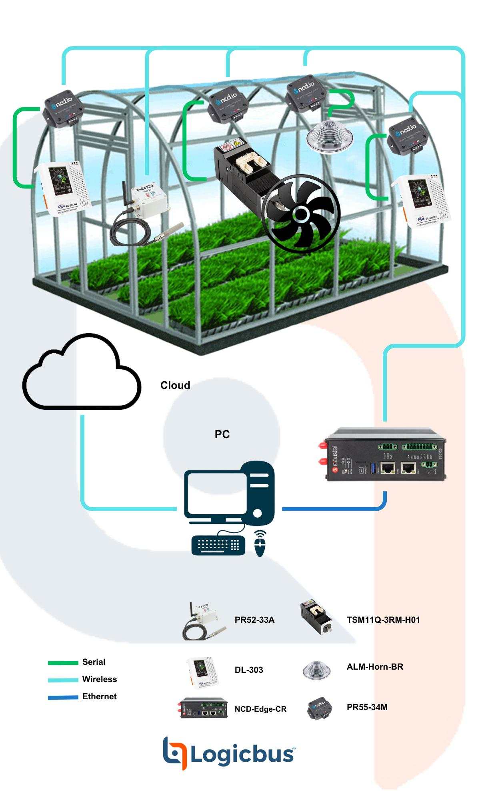
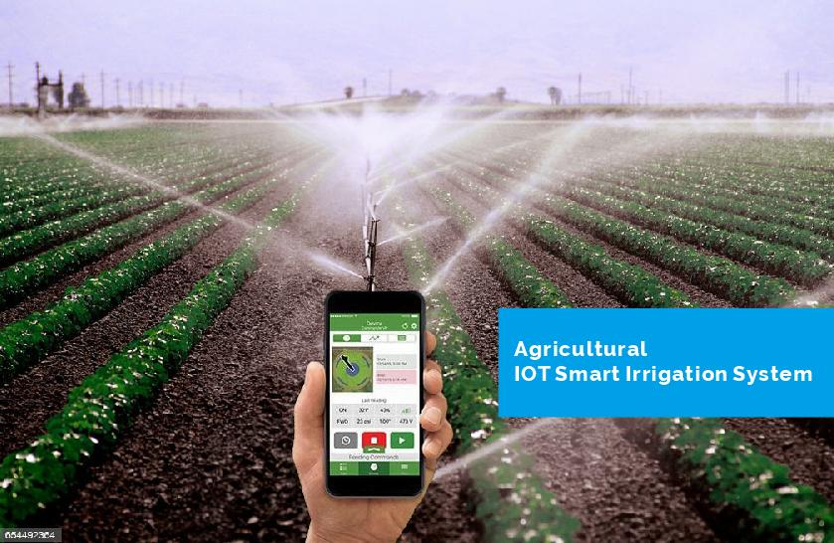
7.APPLICATIONS
Greenhouse automation systems
Water conservation in agriculture
Precision farming
Crop health monitoring

Slide 16
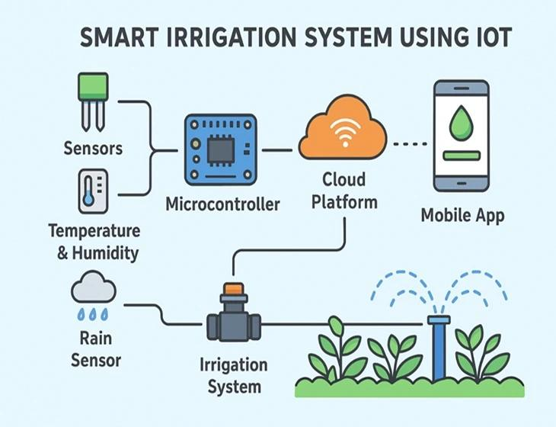
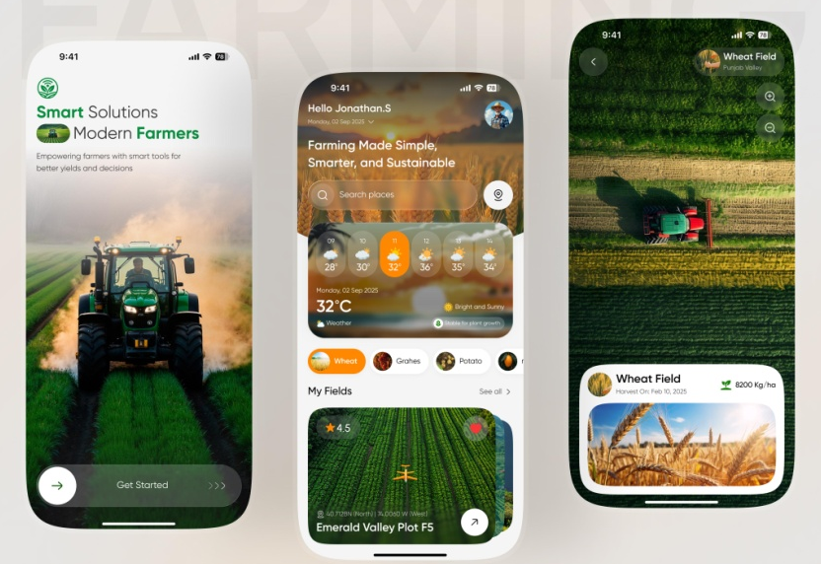
8.Future Scope
Automatic motor control.
Mobile app integration
Weather-based irrigation
AI-based crop prediction

Slide 17
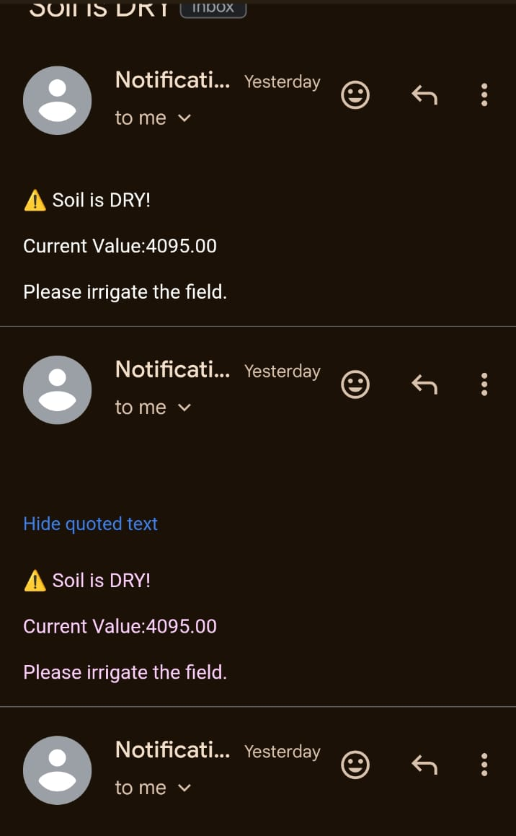
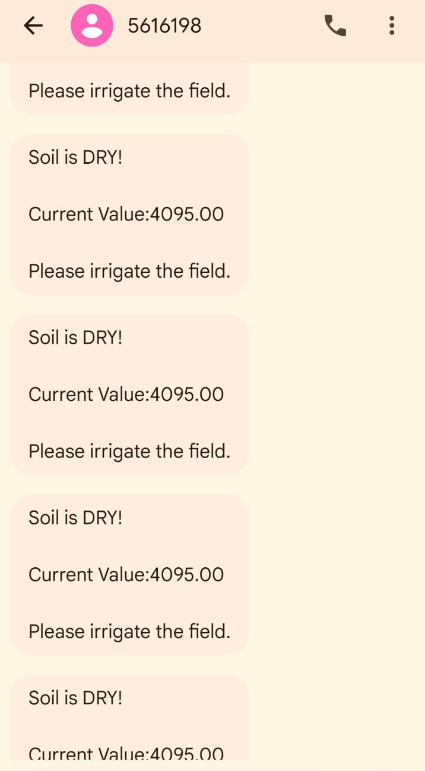
9.Output

Slide 18
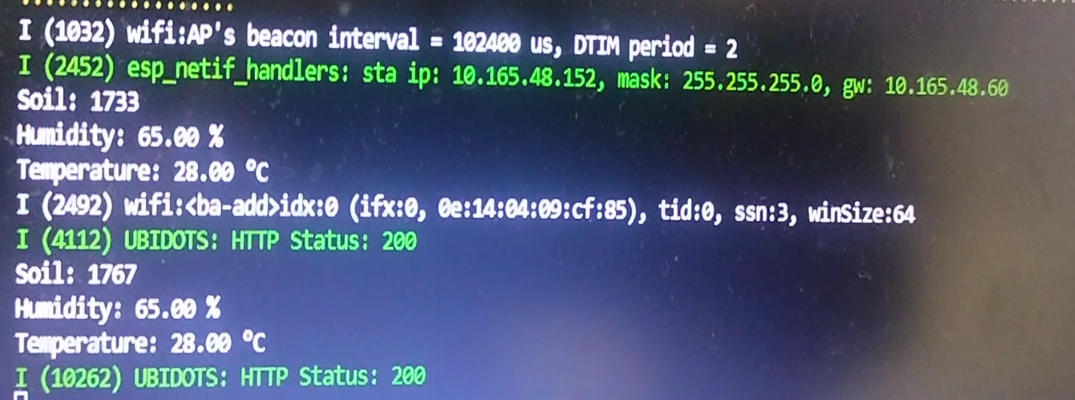
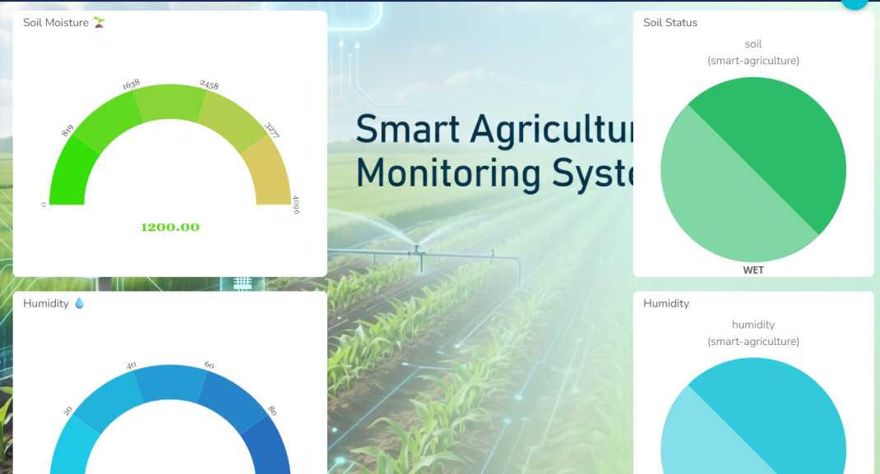
9.Output

Slide 19
THANK YOU

