Slide 1
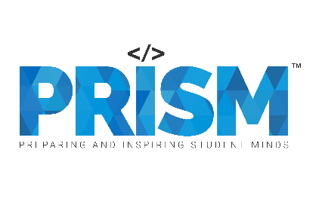
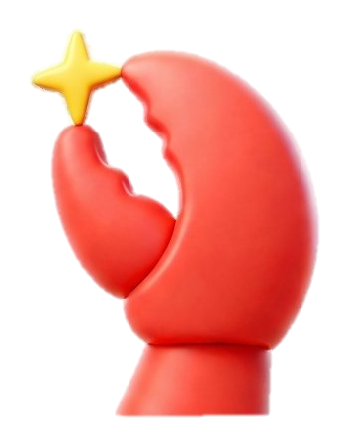
| Tech Management, SRI-B
CLAWS
CLASH OF THE
RV College of Engineering
ContractClaw: Chat with your contracts, never miss a deadline.
Team: Secret Tunnel
Nischal R E
N S Samyak Varma
Nithyasree Subramanian

Slide 2
Idea
Problem Statement
Why this problem statement: We selected this theme because managing legal documents and tracking obligations manually is highly inefficient and prone to human error. Generative AI is uniquely positioned to comprehend complex legal syntax, extract key temporal data, and automate proactive monitoring, effectively turning static documents into active productivity drivers.
What problem are we solving: We are solving the problem of missed critical contract deadlines (such as auto-renewals, termination windows, or compliance deliverables) and the loss of visibility into hidden obligations buried within dense legal PDFs.
Who Faces it (Persona): Freelancers, small-to-medium business (SMB) owners, startup founders, procurement managers, and independent contractors who lack dedicated legal teams or the budget for expensive enterprise contract management software.
Importance: Missing a contract deadline can lead to severe consequences: being locked into unwanted auto-renewals, breaching contract terms, incurring financial penalties, or losing critical negotiation leverage. Managing this manually across fragmented folders and calendar apps is stressful and scales poorly.
Legal jargon is inherently opaque. Non-legal professionals need a way to simply chat with their contracts to understand their risks and duties instantly, without having to pay a lawyer a retainer for routine inquiries.

Slide 3
Idea
Current Solution & Gaps
Current Solutions: People currently rely on manual tracking (Excel spreadsheets, Google Calendar reminders) or heavy Enterprise Contract Lifecycle Management (CLM) software (like Ironclad or DocuSign CLM). Alternatively, they upload documents to standard chatbots like ChatGPT.
Gaps:
Manual Tracking: Extremely high friction. It requires the user to manually read, interpret, and perform data entry for every single deadline. It relies entirely on human memory and diligence.
Enterprise CLMs: These platforms are overwhelmingly expensive, bloated, and complex for individuals or small businesses. They require extensive onboarding and don't integrate into casual, everyday communication channels.
Standard AI Chatbots: While standard GenAI chatbots can summarize a contract once, they lack persistence and agency. They cannot remember your portfolio across sessions, nor can they proactively wake up in the background to alert you when a deadline is approaching.

Slide 4
Idea
Our Solution: ContractClaw
We built ContractClaw, an always-on, autonomous AI contract intelligence agent that lives entirely within your favorite messaging app (Telegram), built on top of the OpenClaw framework.
Core Ideas: We transformed passive PDFs into active, self-monitoring assets. By leveraging OpenClaw's agentic framework and AWS Bedrock/Anthropic LLMs, ContractClaw creates a continuous, automated pipeline. When a user sends a document, the agent ingests it, extracts obligations, evaluates risk, saves the structured data to a persistent YAML registry, and utilizes a background "Heartbeat" daemon to continuously monitor the passage of time against those extracted dates.

Slide 5
Idea
Our Solution: ContractClaw
Key Features:
Frictionless Ingestion: Simply forward or upload a PDF/DOCX to the Telegram bot. No dashboards or complex software required
Smart Extraction & Risk Flagging: Automatically extracts parties, obligations, deadlines, and risk flags. It utilizes a confidence threshold (if extraction confidence is < 80%, it pauses and asks the user for manual confirmation before saving).
Proactive Heartbeat Alerts: A daily background cron job (daemon) that automatically scans the persistent registry and pushes tiered, proactive warnings (e.g., 30 day, 7 day, 1 day alerts) to the user's phone before a deadline hits.
Natural Language Portfolio Querying: Users can chat with their portfolio and the agent responds instantly based on its persistent memory.

Slide 6
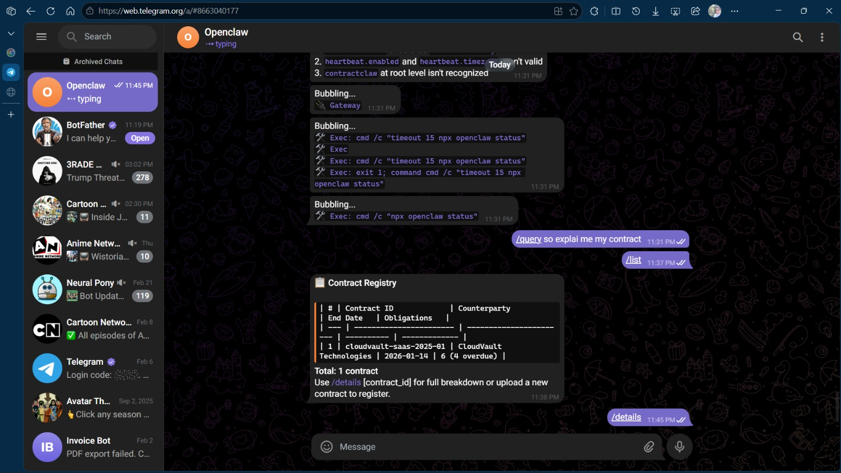
Idea
Demo/Product Walkthrough

Slide 7
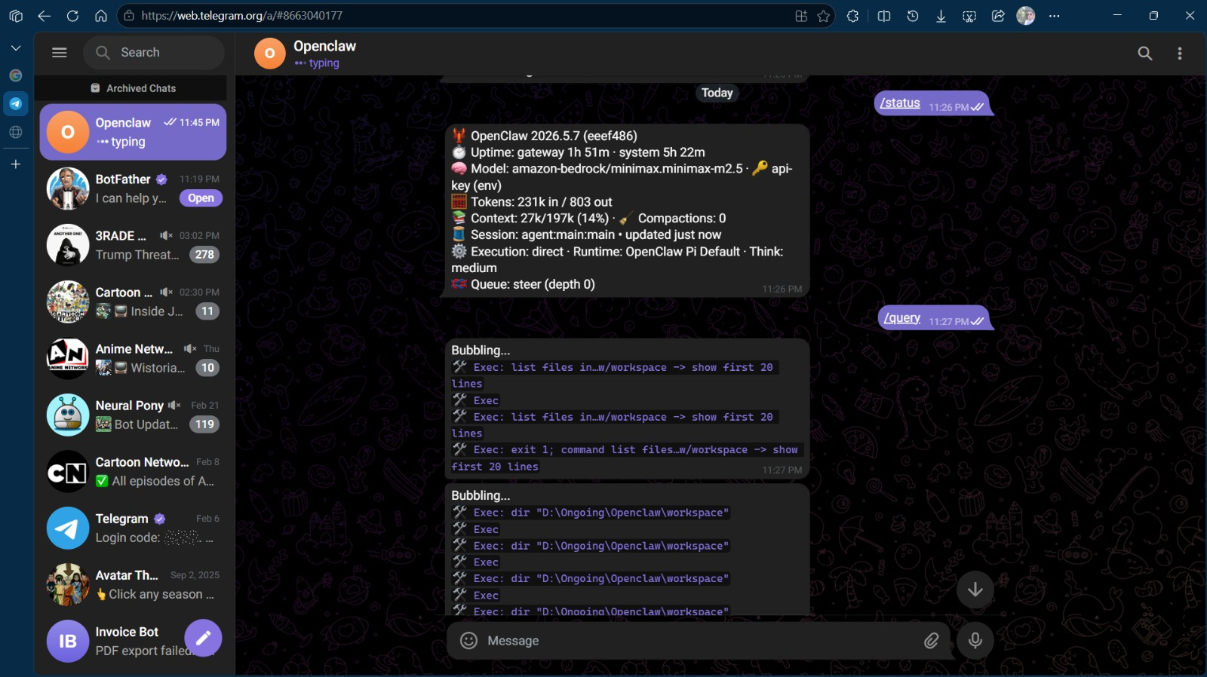
Idea
Demo/Product Walkthrough

Slide 8
Idea
Demo/Product Walkthrough
How User Interacts:
Step 1: The Upload (Ingestion)
Step 2: The Extraction & Confirmation
Step 3: The Query (RAG in Action)
Step 4: The Proactive Alert (The Heartbeat)

Slide 9
Idea
Tech & Architecture
Tech Stack & AI Usage:
Framework: OpenClaw (an agentic framework for Node.js/TypeScript) handles the core execution loop, tool sandboxing, and background daemon processes.
AI Models: AWS Bedrock (Minimax M2.5) or Anthropic (Claude Sonnet). We use these LLMs for two distinct purposes:
Extraction: Parsing dense PDF/DOCX files into structured JSON/YAML (parties, dates, obligations).
RAG/Querying: Answering natural language questions based on the saved contract registry.
APIs & Channels: Telegram Bot API acts as the sole user interface, providing a frictionless, mobile-first conversational experience.
Persistence: Local/Cloud YAML Registry. We bypass heavy databases in favour of a fast, portable, human-readable file system registry that the AI can easily read and write to.

Slide 10
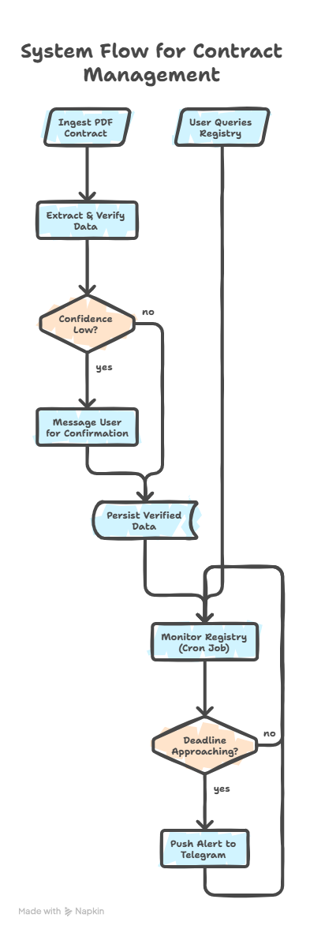
Idea
Tech & Architecture

Slide 11
Idea
Impact & Use cases
Real-Life Scenarios:
1. The Forgetful Freelancer: A designer signs a 6-month retainer with an agency. ContractClaw alerts them 30 days before the contract expires, giving them time to renegotiate instead of letting the contract lapse.
2. The Software Startup (SaaS): A founder signs an enterprise software agreement with a strict 60-day cancellation notice window. ContractClaw pushes a Telegram alert on day 50, preventing an unwanted auto-renewal.
3. The Independent Contractor: A contractor receives a 50-page NDA and Master Service Agreement (MSA). Instead of reading it all, they forward it to ContractClaw and ask, "Are there any non-compete clauses that prevent me from working with other tech companies?"
4. Procurement Manager: Needs to know deliverables for the current quarter. They text the bot: "List all my upcoming vendor payment deadlines for November."

Slide 12
Idea
Impact & Use cases
Scale Potential:
Horizontal Scaling: Easily expandable to other messaging platforms (WhatsApp, Slack, Discord) using OpenClaw's channel integrations.
Enterprise Integration: Can be scaled up to integrate with Google Drive or SharePoint to automatically ingest any contract dropped into a specific folder, turning it into a lightweight CLM for medium-sized businesses.

Slide 13
Idea
Differentiation
Most contract AI tools focus purely on drafting or initial review (acting as a one-time spellchecker for lawyers). ContractClaw focuses on post-signature lifecycle management. It doesn't just read the contract once and forget it; it acts as a persistent, proactive agent that lives in an app the user already opens 20 times a day (Telegram).
Strong MOATs:
Proactive Agency (The Heartbeat): Standard chatbots (like ChatGPT) only speak when spoken to. Our strong moat is the autonomous background daemon. ContractClaw initiates the conversation, reaching out to the user weeks later to warn them of a deadline, entirely unprompted.
Zero-Friction Interface: We completely eliminated the dashboard. Users hate learning new enterprise software. By living entirely inside Telegram, the onboarding time is zero seconds, and accessibility is instantaneous, even on mobile.

Slide 14
Idea
Demo Link
GitHub Repo: https://github.com/nischal2805/Openclaw_hackathon
Demo Link:
https://youtu.be/QpT2LhKakB4
Document submitted:
https://docs.google.com/presentation/d/1k901hLgaTWExU4GZGa0R5fsSwf8JMkg1/edit?usp=sharing&ouid=103195337531181338754&rtpof=true&sd=true

