Slide 1
Virtual Functions
Notes:
Student Book

Slide 2
Advanced C++ Topics
Virtual functions
Abstract Classes
“this” pointer

Slide 3
Virtual functions
Virtual means existing in appearance but not in reality.
When virtual functions are used, a program that appears to be calling a function of one class may in reality be calling a function of a different class.
Furthermore, when we use virtual functions, different functions can be executed by the same function call. The information regarding which function to invoke is determined at run time.

Slide 4
Virtual functions
We should use virtual functions and pointers to objects to achieve run time polymorphism.
For this, we use functions having same name, same number of parameters, and similar type of parameters in both base and derived classes.
The function in the base class is declared as virtual using the keyword virtual.

Slide 5
Virtual functions
When a function in the base class is made virtual, C++ determines which function to use at run time based on the type of object pointed by the base class pointer, rather than the type of the pointer

Slide 6
Motivation: Virtual Functions
a hierarchy of geometric shape classes
  draws circles, ellipses, rectangles etc
just use method draw throughout the hierarchy
Line
draw()‏
Rectangle
Circle
draw()‏
draw()‏
Square
Ellipse
draw()‏
draw()‏

Slide 7
Pointers to Derived Classes
C++ allows base class pointers to point to derived class objects.
Let we have
  class base { … };
  class derived : public base { … };
Then we can write:
  base *p1;
  derived d_obj;
  p1 = &d_obj;

Slide 8
class Base {
public:
void show() {
cout << “base\n”;
}
};
class Derv1 : public base {
public:
void show() {
cout << “derived1\n”;
}
class Derv2 : public base {
public:
void show() {
cout << “derived2\n”;
}
};
void main()
{
Derv1 dv1;
Derv2 dv2;
Base *ptr
ptr = &dv1;
ptr->show();
ptr = &dv2;
ptr ->show();
return 0;
}

Slide 9
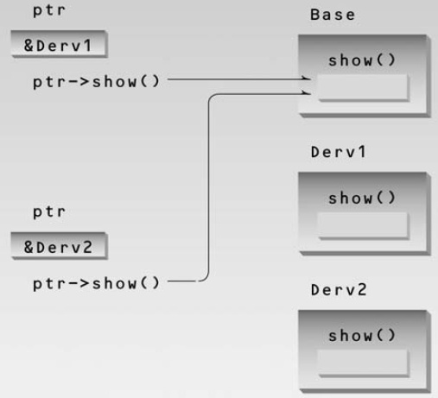
Non-Virtual Pointer Access

Slide 10
class Base {
public:
virtual void show() {
cout << “base\n”;
}
};
class Derv1 : public base {
public:
void show() {
cout << “derived1\n”;
}
class Derv2 : public base {
public:
void show() {
cout << “derived2\n”;
}
};
void main()
{
Derv1 dv1;
Derv2 dv2;
Base *ptr
ptr = &dv1;
ptr->show();
ptr = &dv2;
ptr ->show();
return 0;
}

Slide 11
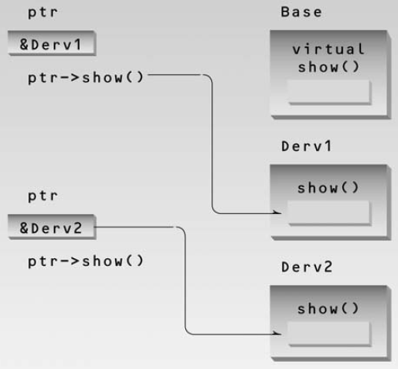
Non-Virtual Pointer Access

Slide 12
Introduction to Virtual Functions
A virtual function is a member function that is declared within a base class and redefined (called overriding) by a derived class.
It implements the “one interface, multiple methods” philosophy that underlies polymorphism.
The keyword virtual is used to designate a member function as virtual.
Supports run-time polymorphism with the help of base class pointers.

Slide 13
Introduction to Virtual Functions
A virtual function is a member function that is declared within a base class and redefined (called overriding) by a derived class.
It implements the “one interface, multiple methods” philosophy that underlies polymorphism.
The keyword virtual is used to designate a member function as virtual.
Supports run-time polymorphism with the help of base class pointers.

Slide 14
Introduction to Virtual Functions (contd.)
While redefining a virtual function in a derived class, the function signature must match the original function present in the base class.
So, we call it overriding, not overloading.
When a virtual function is redefined by a derived class, the keyword virtual is not needed (but can be specified if the programmer wants).
The “virtual”-ity of the member function continues along the inheritance chain.
A class that contains a virtual function is referred to as a polymorphic class.

Slide 15
Abstract Classes and
Pure Virtual Functions
A base class whose objects are never instantiated is called an abstract class. Such a class exists only to act as a parent of derived classes that will be used to instantiate objects.
A base class made as an abstract class must contain at least one pure virtual function.
A pure virtual function is one with the expression “=0” added to the function declaration.
e.g.,
virtual void show() = 0;

Slide 16
class Base {
public:
virtual void show() = 0;
};
class Derv1 : public base {
public:
void show() {
cout << “derived1\n”;
}
class Derv2 : public base {
public:
void show() {
cout << “derived2\n”;
}
};
void main()
{
Base bad; //ERROR
Derv1 dv1;
Derv2 dv2;
Base *ptr
ptr = &dv1;
ptr->show();
ptr = &dv2;
ptr ->show();
return 0;
}

Slide 17
Virtual Function and
person Class

Slide 18
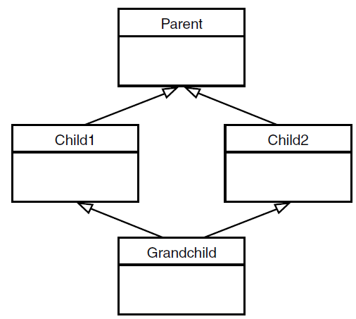
Virtual Base Classes
Multiple Inheritance

Slide 19
Virtual Base Classes
class Parent {
protected:
int basedata;
};
class Child1 : public parent {
  { };
class Child2 : public base {
  { };
class GrandChild:
public Child1, public Child2
{ public:
  int getdata() { return basedata; } //ERROR
};

Slide 20
Virtual Base Classes
class Parent {
protected:
int basedata;
};
class Child1 : public parent {
  { };
class Child2 : public base {
  { };
class GrandChild:
public Child1, public Child2
{
public:
  int getdata()
  { return basedata; } //ERROR
};
class Parent {
protected:
int basedata;
};
class Child1 : virtual public parent {
  { };
class Child2 : virtual public base {
  { };
class GrandChild:
public Child1, public Child2
{
public:
  int getdata()
  { return basedata; } //OK
  };

