Slide 1
Nepal360
360°
Empowering Change Across Nepal
Presented by Nischal Bhattarai
Full-Stack Developer
Crowdfunding Platform
1/17

Slide 2
The Problem in Nepal
Why Nepal needs a better crowdfunding platform
!
No Organized Platform
!
Trust Deficit
Nepal lacks a dedicated, trustworthy crowdfunding infrastructure for social causes
Donors are skeptical due to lack of transparency and accountability in charitable giving
!
No KYC Verification
!
Unregulated Sector
Campaign creators are not verified, leading to potential fraud and misuse of funds
Nepal's charity and social funding sector remains largely unregulated and fragmented
3/17

Slide 3
Impact of the Problem
What the lack of infrastructure has led to
⚠
✖
✉
⌂
Fraud & Misuse
No Tracking
Hard to Reach Donors
Rural Communities Left Behind
Donated funds are misused with no accountability, eroding public trust in charitable giving
Donors cannot track where their money goes or see the real impact of their contributions
Beneficiaries and cause organizers struggle to connect with potential donors effectively
Remote and rural communities remain underserved due to lack of digital fundraising access
4/17

Slide 4
Our Solution
How Nepal360 addresses these challenges
✓
KYC-Verified Campaigns
Every campaign creator must complete identity verification before launching a campaign, ensuring authenticity
≡
Full Transparency & Tracking
Real-time donation tracking, progress bars, donor lists, and detailed financial breakdowns for every campaign
⚙
AI-Powered Intelligence
Machine learning predictions for fundraising success, smart campaign recommendations for donors
⌖
Map-Based Discovery
Interactive district-level map of Nepal for discovering campaigns by location, making local causes visible
5/17

Slide 5
Introducing Nepal360
A comprehensive crowdfunding platform for Nepal
✎
☑
⭐
☆
Campaign Management
KYC Verification
Khalti Payments
Leaderboards & Badges
Create, manage & track campaigns
Identity verified campaign creators
Secure digital payment gateway
Gamified donor engagement
⚙
♪
✉
⌖
AI Predictions
Real-Time Notifications
Certificate Generation
Interactive Map
ML-powered funding forecasts
Instant updates on campaigns
Auto-generated donor certificates
District-level campaign discovery
6/17

Slide 6
UI Preview — Home Page
Homepage with featured campaigns, stats, and hero section
[ Insert Home Page Screenshot Here ]
7/17

Slide 7
UI Preview — Campaign Discovery
Browse campaigns with filters, search, and map view
[ Insert Campaign Discovery Screenshot Here ]
8/17

Slide 8
UI Preview — Campaign Detail + Donation
Campaign details, donation form, progress tracking, and donor list
[ Insert Campaign Detail + Donation Screenshot Here ]
9/17

Slide 9
UI Preview — Admin Dashboard
Admin panel with KYC verification, campaign management, and analytics
[ Insert Admin Dashboard Screenshot Here ]
10/17

Slide 10

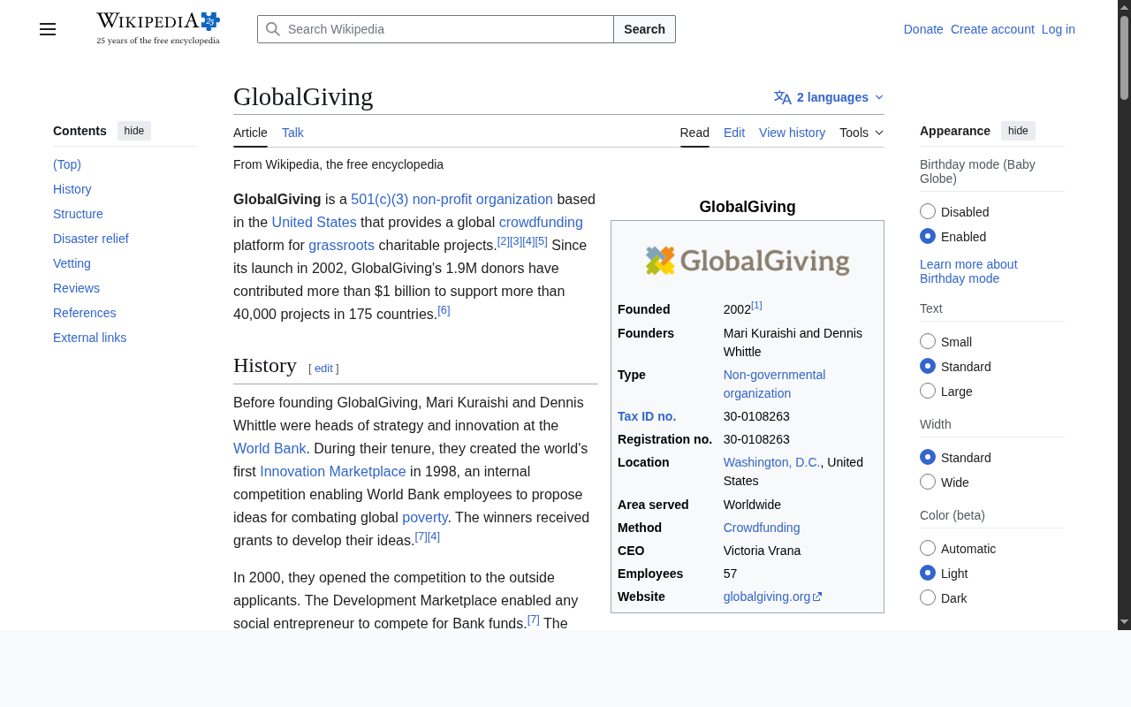
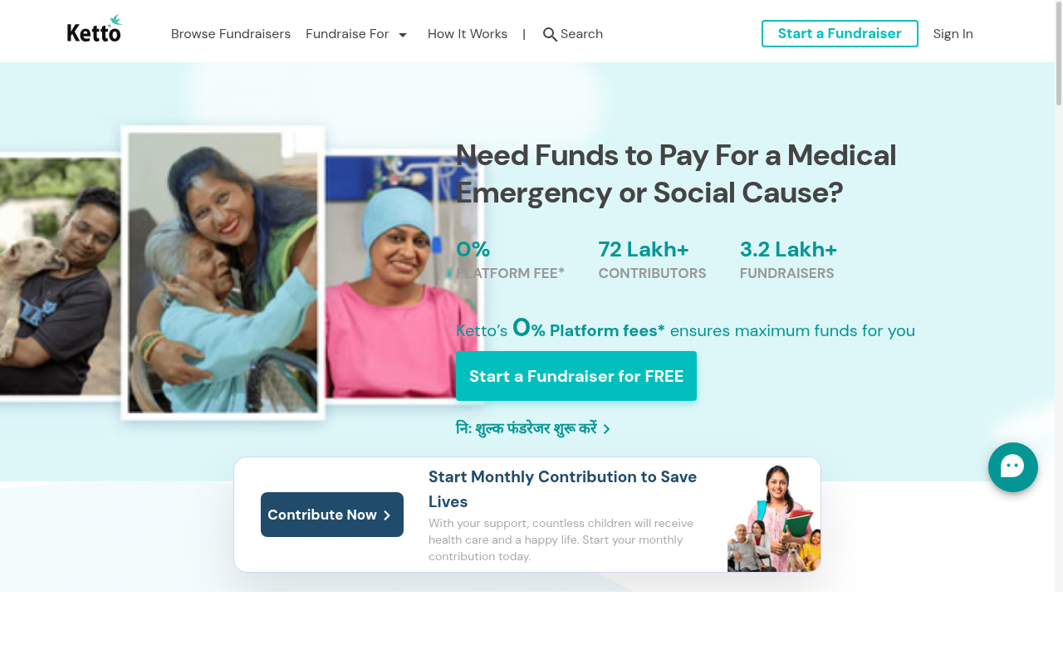
Competitor Analysis — Global
How Nepal360 compares to global platforms
GoFundMe
GlobalGiving
Ketto
Global leader in personal fundraising. No Nepal focus, no KYC, high fees.
Non-profit focused platform. Limited to vetted organizations only.
India-based crowdfunding. No Nepal presence, no local payments.
11/17

Slide 11
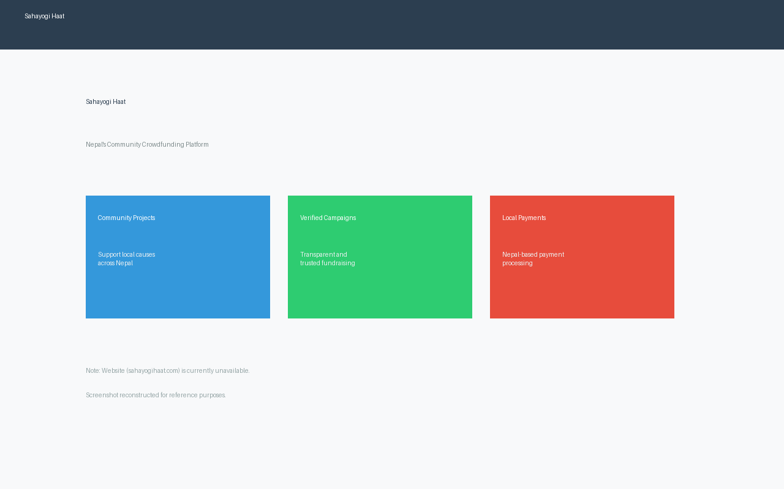
Competitor Analysis — Nepal
The local competitive landscape
What they lack (Nepal360 advantages):
✗
No KYC verification system
✗
No AI-powered predictions
✗
No gamification (badges, leaderboards)
✗
No interactive map discovery
✗
No item/in-kind donations
SahayogiHaat — Only Notable Local Competitor
✗
No recurring donation support
✗
No certificate generation
✗
No real-time notifications
12/17

Slide 12
Market Opportunity
Why now is the right time for Nepal360
~27%
56%+
86%
12th
of GDP from Remittances
Internet Penetration
Wallet-to-Population Ratio
Climate Risk Index
Nepal has one of the highest remittance-to-GDP ratios globally
16.5M internet users with rapidly growing connectivity
Khalti & eSewa driving massive digital payment adoption
Highly vulnerable to floods, landslides & earthquakes
✶ Nepal's unique combination of high remittance inflow, growing digital payments, and disaster vulnerability creates a massive opportunity for a transparent, trusted crowdfunding platform.
13/17

Slide 13
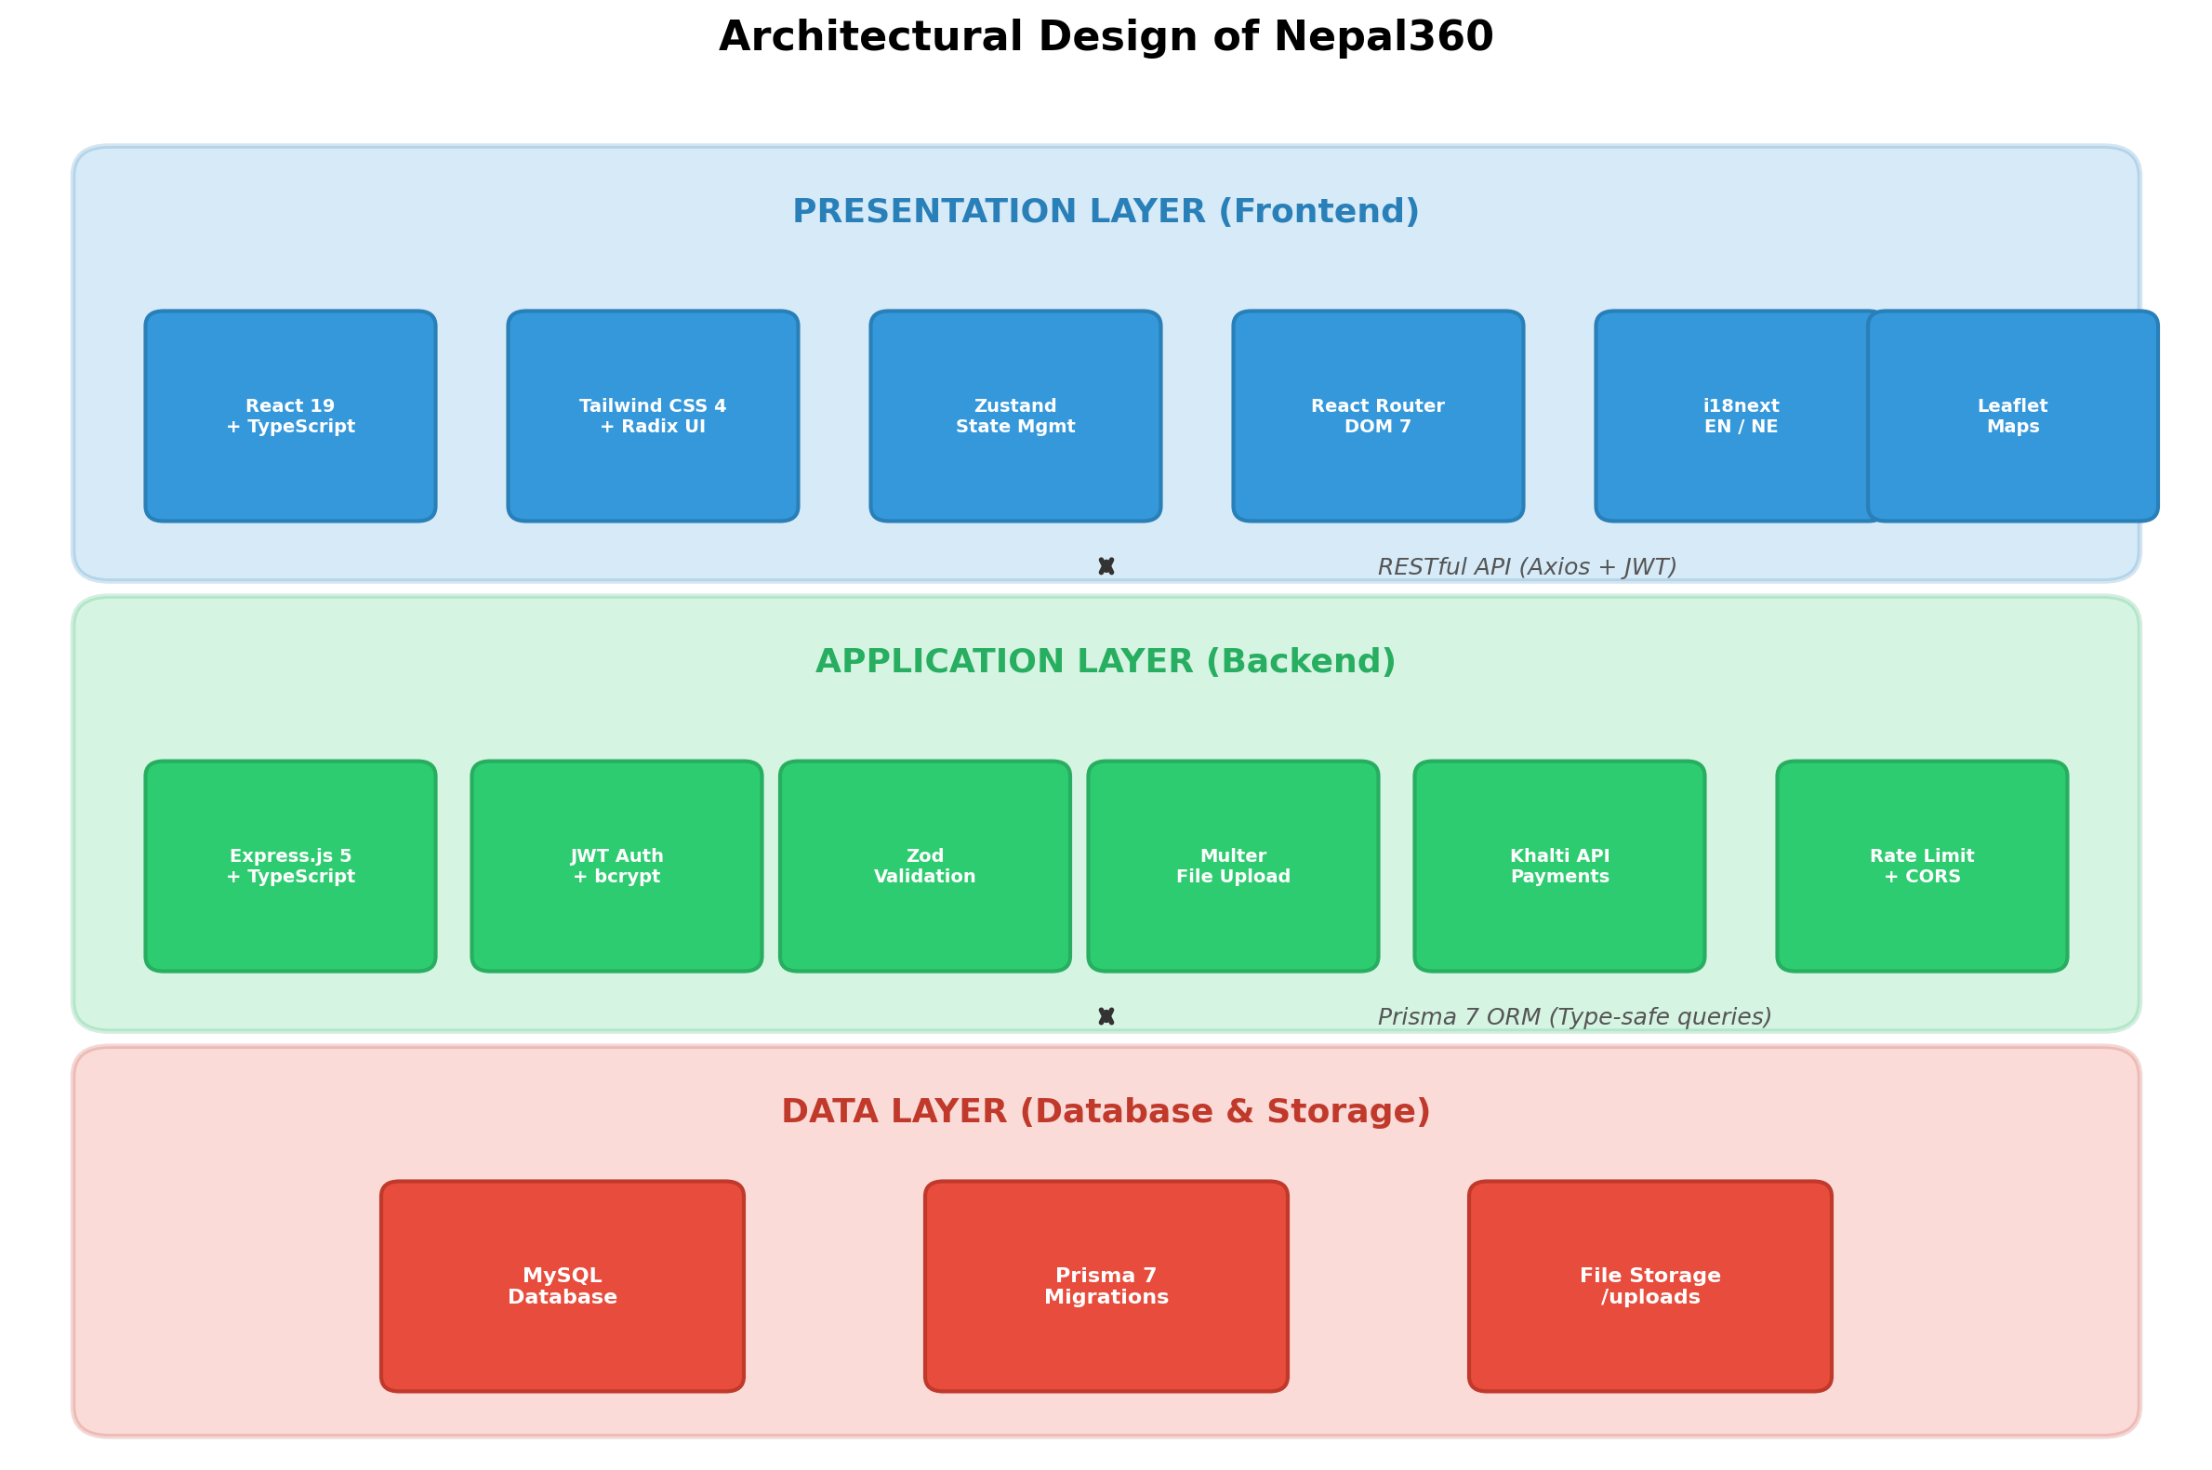
System Architecture
Technical overview of the Nepal360 platform
14/17

Slide 14
Revenue Model
How Nepal360 generates sustainable income
¤
Platform Fee
★
Premium Features
2-5% fee on successful donations
Enhanced campaign tools for creators
Primary revenue stream. Small, transparent fee applied only when campaigns reach their goals.
Priority placement, advanced analytics, custom branding, and extended campaign durations.
⌂
Corporate Partnerships
☆
Sponsored Campaigns
CSR & corporate matching programs
Featured and promoted campaigns
Partner with businesses for matched donations, corporate-sponsored campaigns, and CSR integration.
Organizations can sponsor campaign visibility, badges, and featured placement on the platform.
15/17

Slide 15
▶
Live Demo
Nepal360 Platform Walkthrough
16/17

Slide 16
Thank You!
Nepal360 — Empowering Change Across Nepal
Nischal
BCA Student | Itahari Namuna College
Questions?
17/17

