Slide 1
E-Commerce
Free PowerPoint Templates - prezentr.com

Slide 2
Outlines
> Introduction
> History of ecommerce

Slide 3
E-commerce
Commerce
Buying and selling goods and services
Conducted over an Electronic Medium -> Ecommerce
> Integration of Web and telecommunications technologies for the purpose of buying and selling products and services

Slide 4
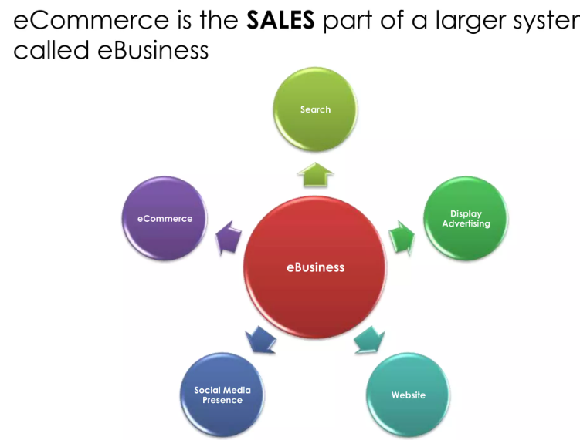
E-Business
E-Business is the conduct of business processes on the internet. These e-business processes include buying and selling goods and services, servicing customers, processing payments, managing production control.

Slide 5
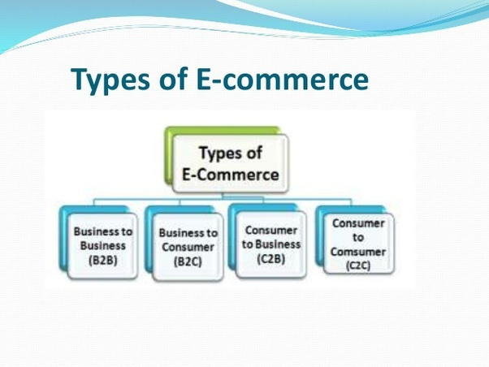
E-Commerce

Slide 6
E-Commerce
Business – to – Consumer (B2C): In B2C model, business sells its products directly to a customer. A customer can view the products shown on the website. The customer can choose a product and order. These B2C businesses are online retailers. Example: Amazon, Flipchart, etc.

Slide 7
E-Commerce
Business – to – Business (B2B): In B2B model, business sells its products to an intermediate buyer who then sells the product to the final customer. As an example, a wholesaler places an order from a company’s website and after receiving the consignment, sells the product to the final customer who comes to buy the product at one of its retail outlets. Example: Tata communications, Allibaba.

Slide 8
Consumer – to – Consumer (C2C): In C2C model, consumer helps consumer to sell their assets like residential property, cars, motorcycles , or rent a room by publishing their information on the website. Website may or may not charge the consumer for its services. Example OLX, Quirk, Hamrobazzar, online auction

Slide 9
Consumer – to – Business (C2B): In this model, consumers have products or services of value that can be consumed by businesses. For example, the comparison of interest rates of personal loan/car loan provided by various banks via websites. A business organization that fulfills the consumer’s requirement within the specified budget approaches the customer and provides its services. For e.g. – A blog can be written by an author for a business to improve sale of products, eBay.

