Slide 1
E-Commerce & E-Business

Slide 2
Outlines
> Introduction
> History of ecommerce

Slide 3
E-commerce
Commerce
Buying and selling goods and services
Conducted over an Electronic Medium -> Ecommerce
> Integration of Web and telecommunications technologies for the purpose of buying and selling products and services

Slide 4
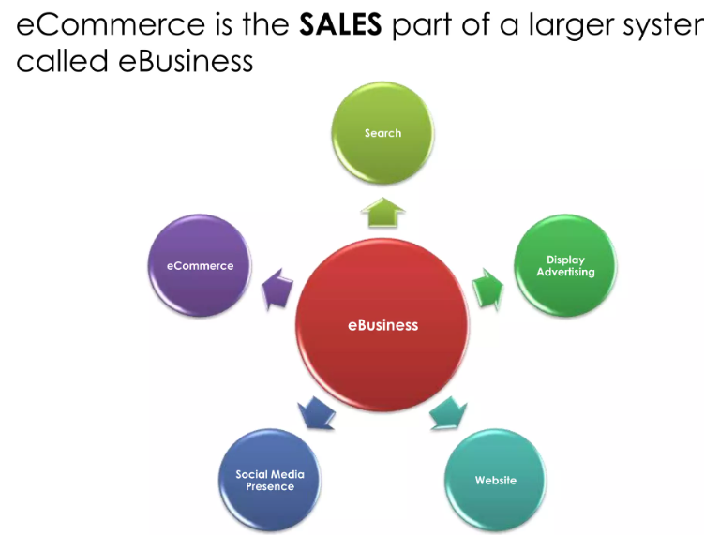
E-Business
E-Business is the conduct of business processes on the internet. These e-business processes include buying and selling goods and services, servicing customers, processing payments, managing production control.

Slide 5
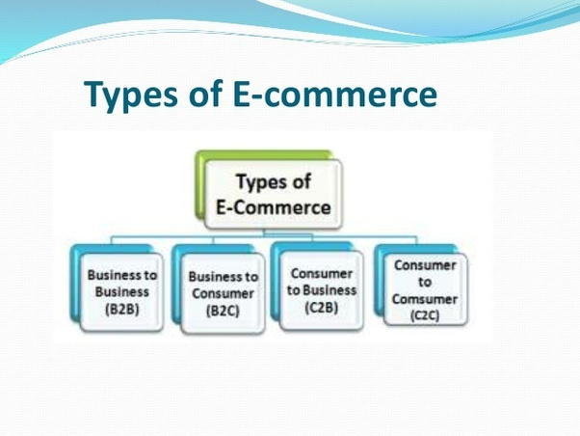
E-Commerce

Slide 6
E-Commerce
Business – to – Consumer (B2C): In B2C model, business sells its products directly to a customer. A customer can view the products shown on the website. The customer can choose a product and order. These B2C businesses are online retailers. Example: Amazon, Flipchart, etc.

Slide 7
E-Commerce
Business – to – Business (B2B): In B2B model, business sells its products to an intermediate buyer who then sells the product to the final customer. As an example, a wholesaler places an order from a company’s website and after receiving the consignment, sells the product to the final customer who comes to buy the product at one of its retail outlets. Example: Tata communications, Allibaba.

Slide 8
E-commerce
Consumer – to – Consumer (C2C): In C2C model, consumer helps consumer to sell their assets like residential property, cars, motorcycles , or rent a room by publishing their information on the website. Website may or may not charge the consumer for its services. Example OLX, Quirk, Hamrobazzar, online auction

Slide 9
E-commerce
Consumer – to – Business (C2B): In this model, consumers have products or services of value that can be consumed by businesses. For example, the comparison of interest rates of personal loan/car loan provided by various banks via websites. A business organization that fulfills the consumer’s requirement within the specified budget approaches the customer and provides its services. For e.g. – A blog can be written by an author for a business to improve sale of products, eBay.

Slide 10
Advantages of E commerce
Faster Buying Process
> E-commerce has speed up the whole buying process for customers. They do not need to visit physical outlets for shopping and can purchase products by just sitting at their home. It saves huge times and performs faster transactions.

Slide 11
ADvavtage
Eliminates Operating Cost
It has reduced the overall operating cost of
businesses. E-commerce has eliminated the need of
opening physical outlets by the business. For
operating an outlet, there are huge expenses in terms
of rent, utilities, various bills, and staff salaries. It
saves all these expenses and operates all business
activities through an online website.

Slide 12
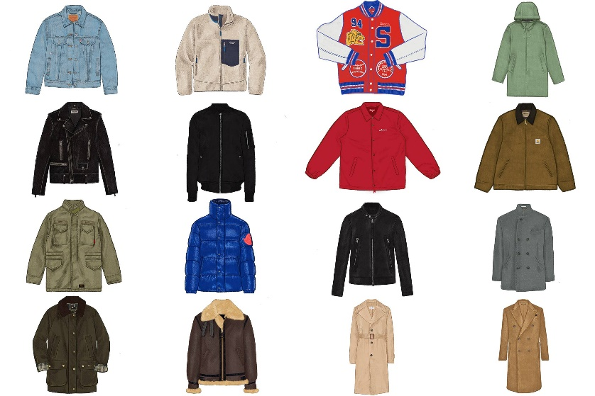
ADvavtage
Personalize Shopping Experience:
> E-commerce enables customers in Enjoying personalized shopping experience. Customers can search for a large variety of products as per their Choice And Needs without any restrictions. Online business shows products to customers according to their interest and their location.

Slide 13
ADvavtage
Online shopping facility is available
at all the time that is 24 hours a day
and 7 days a week. This is one of the
major advantages of e-commerce
that customers can access online
products at any time. Unlike physical
outlets, there is no official opening
and closing time here.

Slide 14
Disadvantage
online shopping is that customers
need to wait for longer time periods for getting their products
delivered. In the case of offline
shopping, customers get on-spot
delivery of their products.

Slide 15
Disadvantage
LACK OF TRY : cannot take a trial of products before
sing when they are doing online shopping. They
have a facility of negotiating the prices and cannot
e better information regarding usage and features
the product as in case of the physical outlet where
"salesperson interacts directly.

Slide 16
Disadvantage
Lack of Personal Touch: Customers lack the facility of touching and feeling products in case of online shopping. They are sometimes more satisfied by purchasing at physical outlets by properly checking the product before buying.

Slide 17
Disadvantage
Security Issues: Customers may lose their essential credentials while shopping online. There are various hackers over the internet which may steal customer’s data and may cause great loss to them.

Slide 18
Conclusion
E-commerce has its advantages and
disadvantages but it is already part of our
lives. Ordering tickets online, ordering food at home or purchasing various products on Amazon are common now. And in the future, everything we need will be in our personal phone.

