Slide 1

TRIBHUVAN UNIVERSITY ​ INSTITUTE OF ENGINEERING KATHMANDU ENGINEERING COLLEGE KALIMATI, KATHMANDU
Minor Project on
SurakshyaCam: AI-Based Smart Security Surveillance System
PRESENTED BY :
Anubhav Kunwar [KAT080BEI002]
Nischal Pandey [KAT080BEI018]
Srijan Regmi [KAT080BEI039]
Unik Poudel [KAT080BEI045]
SUPERVISOR :
Sujan Shrestha

Slide 2
Agenda
Introduction
Background Theory
Problem Statement
Objective
Methodology
Expected Outcome
Cost estimation
Gantt chart

Slide 3
Introduction
SurakshyaCam is a smart AI-based surveillance system built to make campuses safer. Unlike traditional CCTV that only records, our system detects people, recognizes faces, reads banners, and sends instant alerts. Using ESP32-CAM with IoT sensors and server-side AI like YOLOv8 and Tesseract OCR, it provides:
Real-time entry/exit monitoring
Occupancy management to prevent overcrowding
Visitor alerting for unknown individuals
Emergency text detection from banners or notices
In short, SurakshyaCam is a low-cost, intelligent, and proactive security solution for schools, offices, and institutions.

Slide 4
Background Theory
SurakshyaCam is built on the fusion of IoT systems and AI-driven computer vision. The idea is simple: sensors and cameras capture real-world events, edge devices like the ESP32-CAM forward the data, and powerful server-side AI models analyze it in real time.
Core Technologies
IoT Systems – Four layers: sensing (PIR sensor, RTC), edge (ESP32-CAM), communication (Wi-Fi/MQTT), and application (Django web dashboard).
ESP32-CAM – A low-cost microcontroller with a built-in camera, ideal for image capture and streaming.
YOLOv8 – A deep learning algorithm that detects and counts people quickly and accurately.
Dlib Face Recognition – Identifies known individuals versus visitors.
Tesseract OCR – Reads text from banners or notices to trigger emergency alerts.
PIR Motion Sensor – Detects human movement to activate the camera only when needed.
RTC Module – Provides precise timestamps for logging and auditing.

Slide 5
Background Theory
System Concept
Hybrid Edge–Server Architecture → ESP32-CAM captures events, while server-side AI handles heavy computation.
Event-Driven Monitoring → Camera activates only when motion is detected, saving power and resources.
Integrated Alerts → Relay, buzzer, SMS, and email notifications ensure immediate response.
Web Dashboard → Centralized monitoring with logs, live video, and occupancy data.

Slide 6
Problem statement
Educational institutions struggle with manual security and attendance systems that are error-prone, time-consuming, and lack real-time intelligence. Current CCTV setups only record video but cannot automatically detect suspicious activity, verify identities, or respond to emergencies.
Key challenges include:
No real-time occupancy monitoring, leading to overcrowding in classrooms and labs.
Difficulty in distinguishing students, staff, and unknown visitors, which poses security risks.
Lack of automated banner text detection for emergency notices like “FIRE” or “EVACUATE”.
Existing low-cost systems fail to integrate AI-powered detection, IoT sensors, and alert mechanisms into one unified solution.

Slide 7
Problem statement
Therefore, there is a need for a low-cost, AI-powered surveillance platform that combines YOLO-based person detection, face recognition, OCR text detection, and IoT communication protocols to provide comprehensive entry monitoring, occupancy management, visitor alerting, and emergency response in real time.

Slide 8
Objectives
Detect persons and banner text with AI models like YOLOv8, Tesseract OCR and ensure accurate attendance and security logging.
Identify suspicious activities and trigger real-time alerts with buzzer, SMS, or email notifications.
Provide centralized monitoring through a web dashboard with live video, logs, and analytics.

Slide 9
Methodology How It All Connects — System Architecture
EDGE LAYER
SERVER LAYER
APP LAYER
▶ PIR Motion Sensor
▶ YOLOv8 Detection
▶ Django Dashboard
▶ ESP32-CAM Module
▶ Face Recognition
▶ SQLite Database
Wi-Fi
REST API
▶ Arduino UNO
▶ Tesseract OCR
▶ Email Alerts
▶ DS3231 RTC Clock
▶ Python AI Server
▶ Telegram Bot
▶ Buzzer + Relay
▶ Event Classifier
▶ SMS Notifications

Slide 10
Methodology Hardware Components & Their Roles
📷 ESP32-CAM
🔧 Arduino UNO
🌡️ PIR Sensor
Captures images & streams video over Wi-Fi. The brain at the door.
Reads PIR sensor, triggers the camera & controls buzzer/relay.
Detects human movement. Wakes the system only when someone is there.
🕐 DS3231 RTC
🔔 Relay + Buzzer
💻 Laptop/PC
Keeps accurate timestamps for every event, even without internet.
Triggers local alarm and can control door locks physically.
Runs AI models (YOLOv8, OCR) and hosts the Django web dashboard.

Slide 11
Methodology AI Pipeline & Key Algorithms
1
→
2
→
3
→
4
→
5
→
6
Motion Trigger
Image Capture
YOLOv8 Detect
Face Recog.
OCR Scan
Decision
PIR → Arduino → ESP32-CAM wake
JPEG + RTC timestamp → HTTP POST
Person / weapon / mask / card
Dlib encoding → DB match
Tesseract reads banner keywords
Priority alert dispatched
Entry/Exit Detection (IR Sequence)
Alert Channels & Use Cases
• IR1 before IR2 → ENTRY
• IR2 before IR1 → EXIT
• Re-entry < 3s → SUSPICIOUS (siren)
• Night mode: PIR active only after 20:00
• SMS → critical emergencies only
• Telegram → all detection events
• Email → detailed event reports
• Buzzer → local physical alarm

Slide 12
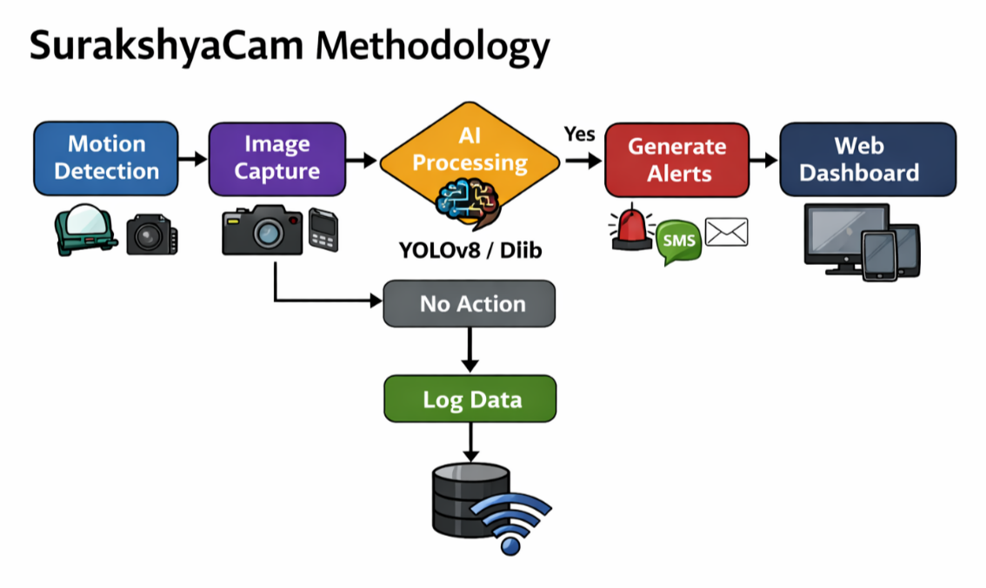
Methodology

Slide 13
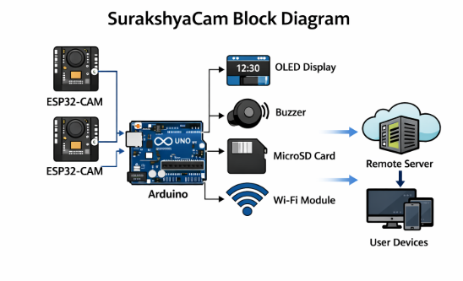
Methodology

Slide 14
Expected Outcome
The expected operational result is a working prototype capable of monitoring one controlled doorway under indoor lighting with moderate traffic. The following outcomes are anticipated:
1.Automatic entry and exit logging for authorized students.
2.Accurate timestamping of events using RTC-backed time records.
3.Near real-time notifications for unknown or unverified persons.
4.Improved campus security through image evidence and database- backed logging.
5.Reduced manual attendance effort at monitored doors.
6.A reusable academic platform for future smart campus research.

Slide 15
Expected Outcome
System performance will depend on camera placement, ID-card visibility, network strength, and OCR quality. In practice, multiple test iterations will be required to tune sensor spacing, image framing, and OCR preprocessing parameters.

Slide 16
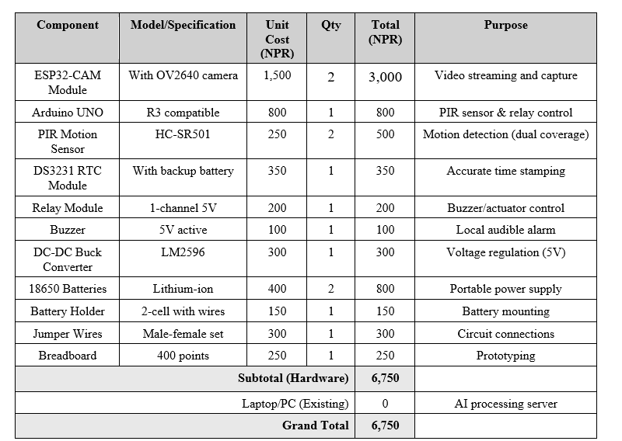
Cost estimation

Slide 17
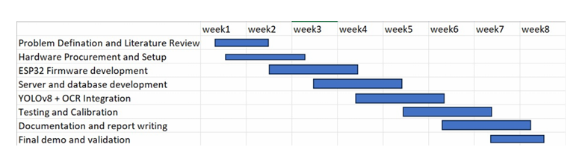
Gantt Chart

Slide 18
THANK YOU !

