Slide 1
Element.setAttribute()
Presented by: Nischal shrestha

Slide 2
What is setAttribute()?
setAttribute() is a method which is used to set the attribute value of any HTML element.
Syntax:
Element.setAttribute(name, value);
Example:
const image = document.querySelector("#img-chair")
image.setAttribute("src", "https://unsplash.com/chair")

Slide 3
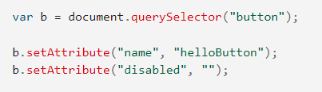

Why use setAttribute()
Used to set certain attribute value of an HTML element.
Example:
- We can change source of image tag.
- We can set button properties as disabled

Slide 4
Demonstration / index.html
<!DOCTYPE html>
<html lang="en"> <head></head> <body>
<img id="img-chair"
src="https://images.pexels.com/photos/7614534/pexels-photo-7614534.jpeg?auto=compress&cs=tinysrgb&dpr=2&h=650&w=940"
alt="">
<script src="./app.js"></script>
</body> </html>

Slide 5
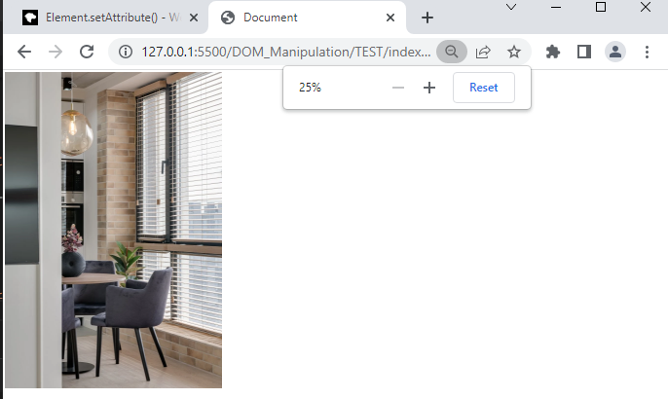
Output before setAttribute() code

Slide 6
Writing setAttribute() code in app.js
const image = document.querySelector("#img-chair")
image.setAttribute(
"src",
"https://upload.wikimedia.org/wikipedia/commons/thumb/b/b6/Image_created_with_a_mobile_phone.png/1200px-Image_created_with_a_mobile_phone.png"
)

Slide 7
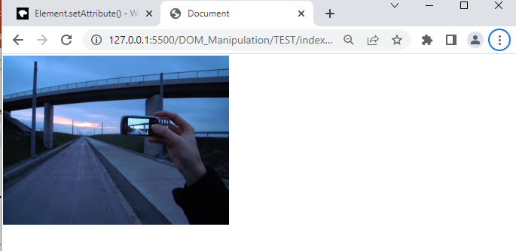
Output After Writing setAttribute() Code

Slide 8
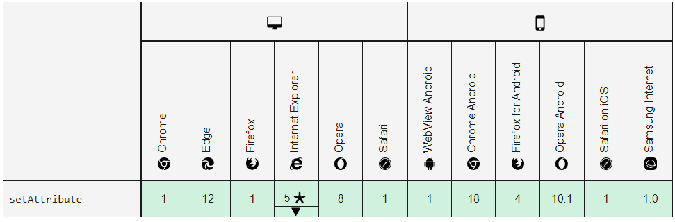
Browser Compatibility for setAttribute()

Slide 9
THANK YOU!

