Slide 1
TweetGuard: NLP-Powered Disaster Monitoring
Nischay
Rajeev
Pranav Sai

Slide 2
Presentation outline
Introduction
Dataset overview
Exploratory Data Analysis
Data Pre-processing
Model Building
Final Thoughts

Slide 3

Introduction
Every second counts during a natural disaster, and timely and accurate information can save countless lives. In this project, we aim to develop a machine learning model that can accurately classify tweets related to natural disasters, enabling faster and more effective emergency response. By leveraging advanced NLP techniques and deep learning models, we strive to improve the accuracy of the classification task and ultimately contribute to the global effort of disaster management.

Slide 4
Data Set Overview
# of observations : 7,613
Each Observation is labeled as either disaster-related or a regular tweet.
Along with the tweet text and target label, each observation includes an ID, keyword, and location from where the tweet was sent.
As the ID doesn't contribute to predictive capabilities, and both keyword and location contain numerous missing values, these features have been excluded from the EDA and model building processes.

Slide 5
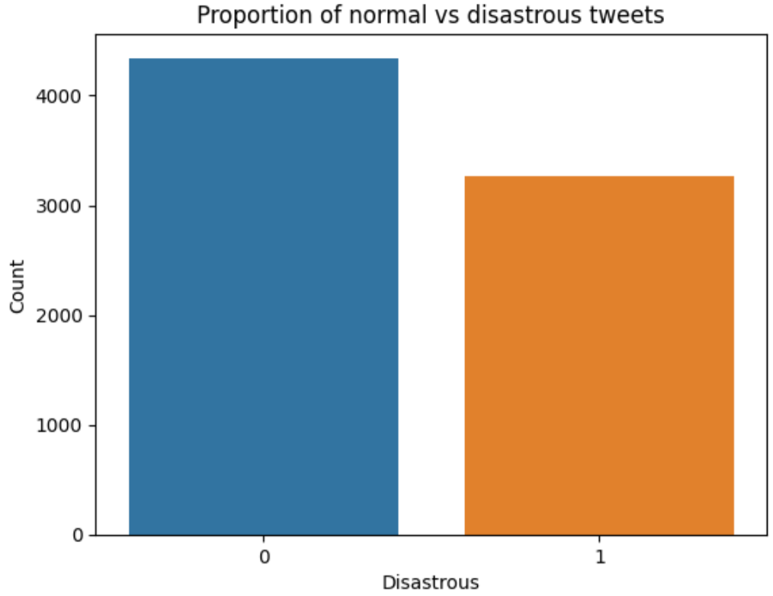
Exploratory Data Analysis
Though in reality the proportion of disaster tweets are low when compared to normal tweets, but from the data set sample we have acquired from Kaggle the percentage of tweets which are related to a disaster are 42.96%.

Slide 6
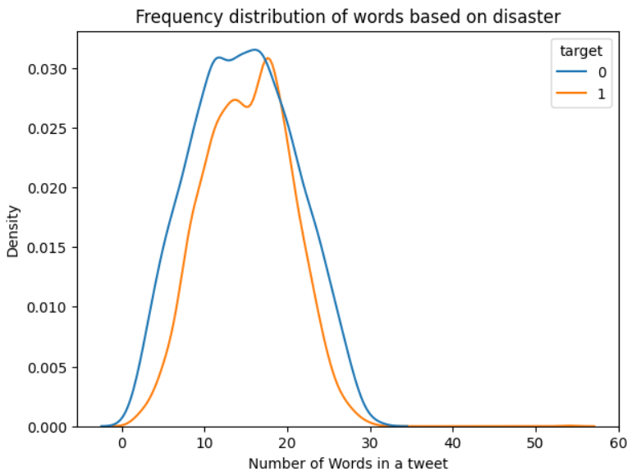
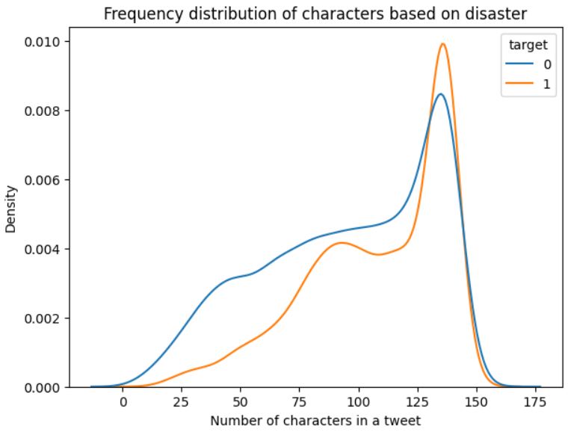
Exploratory Data Analysis
We can see that the word count in tweets is similar, whether they pertain to disasters or not. However, disaster-related tweets have a higher character count and exhibit a more pronounced left skew compared to non-disaster tweets.

Slide 7
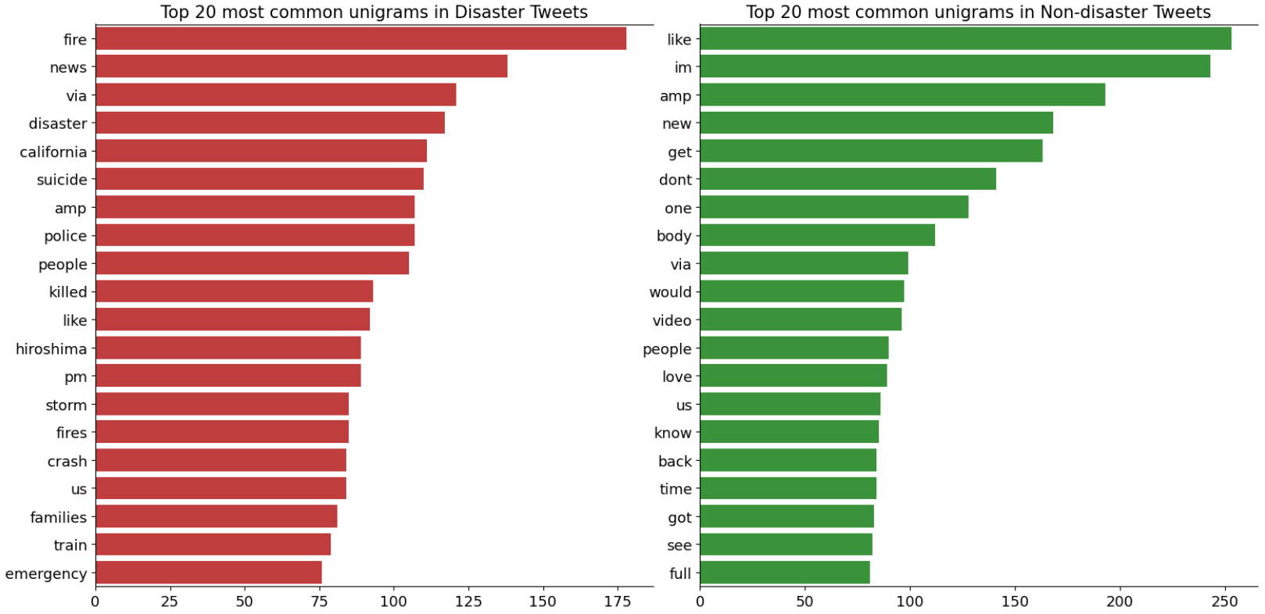
Exploratory Data Analysis
N-grams are an important concept in Natural Language Processing (NLP) as they help capture the context and structure of language. An N-gram is a contiguous sequence of N words or characters in a text. For instance, bigrams (N=2) consist of two consecutive words, trigrams (N=3) consist of three consecutive words, and so on.
Within the unigram analysis, it is evident that disaster-related tweets predominantly contain words associated with catastrophes.

Slide 8
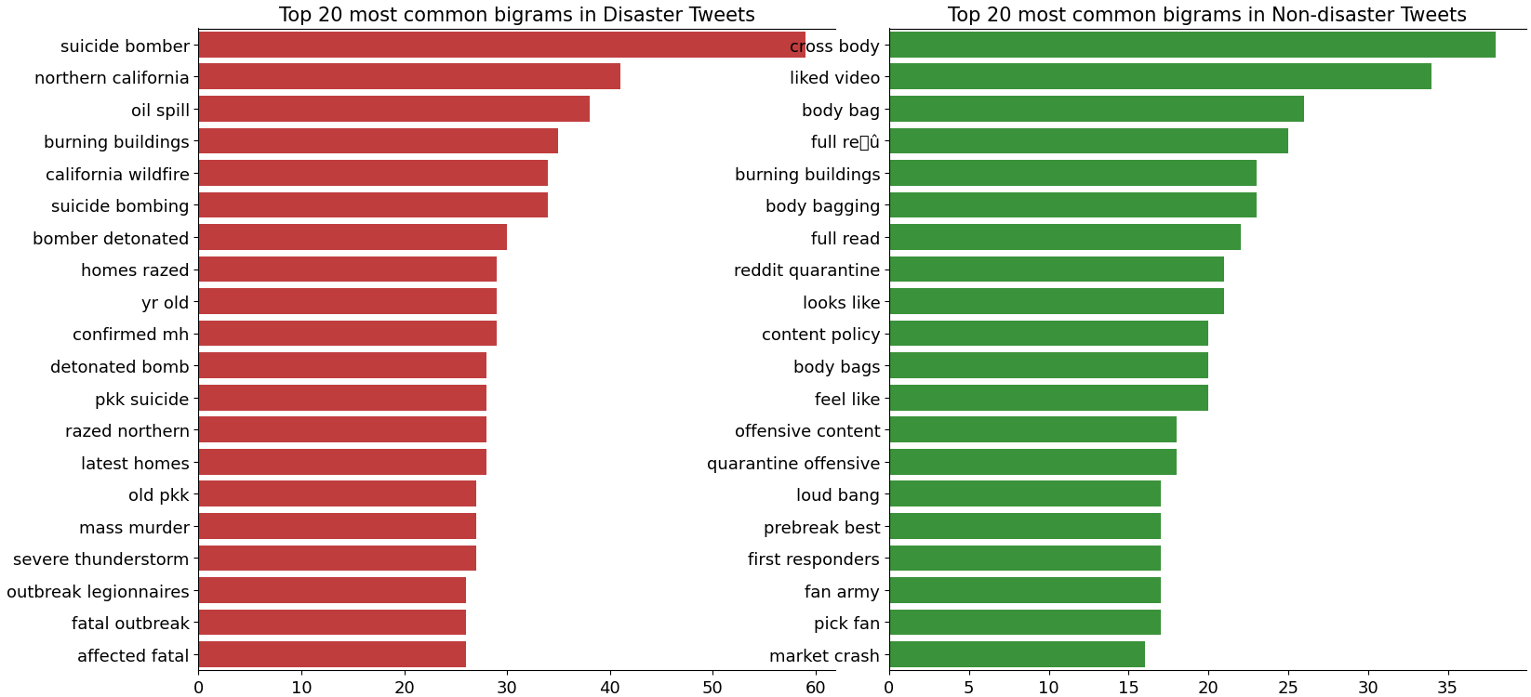
Exploratory Data Analysis
Similar to unigram analysis, for bigrams as well the words in the tweets are predominantly associated with catastrophes.

Slide 9
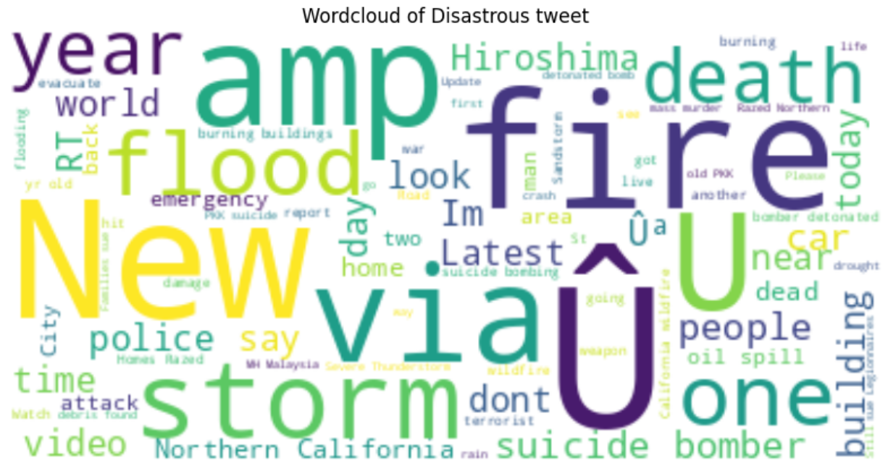
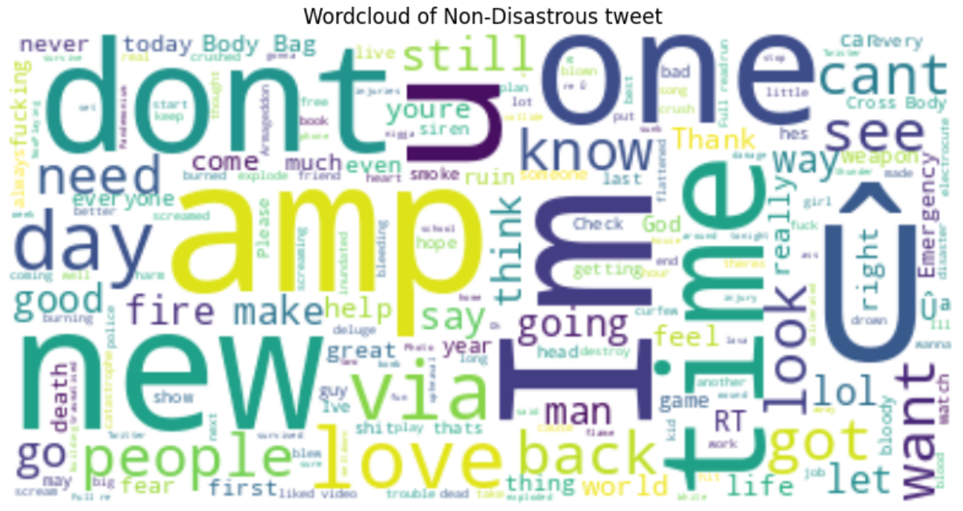
Exploratory Data Analysis
Through the Word Cloud, it's apparent that emergency-related tweets contain words typically used in disaster contexts, such as "Fire," "Police," “Storm” and "Death."
Conversely, regular tweets feature words like "People," "Love," "Time," and so on.

Slide 10
Data Pre-Processing
Data preprocessing is crucial in text data, as it helps eliminate noise and enhance the quality of the data, leading to better model performance and more accurate results.
Removing usernames: Removes the usernames or handles that start with '@' symbol from the text using regular expression.
Removing URLs: Removes any URLs present in the text using regular expression.
Removing punctuation: This function removes all punctuation marks from the text using the string.punctuation module.
Removing stop words: This function removes all the stop words, which are commonly occurring words like 'the', 'and’, 'a', etc. from the text using the NLTK library's stop word corpus.
Removing emojis: This function removes all the emojis present in the text using the demoji library.
Removing numbers: Removes any numerical digits present in the text using regular expression.

Slide 11
Model Building
Based on the Model the pre-processed text is converted into vector format either using Tf-Idf (for Naïve baise & MLP Classifier) or Word Embeddings (For LSTM)
Machine learning models used for classification.
Naïve Baise
MLP Classifier
LSTM
LSTM with bidirectional layer
BERT

Slide 12
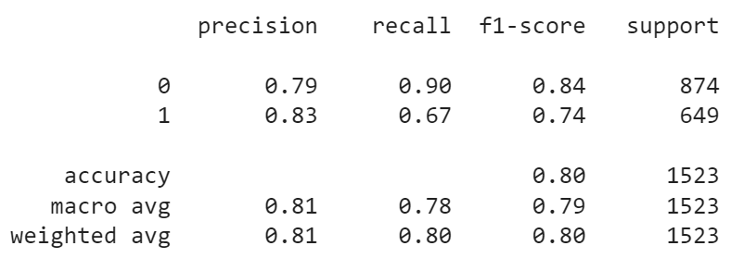
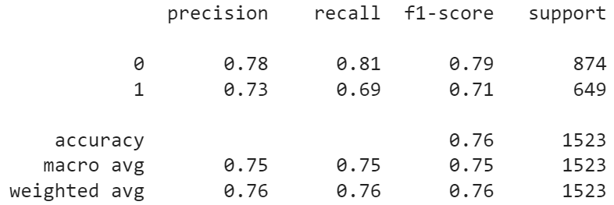
Model Building
Naïve Baise
MLP Classifier
Considering F1 score as the performance metric, Naïve Baise has performed better with F1 score of 0.80 against MLP Classifier which achieved a F1 score of 0.76

Slide 13
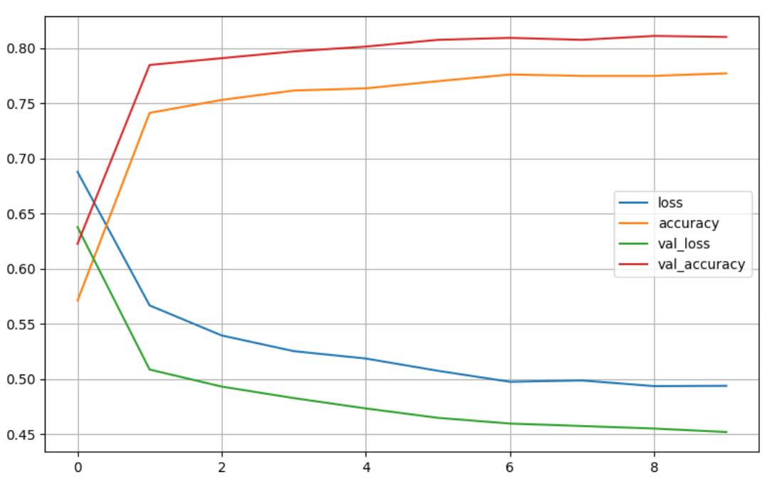
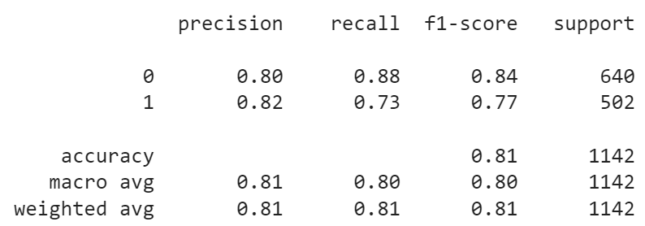
Model Building
LSTM
The F1 Score has improved to 0.81, surpassing the previous best model, Naïve Bayes.
The learning curves display that the training and validation accuracies are closely aligned, confirming that the model is fitting the data appropriately without overfitting or underfitting issues.

Slide 14
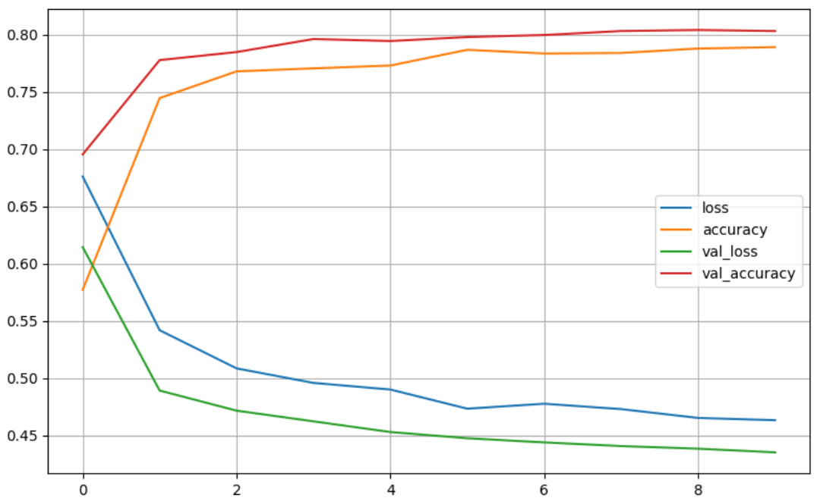
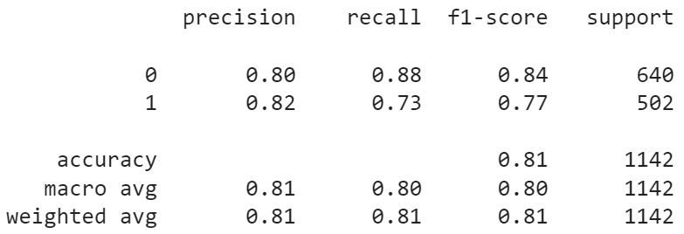
Model Building
Bidirectional LSTM
Adding a Bidirectional layer in LSTM has not made a significant impact on the performance metric “F1 Score”

Slide 15
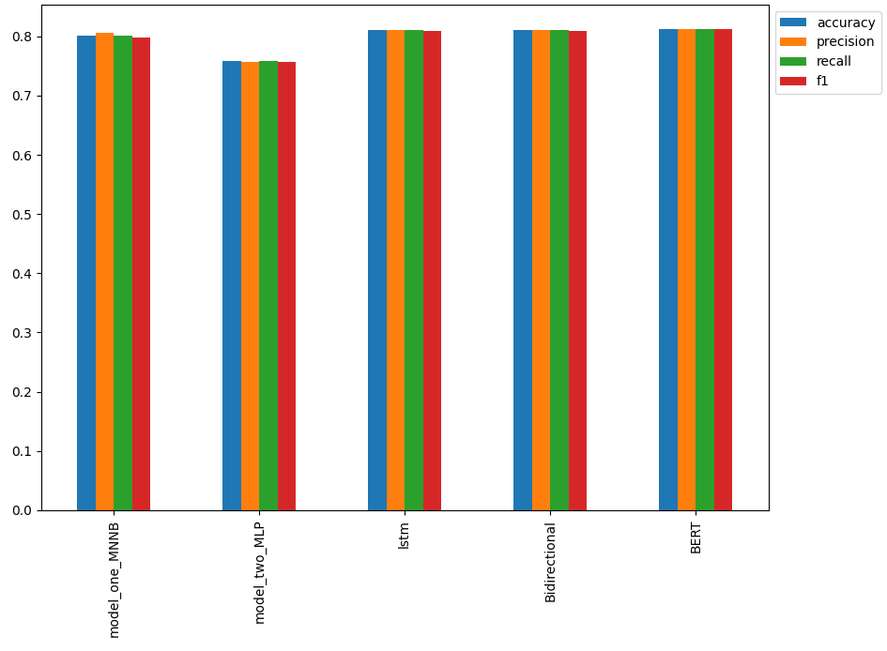
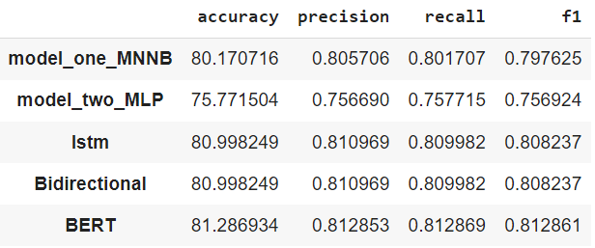
Model Comparison
Evaluating models based on F1 Score:
MLP: Lowest F1 score at 0.75
Naïve Bayes, LSTM, and Bidirectional LSTM: Similar scores around 0.80
BERT: Highest F1 score at 0.81

Slide 16
Concluding Remarks
Top Performer: BERT model achieved 81.29% accuracy and superior precision, recall, and F1 scores.
Practical Applications: Rapid and precise detection of disaster-related tweets to support emergency services and public awareness.
Project Impact: Highlights the capabilities of machine learning and NLP in classifying disaster-related tweets.

