Slide 1
WINE QUALITY DATASET
TEAM 6

Slide 2
CONTENTS
Introduction
Exploratory Data Analysis
Modeling
Conclusion

Slide 3
introduction
In the market, wine is one of the most important social gathering ice breaker.
The wine business relies heavily on wine quality certification.
In order to advertise their quality, they hire experts and research teams in order to rate the quality of their wine.
This method is somewhat costly and time-taking for companies.
This algorithm is built in order to predict the quality of wine ranging from 1 to 10.

Slide 4
Dataset Information
Source of the dataset: https://archive.ics.uci.edu/ml/datasets/wine+quality
Size of the dataset: 6497 observations
Variables: ["type”, "fixed.acidity”, "volatile.acidity”, "citric.acid”, "residual.sugar”, "chlorides”, "free.sulfur.dioxide”, "total.sulfur.dioxide”, "density”, "pH" "sulphates”, "alcohol”, "quality" ]

Slide 5
Smart questions
Can we predict the quality of wine using the factors present in the dataset?
Which factor/factors most affect the quality of wine?
What is the difference between the accuracy obtained from different models?
Is there any difference in quality between red and white wines?

Slide 6
Exploratory data analysis
First, we have two files which are wine_red and wine_white datasets, which we merged.
Next, we checked the distribution of white wine and red wine between the 0 and 10.
Then, we checked the difference between independent variables with red and white wine.
Next, we checked the distribution of wine with every variable in the dataset.
(results in the next slide)

Slide 7
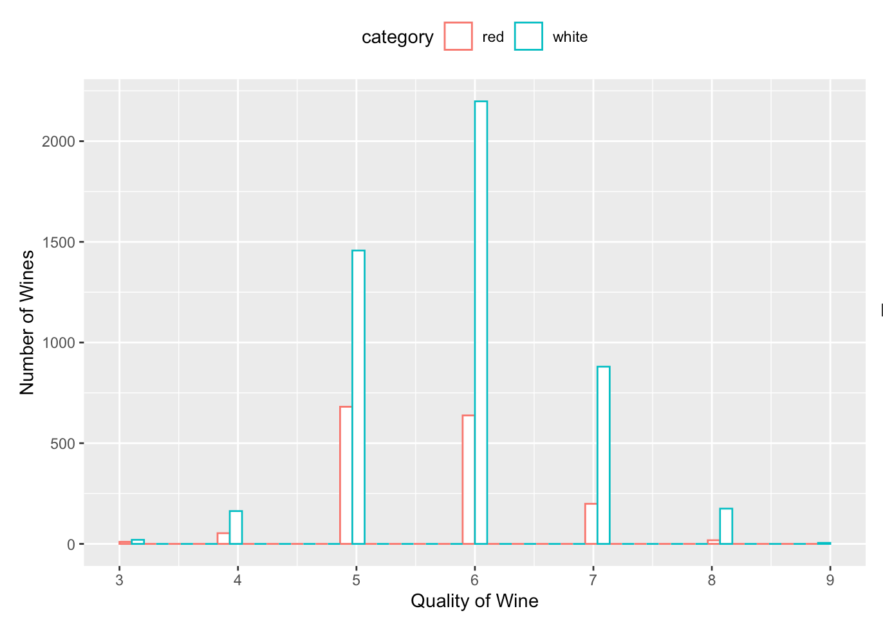
Distribution of red wine and white wine

Slide 8
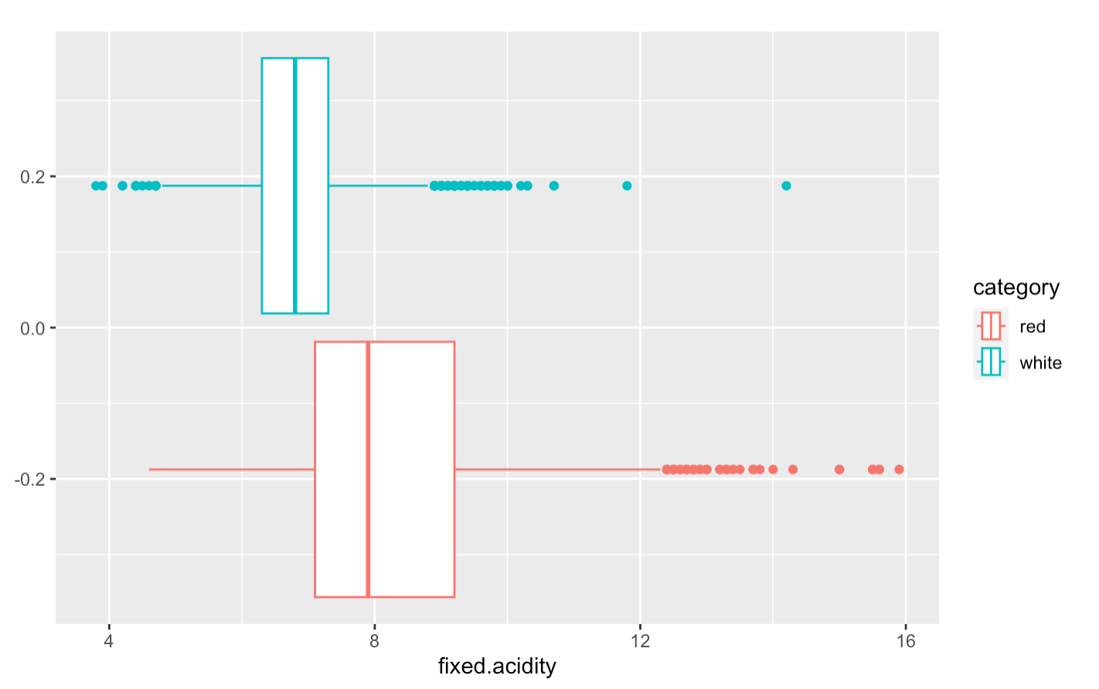
Significant variance

Slide 9
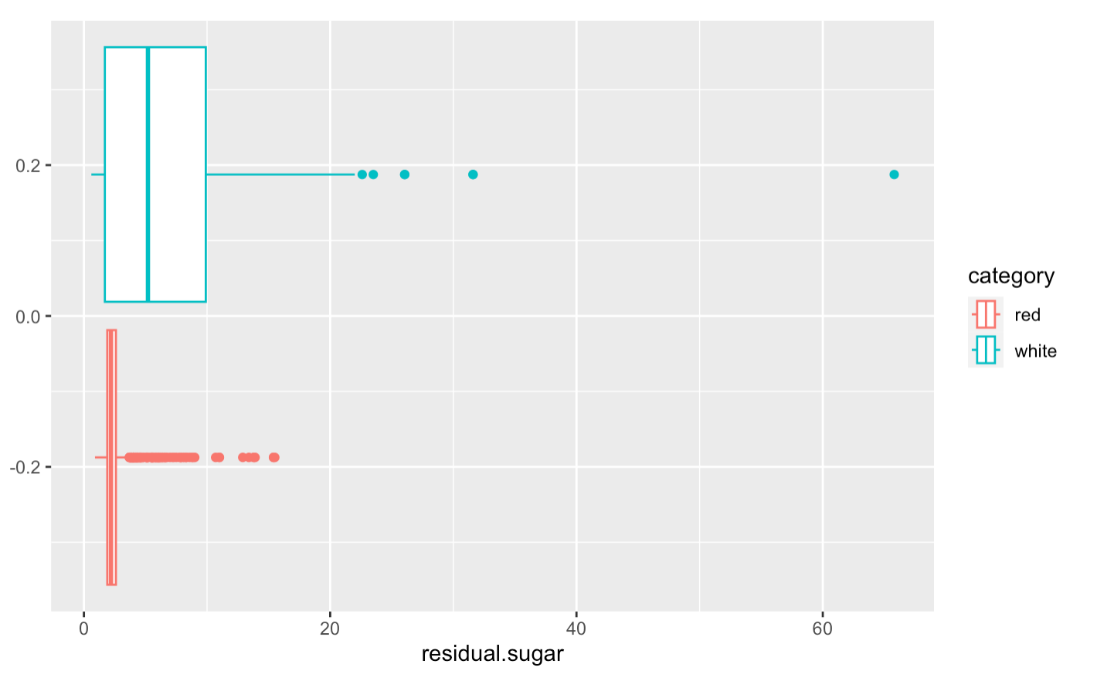
Residual sugar

Slide 10
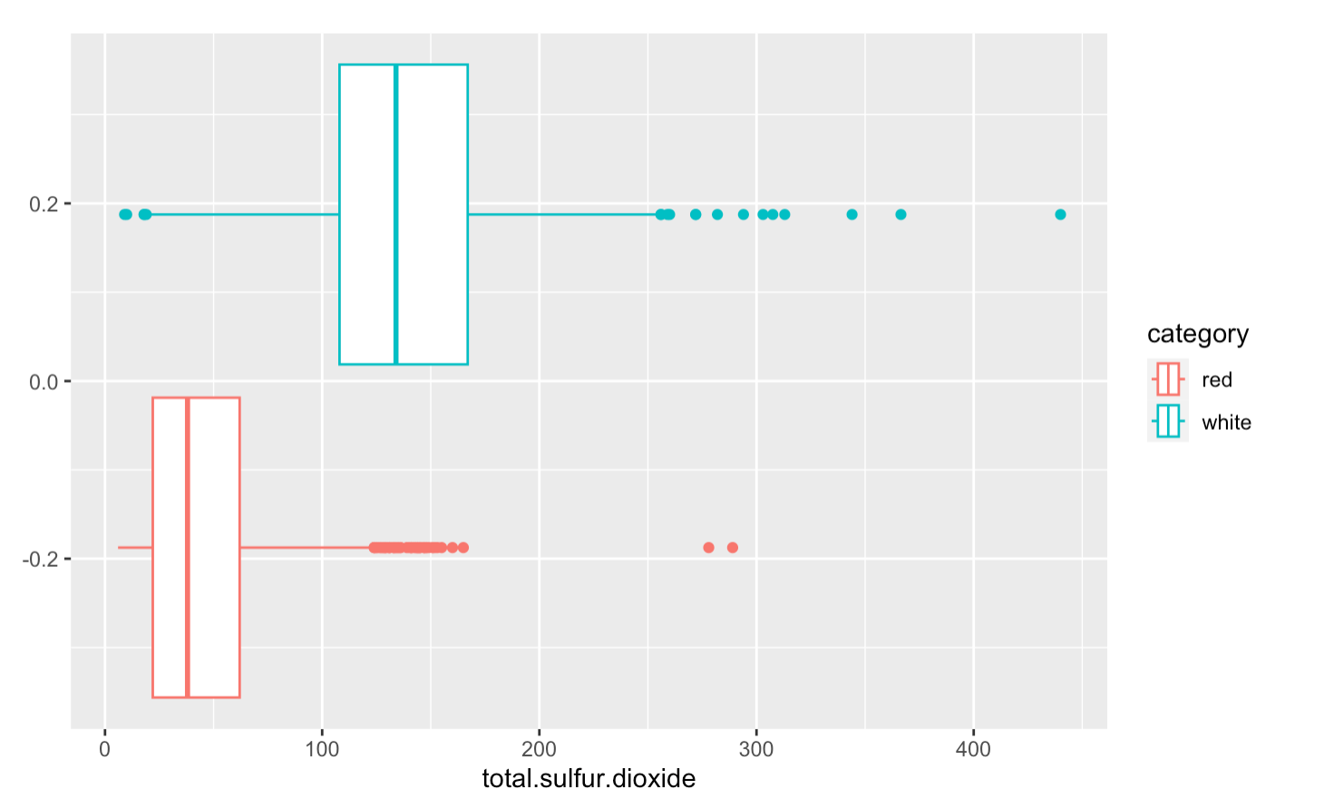
Total Sulfur dioxide

Slide 11
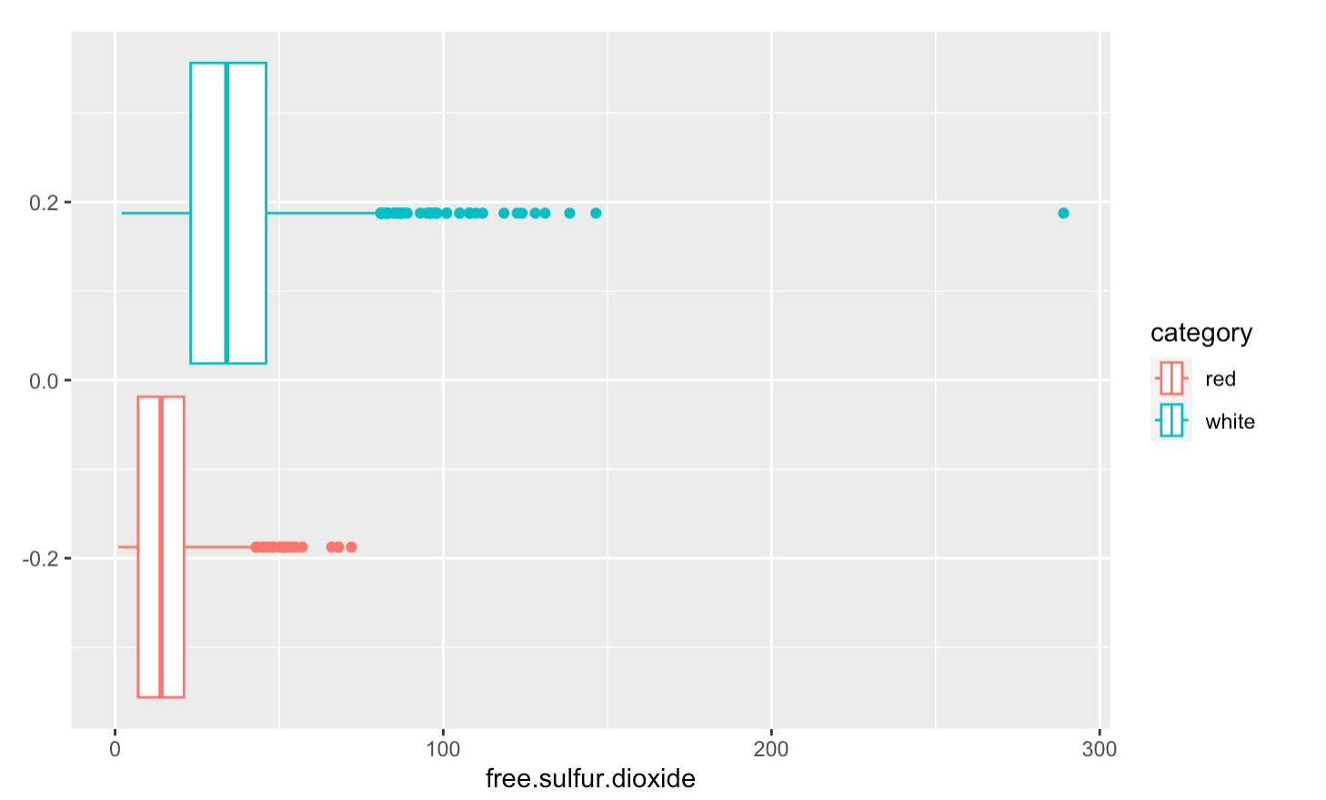
Free sulfur dioxide

Slide 12
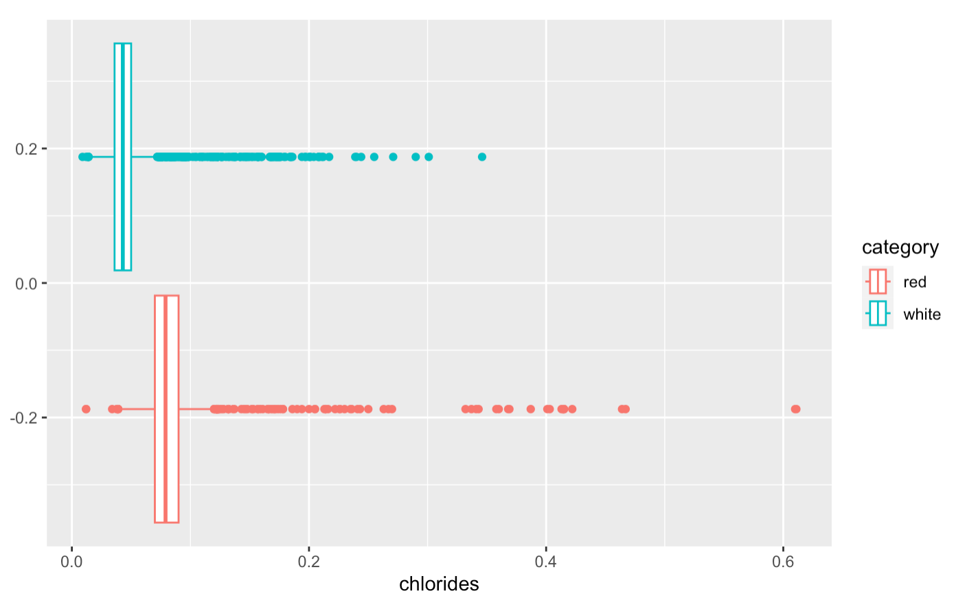
chlorides

Slide 13
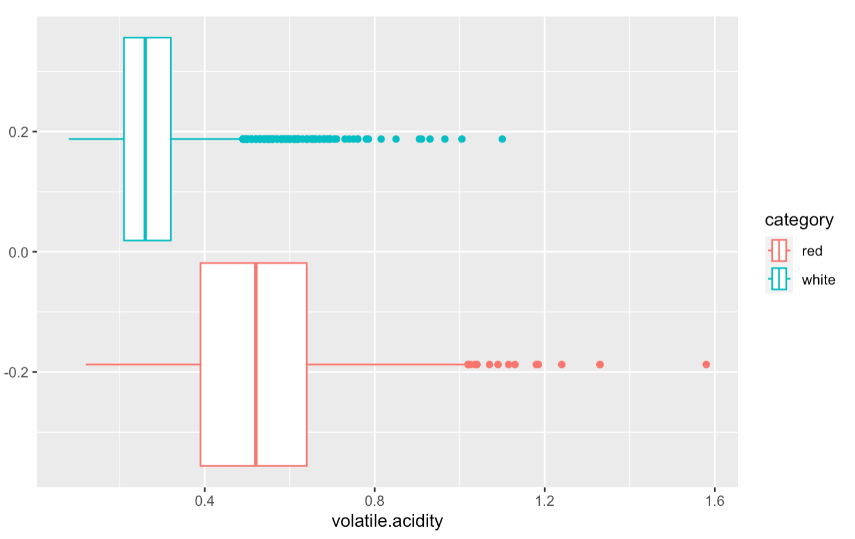
Volatile acidity

Slide 14
EDA summary
We found out that the above variables play a significant role in the determination of the quality of wine.
But these significance is shown in both a positive and a negative way.

Slide 15
Modeling
For the modeling first, we created a new variable called “quality variable” which stores the quality of the wine as “high” or “low”, and we have added that column to the data frame.

Slide 16
KNN modeling
First, we centered and scaled the data as the algorithm uses distance metrics.
scaleddata <- as.data.frame(scale(wineknn[1:11], center = TRUE, scale = TRUE))
We separated the labels and split the data into training and testing data with training data being 67%, and the remaining 33% of the data being test data.
We used the KNN function by providing the required data and used the K value as 19, which provides the best accuracy for the model.
wine_model_pred <- knn(train = wine_training, test = wine_test, cl=wine.trainLabels, k=19)

Slide 17
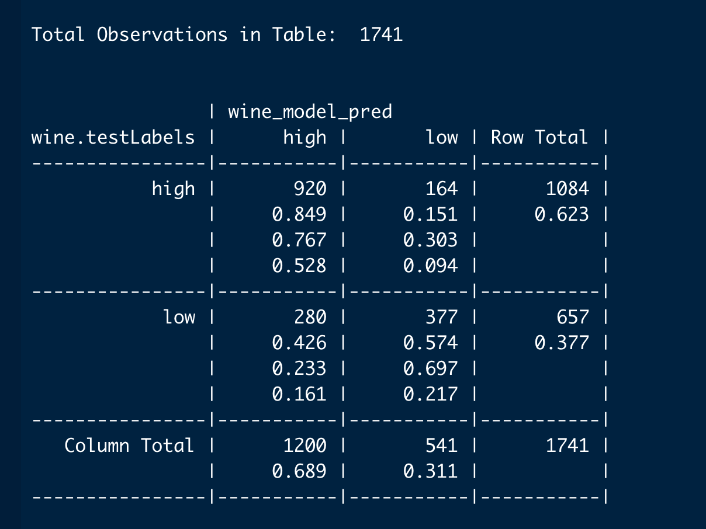
Confusion matrix

Slide 18
Knn accuracy
With the K value as 19, the accuracy of the model is 0.744.
cm = confusionMatrix(wine_model_pred, reference = as.factor(wine.testLabels) )
print( paste("Total Accuracy = ", cm$overall['Accuracy'] ) )
The total accuracy is 74.49%.

Slide 19
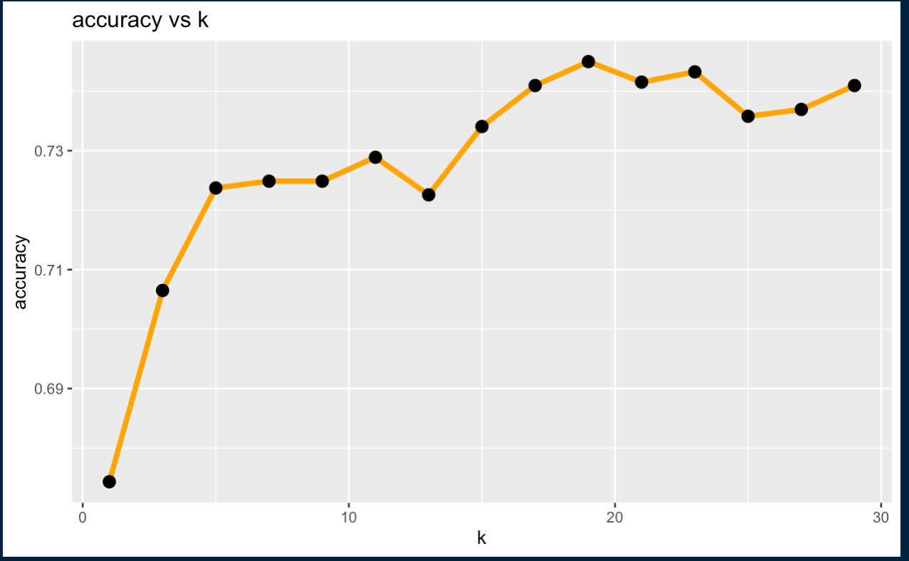
KNN – accuracy vs K value

Slide 20
Decision tree
The training and testing splits are similar to the KNN algorithm.
control <- rpart.control(minsplit = 5L, maxdepth = 5L, minbucket = 5, cp = 0.002, maxsurrogate = 4)
rPartModel <- rpart(qualityvariable ~ ., wine_training_for_dc, method = "class", control = control)

Slide 21
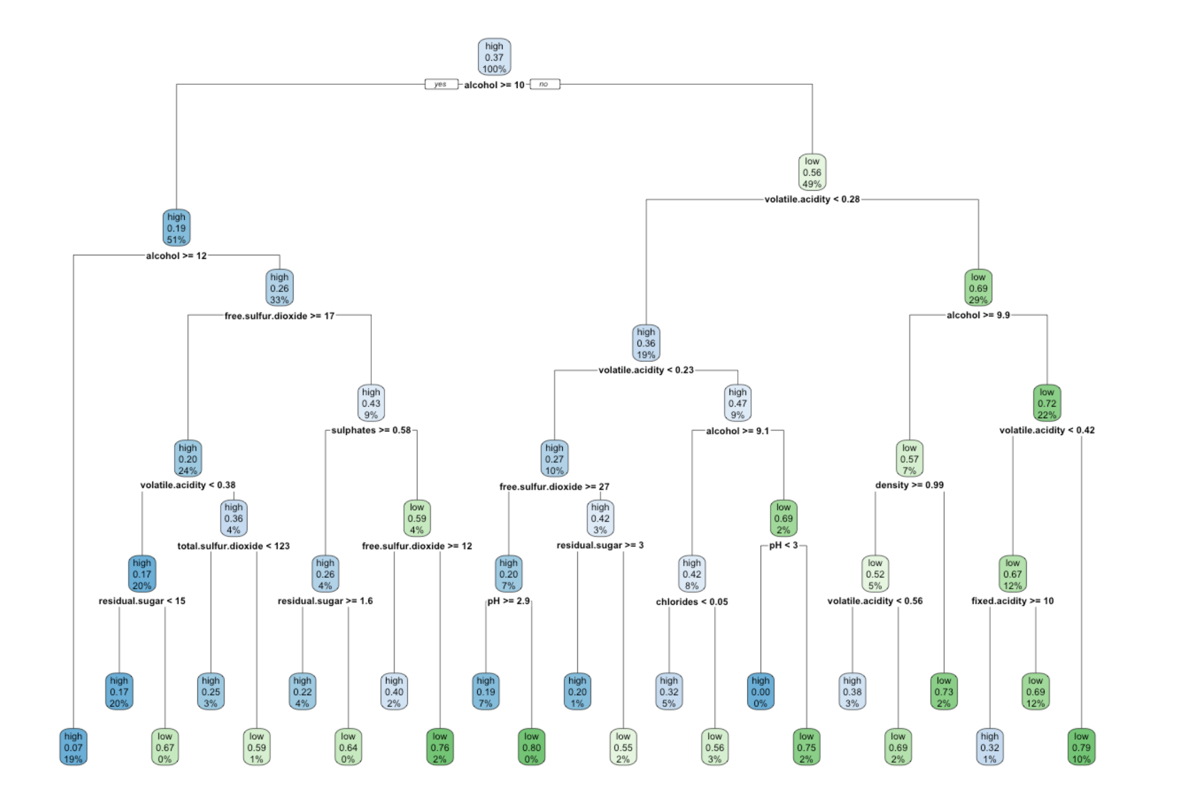
Decision tree

Slide 22
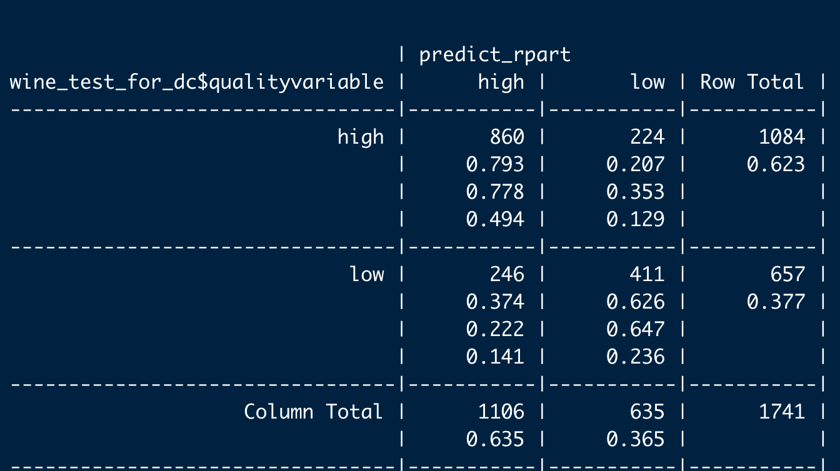
Decision tree – confusion matrix

Slide 23
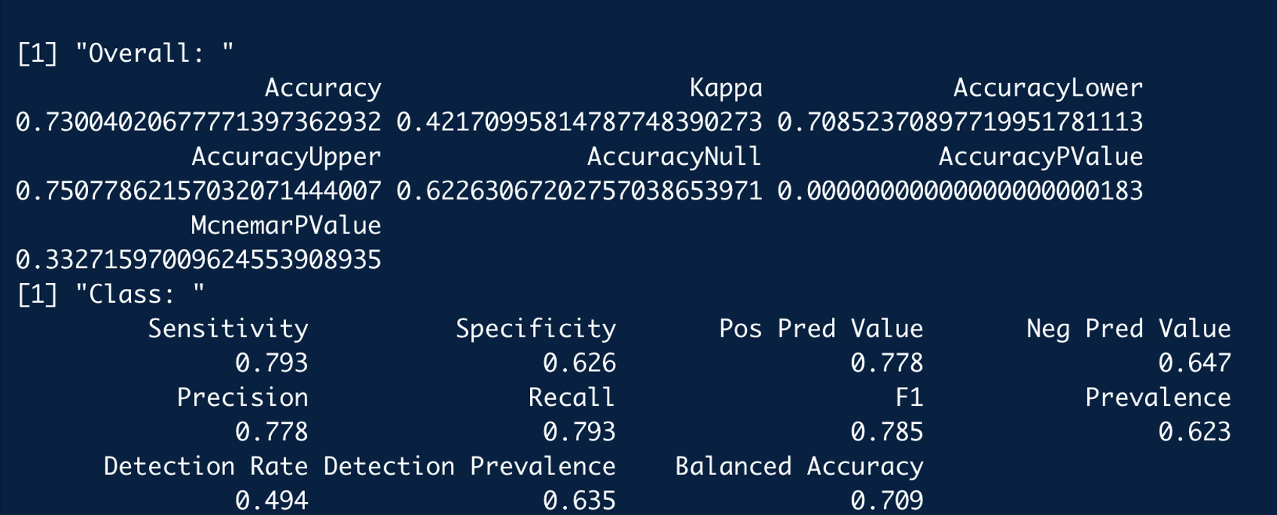
Decision tree – accuracy, precision

Slide 24
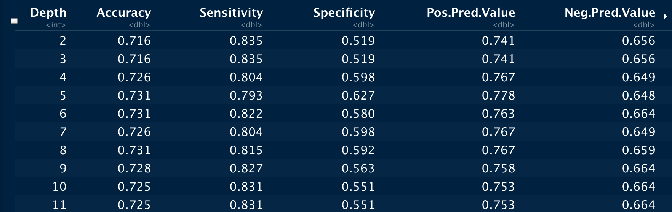
Decision trees for different depths

Slide 25
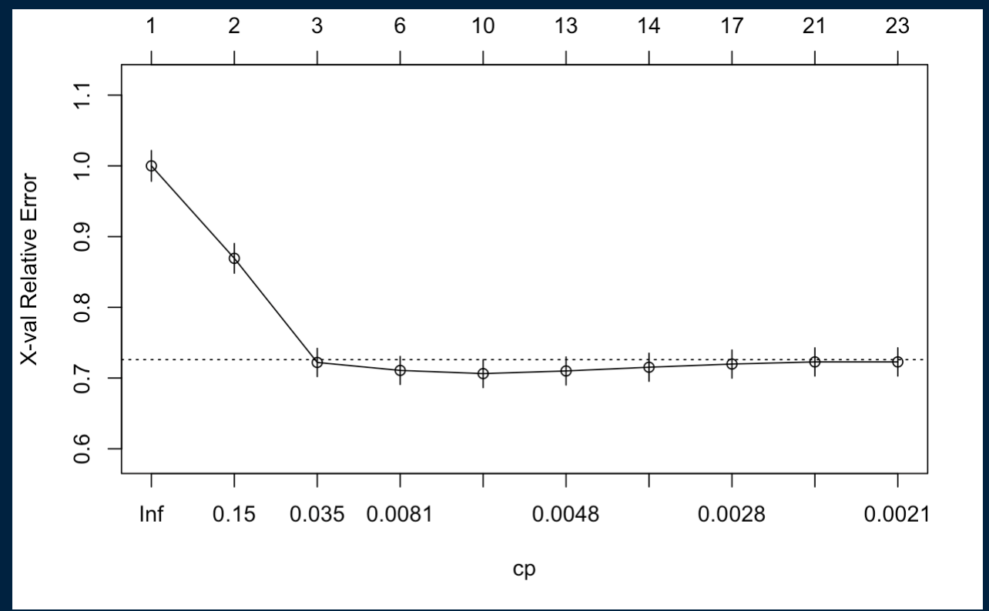
Decision Tree – CP vs X - Val

Slide 26
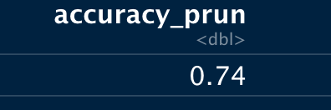
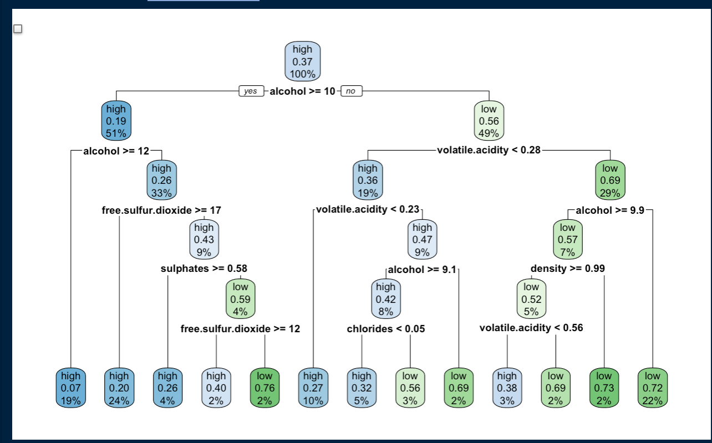
Decision Tree - Pruning

Slide 27
Logistic regression
For the logistic regression, we took all the variables and completed a binomial logistic regression.
We got an accuracy of 73.12% which is not better than decision tree.

Slide 28
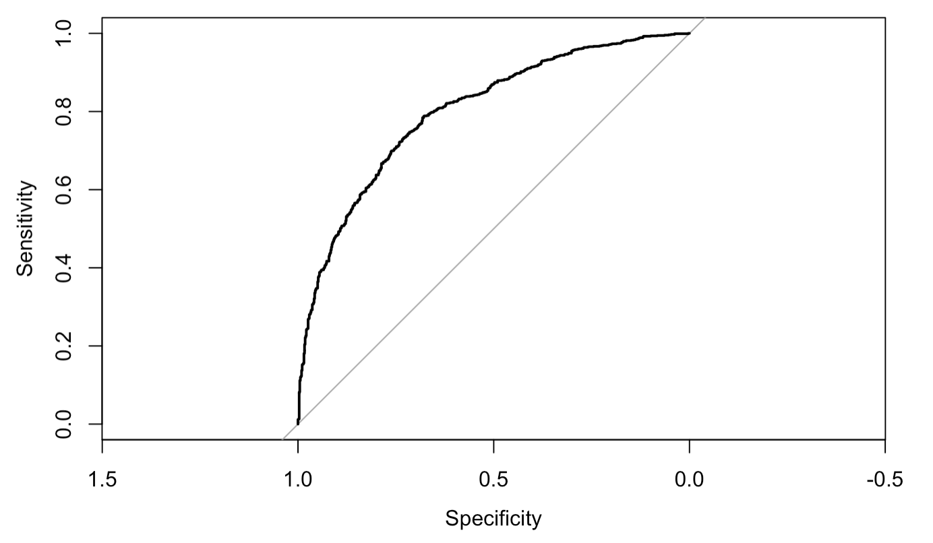
Auc for logit model

Slide 29
Summary
First, we used KNN model which generated 74.49% accuracy.
Secondly, we used Decision Tree algorithm, which, after pruning, gave out 74.9% accuracy.
Third, we used Logistic Regression, which resulted in 73.12% accuracy.
Out of all the three models, Decision Trees performed best. As we work on, we’ll make the necessary changes if any algorithm beats it.

Slide 30
Conclusion
Wine quality prediction is a

