Slide 1
We Watch
NISCHAY CHANDRA
19207733
GGV/19/5089
B.Sc. Computer Science VI
Watch YouTube Videos Together

Slide 2
INTRODUCTION
We Watch is a simple web app that let’s you create a Watch Room for YouTube videos. One may ask why this project has a use in real life, if you can easily use Google Meet to just screencast your playback. But bear with me, in upcoming slide I will show you why this can be useful. I have also integrated live chat so that users in same room can chat with each other.
This works on WebSocket rather than REST, which is required to reflect the events fired by one on other’s player.

Slide 3
Why you might use it ?
The problem with Google Meet or any other video chat app that lets you cast your screen to other joiners is, that, the quality of your screen casted video will decrease no matter how good the internet connection is, and also you have to spend 2x of your bandwidth because first, you are streaming the video from YouTube and then also sending feed to the Chat App. Add voice chat on top of that and you will be dealing with bad network speed.
What We Watch does is that, it splices the part where you have to send the video feed to other joiners and thus saves half of your bandwidth. You just have to pick up a Video URL from YouTube and create a Room for that providing a password and a display name. The app will render the Player and the video on other joiner’s devices natively using their network. They can increase or decrease their video quality according to their convenience.

Slide 4
TECHNOLOGY STACK
Programming Language – JavaScript
Runtime – Browser and Node JS
NPM Packages
Express : A minimal and flexible backend framework in Node JS used for route handling and API building.
Crypto : For creating a unique Room Id
EJS : A templating engine to render dynamic contents as plain HTML for the client.
Cookie – Parser : For parsing the cookies present in HTTP headers.
Socket.io - To enable Realtime bi-directional event based communication working on top of TCP.
For Client interaction - HTML and CSS ( Bootstrap, FontAwesome )

Slide 5
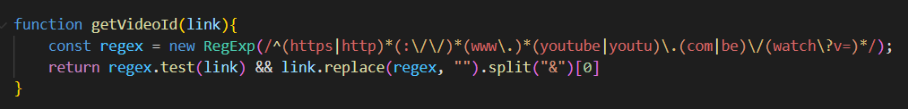
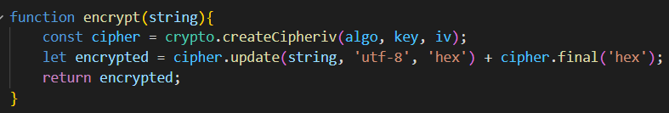
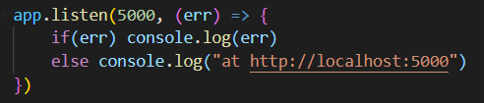
Important Functions
Listing all functions would be un-necessary. So here are some of most important functions.
1
2
3

Slide 6
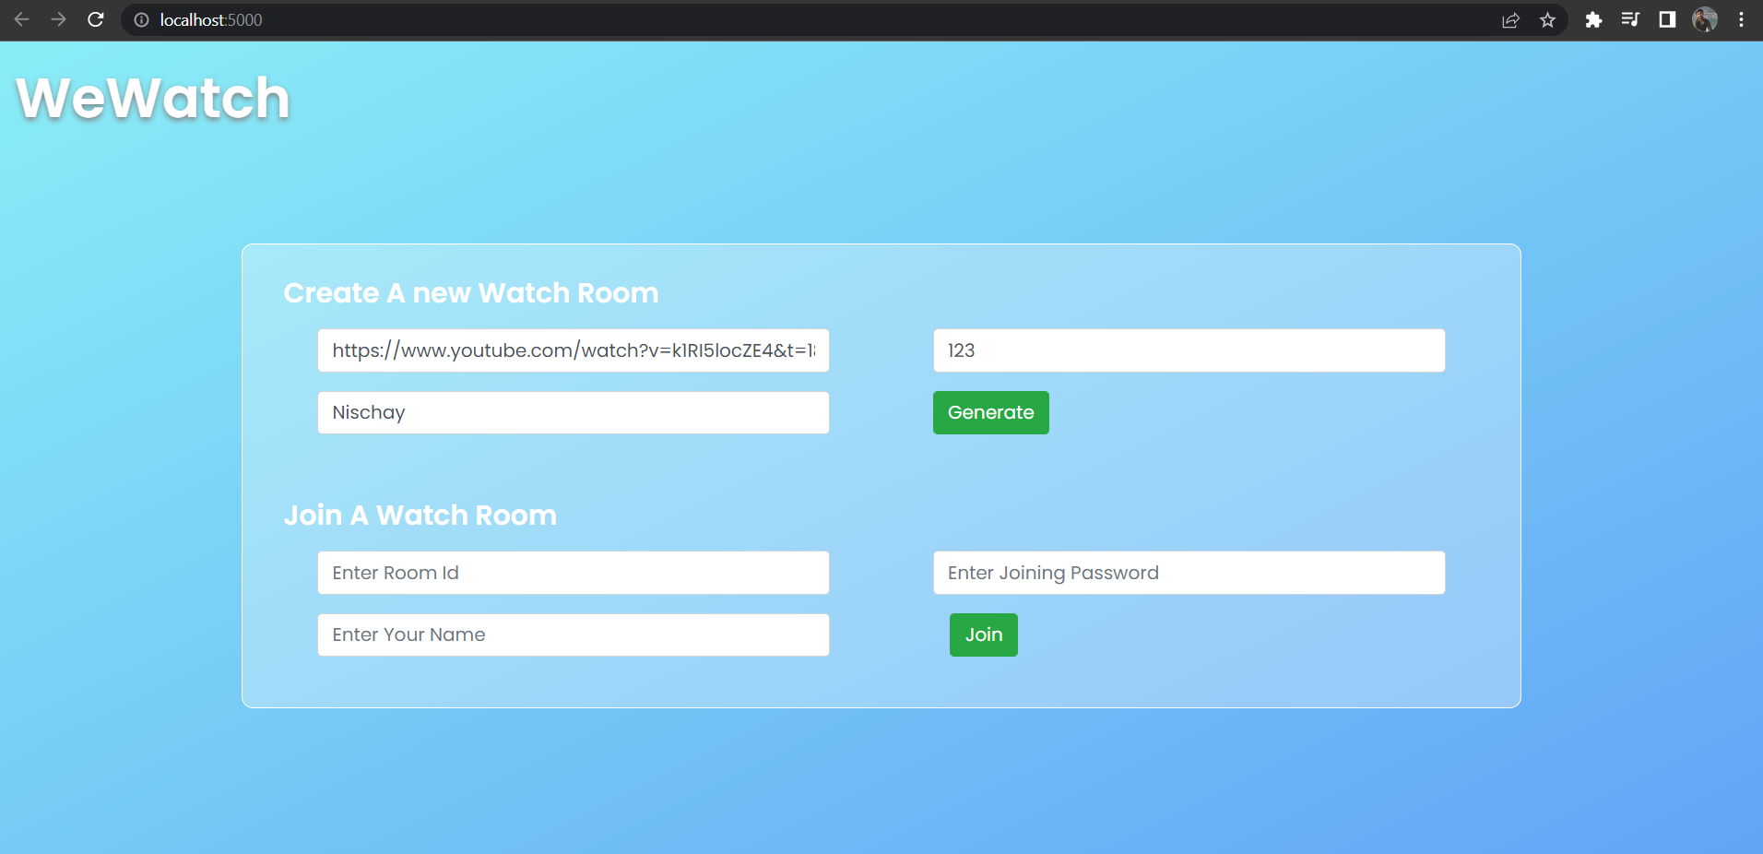
Put a YT video URL
Create a Password
Display Name

Slide 7
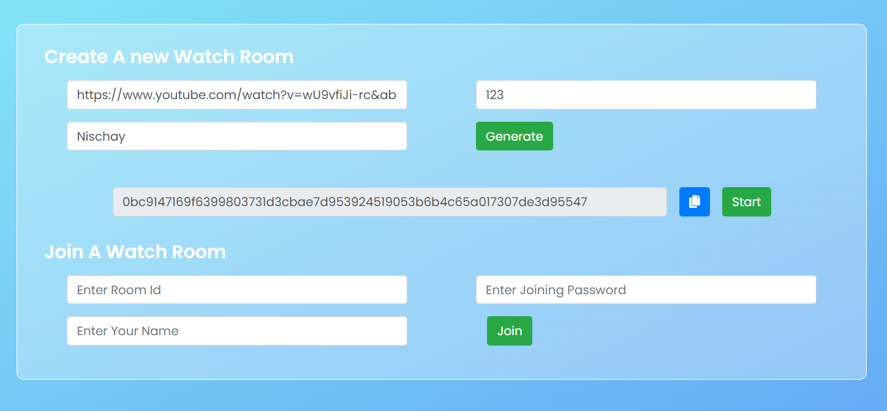
Generated Room Id

Slide 8
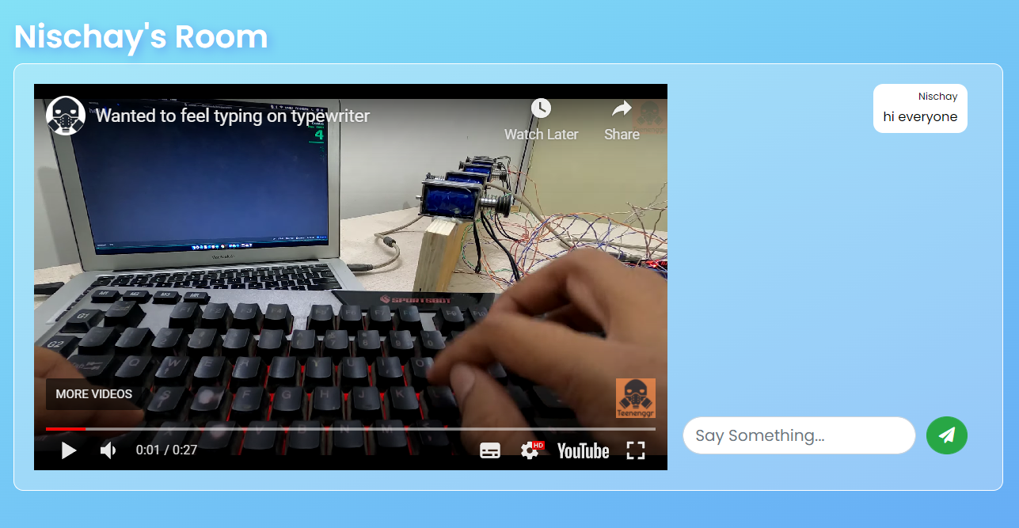
Owner Name
Chat Space

Slide 9
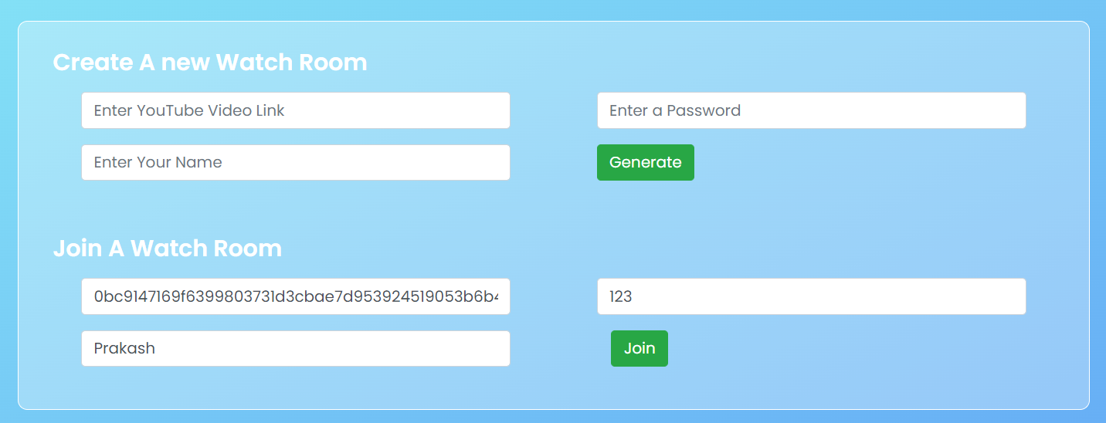
Joining Room ID
Joining Password

Slide 10
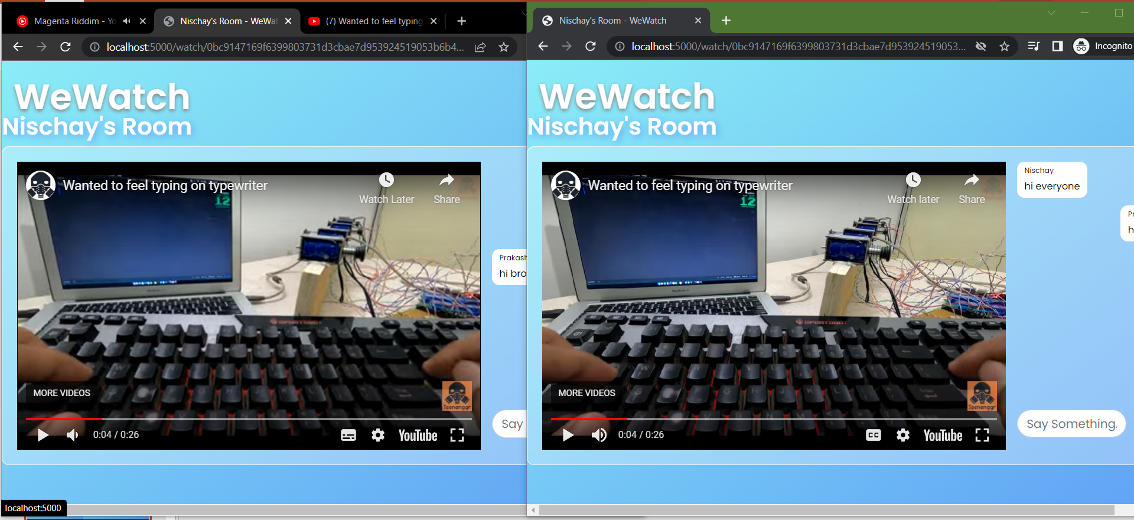
Owner’s Window
Joiners Window

Slide 11
Possible improvements
An option can be given to allow/block the joiners to control the player state.
Instead of Room Id, a link can directly be shared to Join Room.
UI can be made better and responsive.
A chat history can be maintained to let the new Joiners see the context of chat.
conclusion
As of now this is running on localhost i.e. Local Machine, we can use cloud providers like AWS EC2, Digital Ocean, Google App Engine to deploy this to internet. We can also use a database like MongoDB or MySQL for keeping history of rooms and Redis for super fast read write to manage Player State.
The app logic can be used to implement more streaming services in same way.

Slide 12
Thank You !!

