Slide 1
ENTERPRISE APPLICATION
REACT
Enterprise Governance, Risk, Compliance & Procurement Platform (e-GRCP)
A comprehensive React 19 enterprise application for streamlined governance, risk management, compliance, and procurement
React 19
Redux Toolkit
React Router DOM
Axios
Material UI
Vite
Prepared by Nischay Suman Achar

Slide 2
Overview
What is e-GRCP?
A centralized platform designed to streamline enterprise governance, risk management, compliance, and procurement workflows.
Purpose
Business Background
Unify governance, risk, compliance, and procurement into one application.
Address enterprise needs for controlled, auditable procurement and compliance.
Enterprise Use Case
Expected Benefits
Manage vendors, risks, audits, and reporting across departments.
Automation, visibility, governance, and better decision making.

Slide 3
Problem & Vision
From Manual Chaos to Centralized Control
Current Problems
Our Solution
Email-based approvals
Excel sheets
Manual tracking
Compliance issues
Vendor risks
Centralized platform
Automation
Visibility
Governance
Better decision making

Slide 4
Technology Stack
The full suite of libraries and tools powering the e-GRCP platform.
Core Framework
State Management
React 19, Vite, React Router DOM
Redux Toolkit, Redux Persist
Forms & Validation
Networking
React Hook Form, Yup Validation
Axios, Mock API Layer
UI & Charts
Testing
Material UI, Recharts
Jest, React Testing Library

Slide 5
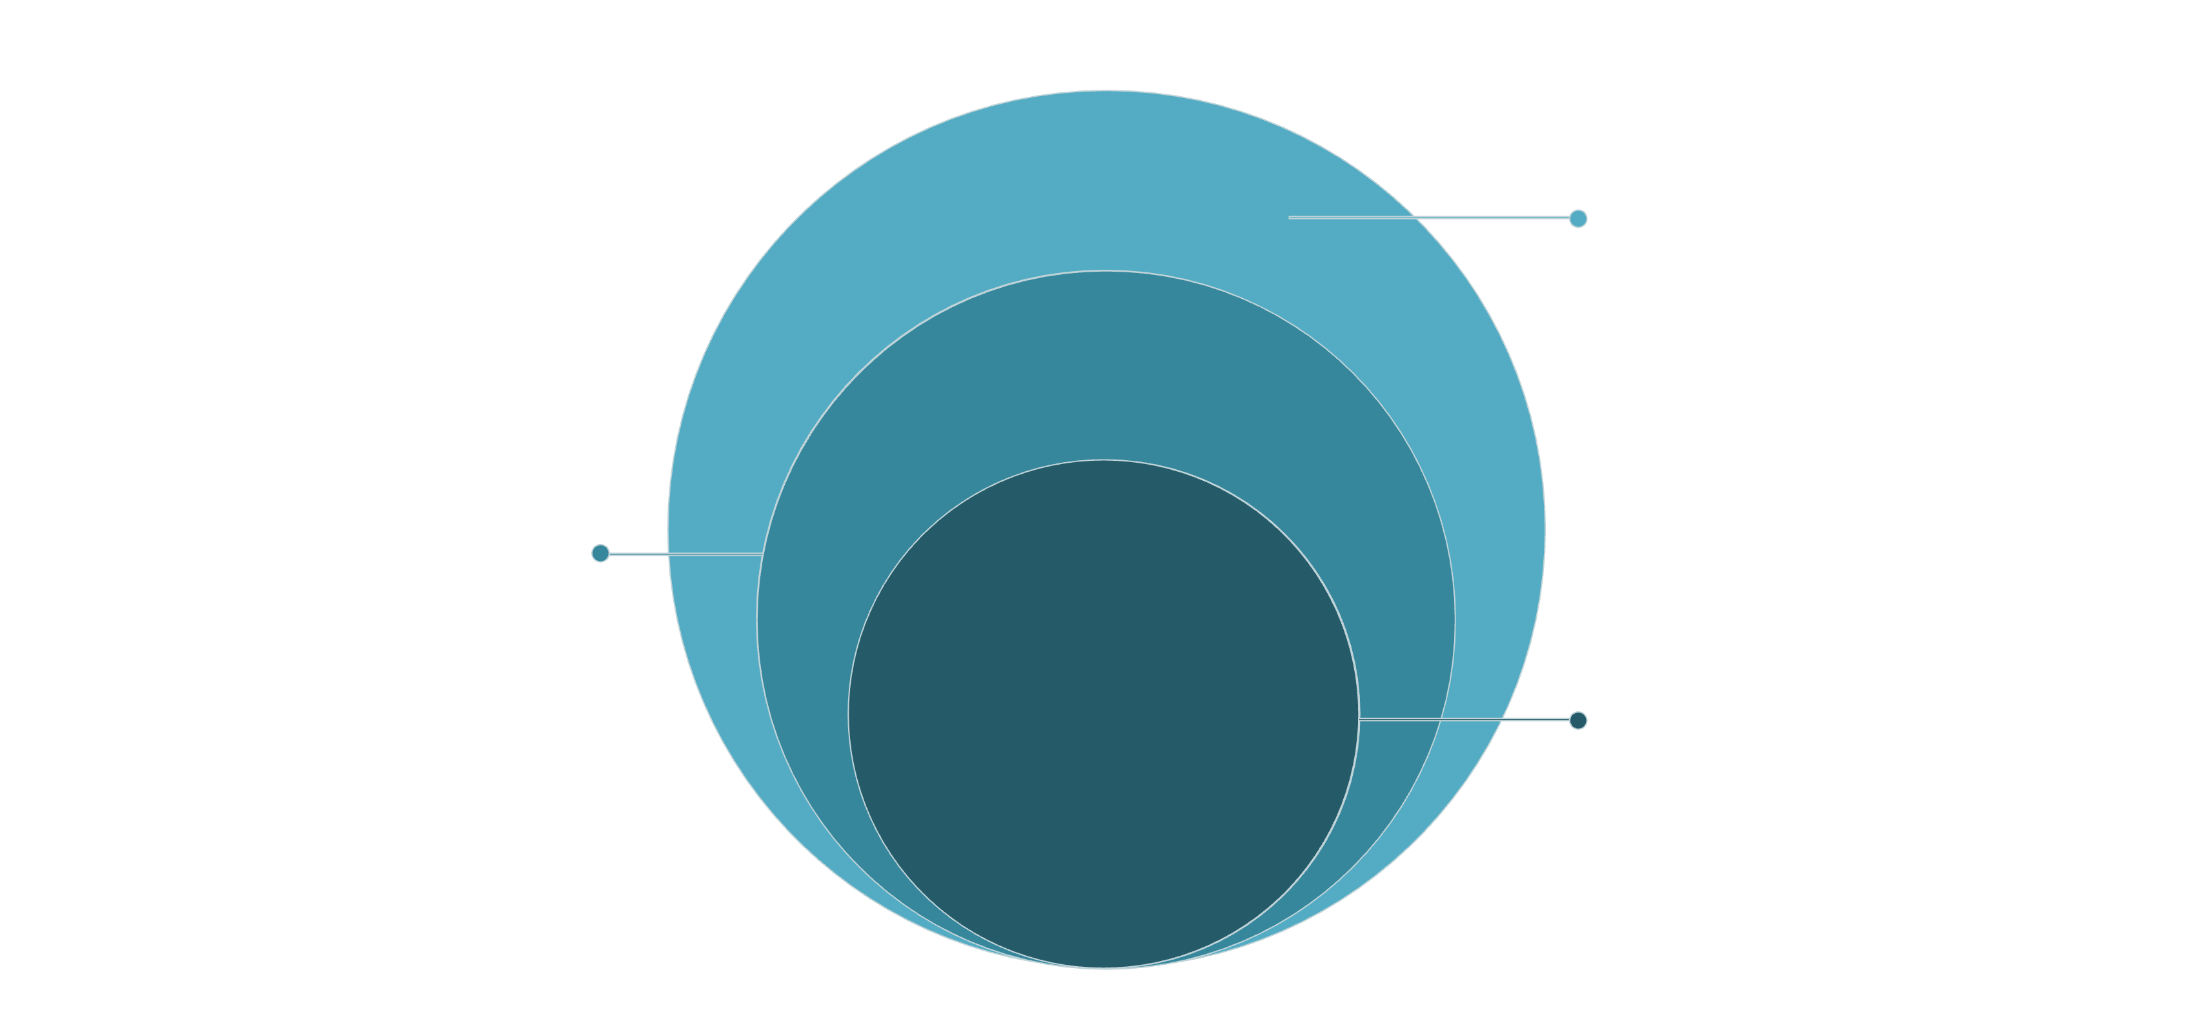
System Architecture
A layered architecture separating UI, state, services, and data access for maintainability and scalability.
Outer: UI & State
Presentation layer and Redux state
Middle: Data & Access
Mock API, Axios, Service interfaces
Core: Deployment
Production hosting and delivery
Each layer has a distinct responsibility: the Presentation Layer renders UI, Redux manages state, the Service Layer handles business logic, Axios manages HTTP, and the Mock API Layer simulates backend responses during development.

Slide 6
Application Modules
Nine core modules covering the full governance, risk, and procurement lifecycle.
Authentication
Dashboard
Procurement
Vendor Governance
Risk Center
Compliance Center
Audit Center
Reporting
Settings

Slide 7
Authentication Module
Screens
Concepts Used
Login
Forgot Password
Reset Password
Session Expired
Access Denied
React Hook Form
Yup Validation
Redux Toolkit
Protected Routes
Role-Based Routing

Slide 8
Executive Dashboard
A real-time overview of key enterprise metrics, activities, and trends.
1
2
3
KPI Cards
Charts
Recent Activities
Key performance indicators at a glance.
Visual analytics powered by Recharts.
Latest actions across all modules.
4
5
6
Department Spending
Risk Trends
Compliance Trends
Spending breakdown by department.
Risk levels tracked over time.
Compliance posture monitored continuously.

Slide 9
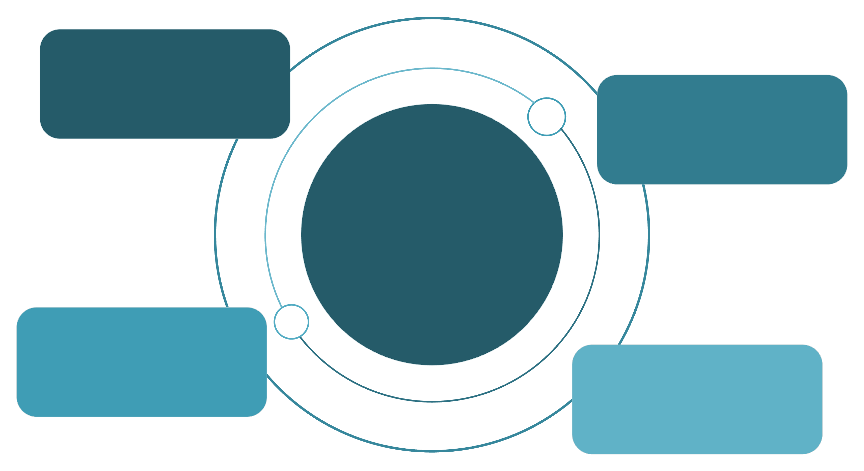
Redux Architecture
State management flow from action dispatch through store update to UI re-render.
Slices
createSlice & createAsyncThunk
Dispatch
Actions trigger reducers
Store
Central state with Redux Persist
Store Update
State is updated immutably
UI Re-render
Components reflect new state
The store is composed of slices created with createSlice. Async operations use createAsyncThunk. Redux Persist saves state to local storage, ensuring data survives page reloads.

Slide 10
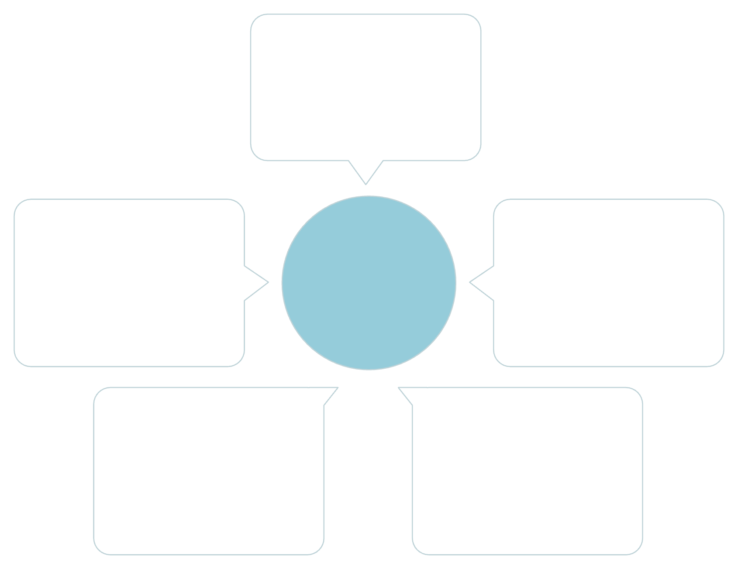
React Router Architecture
A routing strategy that separates public, protected, and role-based access.
Public Routes
Accessible without auth
Access Denied
BrowserRouter
Protected Routes
Shown when permission denied
Require user authentication
404 Page
Role-Based Routes
Rendered for unmatched paths
Access based on user role
BrowserRouter manages all navigation. Protected routes require authentication, while role-based routes enforce access control. Unmatched paths render the 404 page, and unauthorized access triggers the Access Denied screen.

Slide 11
Component Hierarchy
A modular structure organizing components by feature, layout, and shared utilities.
Feature-Based Structure
Layouts
Shared Components
Authentication Components
Dashboard Components
Procurement Components
Vendor Governance Components
Risk Center Components
Compliance Center Components
Audit Center Components
Reporting Components
Settings Components
Main Layout
Auth Layout
Dashboard Layout
Buttons
Forms
Cards
Tables
Modals
Navigation
Pages
Login Page
Dashboard Page
Module Pages

Slide 12
Deployment & Future Enhancements
Current deployment strategy and roadmap for production-ready features.
Current Deployment
Future Enhancements
GitHub Repository: version control and collaboration
Vercel Deployment: serverless hosting and CI/CD
Live Application: production-ready frontend
Backend Integration: connect to real APIs
JWT Authentication: secure token-based auth
Real-Time Notifications: WebSocket integration
Microservices: scalable backend architecture
Database Integration: persistent data storage
Advanced Analytics: deeper insights and reporting
Mobile Responsiveness: optimize for all devices

Slide 13
Performance Optimization
Advanced techniques to ensure fast load times and smooth user interactions.
React Optimization
Code Splitting
React.memo: prevent unnecessary re-renders
useMemo: memoize expensive computations
useCallback: stable function references
Lazy Loading: load components on demand
Dynamic Imports: split code by route
Route Splitting: separate bundle per module
Bundle Analysis
Monitoring
Identify large dependencies
Optimize import statements
Tree shaking unused code
Performance metrics tracking
Load time analysis
User experience metrics

Slide 14
Testing & Error Handling
Comprehensive testing strategy and robust error management across the application.
Testing Framework
Error Handling
Jest for unit testing
React Testing Library for component testing
Redux testing utilities
Error Boundary: catches React component errors
Validation Errors: form field validation feedback
Network Errors: API failure handling
User-Friendly Messages: clear error communication
Testing Coverage
Coverage Report
Component Testing: UI behavior and rendering
Redux Testing: state management and reducers
Integration Testing: module workflows
Aim for 80%+ code coverage
Critical path testing priority
Continuous integration checks

Slide 15

Axios & Mock API Flow
A layered approach to HTTP communication with interceptors and mock data for development.
Axios Client
Interceptors
Centralized HTTP client configuration; Base URL and headers setup
Request interceptors for auth tokens; Response interceptors for error handling; Loading state management
API Response
Data transformation; Error normalization
Service Layer
Business logic encapsulation; API endpoint definitions; Error handling
Mock JSON Files
Simulated API responses; Development data fixtures
This modular design ensures efficient data handling, robust error management, and seamless integration of mock data for testing and development, leading to a resilient and maintainable application.

Slide 16
Conclusion
A comprehensive enterprise application demonstrating modern React architecture and best practices.
Project Summary
Key Learnings
Full-stack governance, risk, compliance, and procurement platform
Production-ready React 19 application
Enterprise-grade architecture and patterns
Advanced state management with Redux Toolkit
Component-driven development
Scalable application architecture
Testing and quality assurance
Performance optimization techniques
Enterprise Architecture
Scalable Design
Layered architecture for maintainability
Separation of concerns
Reusable component patterns
Centralized state management
Modular feature structure
Easy to extend and maintain
Performance optimized
Production ready

Slide 17
Thank You
Presented by Nischay Suman Achar
Enterprise Governance, Risk, Compliance & Procurement Platform (e-GRCP)
A comprehensive React 19 enterprise application demonstrating modern architecture and best practices.

