Slide 1
Have we got a show for you
By the Law & Order SVU Team

Slide 2

Dreams about talking food
They never seem to stop
We can’t seem to find a cure
Also involves rain
Flipping Inside OutTM

Slide 3
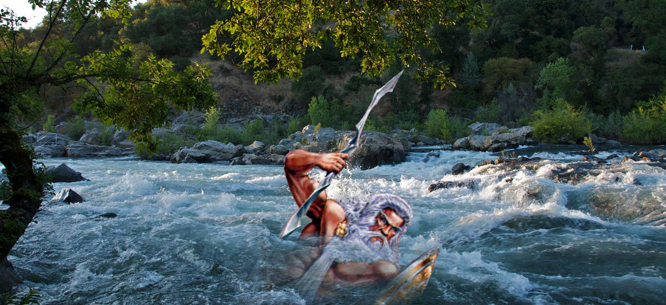
Follow the Seven Zs
Zazzle
Zebra
Zealous
Zoomy
Zeal
Zeus

Slide 4
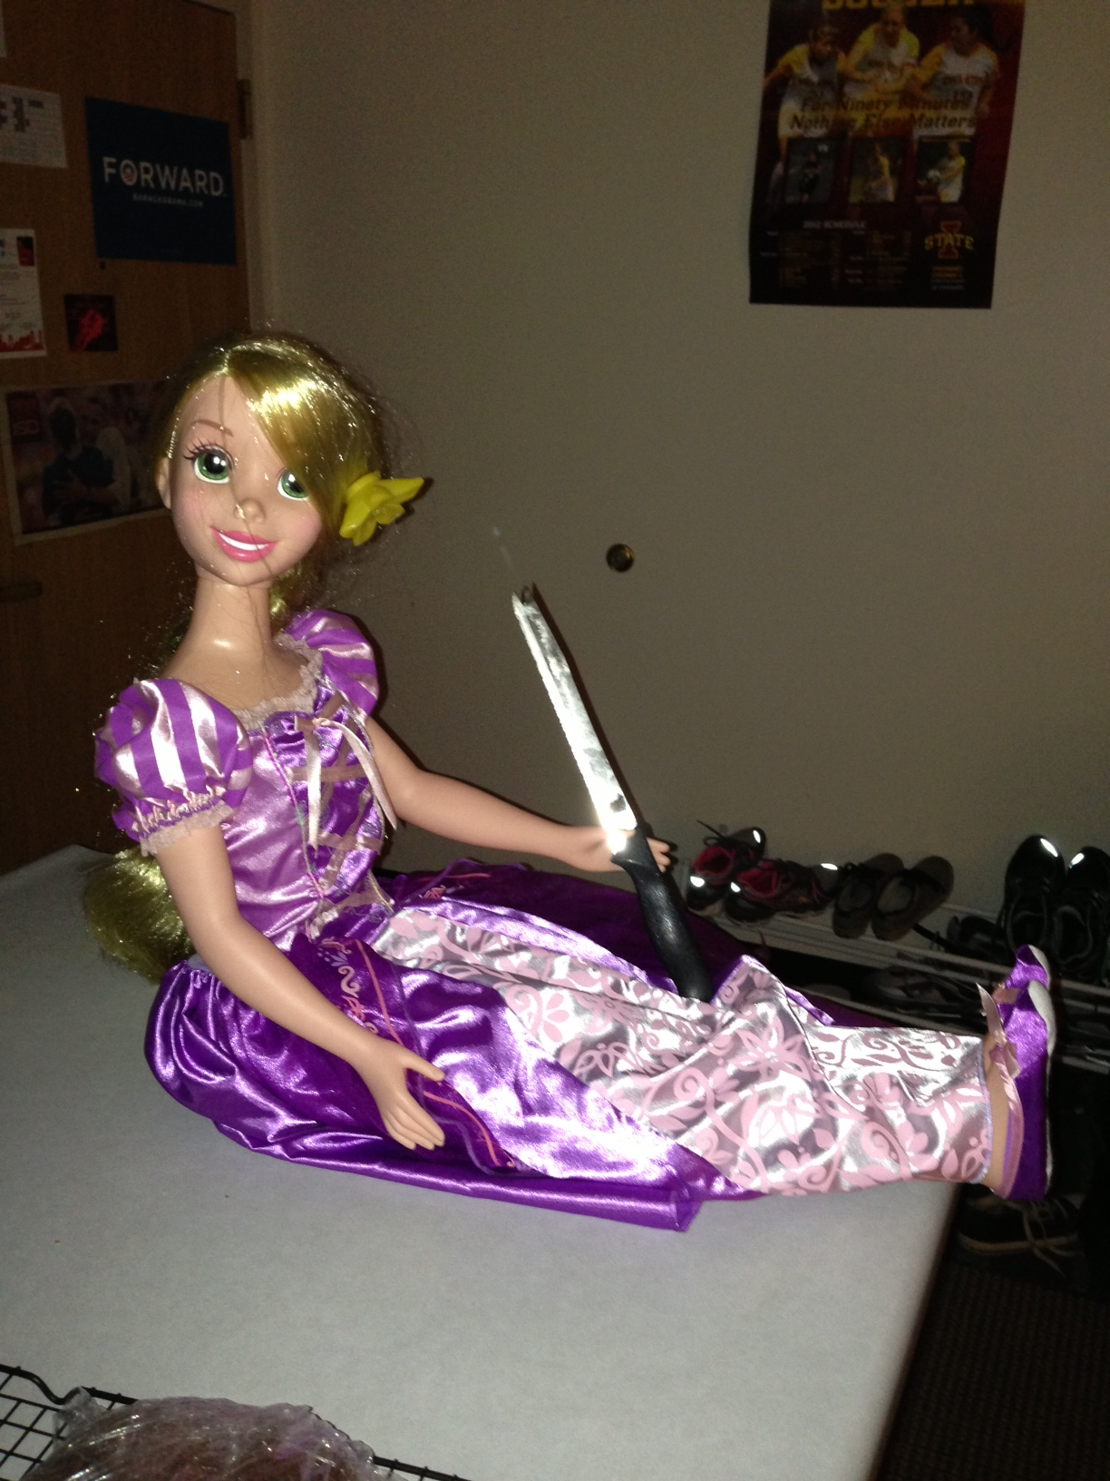
And don’t forget…

Slide 5


