Slide 1
Sensational Surprises
How to pull off the best surprises in the world
A presentation by the Bee Gee Bros

Slide 2
What are surprises?
Definition of surprise
The element of surprise and its origins
Surprises elicit many emotions
Anger (demonstration)
Laughter (demonstration)
Screaming (demonstration)
Kissing (demonstration)

Slide 3
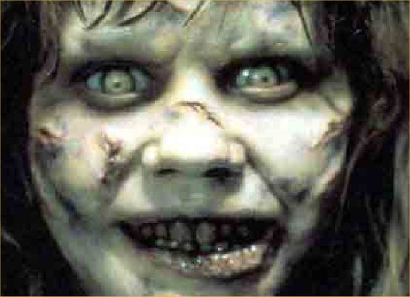
Example

Slide 4
How does one execute such a surprise?
Get in a surprising stance (demonstration)
Prepare your surprise in your head only
Get an unsuspecting victim (pick an audience member)
Try to give them a heart attack lovingly

Slide 5
Where do we go from here?
To your dorm to surprise your roommate
To the library and start screaming
To England

