Slide 1
Has science gone too far?
Skeptics Anonymous

Slide 2
Science is evil
Nobody actually understands it
We only study it so we can please humanity
Examples
It has taken over our minds and our bodies without our permission

Slide 3
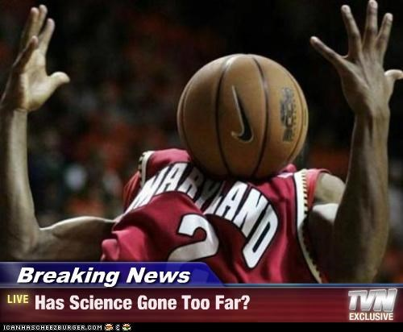
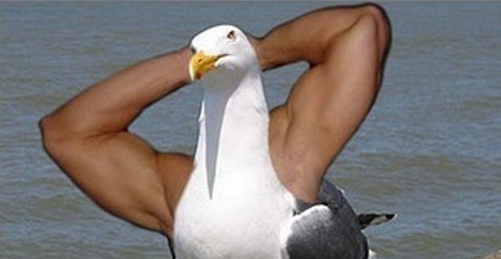
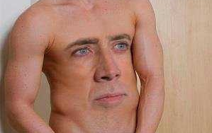
Look at these examples of science
The answer is always yes

Slide 4
Science needs to be stopped
There are very few proven ways to stop science
It is hard to prove these ways because doing so is science
So we have to ignore these problems
Demonstration: How to ignore something obnoxious

Slide 5
And now, an oath. Repeat after me.
I think science is bad.
Science sucks.
Science Science Science.
Bad bad bad.
Science doesn’t deserve its own definition.
Science needs to be stopped.
I want to stop Science.
(whisper) Ssssssscience
(Clap twice)

