Slide 1



TheBoozeBros.
TheBoozeBros.
Resham
A clothing store management web application.
Explore Now
01

Slide 2





TheBoozeBros.
Ledger for everything.
Stockouts and overstock situations
Problem
Inaccurate and inefficient inventory records
Inefficient transaction records
02

Slide 3


TheBoozeBros.
What Resham does?
Simplifies
And
Maximizes
03

Slide 4




TheBoozeBros.
1.Inventory managment
Update inventory automatically with each sale, return or new shipment
Features
05

Slide 5


TheBoozeBros.
2.Inventory categorization
Categorize inventory based on type, brand, size, color and season.
Features
05

Slide 6

TheBoozeBros.
3.Monitor stock levels
Monitor stock levels in real time. get stock alerts and notification.
Features
05

Slide 7


TheBoozeBros.
4.Purchase order managment
Create and manage purchase orders.
Supplier management with contact details and order history.
Features
05

Slide 8
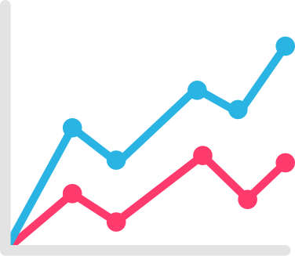
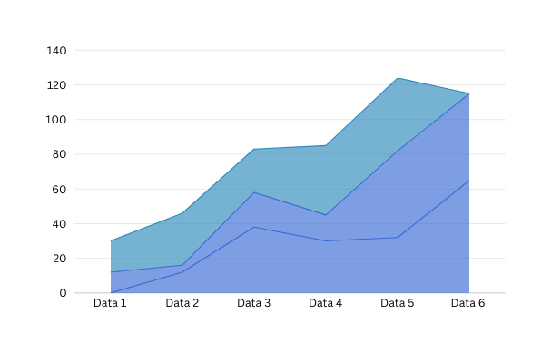
TheBoozeBros.
5.Sales Reports
Get indepth daily ,monthly and yearly sales reports.
Features
05

Slide 9


TheBoozeBros.
6.Backup and data
Security
Data gets backup daily in our state of the art most secured servers.
Features
05

Slide 10




TheBoozeBros.
The team
Nischhal Bohara
Bishal Timilsina
Roll no 44
Roll no 44
Basanta Pokhrel
Milan Thapa Magar
Roll no 44
Roll no 44
07

Slide 11
TheBoozeBros.
Thank
You
10

