Slide 1
ITERATION - 1
DATE: 3/6/2023
TEAM MEMBERS:
ABHISHEK BHASKAR
AISHWARYA KALMANGI
CHARVI REDDY CHALLA
NISCHITHA SADANANDA
SAICHARAN PAGIDIMUNTHALA
INSTRUCTOR
DR.MICHAEL F. SIOK, PE, ESEP
CSE 5324: SOFTWARE ENGINEERING: ANALYSIS, DESIGN, AND TESTING PAWSURE
COMPLETE COVERAGE OFFERS EXTENSIVE PROTECTION FOR YOUR DOGS UNEXPECTED ACCIDENT
AND ILLNESSES PROJECT GROUP 8: TECH TITANS

Slide 2
AGENDA
PROJECT DESCRIPTION
PROJECT REQUIREMENTS
USE CASES
HIGH LEVEL USE CASES
USE CASE DIAGRAM
REQUIREMENT TO USE CASE MATRIX
INCREMENT MATRIX
DOMAIN DIAGRAM
TASK LIST
PRESENTATION SUMMARY

Slide 3
Our naturally curious and active four-legged family members tend to act without thinking, which can lead to problems.
Pets can be vulnerable to a range of injuries and illnesses due to their curious and active nature.
Pet insurance is as crucial as any other type of health insurance. It helps to avoid unexpected veterinary costs, including treatments for common pet health issues such as cancer, ear infections, stomach problems, skin conditions, and urinary issues.
Pet insurance can provide pet owners with peace of mind and help ensure that their furry family members receive the care they need when they need it.
Information accessibility is crucial when it comes to promoting the importance of pet insurance.
A user-friendly mobile application can help pet owners to purchase insurance for their pets. It also provides option to adopt pets, post reviews of the app and refer a friend.
This application is limited to only dogs and can be enhanced later to other types of pets as well.
PROJECT DESCRIPTION

Slide 4
PROJECT REQUIREMENTS
R1 | System shall provide a form with fields Name, email, password and confirm password
R2 | System shall provide a form with fields Name, email, password and confirm password
R3 | System shall provide the user with the form to enter insurance details
R4 | System shall collect, validate and save insurance information like petId, age, breed, medical history
R5 | System shall allow the user to update insurance details
R6 | System shall display the available pets for adoption along with the fee
R7 | System shall allow the user to select and enter details such as contact information, background and lifestyle
R8 | System shall allow the user to update his details such as contact information and background
R9 | System shall allow the user to delete his details such as contact information and background
R10 | System shall provide a form to the user to post reviews
R11 | System shall allow the user to reset their forgotten password
R12 | System shall allow the user to logout

Slide 5
USE CASES
Use Case # | Use Case Name
UC1 | Sign Up
UC2 | Login
UC3 | Pet Insurance
UC3.1 | Create Insurance List
UC3.2 | Update List
UC4 | Pet Adoption
UC4.1 | Create Adoption List
UC4.2 | Update Adoption List
UC4.3 | Delete Adoption List
UC5 | Reviews
UC6 | Forgot Password
UC7 | Logout

Slide 6
HIGH LEVEL USE CASES
UC1: Sign Up
-TUCBW the user being able to create an account after giving all mandatory fields.
- TUCEW the user creating an account.
UC2: Login
-TUCBW the user entering email and password as login credentials and clicking the login button.
- TUCEW the user logging into the application.
UC3: Pet Insurance
- TUCBW the user is provided with form to fill in the pet insurance details.
- TUCEW the insurance is approved or rejected after validating the input details provided.
UC3.1: Create Insurance List
- TUCBW the user can create additional insurance for multiple pets using form.
- TUCEW the new insurance is approved or rejected after validating new inputs.
UC3.2: Update Insurance List
- TUCBW the user can click on update button to make changes to insurance form details. There will be only 24 hours window to update.
- TUCEW the user can view updated details in the list after its approved.
UC4: Pet Adoption
- TUCBW the user can view a list of pets along with the prices. Once user selects the pet a questionnaire where the user can enter background details.
- TUCEW the adoption request is approved or rejected after validating.
UC4.1: Create Adoption List
- TUCBW the user can submit adoption requests for multiple pets.
- TUCEW the adoption requests are approved or rejected after validation.

Slide 7
HIGH LEVEL USE CASES (Continued)
UC4.2: Update Adoption List
- TUCBW the user can update the adoption details.
- TUCEW the updated requests are approved or rejected after validation.
UC4.3: Delete Adoption List
- TUCBW the user can delete the requests.
- TUCEW the adoption requests are deleted.
UC5: Reviews
- TUCBW the user can provide reviews in the form of content/text and provide ratings as stars.
- TUCEW the user being able to see list of reviews provided by the customers who have been using this pet insurance service through this app.
UC6: Forgot Password
- TUCBW the user clicking on forgot password link on login screen and provide registered email ID.
- TUCEW the user being able to reset the forgotten password using the link sent to their registered email ID.
UC7: Logout
- TUCBW the use clicking on Logout button to exit from the application.
-TUCEW the user exiting from the app will be redirected to login page.
Note: TUCEW – This use case End With, TUCBW – This use case Begins With

Slide 8
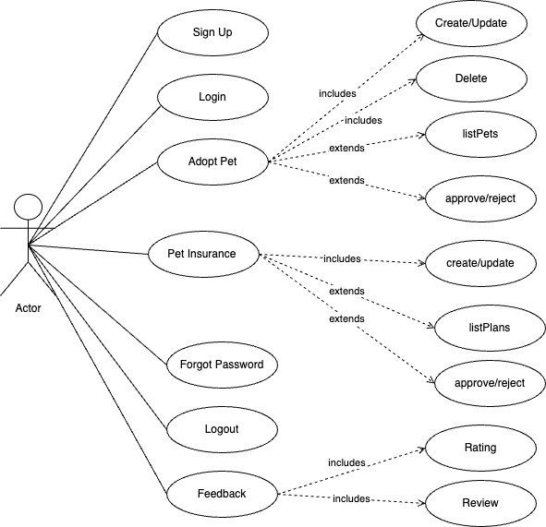
USE CASE DIAGRAM

Slide 9
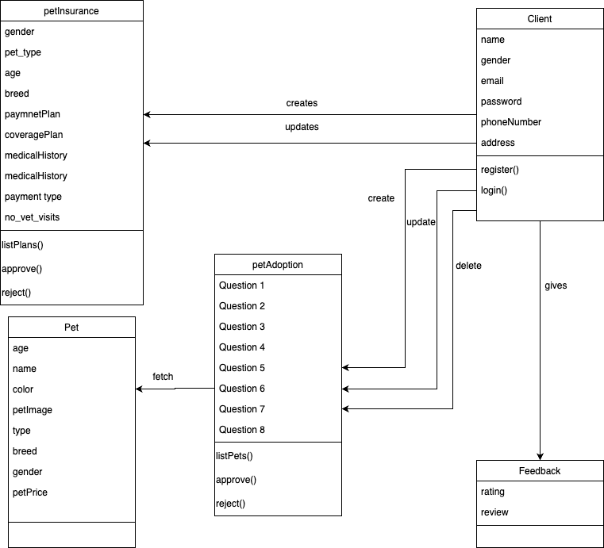
DOMAIN DIAGRAM

Slide 10
REQUIREMENT TO USE CASE TRACEABILITY MATRIX

Slide 11
REQ ID | Priority Weight | UC1 | UC2 | UC3.1 | UC3.2 | UC4.1 | UC4.2 | UC4.3 | UC5 | UC6 | UC7
R1 | 1 | *
R2 | 1 |  | *
R3 | 2 |  |  | *
R4 | 2 |  |  | *
R5 | 3 |  |  |  | *
R6 | 2 |  |  |  |  | *
R7 | 2 |  |  |  |  | *
R8 | 4 |  |  |  |  |  | *
R9 | 4 |  |  |  |  |  |  | *
R10 | 5 |  |  |  |  |  |  |  | *
R11 | 3 |  |  |  |  |  |  |  |  | *
R12 | 2 |  |  |  |  |  |  |  |  |  | *
 | Score | 1 | 1 | 4 | 3 | 4 | 4 | 4 | 5 | 3 | 2
Notes:
Here Priority 1 is the highest Priority

Slide 12
INCREMENT MATRIX

Slide 13
Use Case | Priority | Effort/(Person Weeks) | Depends On | Assigned To | Iteration 1 3/06/2023 | Iteration 2 4/03/2023 | Iteration 3 05/01/2023
UC1 | 1 | 3 | None | NISCHITHA | 3
UC2 | 1 | 3 | None | NISCHITHA | 3
UC3 | 2 | 2 | UC1 AND UC2 | ABHISHEK |  | 2
UC3.1 | 2 | 2 | UC3 | ABHISHEK |  | 2
UC3.2 | 3 | 2 | UC3 | ABHISHEK |  | 2
UC4 | 2 | 2 | UC1 AND UC2 | SAI CHARAN |  |  | 2
UC4.1 | 2 | 2 | UC4 | SAI CHARAN |  |  | 2
UC4.2 | 4 | 2 | UC4 | AISHWARYA |  |  | 2
UC4.3 | 4 | 1 | UC4 | SAI CHARAN |  |  | 1
UC5 | 5 | 2 | UC1 AND UC2 | AISHWARYA |  | 1
UC6 | 3 | 1 | UC1 AND UC2 | CHARVI |  | 1
UC7 | 2 | 1 | UC1 AND UC2 | CHARVI | 1
Total Efforts |  | 23 |  |  | 7 | 8 | 7
1 PW = 5 |  |  |  |  | 35 | 40 | 35

Slide 14
TASK LIST
Use Cases | Use case Name | Team Member Assigned | Iteration
UC1 | Register | Nischitha | 1
UC2 | Login | Nischitha | 1
UC3 | Pet Insurance | Abhishek | 2
UC3.1 | Create Insurance List | Abhishek | 2
UC3.2 | Update Insurance List | Abhishek | 2
UC4 | Pet Adoption | SaiCharan | 3
UC4.1 | Create Adoption List | SaiCharan | 3
UC4.2 | Update Adoption List | Aishwarya | 3
UC4.3 | Delete Adoption List | SaiCharan | 3
UC5 | Reviews | Aishwarya | 2
UC6 | Forgot Password | Charvi | 2
UC7 | Logout | Charvi | 1

Slide 15

Summary
An application that makes getting pets insured easier and provides an online platform for people interested in adopting a pet.
This app can collaborate with insurance companies so it can reach out to a wider range of people.
The app's functionality may be limited, with limited search filters or sorting options. This may make it difficult to find a pet that fits your specific needs and preferences.
This application helps in getting pets insurance and pet adoption right from home in a quicker manner.

Slide 16
Thank You

