Slide 1



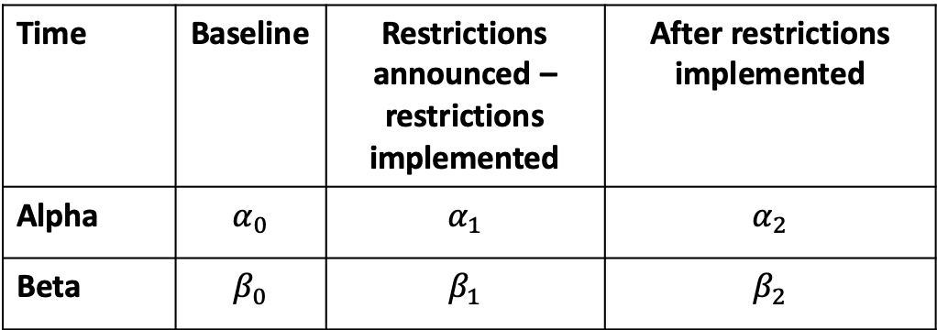



Time | Baseline | Restrictions announced – restrictions implemented | After restrictions implemented
Alpha | $$α_{0}$$ | $$α_{1}$$ | $$α_{2}$$
Beta | $$β_{0}$$ | $$β_{1}$$ | $$β_{2}$$
Restrictions announced after X cases
Restrictions implemented
Force of infection
$$β_{0}$$
$$β_{1}$$
$$β_{2}$$
Travel
$$α_{0}$$
$$α_{1}$$
$$α_{2}$$
Time

