Slide 1

Predicting Contagiousness of Respiratory Viral Infections
Spaindians
Arpit Mehta Daniel Ruiz Nishant Maurya Vaidehi Patel

Slide 2

Overview
Viral Infection
Immune response
Genes and pathways
Symptoms
Runny Nose
Cough
Fever
Headache
Myalgia
Shedding
The above data was provided by the DREAM Respiratory Virus Challenge [http://dreamchallenge.org]

Slide 3

Goal
build predictive models for contagiousness (Shedding)
given gene expression time series data
recorded over a multi-day period
starting prior to exposure
measured at different Time Series intervals following exposure

Slide 4
Data
Respiratory Syncytial Virus (RSV), H3N2 and H1N1
Nasal lavage samples collected over the course of 7-9 days.
viral shedding assessed via qualitative viral culture and/or quantitative influenza RT-PCR.
Blood was collected and gene expression of peripheral whole blood was performed
1 day prior to exposure, immediately prior to exposure, and at regular intervals following exposure
Data includes 7 volunteers who were exposed to sham rather than active virus. (Controls)

Slide 5
Approach

Slide 6
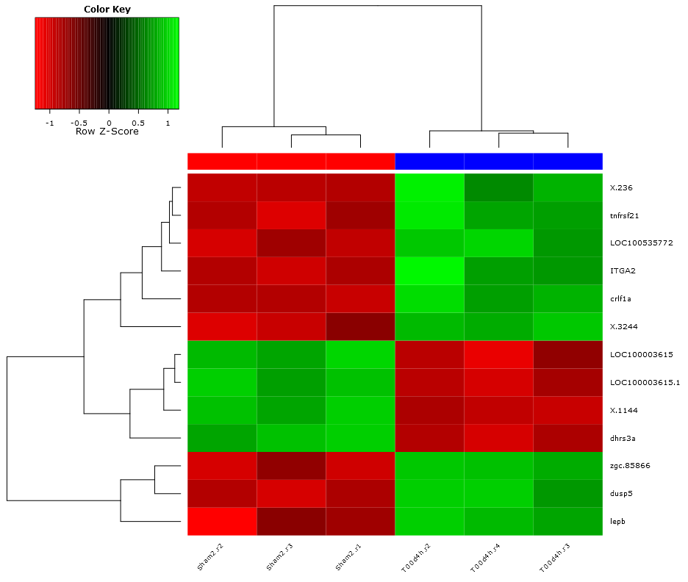
Gene Expression analysis
LIMMA :- Linear Models for Microarray Data
R-package
22,000 genes or attributes
Differential expression
Select genes which are changing between sham and Virus Infected samples

Slide 7
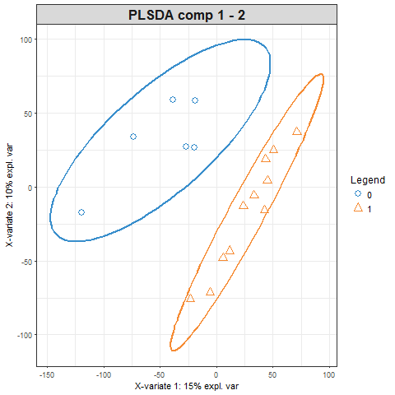
PLSDA
Partial Least Square Discriminant Analysis
R-package Mixomics (sPLS-DA)
20 years old
Supervised
2 class classifier
Not the golden hammer
Just a step in the pipeline
Overfit
Attribute selector (like PCA but with class knowledge)
0 No shedding
1 Shedding
H1N1 virus 24 hr

Slide 8
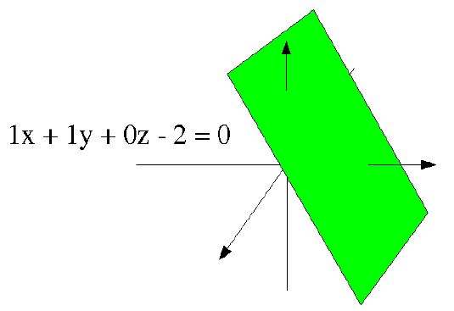
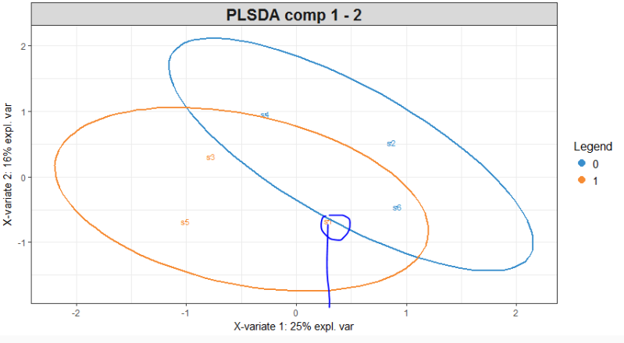
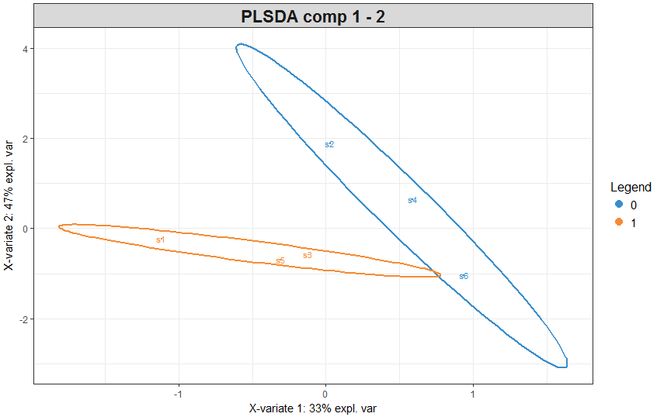
PLSDA: Feature Selection
Loadings
VIP
x+y = 0

Slide 9

Random Forest Classifier
ensemble classifier consisting of many decision trees
outputs the class that is the mode of the class's output by individual trees.
combines Breiman's "bagging" idea and the random selection of features
R-Package

Slide 10
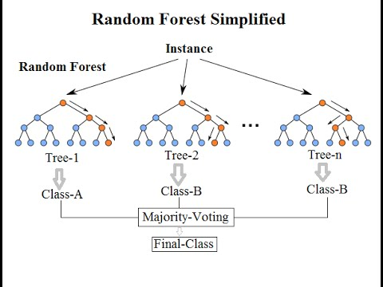
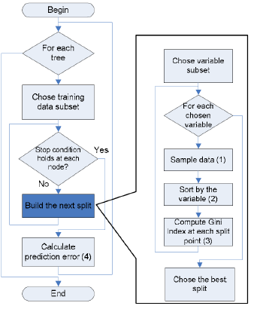
Algorithm and Advantage
Seed Length ; Trees; Variables
accurate learning algorithms
runs efficiently on large databases
handle thousands of input variables without variable deletion.
effective method for estimating missing data and maintains accuracy when a large proportion of the data are missing.
Generated forests can be saved for future use on other data
Variable Importance estimation

Slide 11

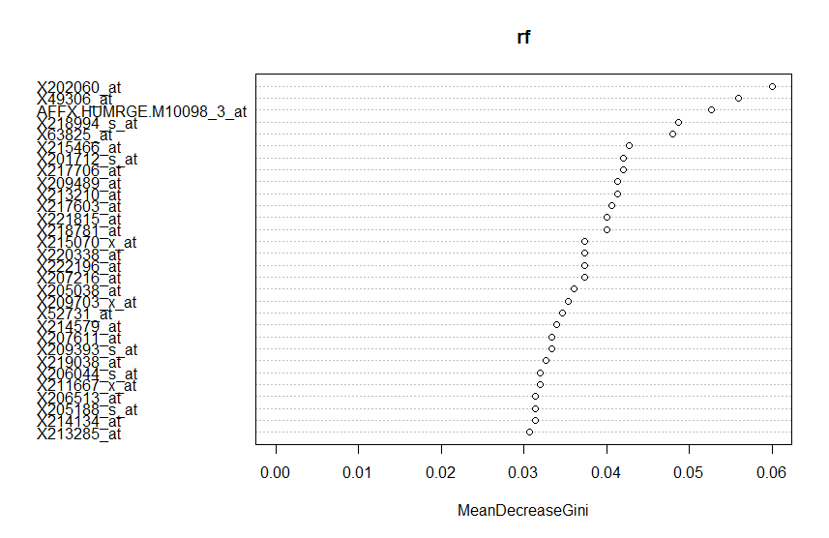




Confusion Matrix and accuracy
0 No shedding
1 Shedding
H1N1 Time -24
Variable Importance estimation
H1N1 Time 12
H1N1 Time 36
H1N1 Time 90
H1N1 Time 141.5

Slide 12
Script
Spandians.ViralChallange.R
Load Data and R packages
Run Differential Expression with Limma
Filter the attributes based on P-values
Input to PLS-DA of mixomics package
Ranks attributes based on VIP
Input to Random Forest
Build Model
Classify using the model
Export output for pathway analysis

Slide 13
Results: Pathway analysis and Annotation
Rows are genes and columns time points.
Each entry in the table is the rank of that gene in the list of importance scores. Some genes act as biomarkers across the entire time range of study. Others are either early or late biomarkers.
The first column gives the name of the gene in question.
The last column represents the functional annotations of the genes.
Related annotations are given the same color
DAVID pathway analysis tool was used

Slide 14
Conclusions
Predictive models for viral shedding and symptoms were constructed.
While predictions are near perfect at later time points, high even at much earlier time points.
Significant genes were detected as early as 5 and 10 hours post infection (PI
Biomarkers were identified for all viruses, both unique and shared.
Genes for defense and immune response were differentially expressed in all four viruses.
Genes annotated with proteolysis were differentially expressed in subjects with and without shedding.

Slide 15
References
Ritchie ME, Phipson B, Wu D, Hu Y, Law CW, Shi W and Smyth GK (2015). “limma powers differential expression analyses for RNA-sequencing and microarray studies.” Nucleic Acids Research, 43(7), pp. e47.
Barker,Matthew,andWilliamRayens."Partialleastsquaresfordiscrimination."Journalofchemometrics17.3(2003):166-173.
Breiman,Leo."Randomforests."Machinelearning45.1(2001):5-32.
DAVIDTOOLS:https://david.ncifcrf.gov/
G-Profiler:http://biit.cs.ut.ee/gprofiler/
http://dreamchallenge.org

Slide 16
Thank YOU
Questions?

