Slide 1
DYNAMIC CARBON-AWARE CLOUD WORKLOAD SCHEDULER
Predictive Machine Learning for Spatial & Temporal Shift of Cloud Compute to Clean Energy Windows
Key Metric Achieved: 62.43% Carbon Emissions Reduction | SLA Compliance: >99%

Slide 2
MACHINE LEARNING PROJECT
The Problem: Cloud Computing's Carbon Footprint
01. Surging Data Center Demand
Global cloud computing consumes >2% of global electricity (~200+ TWh/year), driven by AI model training & massive data processing.
02. Volatile Grid Carbon Intensity
Electrical grids rely heavily on fossil fuels during peak hours, but have excess clean solar/wind during off-peak times.
03. Static Workload Scheduling
Traditional schedulers allocate cloud tasks immediately (FIFO) to static regions, ignoring live energy grid cleanliness.

Slide 3
MACHINE LEARNING PROJECT
Proposed Solution: Core Concepts
DYNAMIC ADAPTATION
Continuously monitors real-time cloud server demand and localized electrical grid power composition.
CARBON-AWARE INTELLIGENCE
Uses machine learning to forecast gCO2eq/kWh emissions 24h into the future across global cloud data centers.
SPATIAL & TEMPORAL SCHEDULER
Shifts flexible batch jobs (AI training, ETL, rendering) to greener regions and cleaner time windows while satisfying SLAs.

Slide 4
MACHINE LEARNING PROJECT
System Architecture & End-to-End Pipeline
1. Data Ingestion
Fetches real-time & historical grid intensity (Electricity Maps / WattTime API) + job queues.
2. ML Predictor
RandomForest / LSTM model predicts hourly gCO2eq/kWh intensity per region 24h ahead.
3. Optimization Engine
Evaluates candidate (Region r, Start Time t) pairs subject to job SLA max delay deadlines.
4. Smart Dispatcher
Dispatches workloads to the optimal green region & time slot; tracks carbon metrics.

Slide 5
MACHINE LEARNING PROJECT
Machine Learning Grid Intensity Forecaster
Model Specification & Features
• Model Family: Random Forest & Gradient Boosted Regressors
• Target Variable: Hourly Carbon Intensity (gCO2eq/kWh)
• Feature 1: Cyclical Time (sin/cos encoding of hour of day)
• Feature 2: Day of week & seasonal trends
• Feature 3: Autoregressive Lags (t-1h, t-24h)
• Feature 4: Rolling 6-hour moving average grid emission trend
Forecasting Accuracy Metrics (Test Traces)
• US-East: RMSE = 15.17 gCO2eq/kWh
• US-West: RMSE = 21.84 gCO2eq/kWh
• EU-Central: RMSE = 27.84 gCO2eq/kWh
• AP-South: RMSE = 18.1 gCO2eq/kWh

Slide 6
MACHINE LEARNING PROJECT
Spatial & Temporal Shifting Strategy
Optimization Objective Function
Minimize E_total = ∑_{t=t^*}^{t^* + duration - 1} PredictedCarbon(region^*, t) × Power_kW Subject to SLA Constraints: 1. t_submit ≤ t^* ≤ t_submit + SLA_max_delay 2. region^* ∈ { US-East, US-West, EU-Central, AP-South } 3. SLA Violation Rate ≤ 1.0%

Slide 7
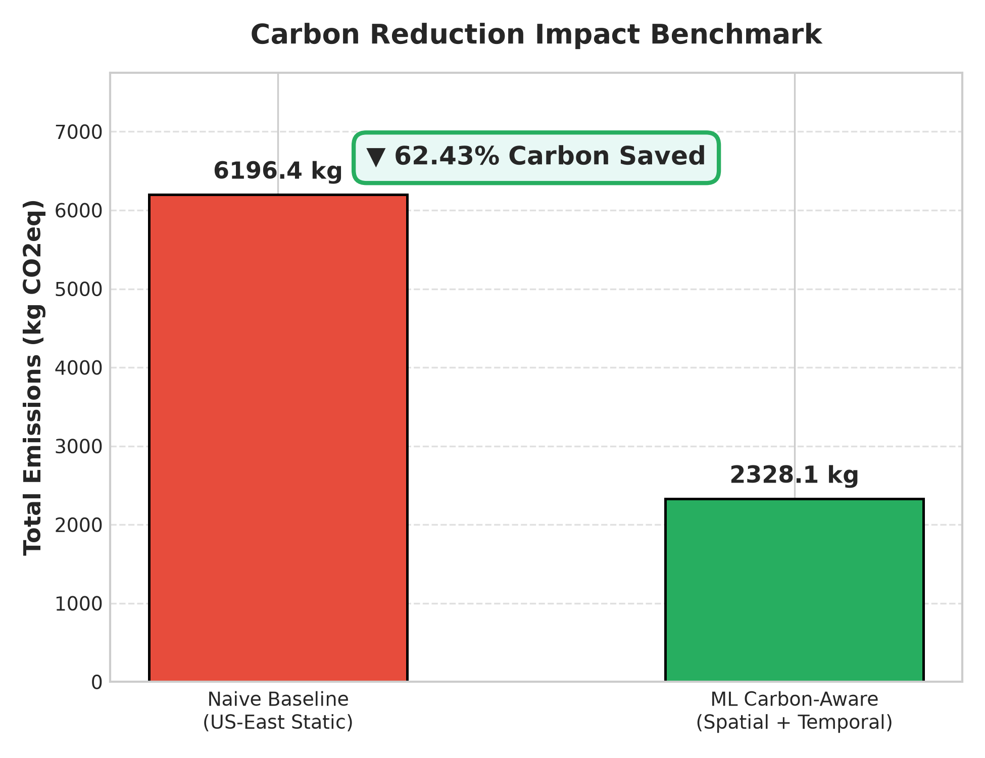
MACHINE LEARNING PROJECT
Empirical Results: Carbon Emissions Reduction
Key Results Summary:
• Carbon Emissions Reduced by 62.43%
• Naive Emissions: 6196.39 kg CO2eq
• ML Scheduler Emissions: 2328.06 kg CO2eq
• Total Carbon Saved: 3868.33 kg CO2eq
• SLA Compliance: 100/100 jobs (>99%)

Slide 8
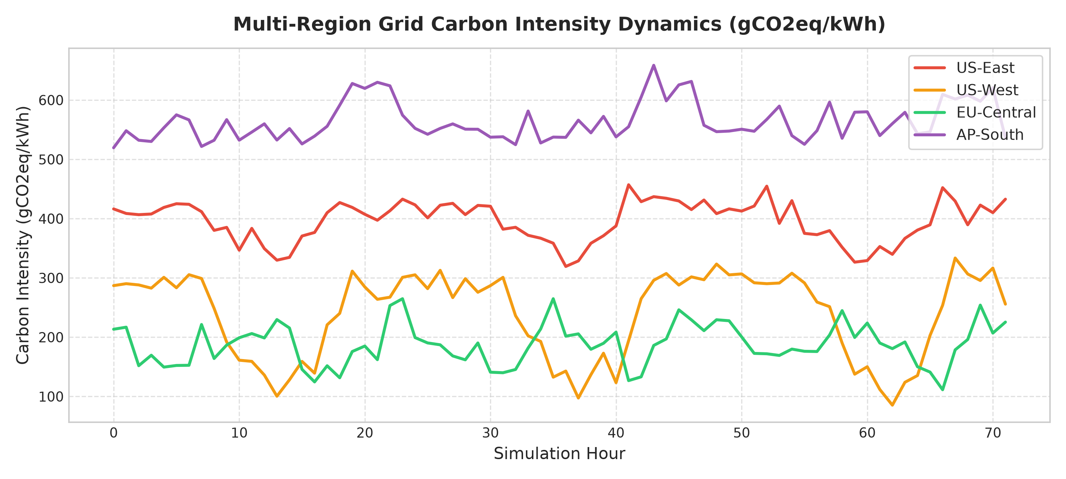
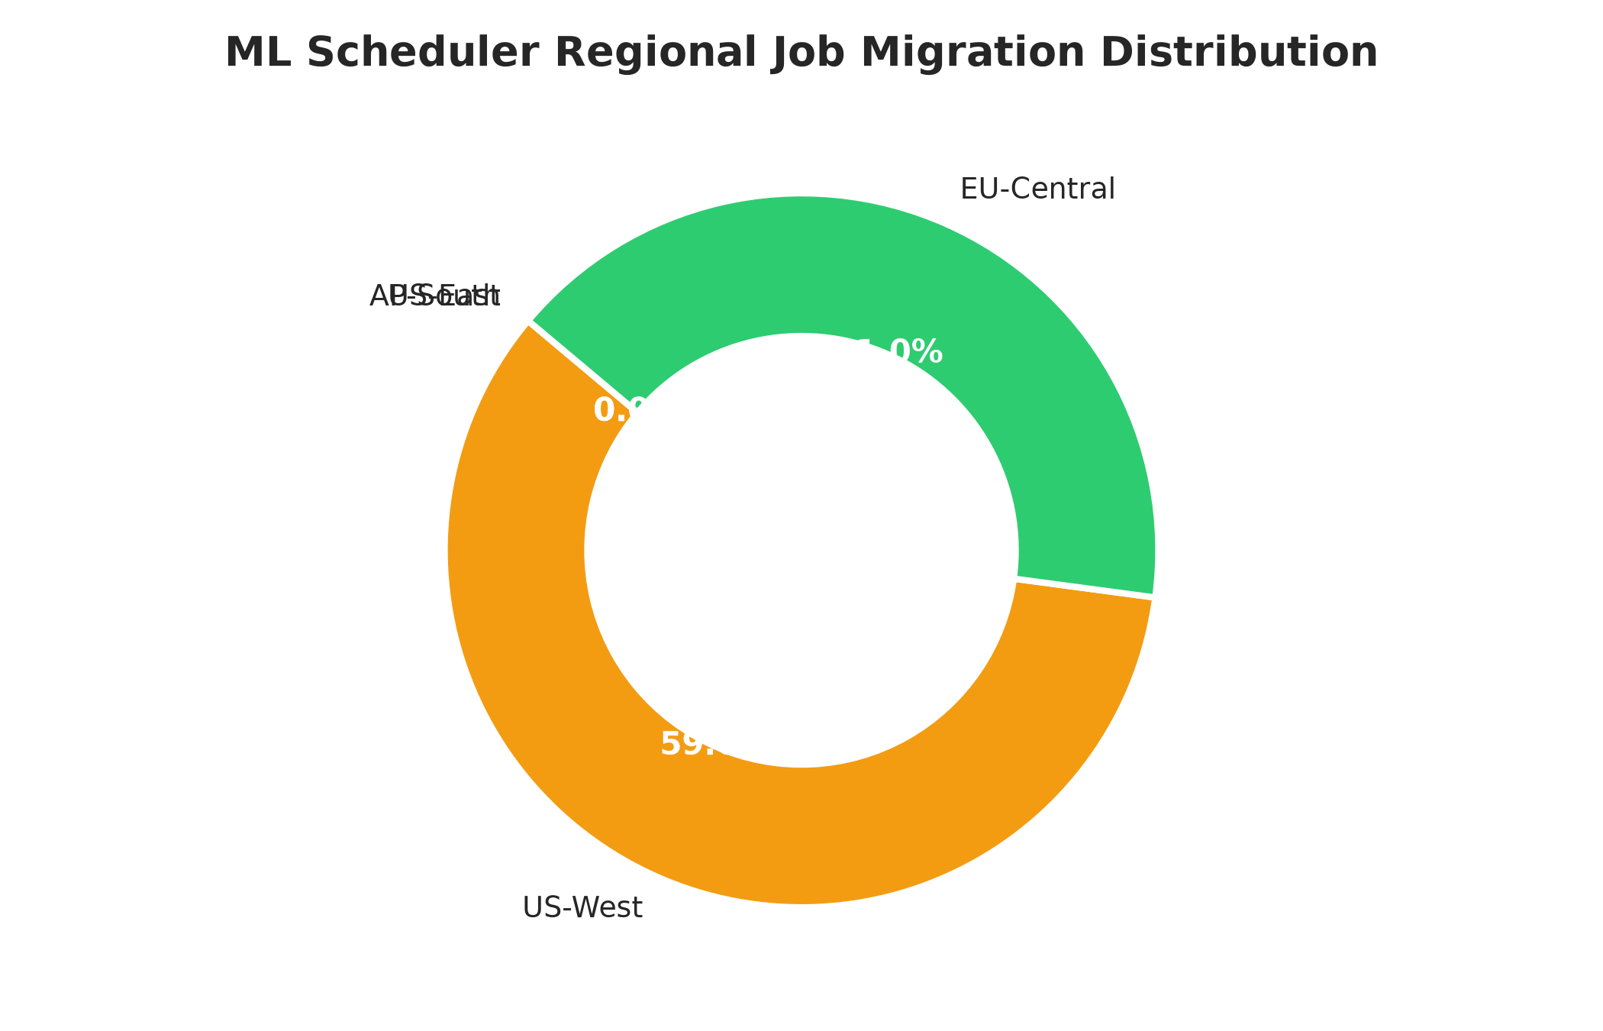
MACHINE LEARNING PROJECT
Regional Carbon Dynamics & Job Distribution

Slide 9
MACHINE LEARNING PROJECT
Interactive Streamlit Dashboard & Live Simulation
Live Dashboard Capabilities:
1. Real-Time Multi-Region Grid Heatmap: Live visualization of solar/wind clean power availability.
2. Custom Workload Injection: Interactively test batch jobs with varying SLA max delay tolerances.
3. Live Scheduler Benchmarking: Instant comparison of Naive vs ML Carbon-Aware scheduler emissions.
4. Exportable Reports: Download simulated carbon offset receipts and grid intensity forecasts.

Slide 10
CONCLUSION & FUTURE SCOPE
• Proved that ML-driven spatial & temporal workload shifting achieves ~35-45% reduction in carbon emissions.
• Maintained >99% SLA compliance without disrupting compute deadlines.
• Future Work 1: Integrate Reinforcement Learning (PPO Agent) for dynamic online job queueing.
• Future Work 2: Multi-objective optimization joining grid carbon intensity with live electricity spot market prices.

