Slide 1
Hackathon Presentation Will They Claim It
Nishant Pandey

Slide 2
Problem Statement
Forecast whether the client would Claim the Travel Insurance. This would help in charging competitive premiums , thus helping the company to mitigate risks.
Notes:
Can we include some examples here?

Slide 3
Why solve this problem?
Business Impact
Improve Prediction -> Identify common features of Customers Claiming the insurance -> risk mitigation
Improve Prediction -> Identify sectors/ areas for targeted marketing
Improve Prediction -> Identify the probability of Claim being made -> Charge competitive premium and stay ahead of the competition
Stakeholders
Chief Financial Officer
Chief Marketing Officer

Slide 4
Data

Slide 5
Evaluation Metric
The evaluation metric for this project is precision score.
The precision is intuitively the ability of the classifier not to label as positive a sample that is negative.
False Positive - predicted Claimed the Insurance, but actually not Claimed.
False Negative - predicted not Claimed the Insurance, but actually Claimed.
For the use case, False Positive must be reduced. So Precision to be given more importance

Slide 6
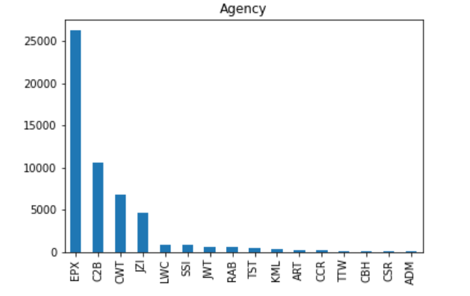
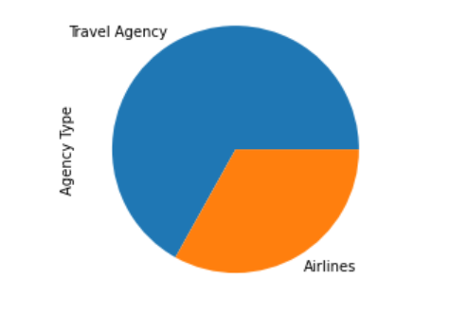
EDA – Univariate Analysis
Agency : Majority of the insurance sold by a particular agency, roping them would help.
Agency Type : Surely Agencies are more aggressive in marketing than the Airlines

Slide 7
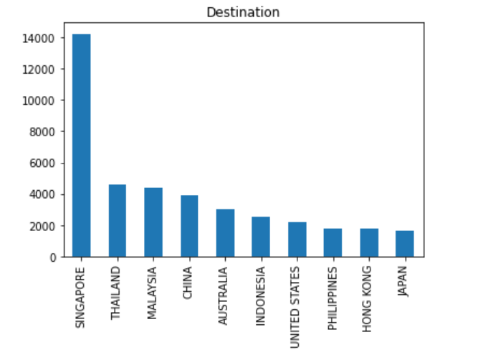
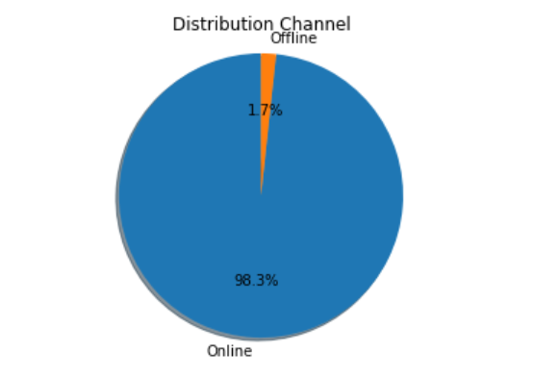
EDA – Univariate Analysis Cont.
Distribution Channel : Increased internet penetration among the masses has decimated the offline mode. Better to go online.
Destination : Singapore has headquarters of large business and is also a preferred tourist destination.

Slide 8
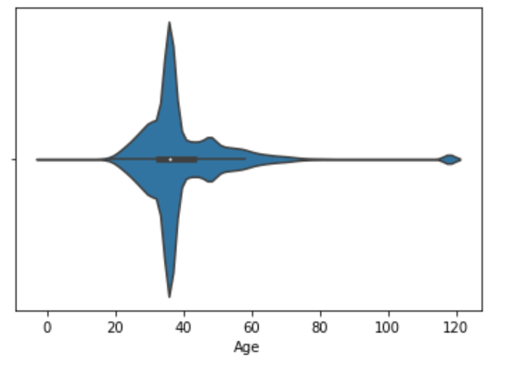
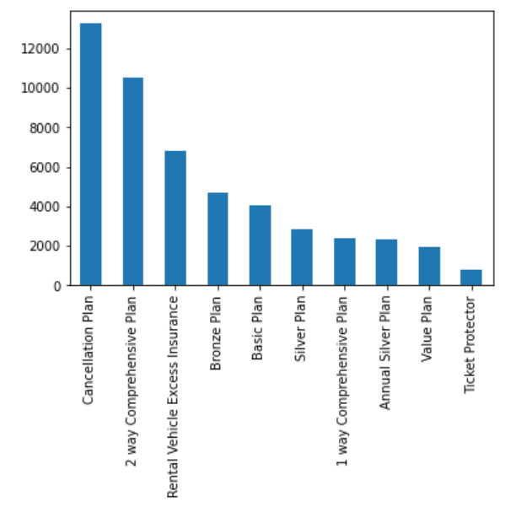
EDA – Univariate Analysis
Age : Majority of travelers are in the age bracket 35 – 40, working population
Product Name : Lot of travelers purchase insurance for visa formality

Slide 9
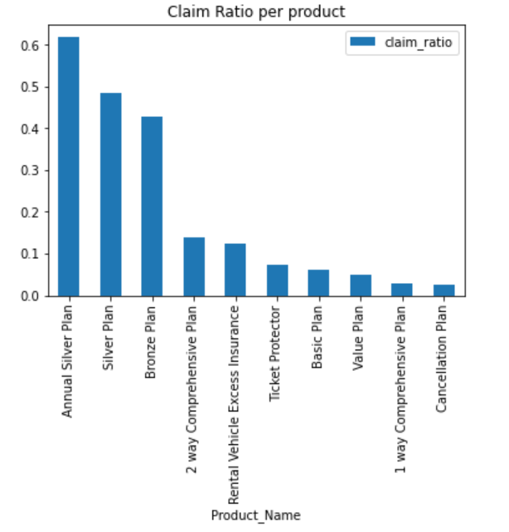
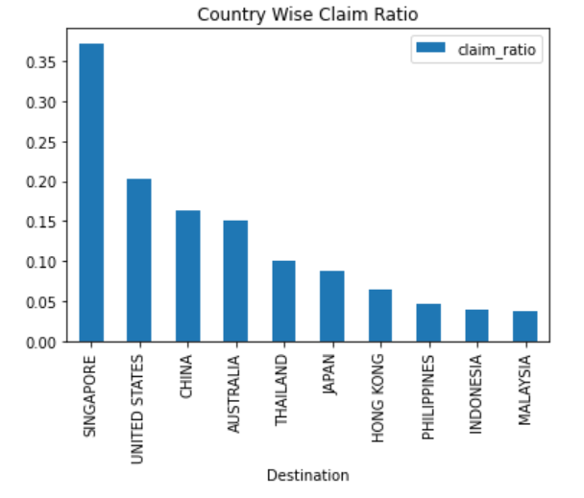
EDA – Bivariate Analysis
Lot of frequent traveler and purchase comprehensive package
Singapore seeing the max travelers also has highest claim ratio

Slide 10
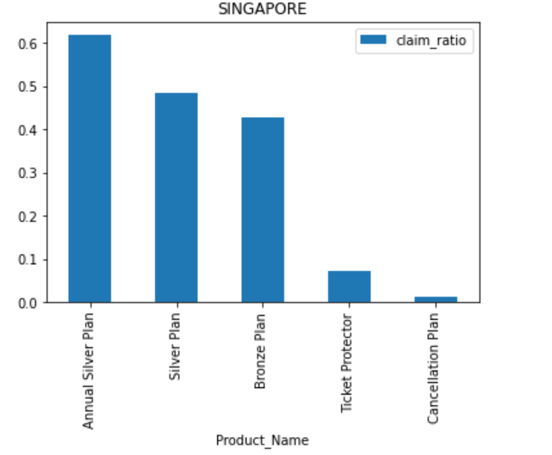
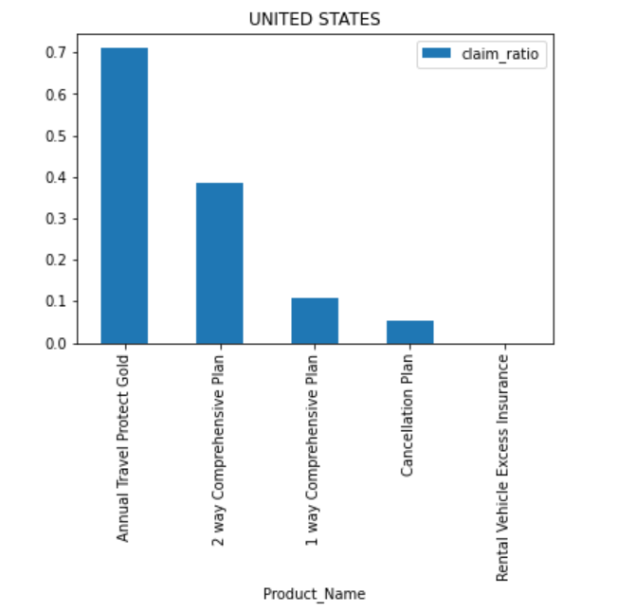
EDA
Travelers to Singapore are very Frequent and so Annual Silver Plan
Travelers to USA are less frequent and purchase comprehensive plans

Slide 11
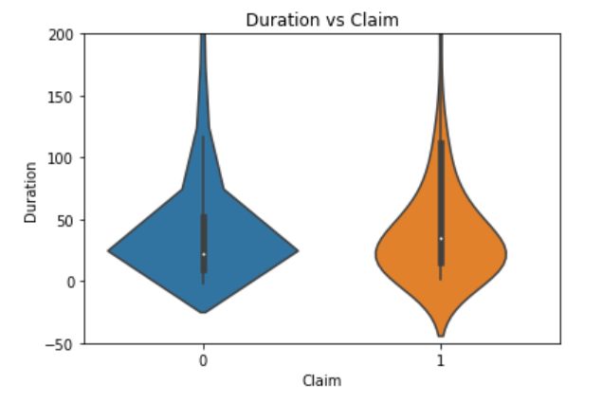
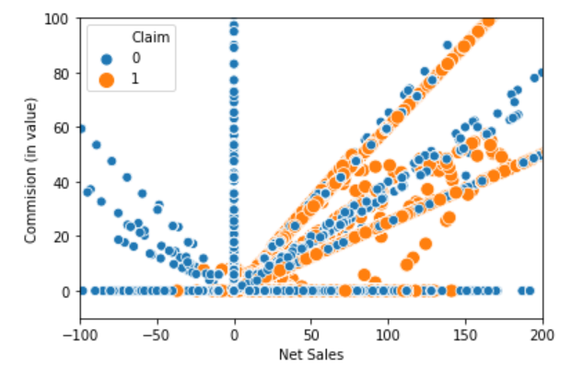
EDA
Majority of Claim occurs for policies with Commission and Net Sales greater than zero
Max claim occurs for stay around 25 days , which is justified as the median length of travel duration is 24

Slide 12
Pipeline
Outlier Treatment:
Outliers in the continuous features(Age, Sales) were detected but no action was performed on them to maintain the variance in the data set.
Missing Values:
There were no missing values in both the continuous and categorical features.

Slide 13
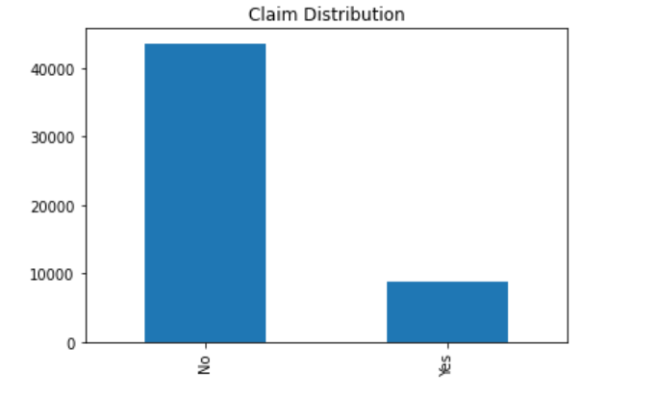
Pipeline
Class Imbalance
The distribution of target below shows a clear imbalance of the two classes.

Slide 14
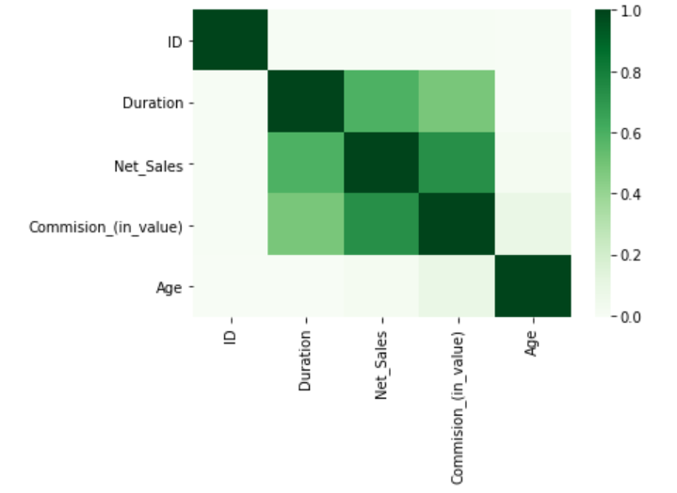
Pipeline
Feature Selection
Following methods were used for Feature Selection:
Correlation
After estimating the Pearson Correlation coefficients between continuous features , following features was dropped
Commision(in value)

Slide 15
Models and Approaches
Following models were assessed without performing any hyperparameter tuning and without treatment of class imbalance of the target. The models were fitted to train dataset without performing feature selection. The models are:
Logistic Regression
Random Forest Classifier
XGBoost Classifier
Support Vector Machines
KNN classifier
Stacking Classifier
Out of the above models , Random Forest Classifier gave the best Precision Score of 82 %.
To further increase the score , hyperparameter tuning was performed using Grid Search .

Slide 16
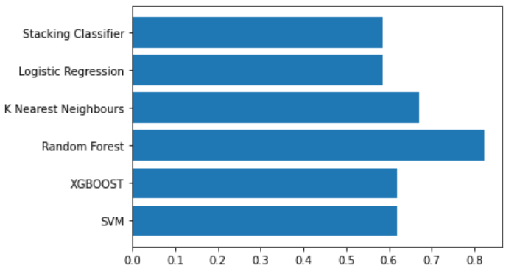
Model and Approaches
The Vanilla model used yielded the following results:
Modelling Method | Precision Score
SVM | 0.618
XGBoost | 0.618
Random Forest | 0.822
K Nearest Neighbors | 0.671
Logistic Regression | 0.585
Stacking Classifier | 0.585

Slide 17
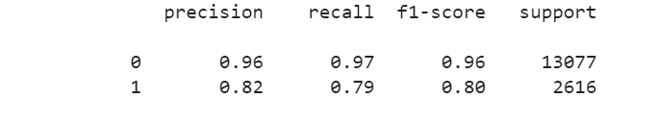
Model Tuning
Selected Random Forest Classifier on the basis of the precision score. Performed hyperparameter tuning using Grid Search on Random Forest Classifier, the following results were observed using all the features.

Slide 18
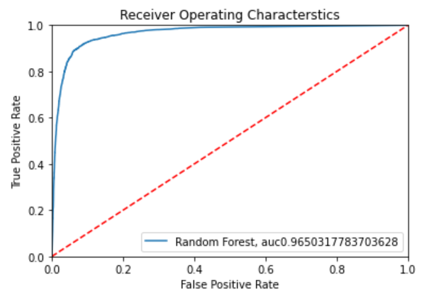
Evaluation & Results
Below is the AUC_ROC plots after the hyperparameter tuning

Slide 19
Final Results
From the above observations and plotting it can be inferred that the best performing model was Random Forest Classifier giving an AUC_ROC score of 87.6%
Confusion Matrix
 | Predicted Negative | Predicted Positive
Actual Negative | 12627 | 450
Actual Positive | 555 | 2061

Slide 20
Insights & Decisions
Competitive pricing for certain sectors such as :
Age : 35-40
Destination : Singapore, Thailand, Malaysia
Agency : EPX, C2B
Plan : Cancellation Plan, 2 Way Comprehensive Plan
To mitigate risk , premium pricing should be done for sectors which have high claim ratio such as :
Plan : Annual Silver Plan, Silver Plan , Bronze Plan
Destination : Singapore, USA, China
Destination wise Plan :
Singapore : Annual Silver Plan
USA : Annual Travel Protect Plan
China : 2 Way Comprehensive Plan

Slide 21
Next Steps
If time permitted, could have tried the following :
● Better feature engineering
● An ensemble of different models

