Slide 1
MedWAY
Nandini Khastagir– 1BM20CS093
Nikhil Srikanth – 1BM20CS096
Nisha P – 1BM20CS099
Gagan M – 1BM20CS222
Guide
G. R. Prasad
Professor
Department of Computer Science & Engineering
BMS College of Engineering

Slide 2
Outline
Introduction
ER Diagram
Schema Diagram
Tools and Technology Used
Resources

Slide 3
Introduction
Want medicines? It’s just a click away !!.
MEDWAY can be accessed by anyone in Karnataka. It has an easy to use dashboard to know more details about the required products. Our website increases the efficiency of ordering medicines to the users.
MEDWAY is a website which provides an online service to people in need of medicines and medicinal products. The users can search for the required medicines, order it online and the product will be delivered to them from the nearest pharmacy.

Slide 4
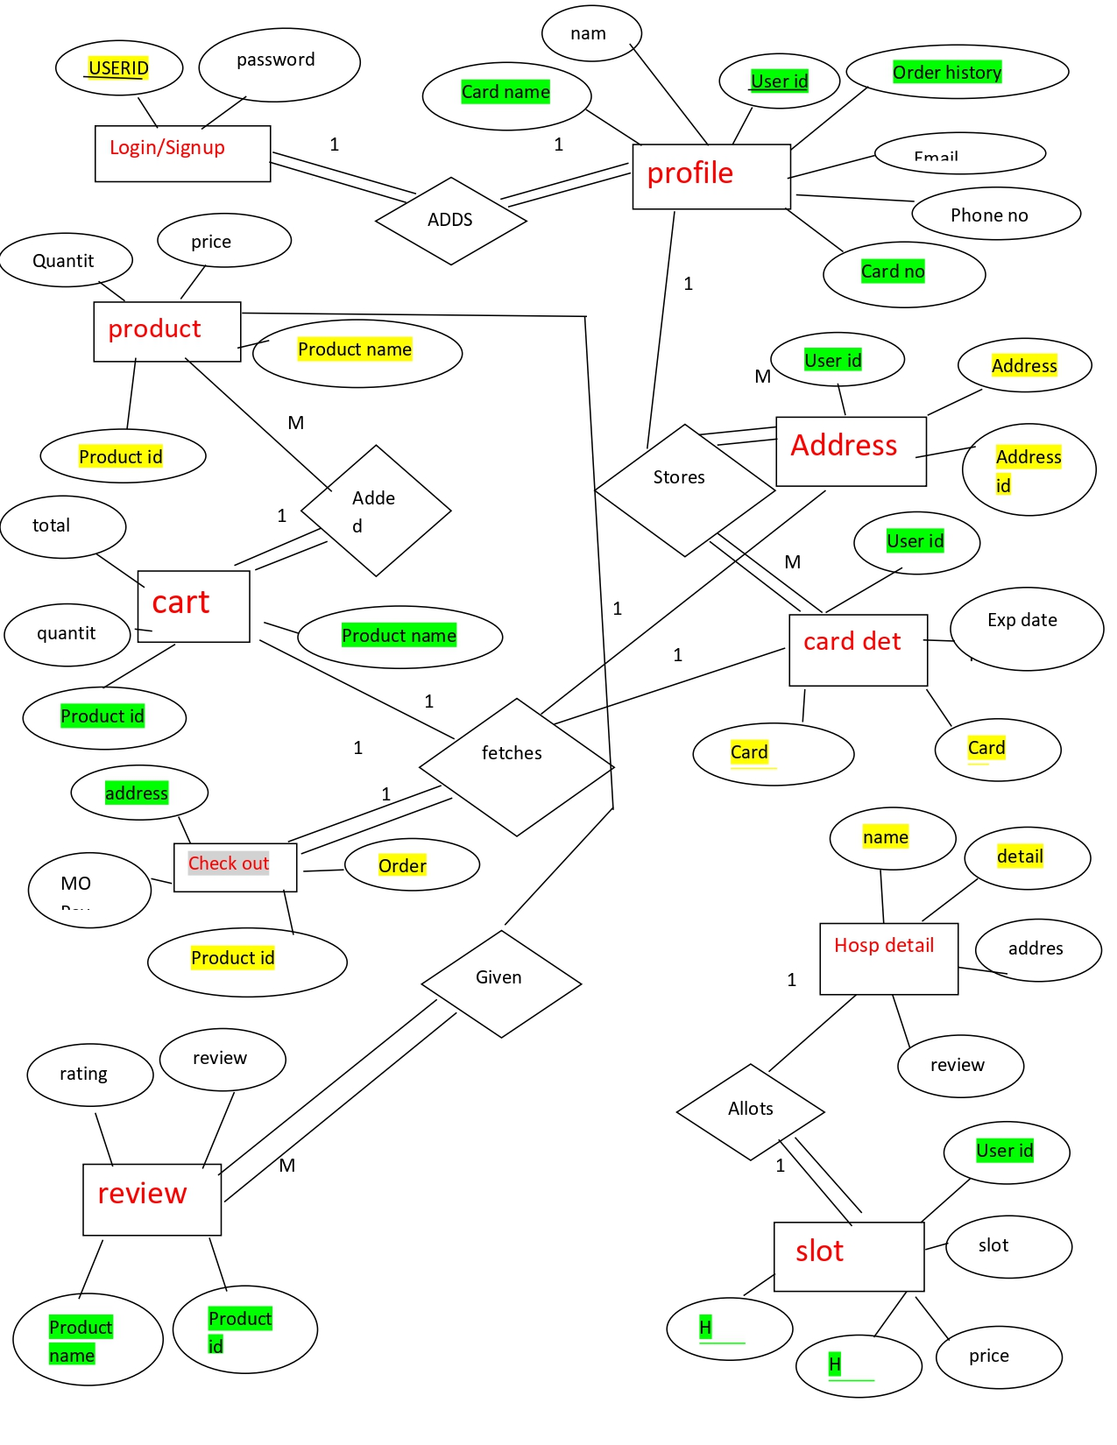
ER Diagram

Slide 5
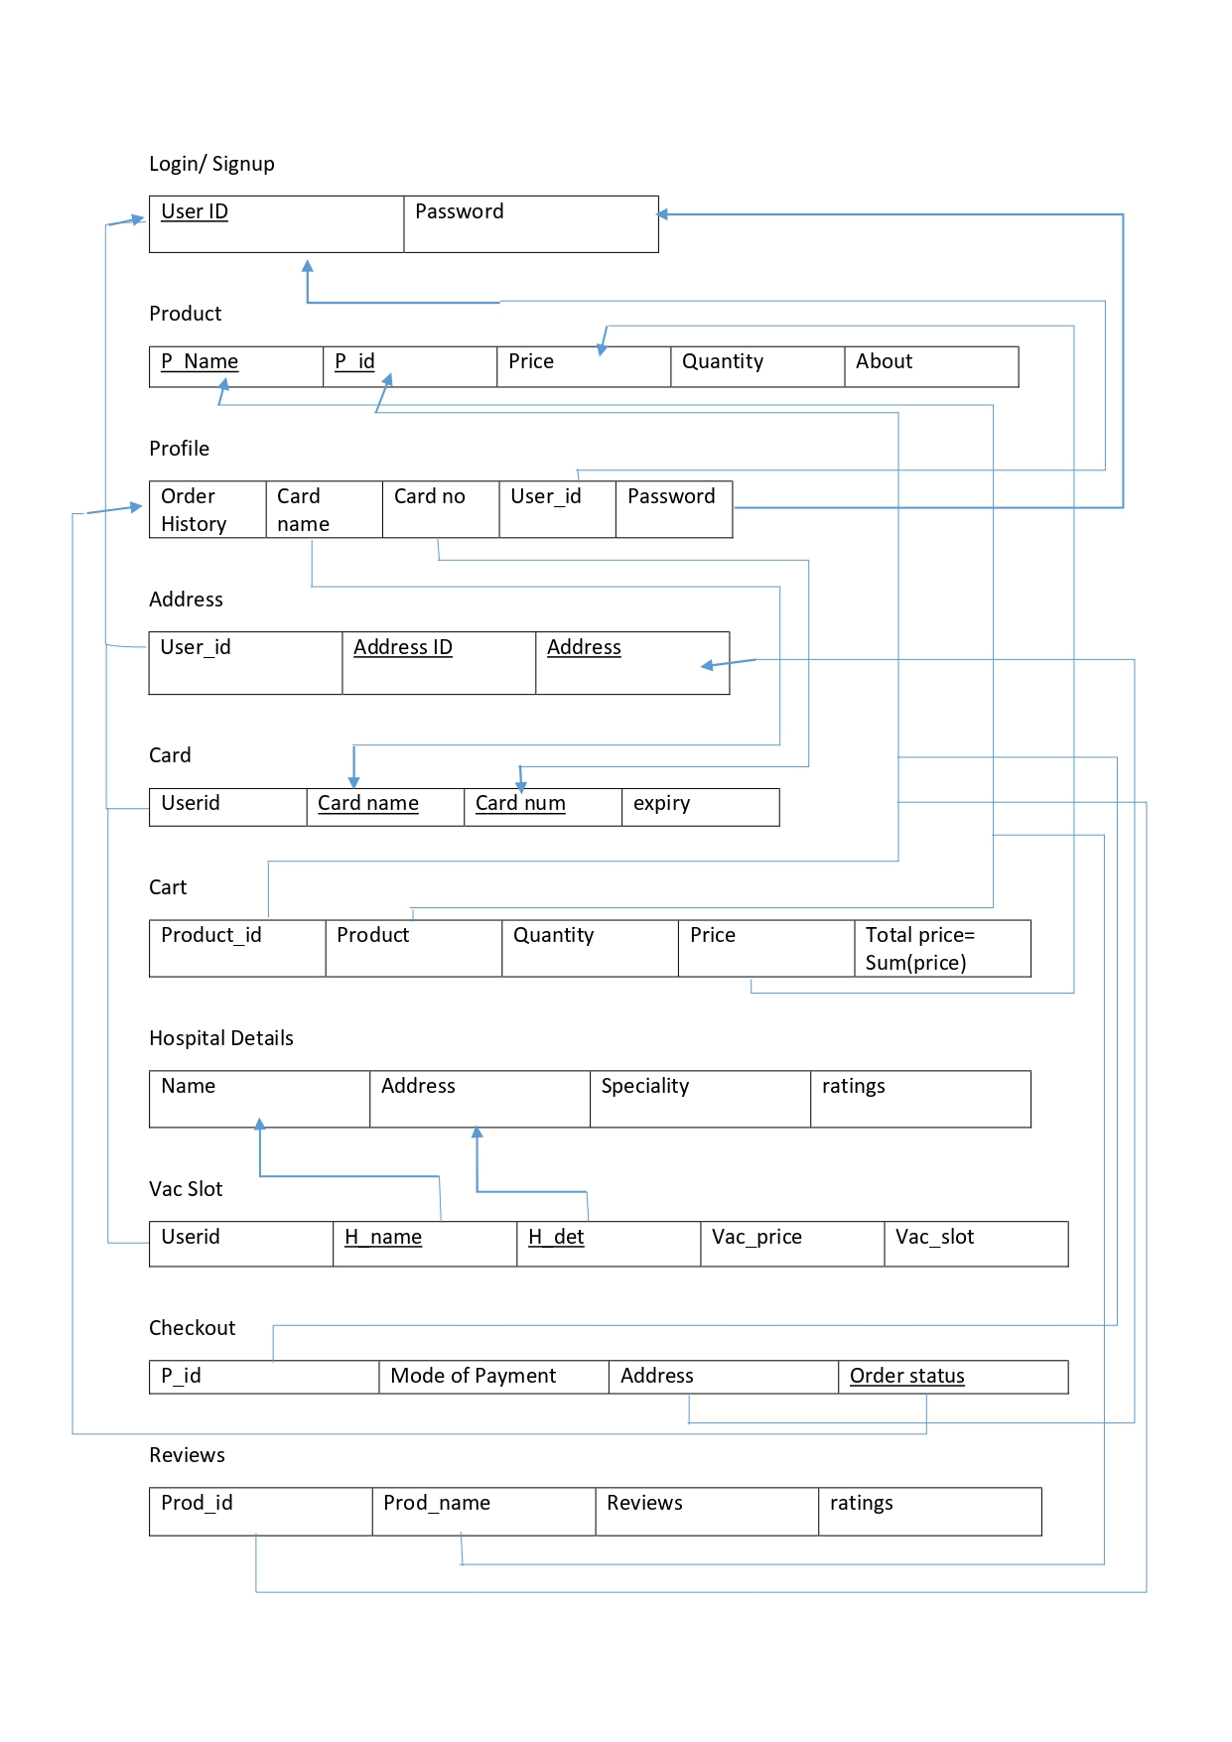
Schema Diagram

Slide 6






Tools And Technologies used:
Front End:
Back End:

Slide 7
Resources:
https://www.w3schools.com
https://undraw.co/illustrations
https://fontawesome.com
https://dribbble.com => for design inspiration
https://github.com/bradtraversy/php-crash

