Slide 1
Studying Effect of Oil Recession on Capital Productivity
REPORT BY: Nisha Iyer
Sayali Paseband
Sidheswar Venkatachalapathi
Sanjana Patil
Rinda Sai Kiran Gunjala

Slide 2
AGENDA
OIL RECESSION
PROBLEM STATEMENT
VARIABLE DESCRIPTION
FIRST DIFFERENCE ESTIMATOR AND PROBLEMS
WHY D-I-D
CONTROL/TREATMENT STATES
D-I-D MODEL : ANALYSIS/OUTPUT
INTERPRETATIONS
CONCLUSIONS

Slide 3
OIL RECESSION OF 1979
Oil - World’s most important asset.
Powers the industries, provides fuel for vehicles, heats homes.
Those with oil reserves better control global economy, and hence power.
1970s - U.S. was one of the leading consumers. Population heavily reliant on oil.
Iranian Revolution of 1979- creates shortages in oil production and hence supplies.
The price of crude oil more than doubled to $39.50 per barrel over the next 12 months.
Notes:
opec was the leading supplier of oil. organization of petroleum exporting countries
Component for many household products - Used everywhere

Slide 4
OIL RECESSION OF 1979
OPEC refused to curtail the price hike and assumed a take it or leave it stance.
U.S. was not a major producer, although many reserves were identified.
inflation rose to 9 percent by the end of 1979.
This recession had far reaching effects on the economy and power balance.
The oil crisis had mixed effects in the United States, due to some parts of the country being oil-producing regions and other parts being non producers.

Slide 5
PROBLEM STATEMENT
To estimate the impact of this oil recession on the productivity of States in US.
we decided to look into the GSP of states across the years spanning before and after the oil recession.
adverse effects would manifest in the form of a decline in GSP of the states
Notes:
Correlation is not causation. Then what is causation? How can it be measured?
Causation is measuring the real impact on Y because of X. E.g., What is the effect of oil recession on the productivity of the nation?
It is critical to precisely understand the causal effects of these interventions on the subject. One of the main threats to causal inference is the confounding effect from other variables. In our case, it could be population change, area size of the state or various other factors that could be inducing the change in GSP at the same time. So how do we correctly attribute the productivity because of the oil recession in 1979?

Slide 6
DATASET AND VARIABLE DESCRIPTION
The dataset contains information from the year 1970–1986
Information of all the states in North America are available.
The treatment year is considered to be the year 1979.
The treatment region is “South Dakota”.
The economic impact measurement variable is GSP per capita (in thousands)

Slide 7
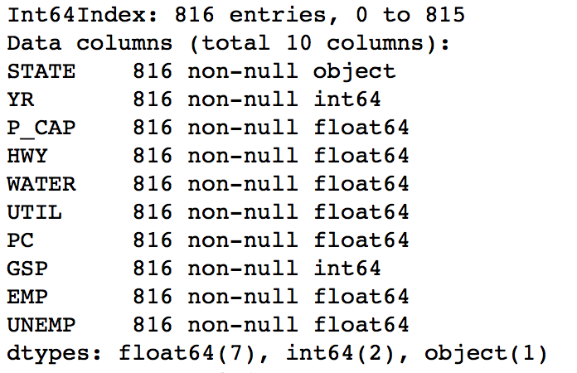
DATASET AND VARIABLE DESCRIPTION

Slide 8
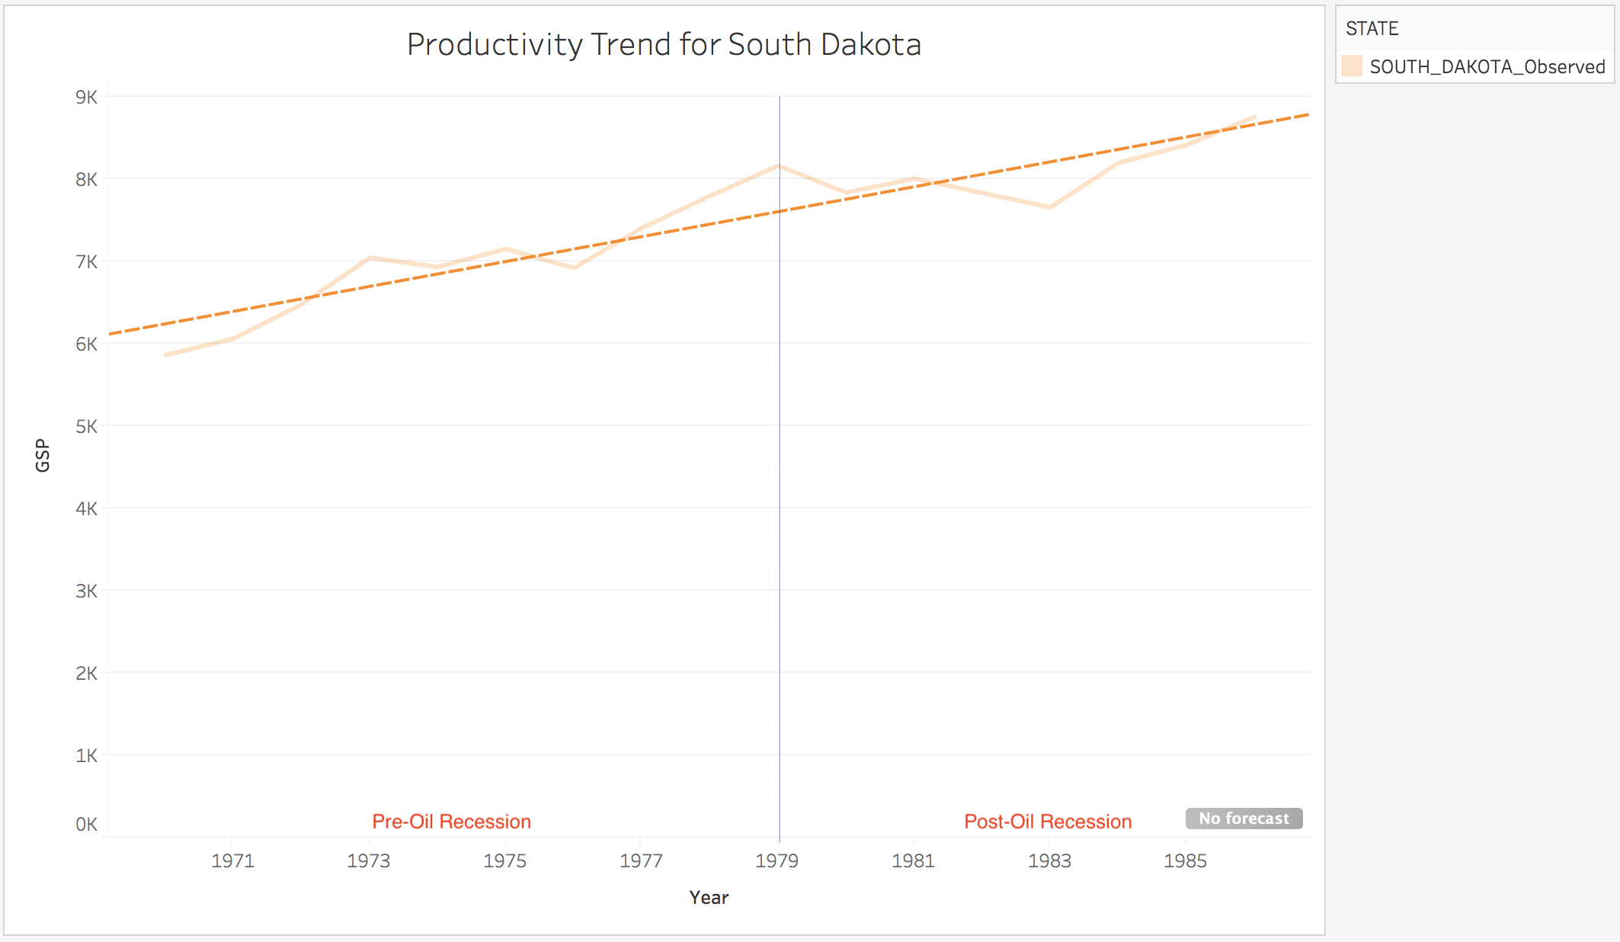
FIRST DIFFERENCE ESTIMATOR MODEL
GOAL : Quantify the impact of GSP before and after the Oil Recession of 1979.

Slide 9
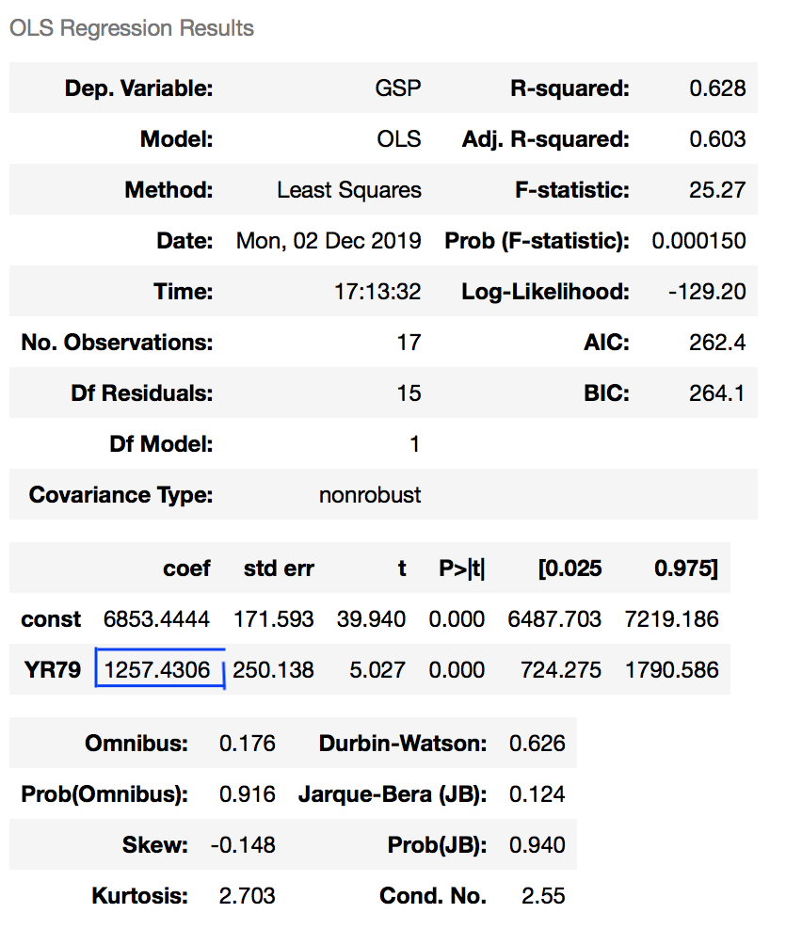
Problem with First Differences
Coefficient of post indicator suggests that there is an increase.
The trend in GSP could have been altered because of other variables known as confounders.
Solution: Compare the trend to a control region which is not impacted by the oil recession.

Slide 10
DIFFERENCE-IN-DIFFERENCES MODEL
Difference-in-Differences models estimate the effect of exposure by using changes over time in a treatment group relative to a control group.
The underlying assumption of Difference-in-Differences design is that the trend of the control group provides an adequate proxy for the trend that would have been observed in the treatment group in the absence of treatment.
The model analyses whatever happened to the control group over time is what would have happened to the treatment group in the absence of the change.

Slide 11
CONTROL/TREATMENT STATES
Control group is not affected by the policy change.
Treatment group is affected by the policy change.
For our analysis, the control state was identified by spotting for the state that had the lowest variation in % difference of GSP across years and had oil reserves.
We studied the GSP trend for treatment and control states.
North Dakota region was recognized to be the best control region.

Slide 12
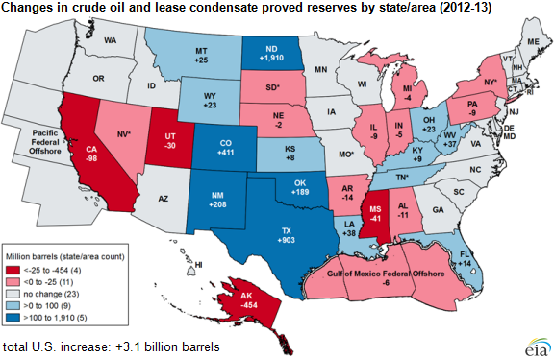
Oil Reserves in US by states

Slide 13
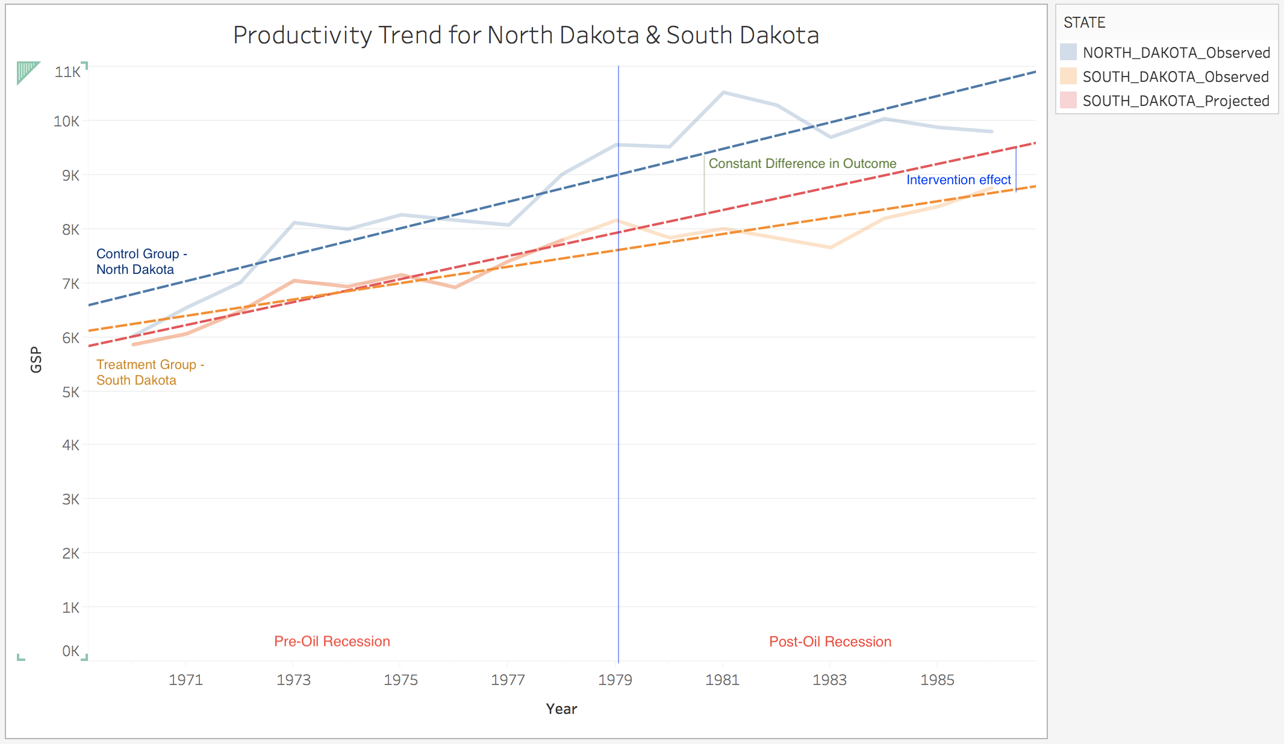
D-I-D MODEL : Analysis
Notes:
GDP trend for ND region goes hand in hand with SD GSP with an exception for a few years in the pre-period. Thus, there should be no problem in considering ND to be our control region.
Let’s go ahead and fit the regression with GSP as the dependent variable and treatment indicator and a pre-post indicator as independent variables. The critical aspect here is to feed the interaction between treatment and pre-post indicator as we want the estimate to contain the effect of being treated along with being in post-period in comparison to not being treated and being in pre-period. After fitting, let’s look at the regression results

Slide 14
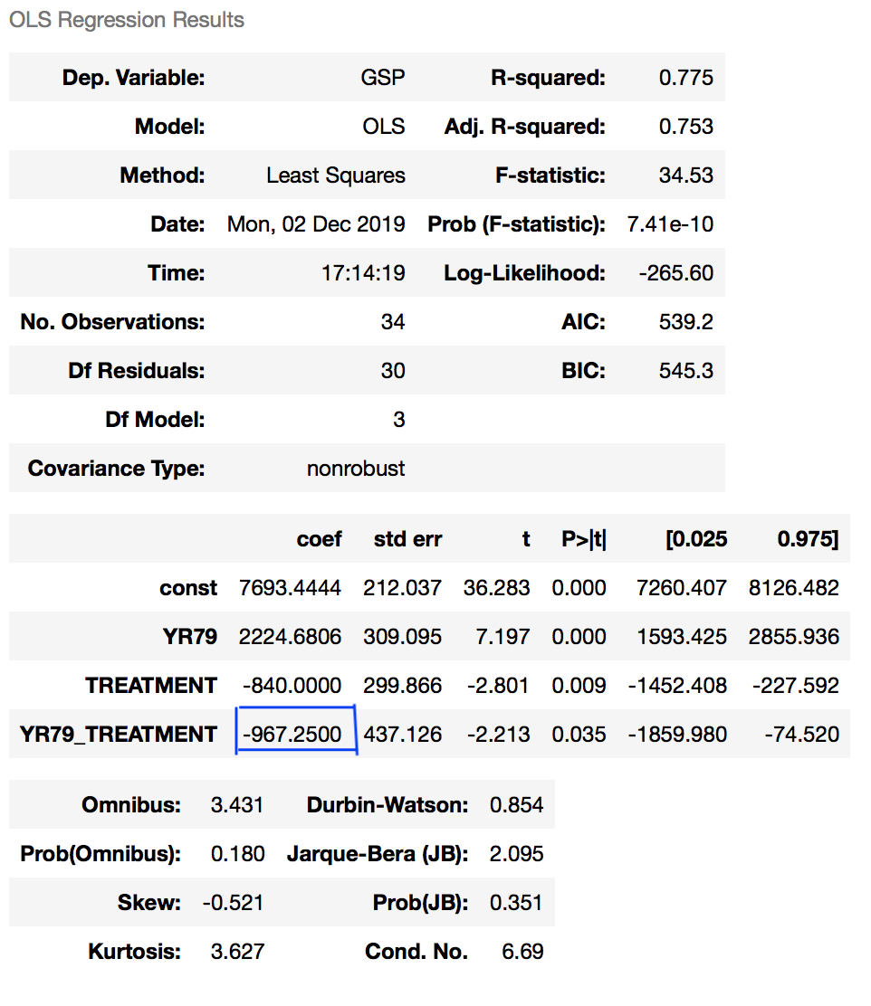
D-I-D MODEL : Output
Fit regression with GSP as dependent variable
Independent Variables :
Dummy variable, YR79 -
0 if Year < 1979; 1 otherwise
Dummy variable, TREATMENT -
0 if STATE is North Dakota
1 if STATE is South Dakota
Interaction term, YR79*TREATMENT
D-I-D Model is able to explain the true estimate
difference of productivity in South Dakota
much better than the First difference model.
Notes:
Looking at the estimate of the interaction variable suggests that the GSP in SD reduced by 967.25 units because of the Oil recession that happened.
Now there is a stark difference between estimates provided by First difference method and the DD method. Quantitatively, we can see how the First difference estimates could be deceiving and naive to look at.

Slide 15
INTERPRETATIONS
Manual Calculation:
Y= B0 + B1*YR79 + B2*Treatment + B3*(YR79*Treatment) + u
YEAR/STATE | Control Group - North Dakota (TREATMENT = 0) | Treatment Group - South Dakota (TREATMENT = 1)
Pre-Oil Recession of 1979 (YR97 = 0) | a = B0 = 7693.44 | b = 6853.44 | b - a = B2 = -840
Post-Oil Recession of 1979 (YR97 = 1) | c = 9918.125 | d = 8110.875
 | c - a = B1 = 2224.685 | d - b = 1257.435 | B3 = (d - b) - (c - a) = -967.25
Notes:
Here at the manual calculations, we see that a,b,c,d are the means of GSP before and after 1979 for the control and treatment group. So, here we see that calculation of the interaction of time and treatment group which is B3 is -967.25 which is exactly same as what we achieved through the regression as well . Looking at the estimate of the interaction variable, it suggests that the GSP in South Dakota reduced by 967.25 units because of the oil recession that happened.

Slide 16
CONCLUSIONS
The oil recession at 1979 affected the productivity of few states, one of which that was majorly impacted was South Dakota (Treatment Group).
North Dakota (Control Group) had oil reserves, due to which the oil recession only minutely affected the GSP of that state.
The productivity trend provides a negative treatment effect, which shows the GSP in South Dakota had a decrease in the trend after the oil recession.
After the First differences model, Difference in differences model, we conclude that, looking at the estimate of the interaction variable, the GSP of South Dakota was reduced by 967.25 units after the oil recession.
Also the future scope of the project is to estimate the treatment effect using causal effect and synthetic control.
Notes:
Methods that coud be researched are :
Causal Impact
Synthetic Control

Slide 17
QUESTIONS?

