Slide 1
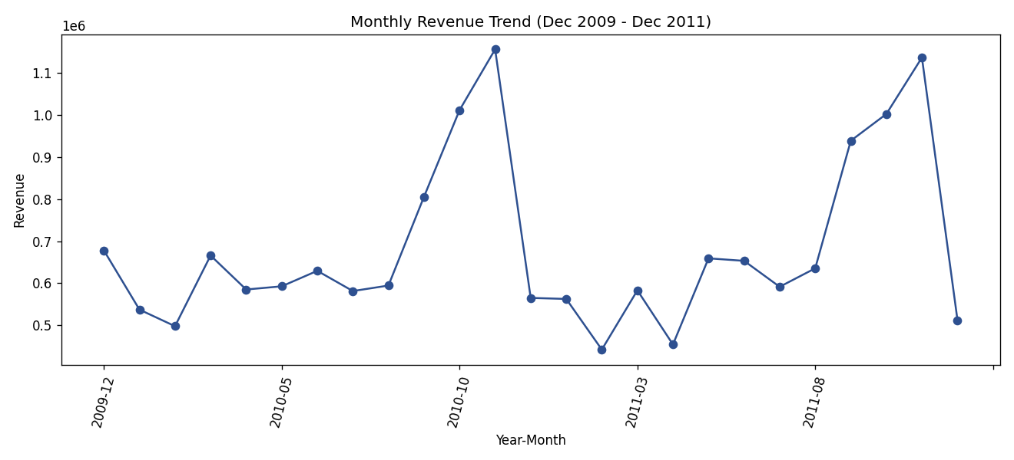
Retail Sales & Customer Purchase Prediction
Group A ·Internship Project
Nisha Kafle
Project Lead / Business Analyst
Soniya Pandey
Data Collection & Quality
Susmita Balami
Python Data Analyst
Swikriti Bhusal
Visualization Analyst
Pratish Shakya
Machine Learning Analyst
Notes:
Introduce the team and the five roles. Say this is a complete end-to-end analytics and machine learning project on a real retail transaction dataset.

Slide 2
Business Problem
2
A retail business wants to understand how it is selling and which customers are likely to become high-value.
Understand sales
Revenue, seasonality, products, countries
1
Find high-value customers
A transparent rule, not a guess
Dataset: Online Retail II, two years of real UK online-retailer transactions.
2
Focus effort
Retention and marketing where it matters
3
Notes:
State the business problem plainly: the business wants to know how it is performing and which customers deserve retention and marketing attention first.

Slide 3
Objectives & KPIs
3
1
Measure sales performance: revenue, trends, top products and countries
17.07M
5,861
2
Define a transparent, reproducible high-value customer rule
Total revenue (valid sales)
Customers with valid sales
Predict high-value customers from past behavior only (no leakage)
25%
0.681
3
Customers who become high-value
Best F1-Score (Random Forest)
4
Compare Baseline, Logistic Regression and Random Forest
KPIs: total revenue, customer count, high-value rate, and Accuracy / Precision / Recall / F1 for each model.
5
Turn findings into evidence-based recommendations
Notes:
Walk through the five objectives, then point to the four headline numbers. Every number comes from the notebooks, not from estimates.

Slide 4
Data Source & Collection Process
4
File: online_retail_II.xlsx, an existing operational export supplied with the project
Two sheets with identical structure: Year 2009-2010 and Year 2010-2011
Verified identical columns and types, then merged into one dataset
Date range: 2009-12-01 to 2011-12-09
No data was invented, simulated or self-collected; every figure is computed from the file
Raw file kept untouched in data/raw
2
1,067,371
Sheets merged
Rows after merge
~24
43
Months of data
Countries
The workbook has no built-in citation or license field, so we document only what the file itself shows.
Notes:
Explain that this is an operational dataset, not self-collected. Be honest that the file does not include a formal citation, so we describe only what we can verify from it.

Slide 5
Dataset Overview
5
Column | Type | Meaning | Missing
Invoice | Text | Transaction ID (C = cancel, A = adjust) | 0
StockCode | Text | Product code | 0
Description | Text | Product name | 4,382
Quantity | Integer | Units (negative = cancellation) | 0
InvoiceDate | Datetime | Date and time of transaction | 0
Price | Float | Unit price (GBP) | 0
Customer ID | Float | Customer identifier | 243,007
Country | Text | Customer country | 0
53,628
Unique invoices (raw)
5,942
Unique customers (raw)
5,305
Unique stock codes (raw)
Customer ID is missing on about 22.8% of rows; these cannot be linked to a customer.
Notes:
Read the columns out loud. Highlight that Customer ID is missing for 243,007 rows, which matters a lot for customer-level prediction. Numbers in the stat cards are from the raw merged data before cleaning.

Slide 6
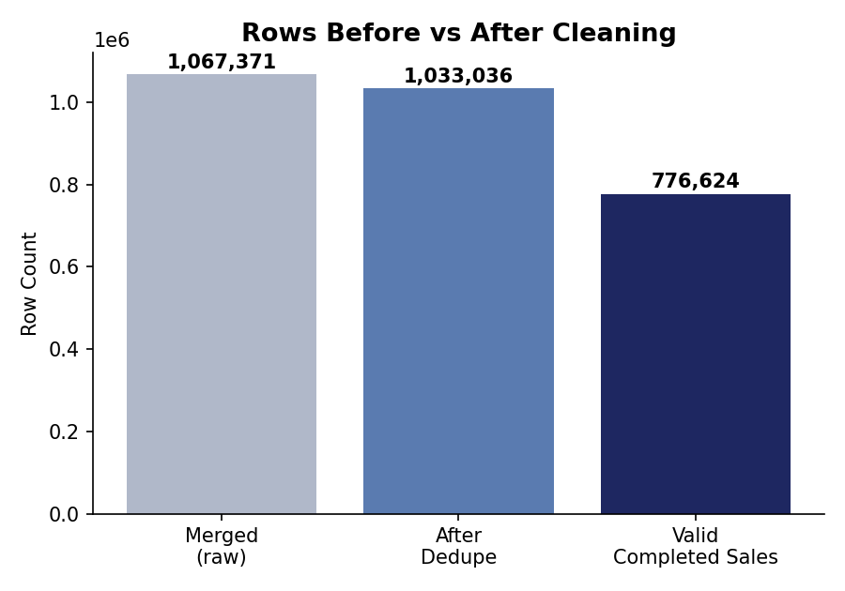
Data Cleaning
6
Rule applied | Rows
Exact duplicates removed | 34,335
Cancelled invoices (flagged) | 19,104
Non-product codes: postage, fees | 5,524
Invalid quantity (<= 0) | 22,496
Invalid price (<= 0) | 6,019
Missing Customer ID (flagged) | 235,151
Valid completed sales | 776,624
Excluded rows are flagged with a reason, not silently deleted. Flag counts are measured after duplicates were removed and can overlap.
Notes:
Emphasize that cleaning is documented and auditable. Valid completed sales are 776,624 rows, which is 72.8% of the merged data. A single row can trigger more than one flag, so the flag counts do not add up to the rows removed.

Slide 7
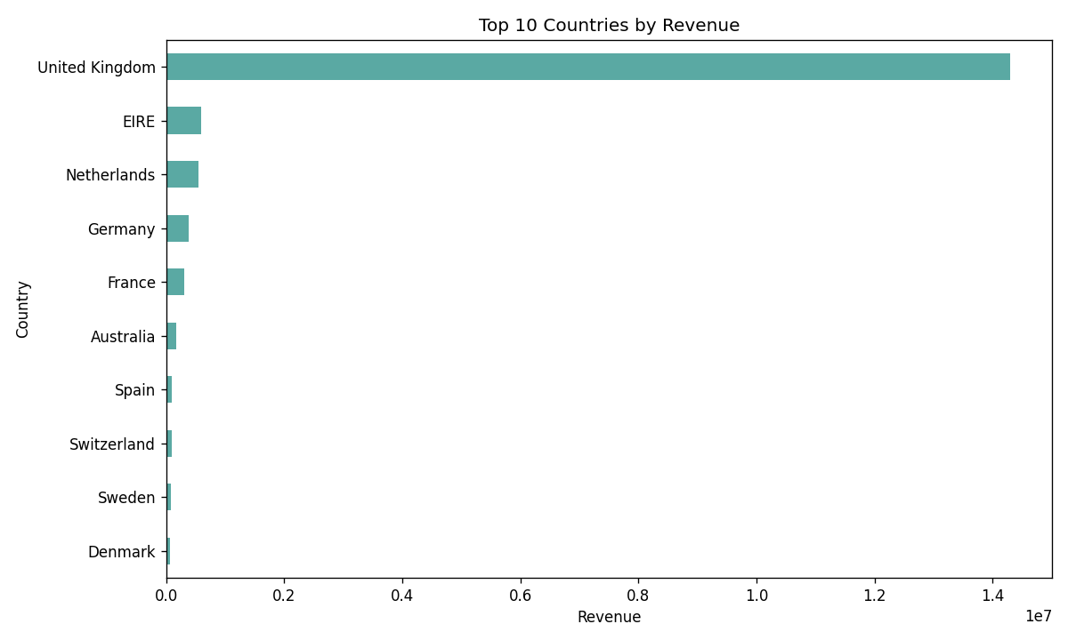
Key EDA Findings
7
17,073,078
5,861
4,624
83.7%
Total revenue (valid sales)
Customers
Products sold
Revenue from the UK
Revenue is strongly seasonal and peaks around October and November
The business depends heavily on the United Kingdom
Notes:
Summarize the 12 business questions answered in Notebook 2. Point at the seasonal peak on the left chart and the UK dominance on the right chart.

Slide 8
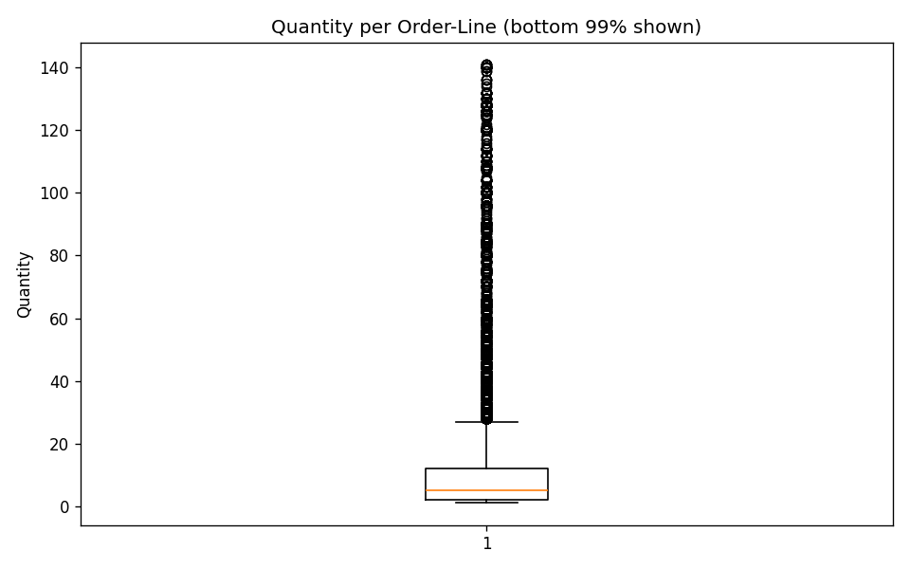
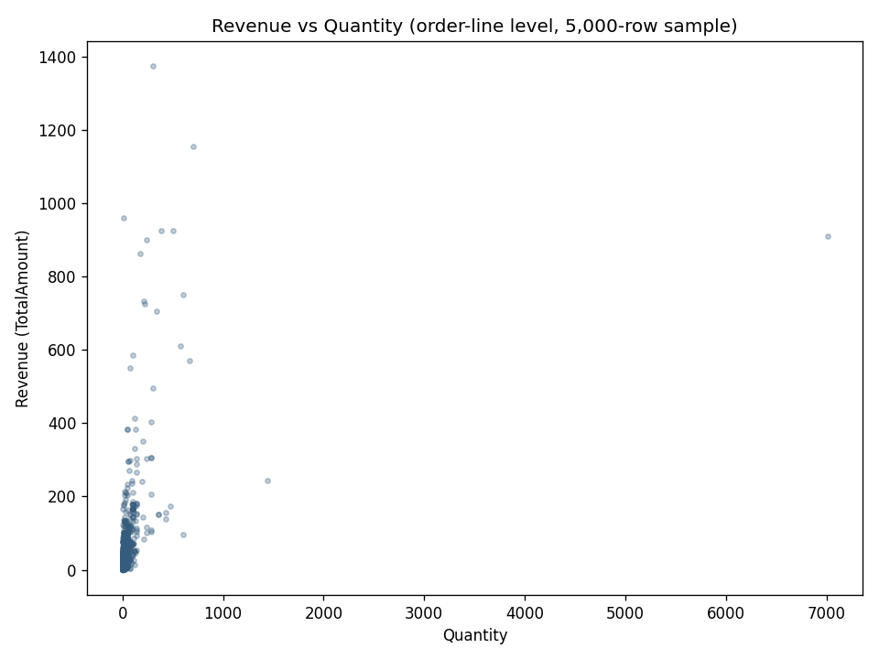
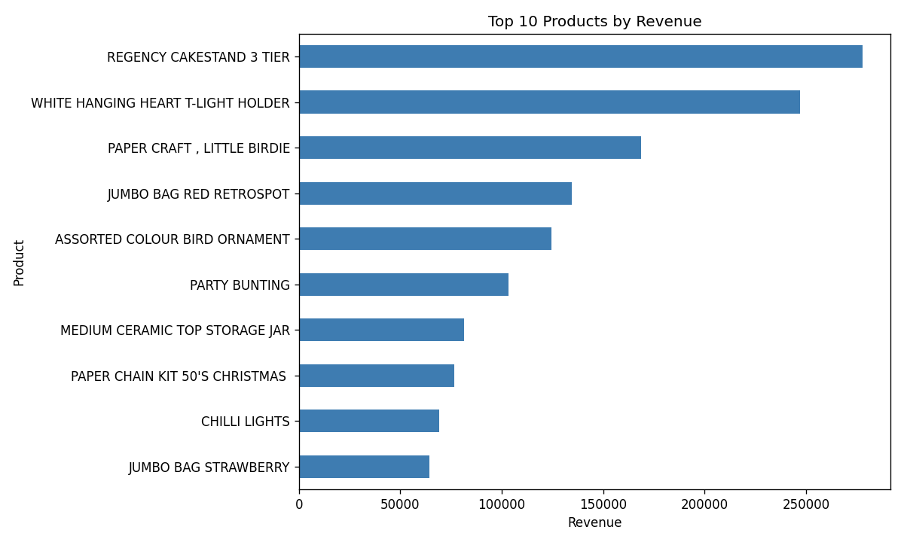
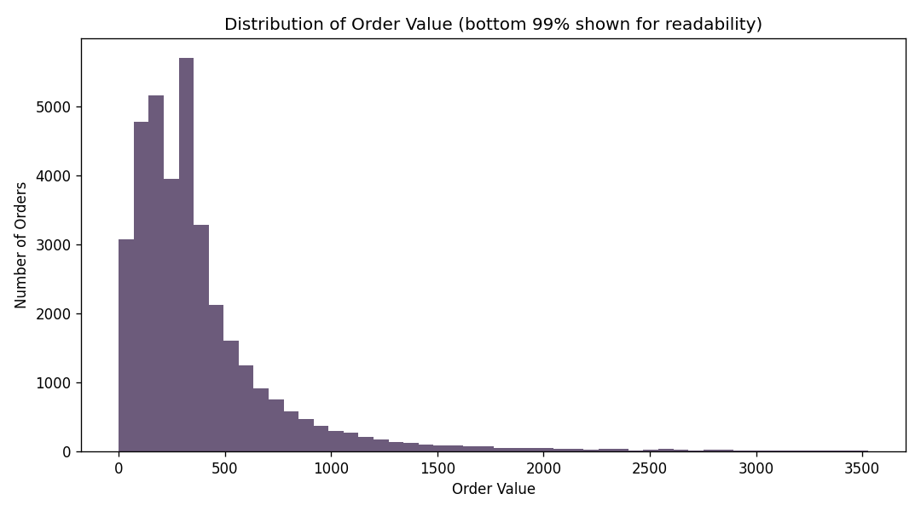
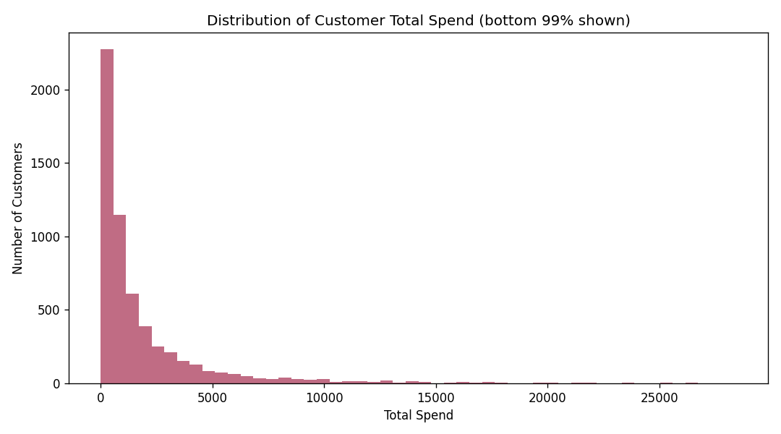
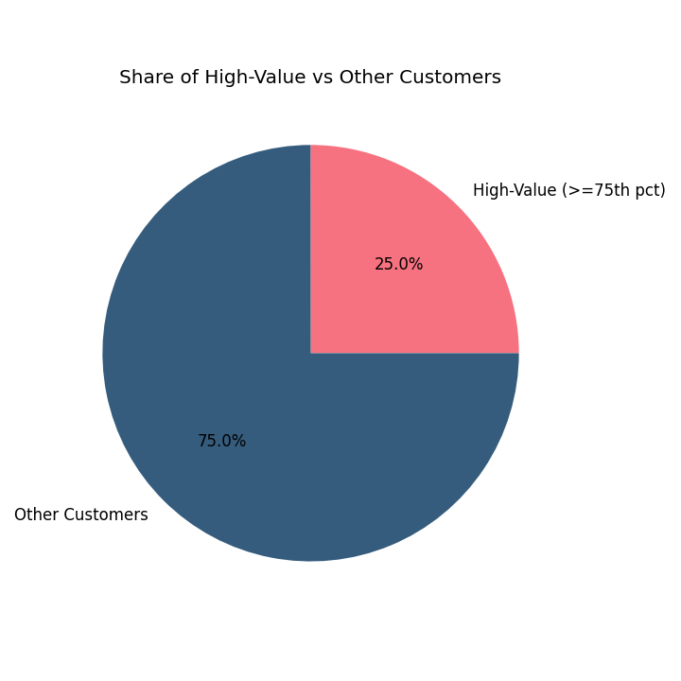
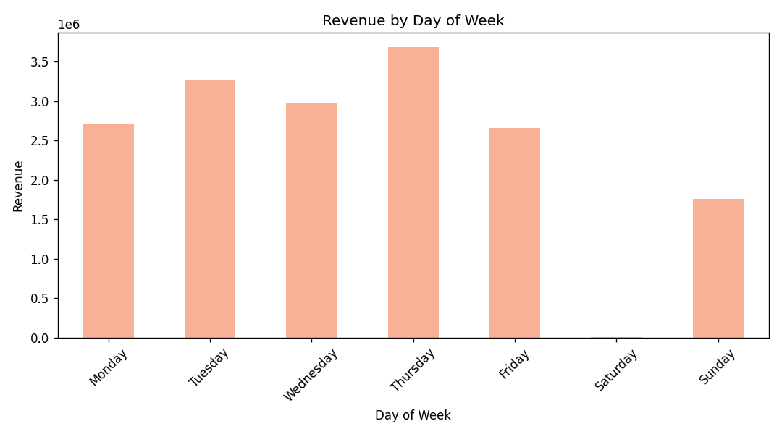
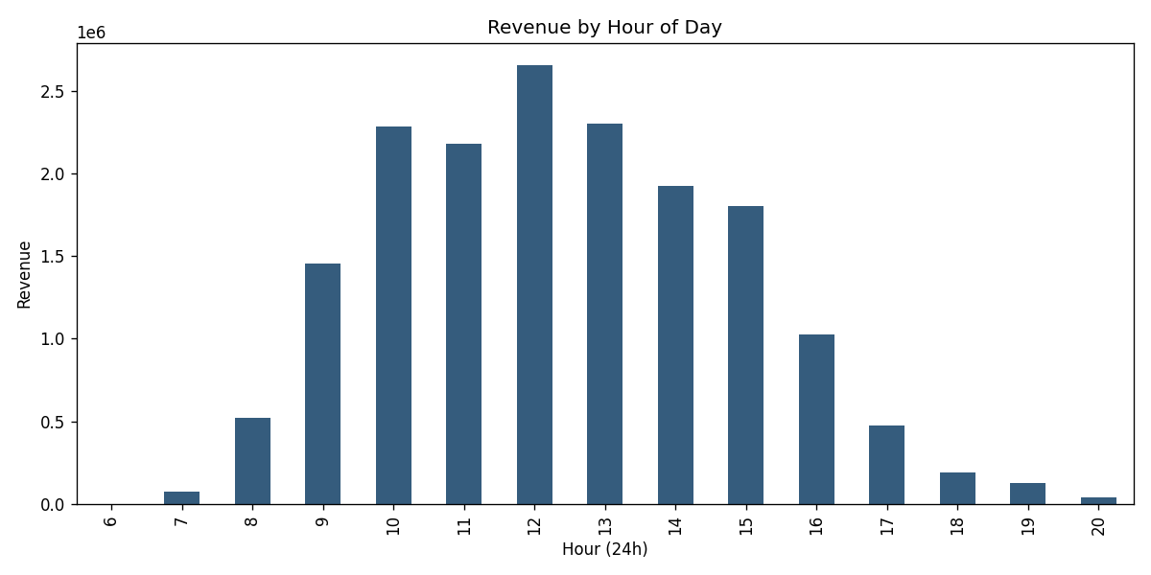
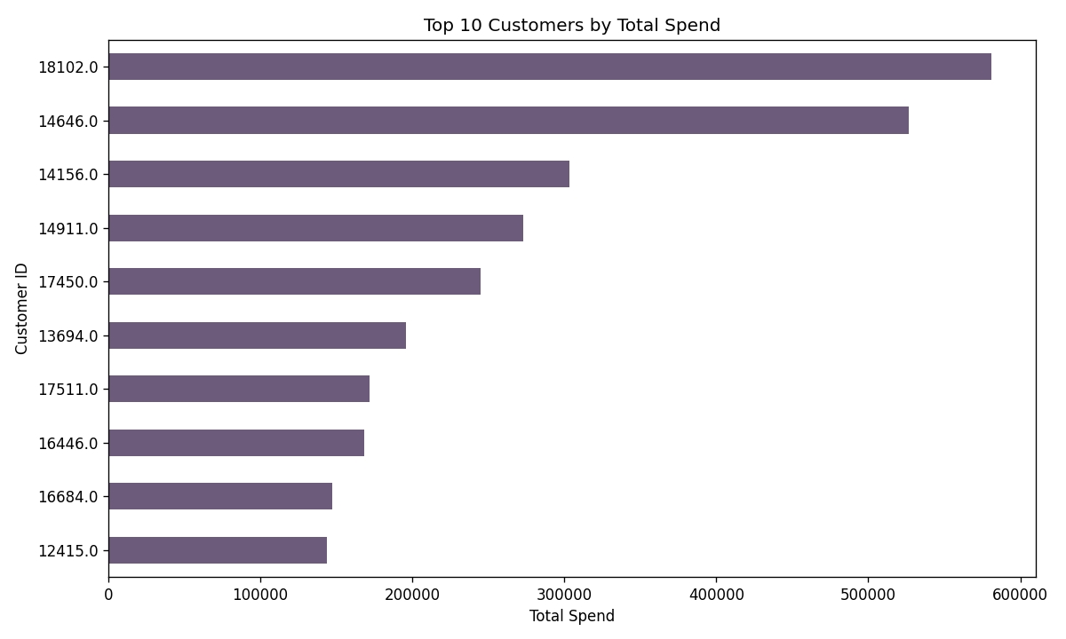
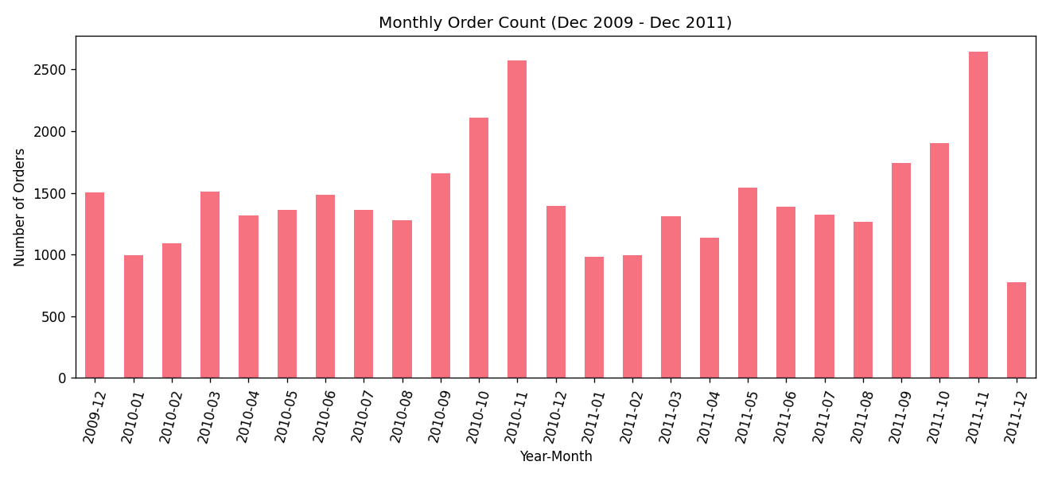
Matplotlib Visualizations
8
Top 10 products
Order value
Customer spend
Quantity per line
Revenue vs quantity
Monthly orders
Sales by weekday
Sales by hour
Top 10 customers
High-value share
Ten charts shown here, plus the revenue trend and country charts on slide 7. Every chart has a title, axis labels and an interpretation in Notebook 2.
Notes:
Do not read every chart. Pick two or three (order value is right-skewed, sales concentrate on weekdays and daytime hours, top customers contribute very large totals) and say the full-size versions with interpretations are in Notebook 2.

Slide 9
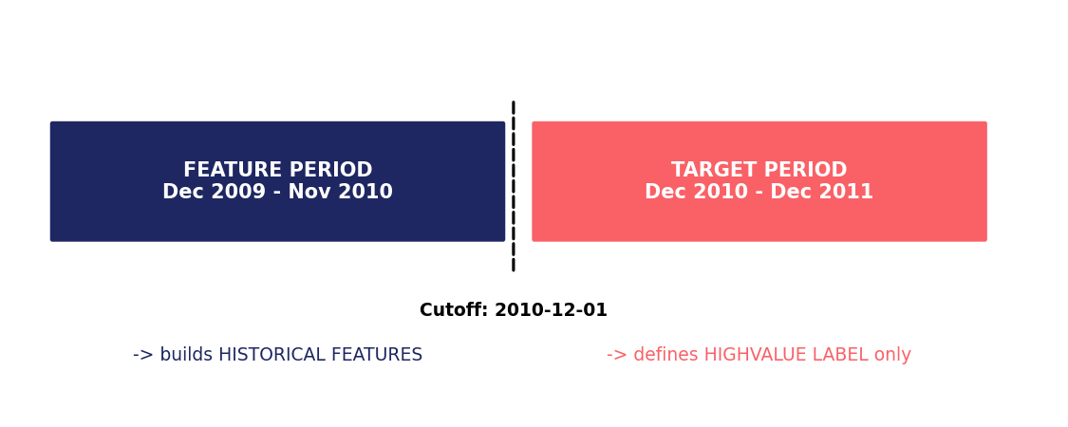
ML Target, Features & Methodology
9
9 historical features
HistTotalSpend
HistNumOrders
HistNumItems
HistNumUniqueProducts
HistAvgOrderValue
HistRecencyDays
HistLifespanDays
HistPurchaseFrequency
IsUK
Label HighValue = 1 if target-period spend >= 75th percentile (threshold 1,268.98)
4,249 customers from the feature period, classes split 75% / 25%
Stratified 75/25 train-test split, random_state = 42
All features come only from before 2010-12-01. The label uses only spending after it.
Notes:
This is the most important technical slide. Explain that features are built only from the earlier period and the label only from the later period, so the model never sees the future. Customers who did not return in the target period count as 0 spend.

Slide 10
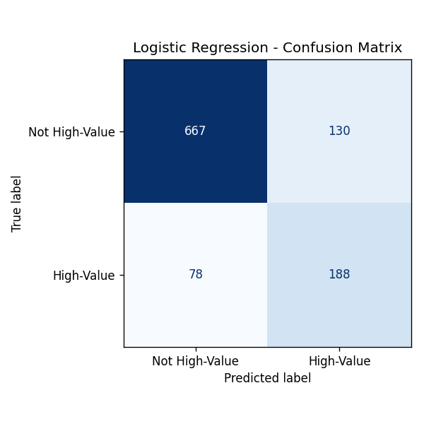
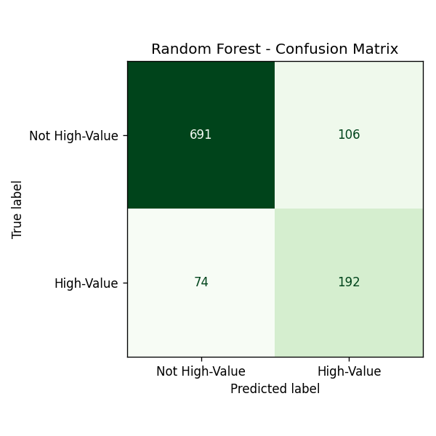
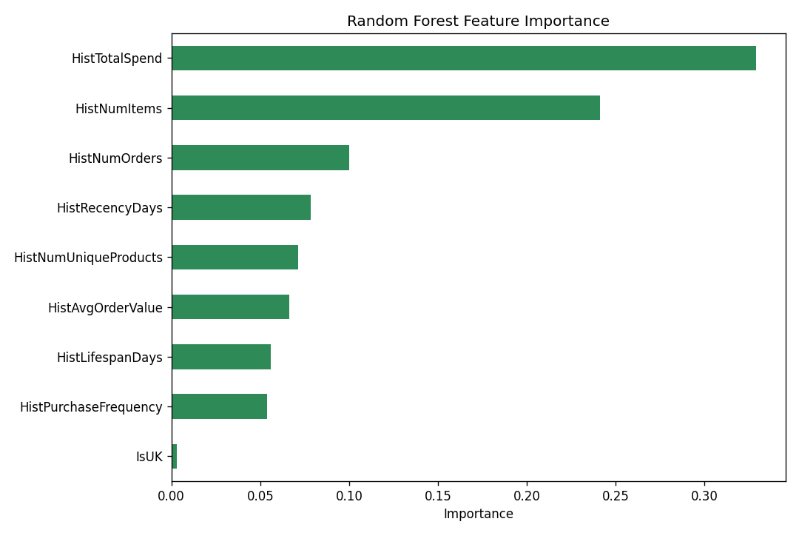
Model Comparison & Evaluation
10
Model | Accuracy | Precision | Recall | F1-Score
Baseline (always 'not high-value') | 0.750 | 0.000 | 0.000 | 0.000
Logistic Regression | 0.804 | 0.591 | 0.707 | 0.644
Random Forest | 0.831 | 0.644 | 0.722 | 0.681
Logistic Regression
Random Forest
Random Forest feature importance
The baseline never finds a high-value customer, so its 75% accuracy is misleading. Random Forest is best on all four metrics. Top predictors: HistTotalSpend, HistNumItems, HistNumOrders.
Notes:
Explain why baseline accuracy is misleading. For a retention program a false negative (missing a future high-value customer) is the costly error, so recall and F1 matter. Feature importance shows predictive usefulness, not cause and effect.

Slide 11
Business Recommendations
11
Finding
Recommendation
A small set of products drives much of the revenue
Keep top-revenue products well stocked and promoted
Revenue peaks around October and November
Plan seasonal marketing and inventory ahead of the peak
About 25% of customers become high-value
Use the model to flag likely high-value customers early for loyalty and retention
Past spend and items bought are the strongest predictors; country adds almost nothing
Target on buying behavior, not geography
Recommendations rest on association in past data; they are not proof of cause and effect.
Notes:
Use the Finding, Interpretation, Recommendation structure from the report. Each recommendation is tied to a number we computed.

Slide 12
Conclusion, Limitations & Live Demo
What we showed
Limitations
Full pipeline from raw data to recommendations
Leakage-safe time split for prediction
Random Forest best: F1 0.681, clearly above baseline
Historical data from 2009 to 2011
22.8% of rows had no Customer ID
No margin, demographic or satisfaction data
Prediction shows association, not causation
Live demo: open 03_machine_learning.ipynb and walk from the time split to the model comparison.
Notes:
Close with a short summary, be upfront about limitations, then switch to the live notebook demo. Every team member should be ready to answer questions about any stage of the pipeline.

