Slide 1
Iaac Setup with Terraform
An Iaac setup we learned in lesson 19-22 using Terraform.

Slide 2
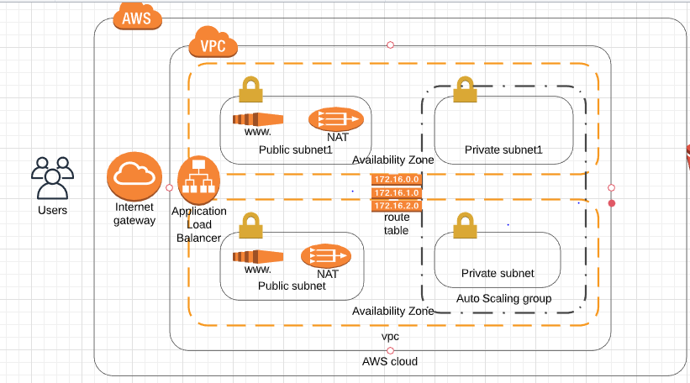
Infrastructure Diagram

Slide 3
Aws Concepts Covered
VPC
SUBNETS
GATEWAY
IPS
CIDR
ELB
AUTO SCALING

Slide 4
Future Improvements
To develop a code pipeline for automatic deployment of an application on the ec2 instance with all the dependency installed using scripts only.
To integrate my Chabot project written in Flask with this infrastructure.

