Slide 1
Loan Risk Analysis for Consumer Finance
Optimizing Loan Approval Decisions for Urban Customers
Balancing Business Growth and Risk Mitigation in Loan Approvals
Striking a Balance Between Business Growth and Loan Default Risks
Nisha Pathnia & Mahendra
Batch ML C69
Submitted By:
Submitted On: Nov, 20 2024

Slide 2

Problem Statement
Balancing Loan Approvals to Minimize Financial Risks and Maximize Business Growth
The consumer finance company faces a critical challenge in deciding loan approvals for urban customers. The decision-making process involves assessing the risk profile of applicants to ensure a balance between business growth and financial stability. Incorrect decisions can lead to two major risks:
Business Loss - Rejecting loans for customers who are likely to repay, resulting in missed revenue opportunities
Financial Loss - Approving loans for customers who are likely to default, leading to financial losses. Addressing these risks requires a data-driven approach to identify key factors contributing to loan defaults and optimize the decision-making process.

Slide 3
Business Objective
EDA to understand how consumer attributes and loan attributes influence the tendency of default
The company operates as the largest online loan marketplace, offering personal loans, business loans, and medical financing through a quick and efficient online platform. While it provides lower interest rates for borrowers, the company faces significant financial risks from "risky" applicants, who default on their loans and cause substantial credit losses.
The primary goal is to minimize such losses by identifying potential defaulters—those categorized as "charged-off." Using exploratory data analysis (EDA), the company aims to uncover the key factors influencing loan defaults. Understanding these factors will enable better risk assessment and portfolio management, ensuring smarter lending decisions and reduced credit losses.
In other words, the company wants to understand the driving factors (or driver variables) behind loan default, i.e. the variables which are strong indicators of default. The company can utilize this knowledge for its portfolio and risk assessment.

Slide 4
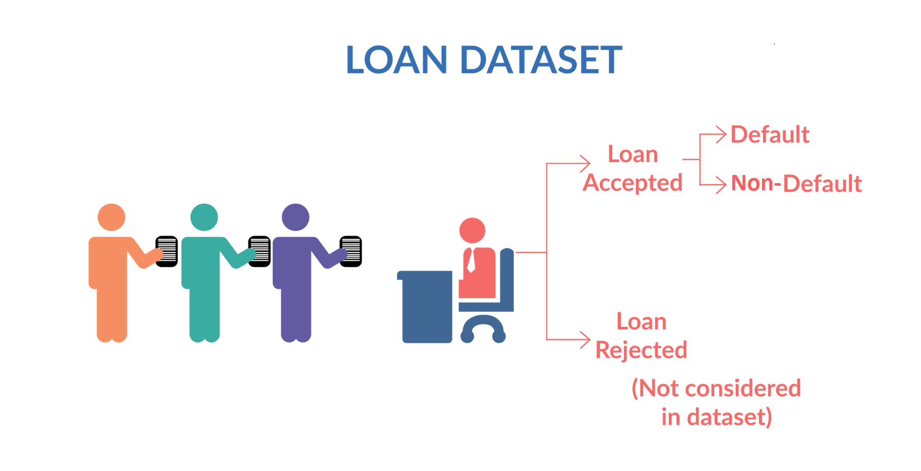
Goal
When a person applies for a loan, there are two types of decisions that could be taken by the company:
Loan accepted: If the company approves the loan, there are 3 possible scenarios described below:
Fully paid: Applicant has fully paid the loan (the principal and the interest rate)
Current: Applicant is in the process of paying the instalments, i.e. the tenure of the loan is not yet completed. These candidates are not labelled as 'defaulted'.
Charged-off: Applicant has not paid the instalments in due time for a long period of time, i.e. he/she has defaulted on the loan
Loan rejected: The company had rejected the loan (because the candidate does not meet their requirements etc.). Since the loan was rejected, there is no transactional history of those applicants with the company and so this data is not available with the company (and thus in this dataset

Slide 5
Approach
Understanding the Dataset:
Assess the structure, size, and features of the dataset.
Review column descriptions to understand the variables (e.g., loan_status, purpose, int_rate).
Univariate Analysis:
Analyze the distribution of individual variables like loan amount, interest rate, and annual income.
Identify trends and outliers in numerical and categorical variables.
Bivariate Analysis:
Explore relationships between key variables (e.g., loan_status and int_rate).
Use visualizations like box plots, scatter plots, and correlation matrices.

Slide 6
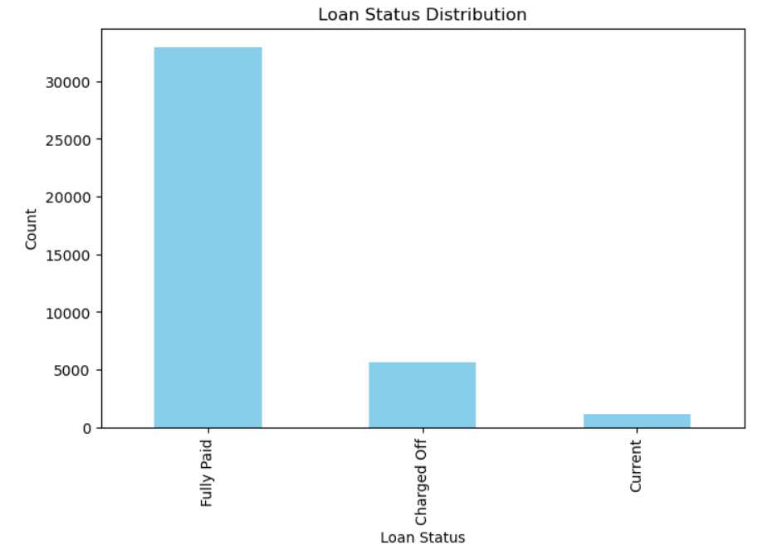
Insights from the Chart
Fully Paid Loans :
The majority of the loans fall under the "Fully Paid" category, indicating most borrowers successfully repay their loans.
Charged Off Loans:
A significant number of loans are "Charged Off," representing the defaulters who failed to repay the loan. This is the key area of financial risk for the company.
.
Current Loans:
A small portion of loans is still active and yet to be completed or repaid.

Slide 7
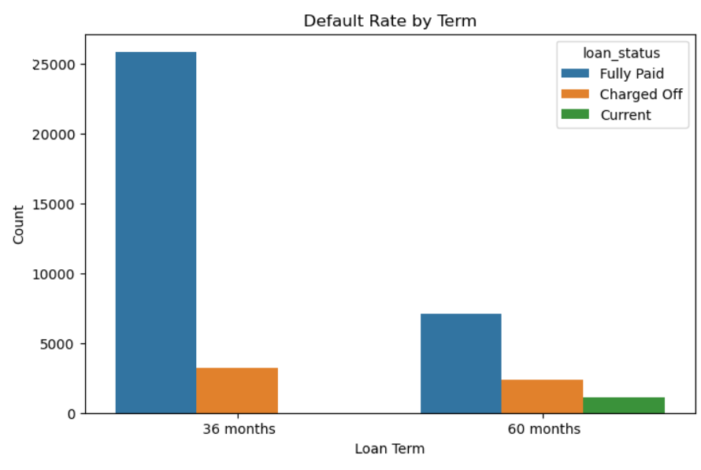
Insights from the Chart
36-Month Term:
Most loans with a 36-month term are "Fully Paid," indicating shorter-term loans are generally less risky.
A smaller but notable proportion of 36-month loans are "Charged Off," reflecting some defaults in this category.
60-Month Term:
Loans with a 60-month term show a higher proportion of "Charged Off" loans compared to 36-month loans, suggesting longer-term loans carry higher risk.
Current Loans:
Both 36-month and 60-month terms have a small number of "Current" loans, indicating ongoing repayments.

Slide 8
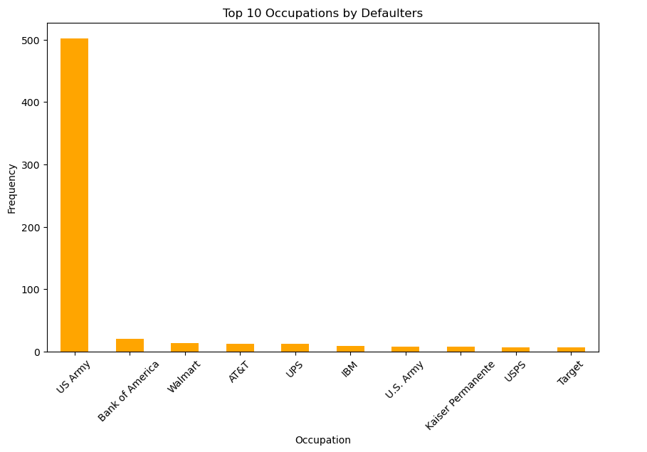
Insights from the Chart
The high number of defaulters in the US Army could
be due to various factors, such as lower income levels,
high debt burdens, or financial stress related to military service.
The lower number of defaulters in other occupations
might be due to higher income levels, better financial stability, or access to financial resources.

Slide 9
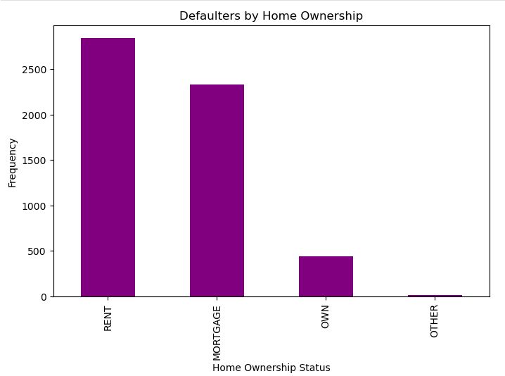
Insights from the Chart
Customer which is on rent are the higher chances of defaulter.
Customer which is on Mortgage are the high chances of defaulter.
Customer have their own house have less possibility to be of defaulter.

Slide 10
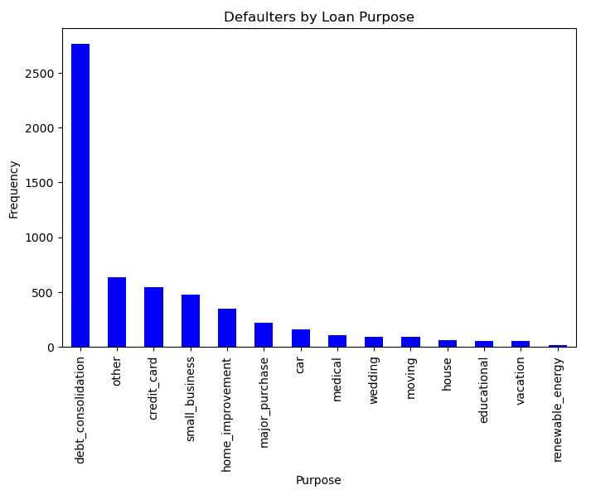
Insights from the Chart
Debt Consolidation is the Top Reason:
The highest number of defaulters took loans for debt consolidation, significantly outnumbering other purposes.
Other Significant Reasons:
Other common purposes for defaults include "other," credit card, small business, and home improvement loans.
Least Common Reasons:
Few defaulters took loans for purposes like renewable energy, vacation, educational, or house.

Slide 11
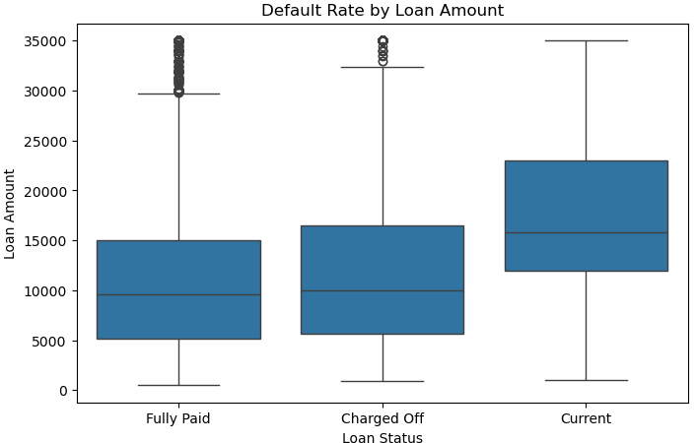
Insights from the Chart
Median Loan Amounts:
The median loan amount is slightly higher for Current loans compared to Fully Paid and Charged Off loans.Charged Off loans (defaulted loans) have a similar median loan amount as Fully Paid loans.
Spread of Loan Amounts:
Loan amounts for Current loans have the widest range, suggesting borrowers with ongoing loans tend to have more variation in the loan amounts.
Fully Paid and Charged Off loans have similar spreads but fewer extreme outliers.

Slide 12
Insights from the Chart
Outliers:
There are more high-value outliers in Fully Paid loans compared to Charged Off, indicating that some large loans were successfully repaid.
General Trend:
Loan amounts don’t differ drastically between Fully Paid and Charged Off, implying default risk may not strongly correlate with loan amount alone.

Slide 13
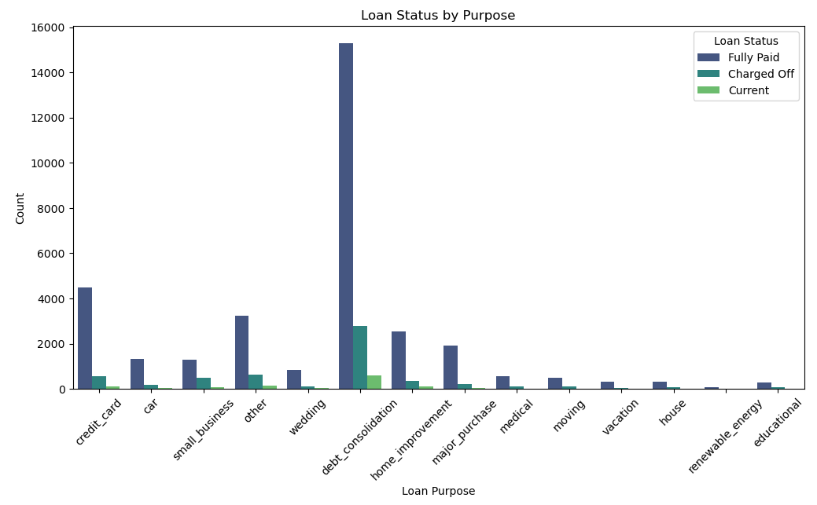
Insights from the Chart
Debt consolidation is the most common loan purpose.
Credit card and small business loans also have a significant number of cases.
Renewable energy and educational loans are the least common..

Slide 14
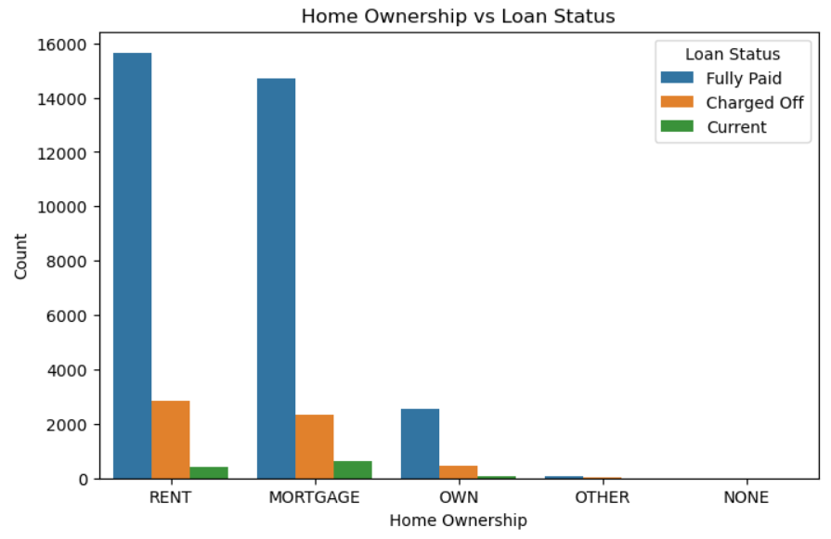
Insights from the Chart
Fully Paid is the most common status for most home ownership categories.
Charged Off is the second most common status, particularly for Rent and Mortgage
Possible Interpretations:
Renters might have a higher risk profile, leading to more charge-offs.
Homeowners might have better financial stability, leading to higher repayment rates.

Slide 15
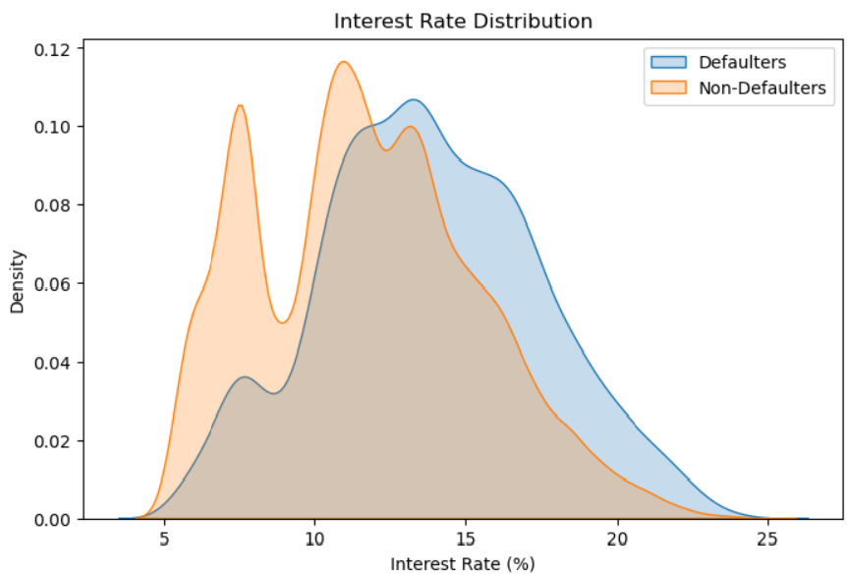
Insights from the Chart
Defaulters have a higher percentage of loans with interest rates between 10% and 15%.
Non-defaulters have a higher percentage of loans with interest rates below 10%.
Possible Interpretations:
Lenders might charge higher interest rates to borrowers they perceive as higher risk, which could lead to higher default rates.
Borrowers with lower interest rates might have better credit scores or financial stability, making them less likely to default.

Slide 16
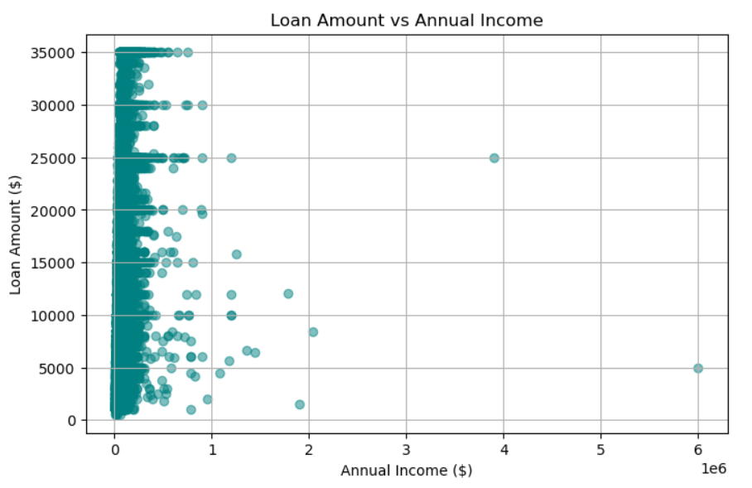
Insights from the Chart
As annual income increases, loan amounts tend to increase as well.
There are a few outliers with very high annual incomes and relatively low loan amounts.
Possible Interpretations:
Lenders might be more willing to give larger loans to borrowers with higher incomes.
Borrowers with higher incomes might be able to afford larger loans.
The outliers might represent unique situations, such as borrowers with low debt or high savings.

Slide 17
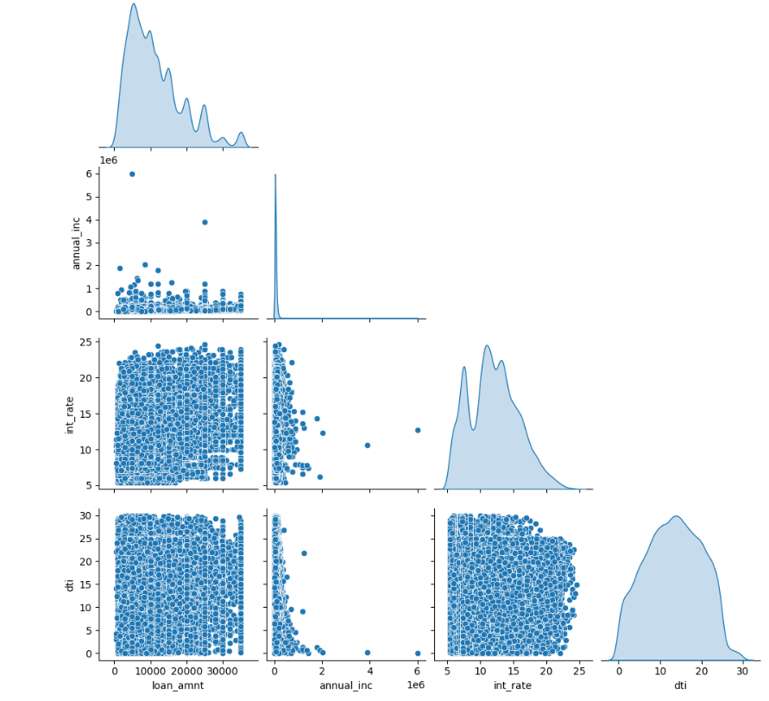
Insights from the Chart
Lenders might be more willing to give larger loans to borrowers with higher incomes.
Borrowers with higher debt-to-income ratios might be perceived as higher risk, leading to higher interest rates.
The right-skewed distribution of loan_amnt and annual_inc might be due to the fact that most borrowers are not high-income earners.

Slide 18

Conclusion
By leveraging these insights, the company can:
Build more accurate predictive models to identify risky applicants.
Implement targeted strategies for loan approval to minimize credit losses.
Create tailored lending policies based on loan terms, purposes, and interest rates.
This analysis emphasizes the importance of combining business knowledge with data exploration to enhance decision-making in loan lending processes.
Click here to visit Github link

