Slide 1
Digital Portfolio
STUDENT NAME: NISHAANTH VS
REGISTER NO AND NMID: 2428B0330 AND B53E3DD5B257218946B474692DA174DD
DEPARTMENT: BSc Computer Science With Data Analytics
COLLEGE: KPR College Arts Science And Research / Bharathiyar University

Slide 2
Empowering Peers:Achievements in Certifications

Slide 3


AGENDA
Problem Statement
Project Overview
End Users
Tools and Technologies
Portfolio design and Layout
Features and Functionality
Results and Screenshots
Conclusion
Github Link
3/21/2024 Annual Review

Slide 4

PROBLEM STATEMENT
In today’s competitive professional environment, showcasing verified certifications is crucial for standing out in job applications, freelance portfolios, and academic submissions. While platforms like LinkedIn allow listing certifications, they often lack customization, interactivity, and personal branding.

Slide 5

PROJECT OVERVIEW
The "Achievements in Certifications" project is a web-based portfolio designed to showcase a user’s professional and academic certifications in a visually appealing and organized format. Built using only HTML, CSS, and JavaScript within a single HTML file, this project highlights frontend development skills while presenting real-world accomplishments.
The portfolio features a responsive layout with card-based sections for each certification, displaying the title, issuer, and date of issuance. JavaScript is used to dynamically render certifications from a structured data array, allowing easy customization and scalability. The project emphasizes clean design, interactivity, and accessibility without relying on any external libraries or backend services.

Slide 6

END USERS 1.Job Seekers & Professionals Individuals who want to showcase their certifications (e.g., from Oracle, AWS, Coursera) in a clean, professional online format for resumes, interviews, or personal branding. 2. Students & Graduates Students looking to present their completed academic or online course certifications for internship or scholarship applications. 3. Educators & Trainers Instructors who want to demonstrate their certified qualifications on personal or institutional websites.

Slide 7

TOOLS AND TECHNIQUES
CSS (Cascading Style Sheets) Applied for styling the layout, creating responsive designs, card effects, and hover animations to enhance visual appeal.
DOM Manipulation JavaScript techniques used to create and insert HTML elements dynamically based on certification data.
HTML (HyperText Markup Language) Used to structure the content and elements of the certification portfolio, such as headers, cards, and footers.
Responsive Web Design CSS techniques (media queries, flexbox) ensure the portfolio works well on mobile, tablet, and desktop devices.

Slide 8
POTFOLIO DESIGN AND LAYOUT
Header Section
Positioned at the top of the page.
Includes the portfolio title (e.g., "Achievements in Certifications") and a short introductory tagline.
Uses a bold background color (e.g., navy or dark blue) with white text for emphasis.
Main Content Area (Certifications Section)
Contains individual certification cards.
Each card includes:
Certification Title (bold and prominent)
Issuing Organization
Date of Issuance
Cards are styled with shadows, padding, and hover effects to improve readability and engagement.
Dynamic Rendering
Certifications are displayed using JavaScript, which dynamically loops through a data array to create and append cards.
8

Slide 9
FEATURES AND FUNCTIONALITY *.Single-Page Design All content (HTML, CSS, JavaScript) is contained in one HTML file for simplicity and portability. *.Dynamic Certification Display Certifications are stored in a JavaScript array and rendered dynamically using DOM manipulation. *.Responsive Layout The portfolio adapts to different screen sizes (mobile, tablet, desktop) using responsive CSS. *.Interactive Certification Cards Hover effects and animations enhance user interaction and make the interface more engaging.

Slide 10
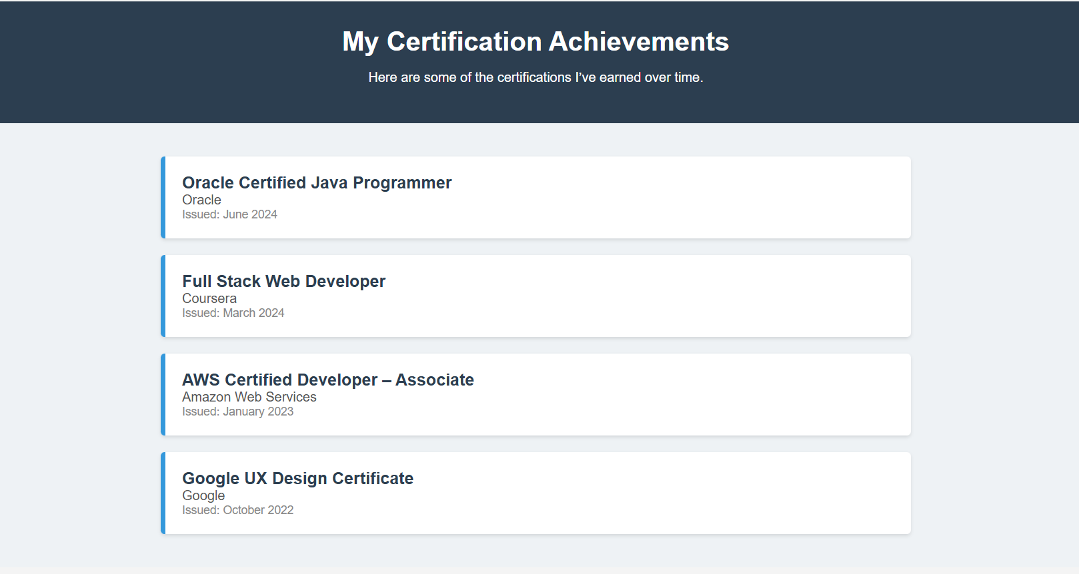

RESULTS AND SCREENSHOTS The "Achievements in Certifications" portfolio successfully demonstrates a clean, responsive, and interactive interface for showcasing professional certifications.
3/21/2024 Annual Review
10

Slide 11
CONCLUSION
The "Achievements in Certifications" portfolio project successfully demonstrates the ability to design and develop a responsive, interactive, and professional web page using only HTML, CSS, and JavaScript. By dynamically displaying certification data through clean, card-based layouts, the project provides an effective platform for users to showcase their verified skills and accomplishments.
11

Slide 12
Github Link
https://nishaanthvs65-source.github.io/nishaanth-/

