Slide 1

Online Auction Fraud Detection
Shaik Abdul Sahil Majeed (15RA1A0531)
Nisha Kumari Bidla (15RA1A0522)
S. Sai Shravya ( 15RA1A0528)

Slide 2
Online Auction
An online auction is a service in which auction users or participants sell or bid for products or services via the Internet.
An online auction is also known as a virtual auction.
Virtual auctions facilitates activities between buyers and sellers in different locations. Various auction sites provide users with platforms powered by different types of auction software.

Slide 3
Online auctions are a widely accepted business model for the following reasons:
Flexible time limits
No geographical limitations
Offers highly intensive social interactions
Includes a large numbers of sellers and bidders, which encourages a high-volume online business

Slide 4
Abstract
Online auction fraud has been one of the top 10 internet crime complaints for years. To protect legitimate traders from becoming victims of internet fraud, it is important to identify camouflaged fraudsters as early as possible. Users need an effective but efficient early fraud detection system to assist in making final trading decisions. To end this, a series of cost-effective measures are developed in this study.

Slide 5
Existing System
The traditional online shopping business model allows sellers to sell a product or service at a preset price, where buyers can choose to purchase if they find it to be a good deal. Online auction however is a different business model by which items are sold through price bidding.
There is often a starting price and expiration time specified by the sellers. Once the auction starts, potential buyers bid against each other, and the winner gets the item with their highest winning bid.

Slide 6
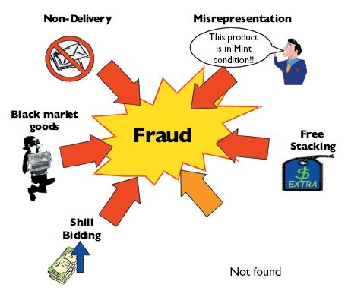

Slide 7
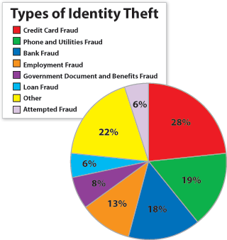
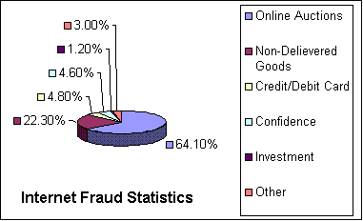

Slide 8
Proposed System
We propose an online probit model framework which takes online feature selection, co-efficient bounds from human knowledge and multiple instance learning into account simultaneously.
By empirical experiments on a real-world online auction fraud detection data, we show that this model can potentially detect more frauds and significantly reduce customer complaints compared to several baseline models and the human-tuned rule-based system.
Continue….

Slide 9
Human experts with years of experience created many rules to detect whether a user is fraud or not.
If the fraud score is above a certain threshold, the case will enter a queue for further investigation by human experts. Once it is reviewed, the final result will be labeled as Boolean, i.e. fraud or clean.
Cases with higher scores have higher priorities in the queue to be reviewed. The cases whose fraud score are below the threshold are determined as clean by the system without any human judgment.

Slide 10
Hardware system configuration
Processor - Intel ®core
Speed - 1.1 GHz
RAM - 256 MB(min)
Hard Disk - 20 GB
Floppy Drive - 1.44 MB
Key Board - Standard Windows Keyboard
Mouse - Two or Three Button Mouse
Monitor - SVGA (Super Video Graphics Array)

Slide 11
Software System Configuration
Operating System : Windows 10
Application Server : Tomcat 5.0/6.X/7.0
Front End : HTML, Java, JSP
Scripts : JavaScript
Server side Script : Java Server Pages
Database : MySQL
Database Connectivity : JDBC.

Slide 12

About System
There are 3 actors in our system.
Admin
Seller
User

Slide 13
Admin
Have ability to add new categories in system.
Manage submitted items (accept or reject).
Manage system users (can add or remove them).
Can see “Active Events” such as seller requests.
Can see number of statics such as number of users, requests and daily sales.
Cannot use registration form to create an account.

Slide 14
Seller
Seller must have to register and login.
Seller can submit new products in a system and admin have the ability to accept or reject them.
Seller cannot edit information of his product.
Seller can add offers to his product.

Slide 15
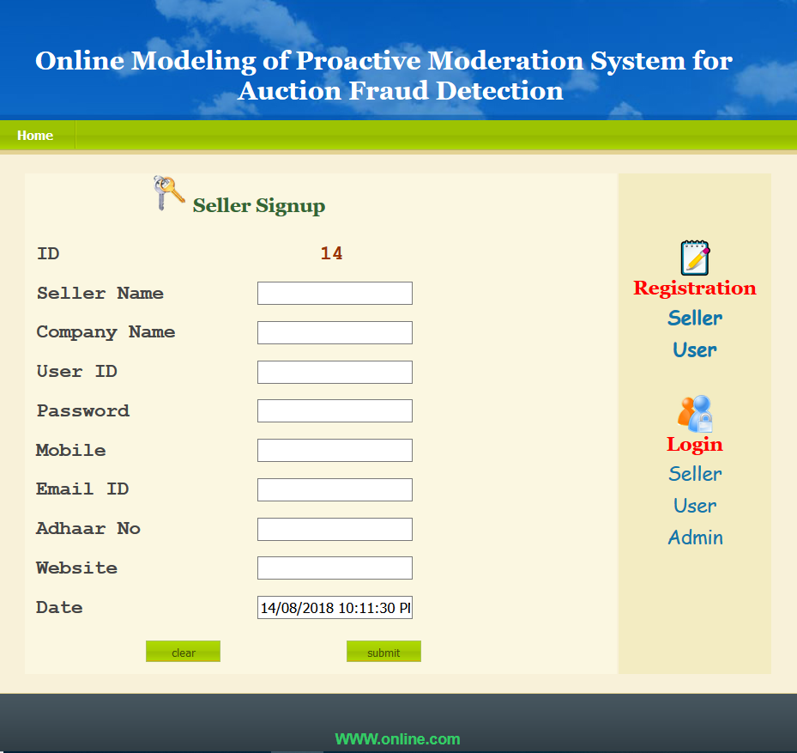
Seller registration
Enter the details of seller.

Slide 16
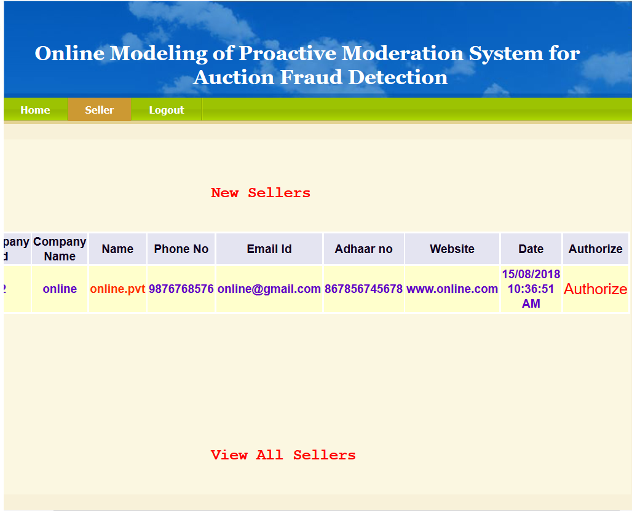
Seller Authorization
Once the seller signup’s the Admin authorizes the seller.

Slide 17
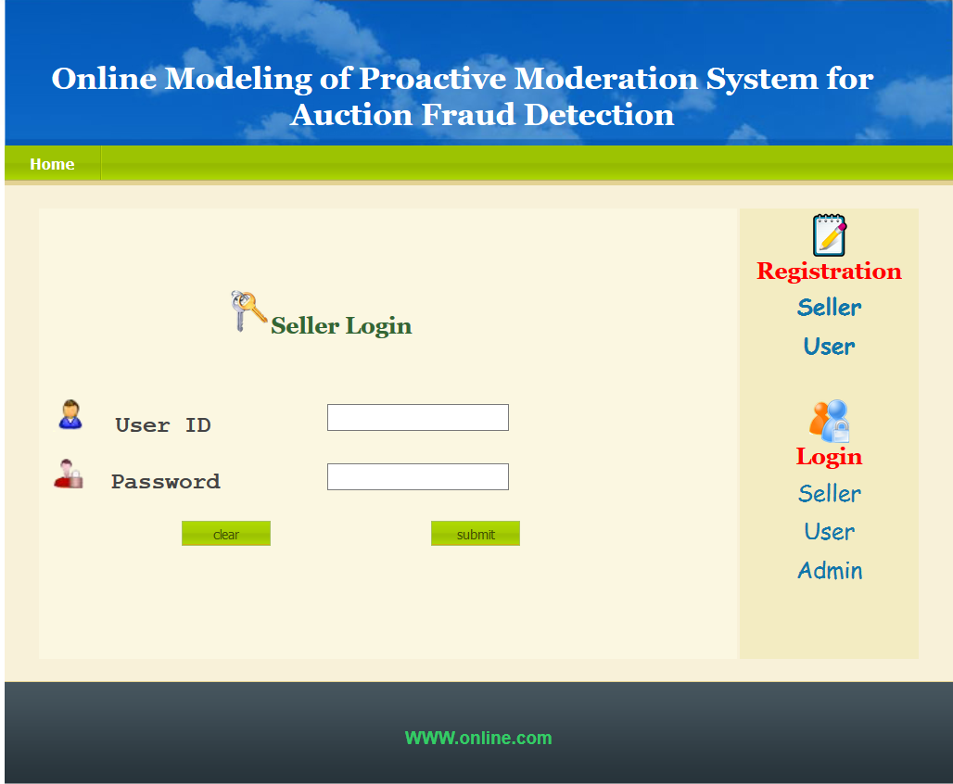
Seller login
After authorization, the seller can login.

Slide 18
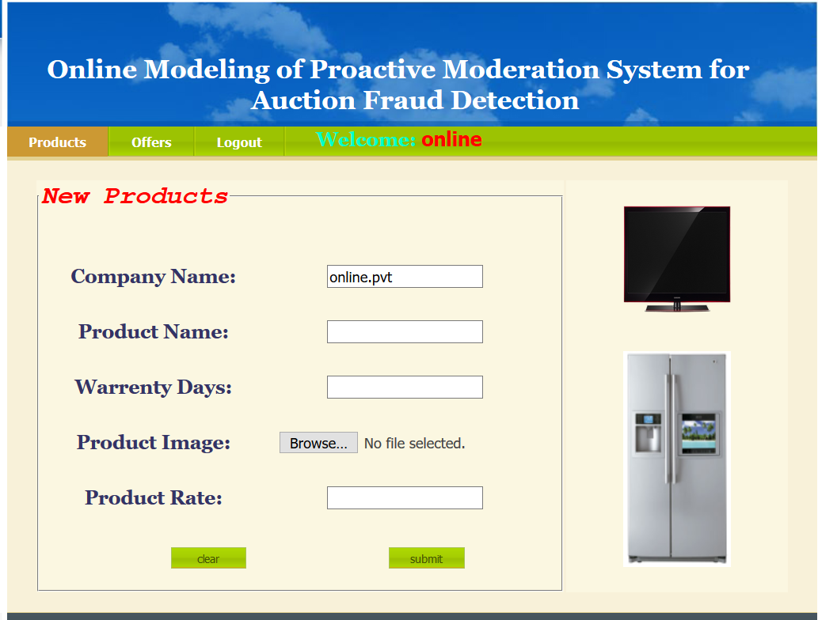
Add product and offers
The seller can add products and price accordingly.

Slide 19
User
Can view details of any product.
Has to register and login to search products.
Can search for any product by category.

Slide 20
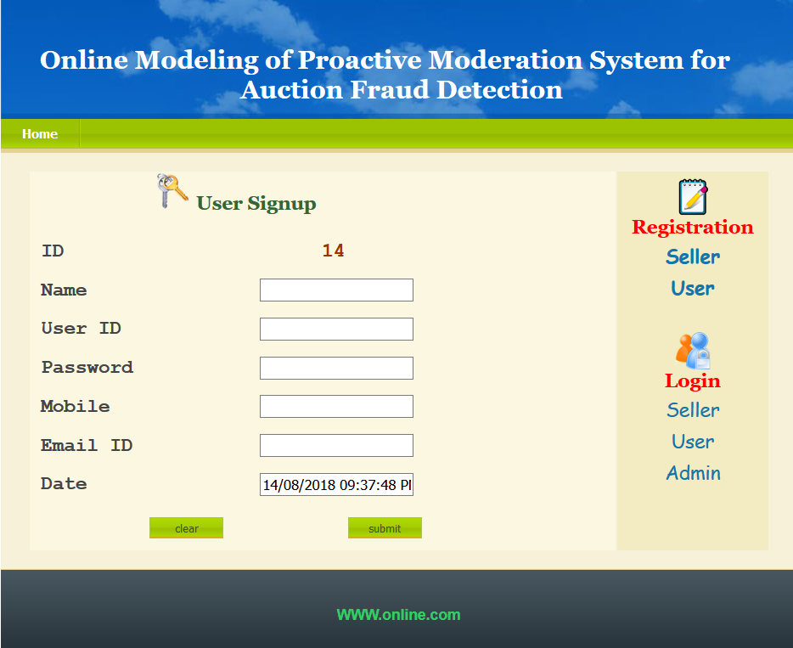
User registration
Enter the details of user.

Slide 21
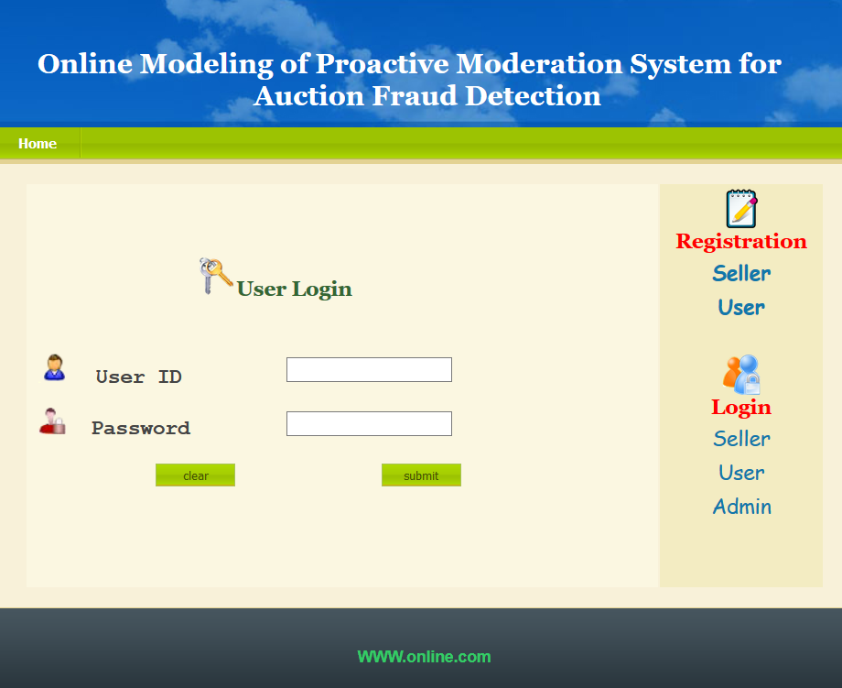
User login
Once the user sign up then he/she can login from user login page.
Enter the user id and password and submit.

Slide 22
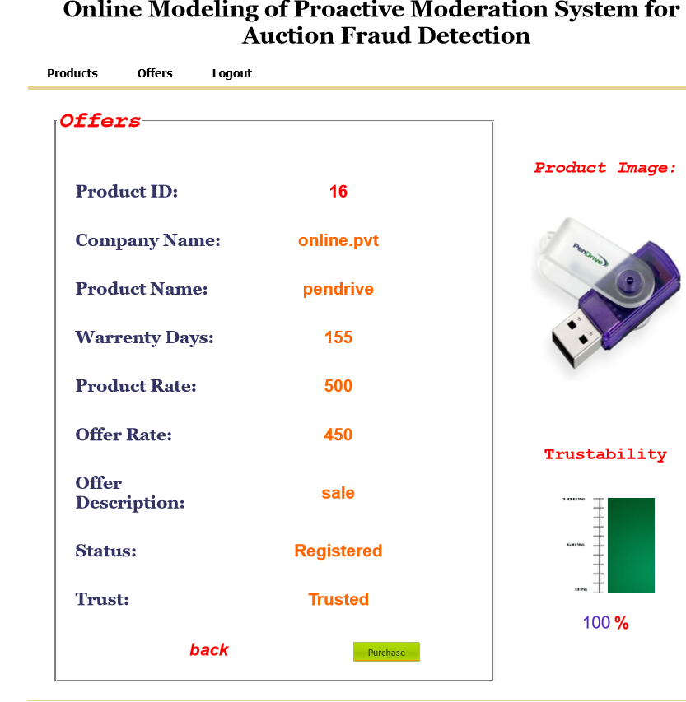
Purchasing product
After login the user can view products with offers to buy any product of his choice.

Slide 23
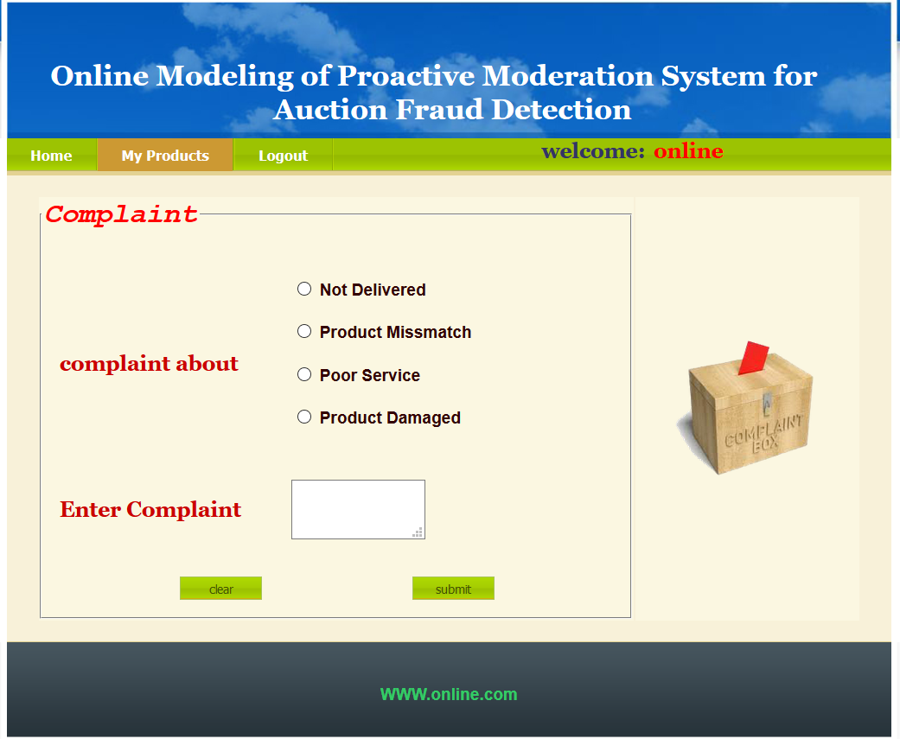
Complaint
User is allowed to place a complaint if he/she is not satisfied with the product.

Slide 24
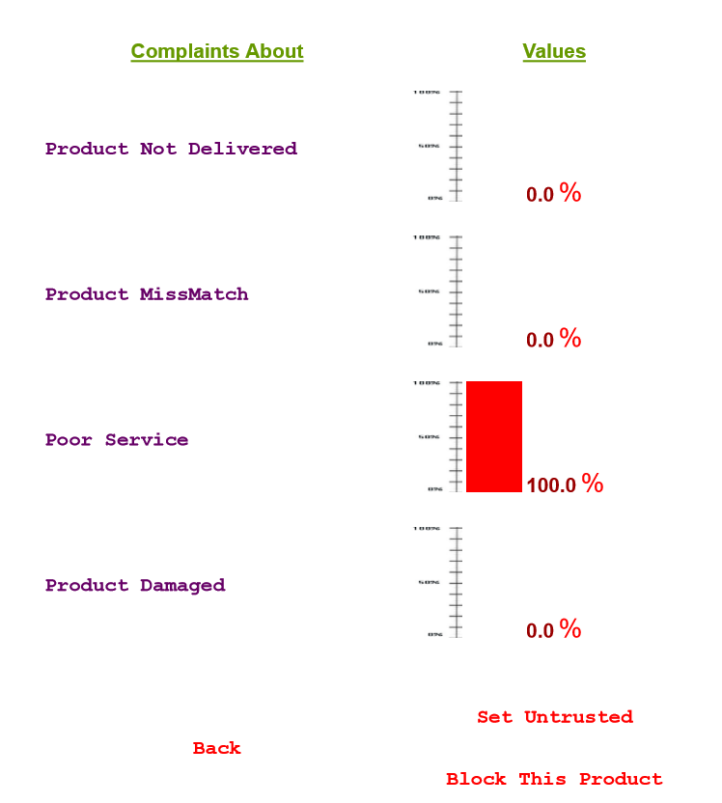
Blocking product
Based on the user complaints the admin can set a particular product under blocked or untrusted categories.

Slide 25
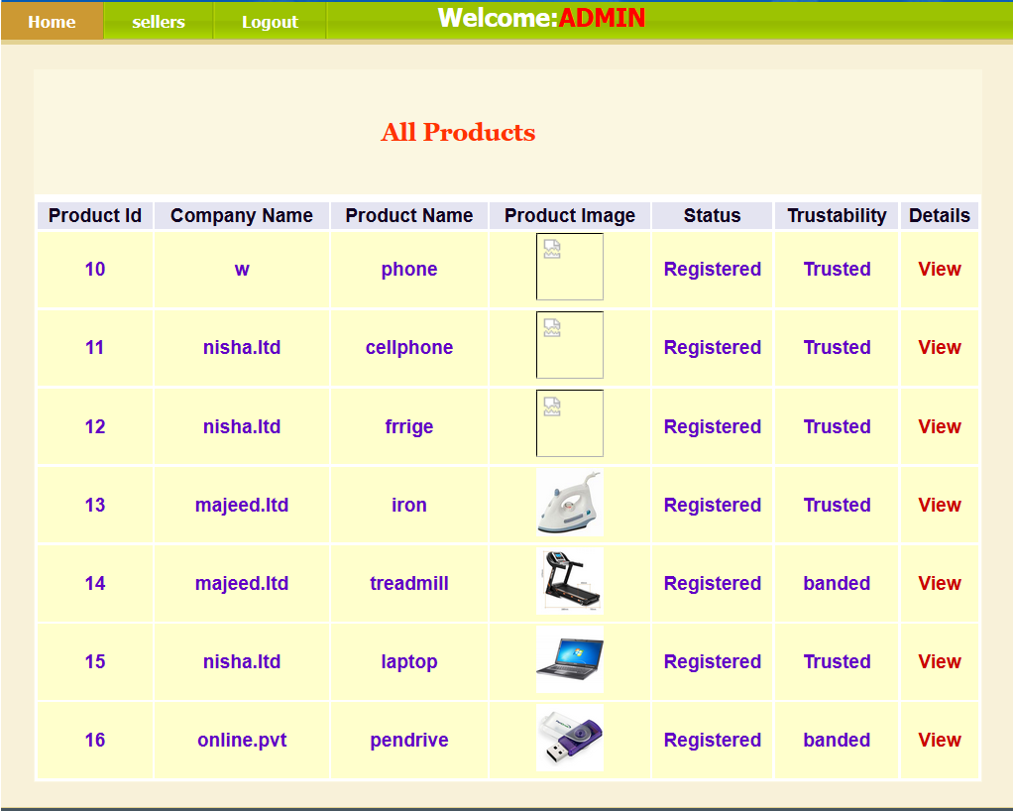
After blocking product
Here, the status of blocked products can be seen.

Slide 26
FLOW CHART FOR ADMIN AUTHORIZE SELLERS
Admin
Yes
Check
No
View new sellers
Unauthorized user
Allow new sellers
View products
View complaints
Set untrusted
End process

Slide 27
FLOW CHART FOR HOW SELLER LAUNCHES PRODUCTS
Seller
Yes
check
No
Launch products
Unauthorized user
View products
Offers for products
End process

Slide 28
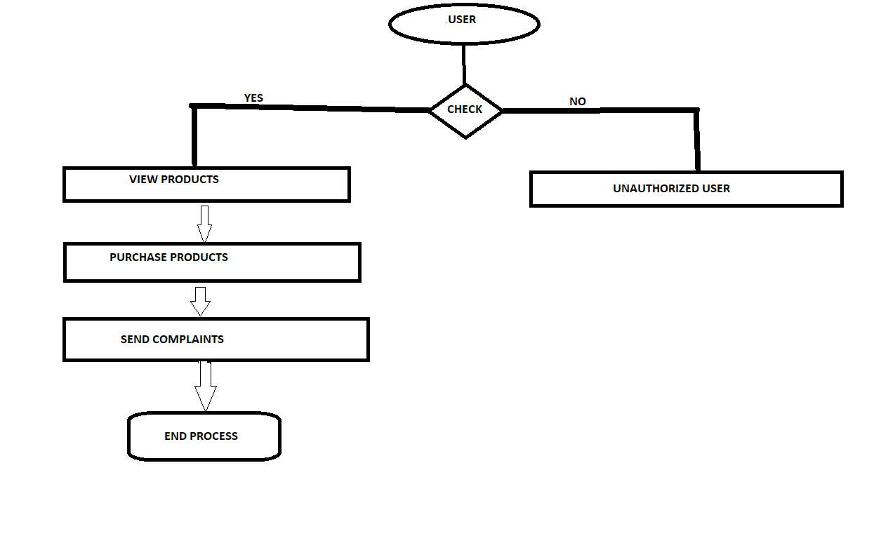
FLOW CHART FOR HOW USER PURCHASE PRODUCTS

Slide 30
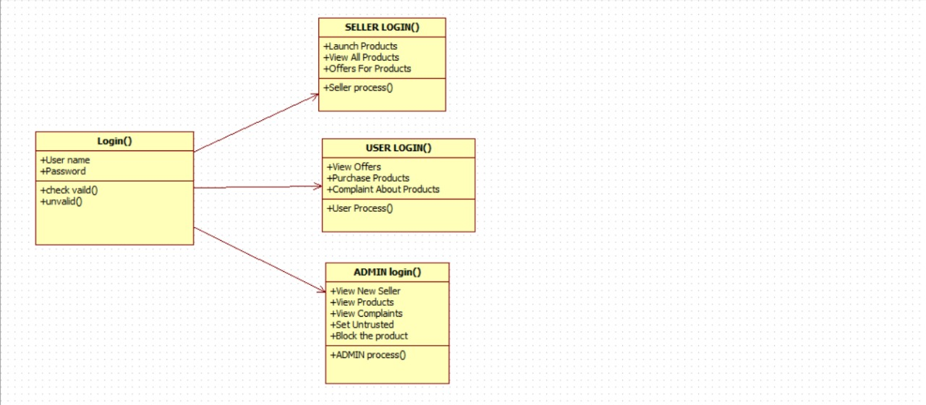
CLASS DIAGRAM

Slide 31
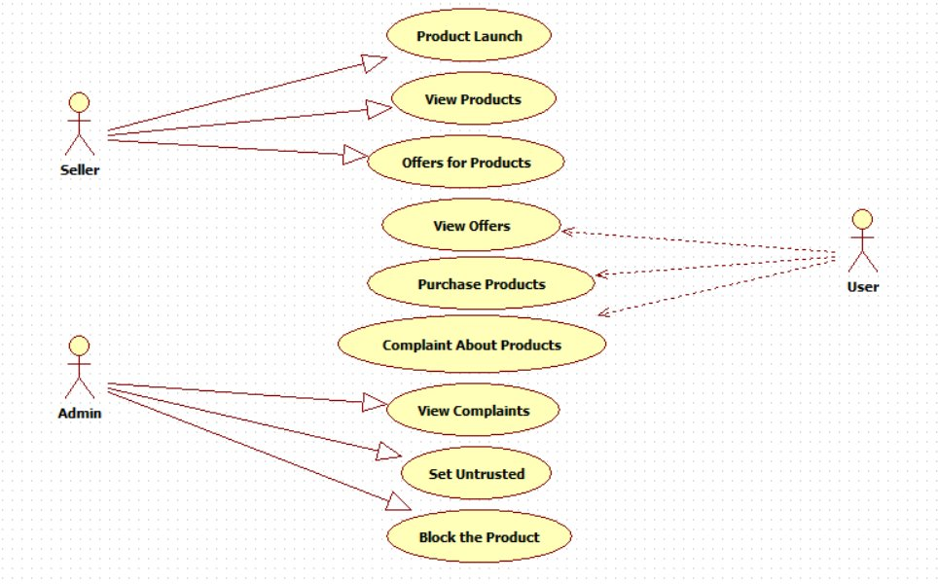
USECASE DIAGRAM

Slide 32
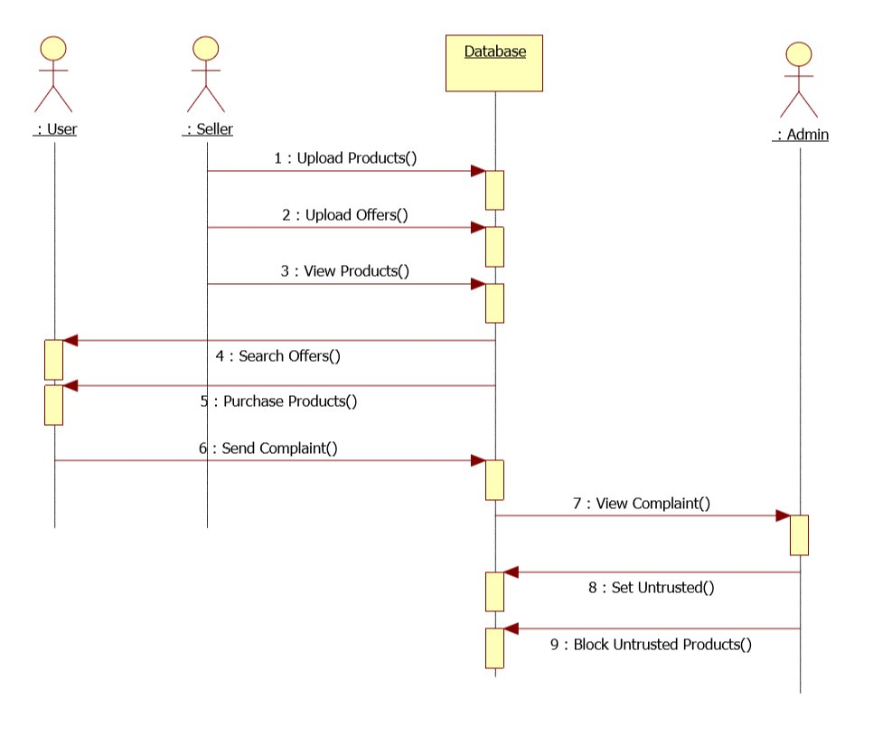
SEQUENCE DIAGRAM

Slide 33
Conclusion
We build online models for the auction fraud moderation and etection system designed for a major Asian online auction website. By empirical experiments on a real-world online auction fraud detection data, we show that our proposed online probit model framework, which combines online feature selection, bounding coefficients from expert knowledge and multiple instance learning, can significantly improve over baselines and the human-tuned model. Note that this online modeling framework can be easily extended to many other applications, such as web spam detection, content optimization and so forth. Regarding to future work, one direction is to include the adjustment of the selection bias in the online model training process.

Slide 34
Contd…
It has been proven to be very effective for offline models . The main idea there is to assume all the unlabeled samples have response equal to 0 with a very small weight. Since the unlabeled samples are obtained from an effective moderation system, it is reasonable to assume that with high probabilities they are non-fraud. Another future work is to deploy the online models to the real production system and also other applications.

Slide 35
THANK YOU ANY QUERIES…?

