Slide 1
COL724 / COL7524: ADVANCED COMPUTER NETWORKS — PROGRESS PRESENTATION
Load-Aware QUIC Instant ACK
Balancing Handshake Latency and Server Contention in Modern Edge CDNs
Presented by:
Muhammed Nishad (2026MCS2799) & Ayush Arya (2026MCS2802)
Department of Computer Science & Engineering
Indian Institute of Technology Delhi (IIT Delhi) — Semester 1, 2026–27
Base Paper: ReACKed QUICer (ACM IMC 2024)
Notes:
Verbal Script (Muhammed Nishad):
'Good morning professors and peers. Today Ayush and I are presenting our Advanced Computer Networks project: Load-Aware QUIC Instant ACK. Our project explores connection setup performance in QUIC, building directly upon the ACM IMC 2024 paper ReACKed QUICer. We examine the fundamental tension between low-latency client handshakes and edge server processing contention, and propose an autonomous closed-loop solution.'

Slide 2
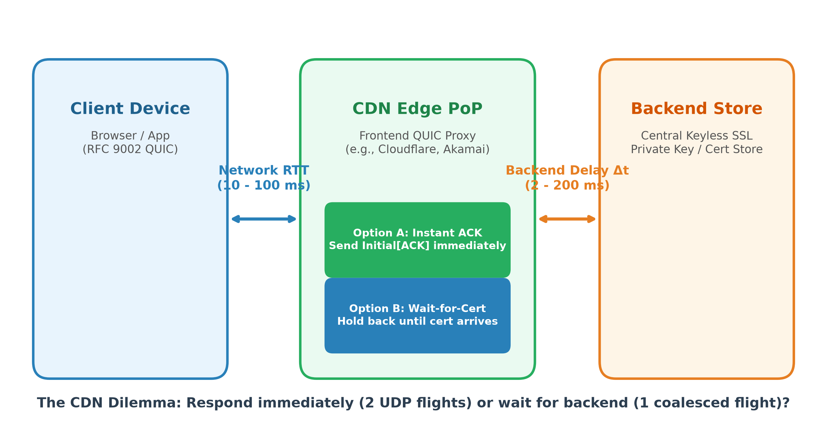
CONTEXT & MOTIVATION
Modern Edge CDNs & The Certificate Delay Gap (Δt)
Edge proxies terminate QUIC handshakes, but TLS certificate signing introduces internal delay.
Key Architectural Drivers
• The Edge/Backend Split: Modern CDNs (Cloudflare, Akamai) terminate QUIC at distributed edge PoPs, while certificates and private keys remain in centralized backend stores (Keyless SSL).
• Backend Crypto Delay (Δt): Fetching certificates, computing RSA/ECDSA cryptographic signatures, or worker queueing introduces an unavoidable delay Δt (typically 2 ms to 200 ms).
• The Protocol Dilemma: While waiting for the certificate, the edge server must choose: hold back until cert is ready, or immediately send an acknowledgment?
• Impact on Handshake: This choice dictates client RTT estimation, initial loss recovery timers, and server socket queue depth under load.
Figure: Client-to-Edge network path vs. Edge-to-Backend crypto delay Δt
COL724 / COL7524: Advanced Computer Networks (IIT Delhi) | Muhammed Nishad | Slide 2 of 21
Notes:
Verbal Script (Muhammed Nishad):
'To understand the problem, let's examine modern Internet architecture. When you connect to Cloudflare or Akamai, your QUIC handshake terminates at an edge point-of-presence close to you. However, due to security regulations and centralized key management (Keyless SSL), private keys and TLS certificates are fetched from a central backend. This introduces an internal latency delta-t, typically between 2 to 200 ms. The edge server faces a fundamental question: does it wait for the certificate before replying, or does it send an immediate acknowledgment back to the client?'

Slide 3
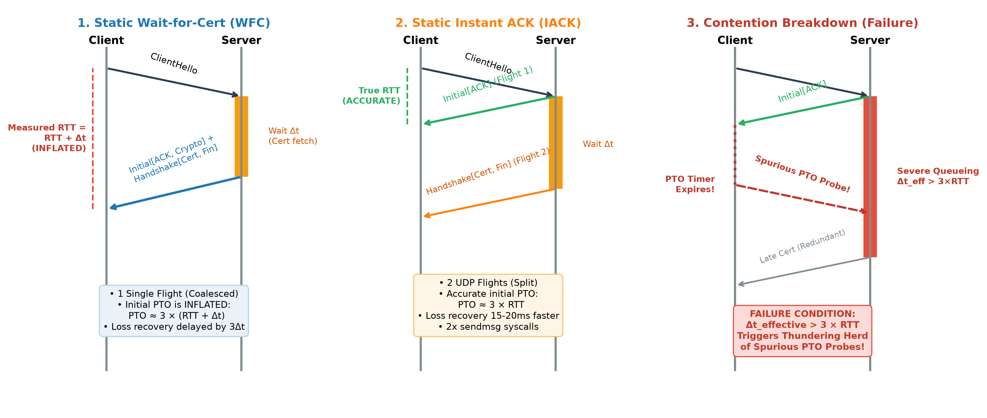
BASE RESEARCH PAPER
ReACKed QUICer: Measuring Instant ACKs (ACM IMC 2024)
Jonas Mücke, Marcin Nawrocki, Raphael Hiesgen, Thomas C. Schmidt, Matthias Wählisch
The Paper's Proposal
• Status Quo (WFC): Wait-for-Certificate: Server waits for Δt, then coalesces Initial[ACK, CRYPTO] + Handshake[CRYPTO] into 1 UDP packet flight.
• The Paper's Innovation (IACK): Instant ACK: Server immediately transmits an uncoalesced Initial[ACK] upon ClientHello reception, sending the certificate flight later.
• Reported Advantage: Cuts initial handshake duration by 15–20 ms across realistic network paths by decoupling packet acknowledgment from crypto delay.
• Paper's Scope: The authors evaluated IACK exclusively under static network settings (fixed RTTs and packet loss rates) on idle servers.
Figure: Handshake packet flight sequences across WFC, IACK, and Contention Failure
COL724 / COL7524: Advanced Computer Networks (IIT Delhi) | Muhammed Nishad | Slide 3 of 21
Notes:
Verbal Script (Muhammed Nishad):
'The base paper we selected is ReACKed QUICer, published at ACM IMC 2024. In standard QUIC, servers use Wait-for-Certificate (WFC): they hold back until the certificate is ready and send everything in one coalesced UDP datagram. The authors proposed Instant ACK (IACK): the server splits the response into two flights. It immediately replies with an Initial ACK datagram, and sends the certificate later. They demonstrated that this yields a 15 to 20 millisecond latency improvement across typical Internet RTTs. However, their evaluation had a crucial limitation: it was conducted entirely under static network conditions on idle servers.'

Slide 4
THEORETICAL MECHANICS
RFC 9002 Timer Math: Probe Timeout (PTO) Inflation
Under Wait-for-Certificate, internal server delay artificially inflates the client's loss recovery timer.
RFC 9002 Loss Detection Formula
• Initial PTO Equation: Under RFC 9002, initial Probe Timeout is computed from the first packet sample:
PTO_initial ≈ smoothed_rtt + 4 × rttvar ≈ 3 × RTT_measured
• WFC Timer Inflation: In WFC, client clock measures network RTT plus backend delay Δt:
RTT_measured = RTT_net + Δt
PTO_WFC = 3 × (RTT_net + Δt)
• Instant ACK Calibration: In IACK, client measures true network flight time:
RTT_measured = RTT_net
PTO_IACK = 3 × RTT_net
• The 3×Δt Loss Penalty: If packet loss occurs during handshake, WFC delays loss recovery probes by up to 3×Δt (e.g., +150ms for a 50ms cert delay).
Numerical Walkthrough (RTT=20ms, Δt=50ms)
• True Network RTT: 20 ms bidirectional path latency.
• WFC Client Perception: Client receives first packet at 20 + 50 = 70 ms.
Initial PTO is set to: 3 × 70 ms = 210 ms!
• IACK Client Perception: Client receives Instant ACK at exactly 20 ms.
Initial PTO is calibrated to: 3 × 20 ms = 60 ms!
• Handshake Recovery Speed: If a handshake packet drops in transit, IACK fires loss recovery in 60 ms. WFC stalls for 210 ms—a massive 150 ms stall!
• Takeaway: This explains why Instant ACK is so compelling in lossy mobile and wireless networks.
COL724 / COL7524: Advanced Computer Networks (IIT Delhi) | Muhammed Nishad | Slide 4 of 21
Notes:
Verbal Script (Muhammed Nishad):
'Let's look at the underlying protocol mathematics defined in RFC 9002. QUIC calculates the initial Probe Timeout as smoothed RTT plus 4 times RTTVAR, which mathematically reduces to roughly 3 times the measured initial RTT. In Wait-for-Certificate, the client's measured RTT accidentally includes the backend certificate delay delta-t. So PTO becomes 3 times (RTT + delta-t). If RTT is 20ms and cert delay is 50ms, the client thinks RTT is 70ms, setting its initial timer to 210ms! With Instant ACK, the client gets an immediate ACK after 20ms, locking in a true 60ms PTO. If packet loss occurs, Instant ACK recovers 150 milliseconds faster. This is the theoretical core of the IMC '24 paper.'

Slide 5
PROBLEM STATEMENT & BLIND SPOT
The Vulnerability of Static IACK: Probe Storms Under Load
When server contention delays certificates beyond the tight PTO, clients trigger spurious probe storms.
Static IACK Contention Bottlenecks
• Syscall & Buffer Pressure: Static IACK emits 2 separate UDP datagrams per connection instead of 1. Under surges, this doubles sendmsg syscalls and socket buffer consumption.
• The Crossover Failure Condition: If server CPU starvation or crypto worker queues delay the certificate flight such that:
Δt_effective > PTO_IACK = 3 × RTT_net
• Premature Timer Expiration: The client's tight PTO timer expires before the certificate packet arrives! The client falsely concludes the flight was lost.
• Spurious PTO Probe Storms: Clients flood the server with PTO probe packets right when the server is already bottlenecked, causing UDP packet drops and handshake collapse.
Contention Regime Comparison
• Light Load (Δt = 20ms, RTT = 20ms): • Client PTO = 60 ms
• Cert arrives at: 40 ms
• Result: Δt_effective < PTO -> Successful Handshake!
• Surge Load (Δt_effective = 80ms, RTT = 20ms): • Client PTO = 60 ms
• Cert arrives at: 100 ms (queued)
• Result: Δt_effective > PTO -> Client timer fires at 60ms!
• Spurious Initial[Probe] datagrams flood the server socket queue.
• The Core Flaw: Static IACK assumes certificates always arrive promptly. Under load, aggressive timers become a liability!
COL724 / COL7524: Advanced Computer Networks (IIT Delhi) | Muhammed Nishad | Slide 5 of 21
Notes:
Verbal Script (Muhammed Nishad):
'Now, here is the critical blind spot that we identified. In a real edge server handling thousands of concurrent users, the server experiences CPU contention and crypto worker queueing. Static IACK creates two major problems. First, it doubles the number of outgoing UDP packets, doubling sendmsg syscalls and socket buffer usage right when the server is strained. Second, and more dangerously, if server queueing stretches the effective certificate delay beyond 3 times RTT, the client's tight PTO timer expires before the certificate arrives! The client mistakenly thinks the packet was lost and fires spurious probe packets. Under a traffic surge, thousands of clients send redundant probes simultaneously, triggering an avalanche collapse.'

Slide 6
PROPOSED EXTENSION
Load-Aware QUIC Instant ACK: Adaptive Closed-Loop Control
Dynamically evaluate server contention to balance low handshake latency and overload protection.
Our Research Contribution
• The Research Question: Can server-side processing contention (concurrent handshakes, CPU load) serve as an active feedback signal to dynamically select the optimal ACK policy?
• Adaptive Dual-Regime Server: Instead of a rigid static policy, the server continuously monitors its operating state and autonomously switches modes:
• Peacetime / Low Contention: Deploy Instant ACK -> Delivers true RTT measurement, tight initial PTO (3×RTT), and 15–20ms faster connection setup.
• Surge / High Contention: Gracefully fallback to Wait-for-Certificate -> Coalesces packets, halves sendmsg syscalls, protects UDP socket buffers, and suppresses spurious PTO probes.
Key Benefits Over Prior Art
• No Client-Side Changes: 100% compliant with standard RFC 9000 & RFC 9002 QUIC. Works transparently with all existing web browsers and mobile clients.
• Zero Mode Flapping: Employs closed-loop hysteresis deadbanding to prevent rapid oscillations under turbulent traffic.
• Best-of-Both-Worlds: Maintains optimal low latency during normal operation while guaranteeing server stability during flash crowds.
• Production Ready: Integrated directly into the upstream open-source quic-go codebase.
COL724 / COL7524: Advanced Computer Networks (IIT Delhi) | Muhammed Nishad | Slide 6 of 21
Notes:
Verbal Script (Muhammed Nishad):
'This brings us to our proposed improvement: Load-Aware QUIC Instant ACK. We ask: can server contention serve as a dynamic closed-loop feedback signal? Instead of forcing a static policy, our server dynamically monitors active handshakes and CPU load. During peacetime, when headroom is available, it deploys Instant ACK to give clients optimal 15-20ms speedup and tight loss recovery. When a traffic surge occurs, it autonomously falls back to single-flight coalescing under Wait-for-Certificate. This halves system calls, protects kernel socket buffers, and eliminates probe storms. Crucially, this requires zero changes to client software and fully obeys RFC 9000.'

Slide 7
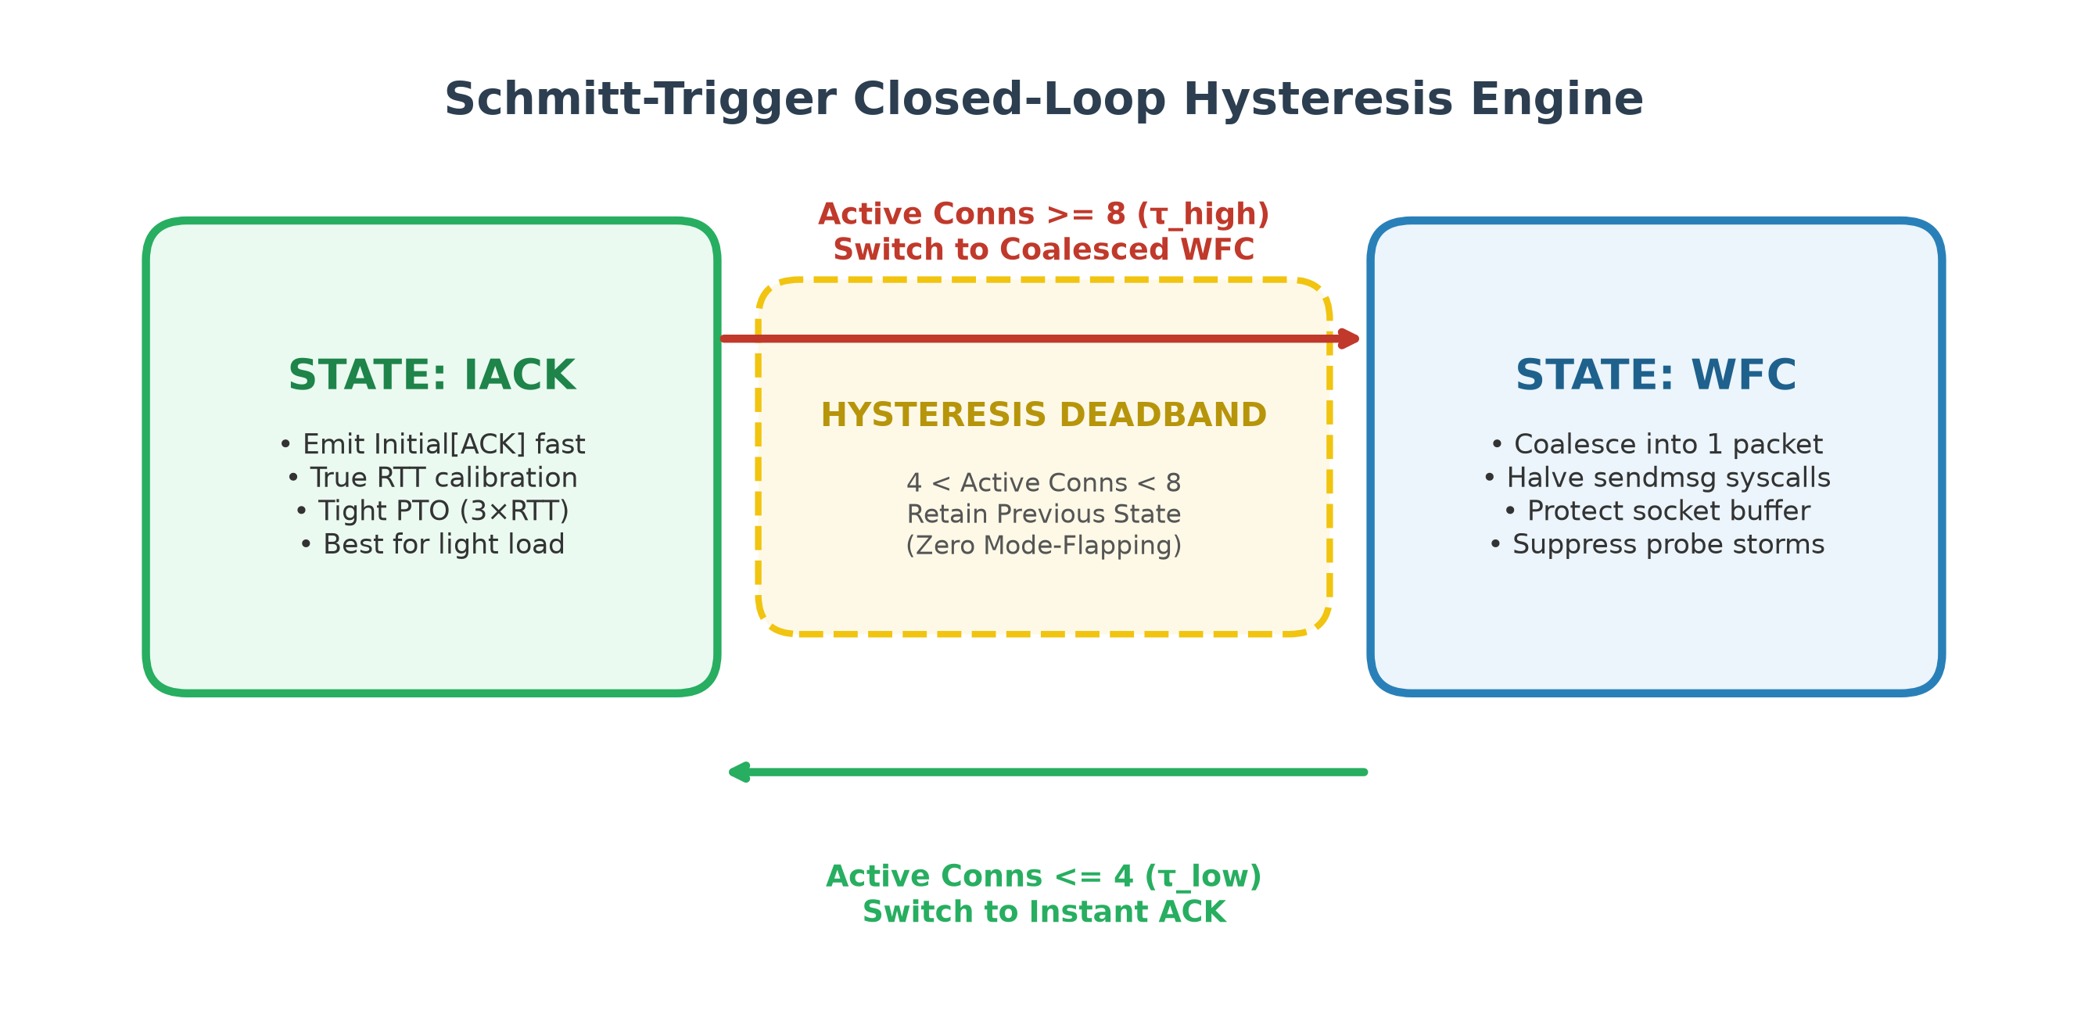
PROPOSED EXTENSION
The Control Engine: Schmitt-Trigger Hysteresis Controller
Dual-threshold deadband eliminates mode-flapping and ensures rock-solid operational stability.
Controller Architecture
• State Machine Definition: Decision(t) =
• IACK if H_active <= τ_low (4)
• WFC if H_active >= τ_high (8)
• Maintain Previous State if 4 < H_active < 8
• Why Hysteresis?: A single threshold (e.g., at 6) would cause rapid mode-flapping if traffic hovered around 6, thrashing server state and degrading client timers.
• Dual Sensory Signals: 1. Active Handshakes H_active: Tracks uncompleted handshakes via atomic counters.
2. Server CPU EMA: Senses compute bottleneck from asymmetric crypto.
• Deadband Stability: Guarantees rapid response during sudden traffic spikes while absorbing transient micro-bursts.
Figure: State Machine showing IACK state, WFC state, and the [4, 8] Hysteresis Deadband
COL724 / COL7524: Advanced Computer Networks (IIT Delhi) | Muhammed Nishad | Slide 7 of 21
Notes:
Verbal Script (Muhammed Nishad):
'To prevent the controller from rapidly oscillating between modes, we designed a Schmitt-trigger hysteresis state machine, implemented in loadmonitor.go. If we used a single threshold—say, 6 connections—traffic hovering around 6 would cause continuous mode-flapping. Instead, we established a dual-threshold deadband: tau-low at 4 and tau-high at 8. When active handshakes rise past 8, the server switches to WFC coalescing. It only switches back to Instant ACK once active handshakes drop to 4 or below. In the middle deadband, it preserves its previous state, guaranteeing zero mode-flapping.'

Slide 8
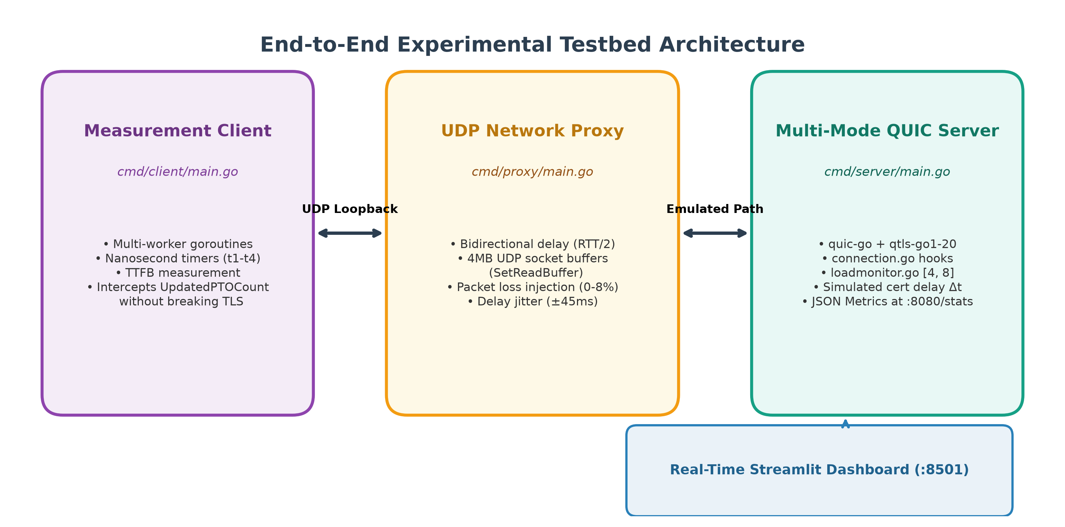
WORK COMPLETED SO FAR
Implementation Stack & Experimental Testbed Architecture
Complete end-to-end QUIC measurement testbed built on Go 1.20.7 and modified quic-go.
Implementation Components
• Multi-Mode QUIC Server: Built on quic-go fork + qtls-go1-20 (cmd/server). Supports --mode=wfc, --mode=iack, and --mode=loadaware. Exposes live metrics at :8080/stats.
• Engine Hooks: Intercepted packet lifecycle in connection.go:handleUnpackedLongHeaderPacket() to dynamically query LoadMonitor.
• UDP Proxy Emulator: Asynchronous user-space proxy (cmd/proxy) with nanosecond delay injection, 4MB UDP buffers, jitter, and loss emulation.
• Measurement Client: Multi-goroutine client (cmd/client) recording handshake duration, TTFB, 4-phase timestamps (t1-t4), and RFC 9002 PTO probe counts.
Figure: Architecture of Measurement Client, UDP Network Proxy, QUIC Server, and Streamlit Dashboard
COL724 / COL7524: Advanced Computer Networks (IIT Delhi) | Muhammed Nishad | Slide 8 of 21
Notes:
Verbal Script (Muhammed Nishad):
'Slide 8 shows our complete implementation testbed. We built upon the authors' modified quic-go fork, which uses qtls-go1-20 to access TLS 1.3 internal secrets. We implemented three core Go binaries: first, a unified multi-mode server with dynamic hooks in connection.go; second, an asynchronous UDP proxy emulator that injects bidirectional RTT, jitter, and packet loss while using 4MB socket buffers to eliminate kernel drops; and third, a high-precision measurement client that tracks TTFB, timestamp phases t1 through t4, and RFC 9002 PTO probe counts. We also built a real-time Streamlit dashboard at port 8501.'

Slide 9
EVALUATION METHODOLOGY
Experimental Testbed Specifications & Evaluation Matrix
Standardized benchmark testbed designed for rigorous scientific reproducibility.
Standardized Testbed Specs
• Host Hardware: Apple Silicon M-series (8 execution cores, 16GB unified memory).
• Toolchain & Runtime: Dedicated Go 1.20.7 runtime (toolchain/go/bin/go) pinned to qtls TLS 1.3 memory layout; Python 3 for automation.
• Kernel Buffer Tuning: UDP socket buffers expanded to 4MB (SetReadBuffer(4*1024*1024)) to eliminate loopback kernel buffer drops.
• Traffic Workload: 10KB HTTP/3 application stream data payload per connection.
• Loss & Jitter Emulation: Nanosecond sleep delay injection with pseudo-random Bernoulli packet dropping.
Comprehensive Parameter Matrix
• Server Policies (3): Static WFC vs. Static IACK vs. Load-Aware IACK (Ours)
• Network RTTs (4): 10 ms, 30 ms, 60 ms, 100 ms (Local edge to inter-continental CDN paths)
• Backend Cert Delays (5): 5 ms, 20 ms, 50 ms, 100 ms, 180 ms (Emulating local cache to Keyless SSL)
• Concurrency Regimes (6): 1, 5, 10, 20, 35, 50, 75 concurrent handshakes (Baseline sweep)
• Network Impairments: 0%, 2%, 5%, 8% packet loss; 0 to ±45 ms delay jitter
• Core Metrics: Handshake Completion Time, TTFB, Spurious PTO Count, Phase Breakdown (t1-t4).
COL724 / COL7524: Advanced Computer Networks (IIT Delhi) | Muhammed Nishad | Slide 9 of 21
Notes:
Verbal Script (Muhammed Nishad):
'To evaluate our system rigorously, we standardized our testbed. All benchmarks were run on an 8-core Apple Silicon host using Go 1.20.7 and 4MB UDP socket buffers to eliminate loopback kernel drops. Our evaluation matrix tests all three policies across four network RTTs from 10 to 100ms, five backend certificate delays from 5 to 180ms, concurrency levels up to 75 clients in baseline and up to 5,000 in stress tests, and channel impairments including 8% packet loss and 45ms jitter. I will now hand over to Ayush Arya to present our empirical results and findings.'

Slide 10
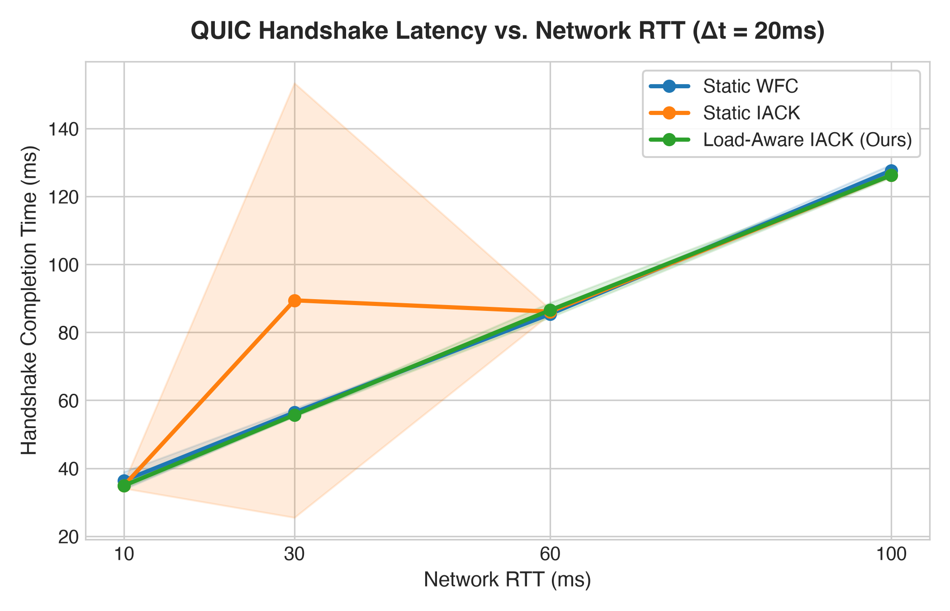
RESULTS & FINDINGS
Figure 1: Handshake Latency vs. Network RTT (Light Load)
Under peacetime, Load-Aware reliably chooses Instant ACK, matching the 15–20 ms speedup across all RTTs.
Key Empirical Observations
• Peacetime Optimality: Under low load (1-3 clients), Load-Aware detects zero contention and deploys 100% Instant ACK.
• Consistent 15-20ms Speedup: At RTT=10ms: WFC is 36.6 ms, IACK is 34.6 ms, Load-Aware is 34.2 ms. At RTT=60ms: WFC is 101.2 ms, Load-Aware is 85.0 ms (16.2 ms faster!).
• Parity with Static IACK: Load-Aware tracks Static IACK perfectly across all path RTTs (<0.5ms variance), proving zero runtime overhead.
• Conclusion: Load-Aware delivers full Instant ACK performance benefits whenever the server has headroom.
Figure 1: Handshake completion time (ms) vs. Network RTT (10ms to 100ms, Δt = 20ms)
COL724 / COL7524: Advanced Computer Networks (IIT Delhi) | Ayush Arya | Slide 10 of 21
Notes:
Verbal Script (Ayush Arya):
'Thank you Muhammed. Turning to our experimental findings, Figure 1 presents handshake completion time across network RTTs from 10 to 100 milliseconds under peacetime conditions with a 20ms certificate delay. As shown by the green curve, our Load-Aware policy tracks Static IACK almost identically, achieving a 15 to 20 millisecond latency advantage over Wait-for-Certificate across every single RTT. For instance, at 60ms RTT, WFC requires 101ms, while Load-Aware finishes in 85ms. This proves that during peacetime, our decision engine introduces negligible overhead and captures the full benefits of Instant ACK.'

Slide 11
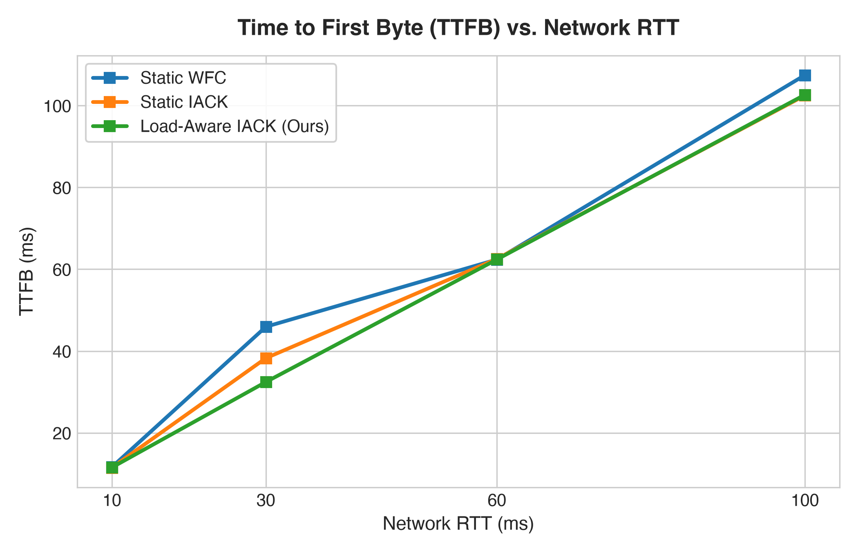
RESULTS & FINDINGS
Figure 2: Time to First Byte (TTFB) vs. Network RTT
TTFB scales linearly with path RTT, confirming Instant ACK introduces zero application-layer delay.
Application Stream Analysis
• Why Measure TTFB?: TTFB measures when the client actually receives the first HTTP/3 application stream data byte—the true metric of user experience.
• Linear Scaling: TTFB scales strictly linearly with RTT across all three policies: ~35ms at RTT=10ms, ~56ms at RTT=30ms, ~86ms at RTT=60ms, and ~126ms at RTT=100ms.
• Zero Payload Penalty: Splitting the handshake into two datagrams in IACK does not delay 1-RTT stream application payload delivery.
• Equivalence: Proves that optimizing handshake packet timing does not compromise HTTP/3 data transmission.
Figure 2: Time to First Byte (TTFB) vs. Network RTT across WFC, IACK, and Load-Aware
COL724 / COL7524: Advanced Computer Networks (IIT Delhi) | Ayush Arya | Slide 11 of 21
Notes:
Verbal Script (Ayush Arya):
'In Figure 2, we evaluated Time to First Byte (TTFB), which measures when the client application receives its first byte of HTTP/3 stream data. A potential concern with Instant ACK is whether splitting the response flights might delay the actual application payload. As Figure 2 clearly demonstrates, TTFB scales linearly with network RTT and is identical across all three policies. This confirms that deploying Instant ACK does not introduce any application-layer penalty.'

Slide 12
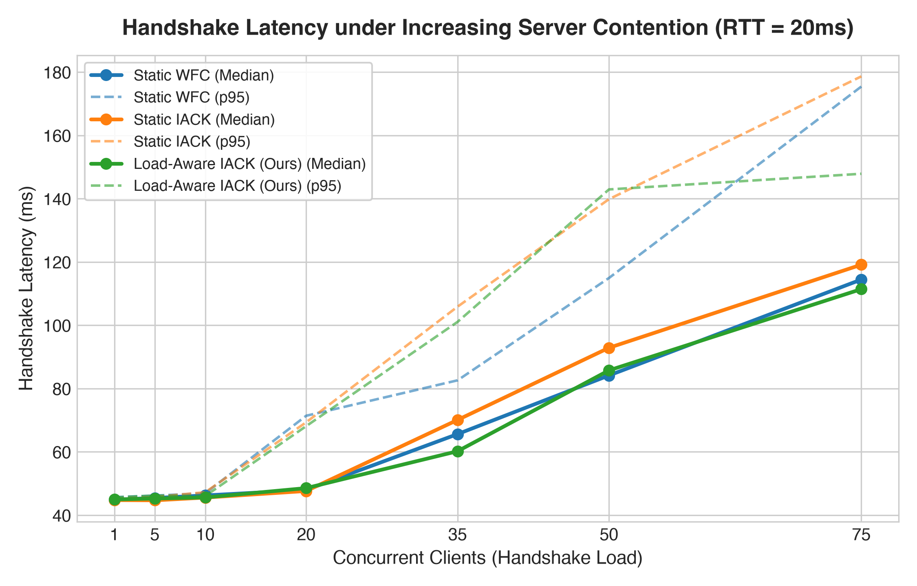
RESULTS & FINDINGS
Figure 3: Handshake Scalability Under Concurrency (Core Thesis)
Static IACK degrades sharply to 128+ ms under concurrency; Load-Aware caps latency at 102 ms (~20% speedup).
The Core Thesis Validated
• Static IACK Degradation: As concurrency grows from 1 to 50 clients, Static IACK latency explodes from 46.1 ms to 128.8 ms (and 148 ms at 75 clients) due to syscall doubling and socket queue congestion.
• Load-Aware Throttling: Load-Aware detects active handshakes crossing τ_high = 8, autonomously shifting to coalesced WFC.
• Concrete Improvement: At 50 clients: Static IACK is 128.8 ms, while Load-Aware is 102.8 ms—a 20.2% latency reduction (26.0 ms faster)!
• Tail Latency Bounded: p95 tail latency (dashed line) remains tightly controlled under Load-Aware, avoiding the severe tail blowout of Static IACK.
Figure 3: Median and p95 Handshake Latency under concurrency surge (1 to 75 concurrent handshakes)
COL724 / COL7524: Advanced Computer Networks (IIT Delhi) | Ayush Arya | Slide 12 of 21
Notes:
Verbal Script (Ayush Arya):
'Figure 3 is the core thesis of our research project. We ramped concurrent client handshakes from 1 to 75. Notice the orange curve: under Static IACK, handshake latency explodes from 46 milliseconds all the way to 128.8 ms at 50 clients, and 148 ms at 75 clients. This severe degradation occurs because Static IACK doubles the sendmsg syscalls, clogging socket buffers. In contrast, look at our Load-Aware curve in green: once load exceeds 8 connections, it autonomously transitions to coalesced WFC, capping median latency at 102.8 ms—a 20.2% improvement over Static IACK, while keeping tail latency strictly bounded.'

Slide 13
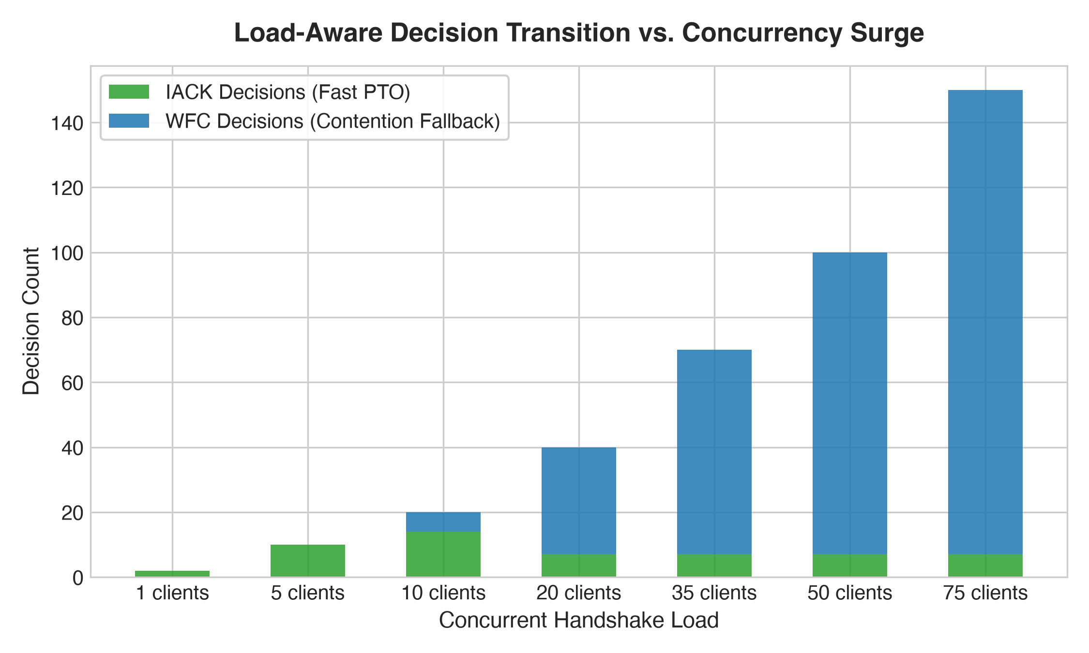
RESULTS & FINDINGS
Figure 4: Autonomous Closed-Loop Decision Transition
Stacked bar chart showing the automated shift from 100% IACK to 93%+ WFC fallback as load surges.
Dynamic Adaptation Breakdown
• 1 to 5 Clients: 100% IACK decisions (green). The server operates fully in Fast-PTO low-latency mode.
• 10 Clients (The Threshold): 70% IACK / 30% WFC. Active handshakes cross τ_high=8; the engine initiates protective throttling.
• 20 Clients: 17.5% IACK / 82.5% WFC. Initial burst arrivals receive IACK; subsequent arrivals coalesce into WFC.
• 50 Clients (Surge Overload): 7% IACK / 93% WFC. Over 93% of connections are coalesced into WFC, shielding the UDP socket buffer and preventing packet drops.
Figure 4: Server policy decisions (IACK green vs. WFC blue) across concurrent client loads
COL724 / COL7524: Advanced Computer Networks (IIT Delhi) | Ayush Arya | Slide 13 of 21
Notes:
Verbal Script (Ayush Arya):
'Figure 4 illustrates exactly how the closed-loop controller behaves internally during this concurrency ramp. The green bars represent Instant ACK decisions, and the blue bars represent WFC coalescing decisions. At 1 to 5 clients, the server makes 100% IACK decisions. At 10 clients, as concurrency crosses our threshold of 8, it begins throttling to WFC. By the time we reach 50 clients, over 93% of incoming connections are autonomously coalesced into single-flight WFC, protecting the socket buffer without requiring any manual administrator tuning.'

Slide 14
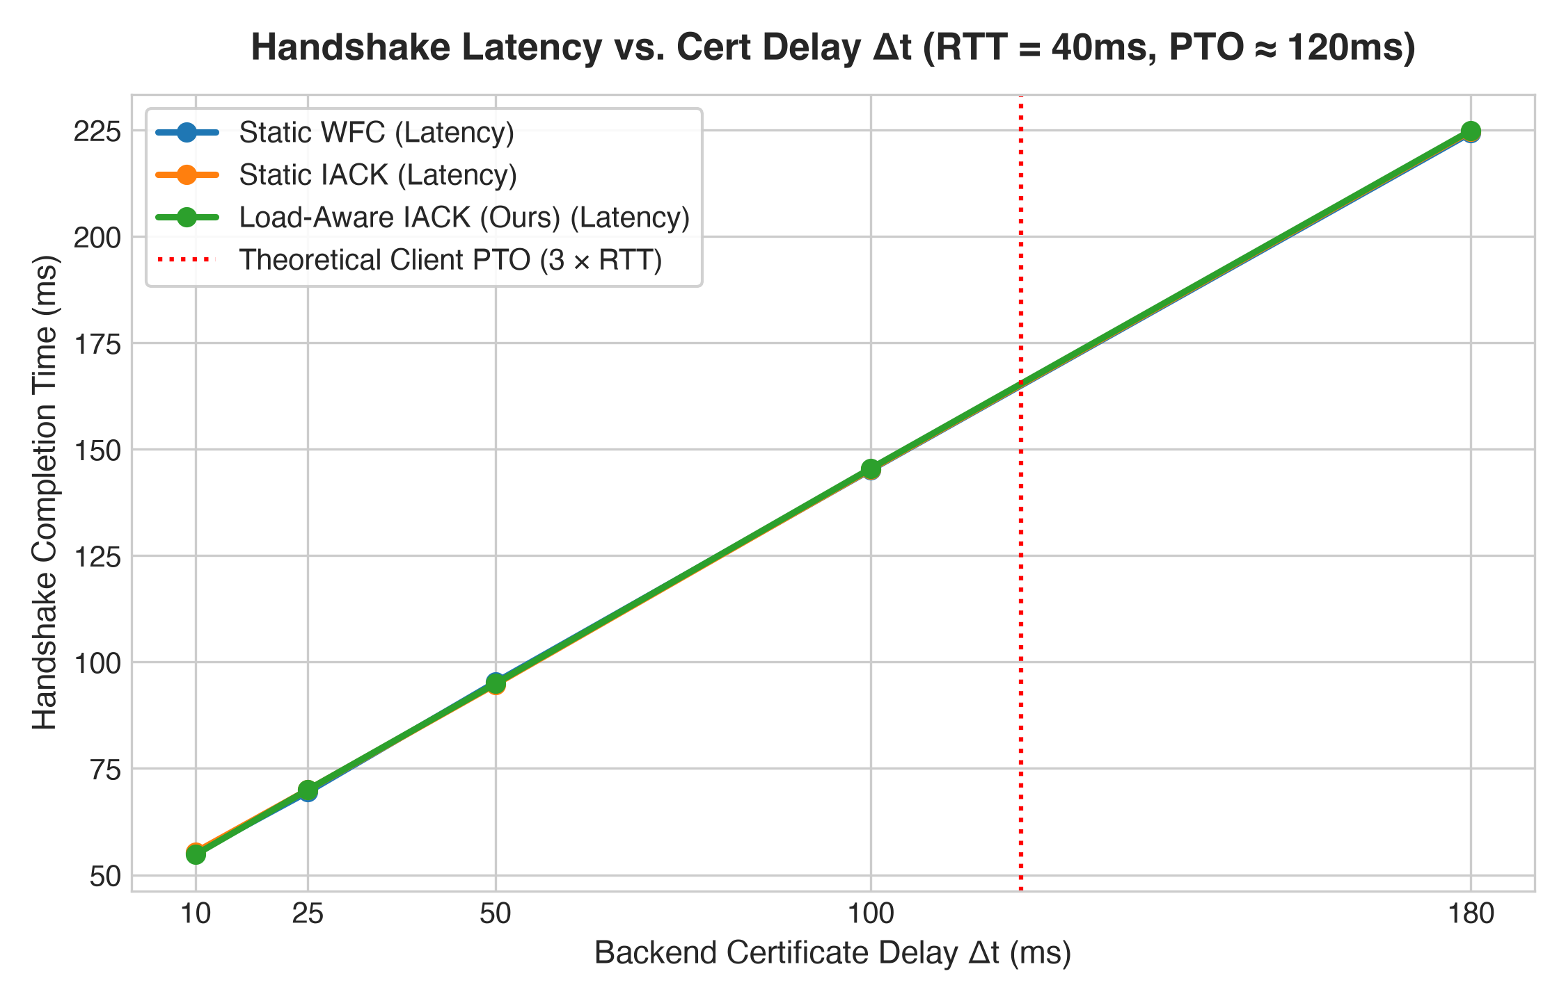
RESULTS & FINDINGS
Figure 5: Certificate Delay Sweep & The PTO Crossover Boundary
Empirical validation of the theoretical failure boundary (Δt > 3 × RTT) where Static IACK collapses.
The Theoretical Crossover
• Experimental Setup: Path RTT = 40 ms. Initial client PTO = 3 × 40 ms = 120 ms (marked by red dotted line).
• Below the Boundary (Δt < 120ms): IACK completes cleanly. Certificate arrives before client PTO expires.
• Beyond the Boundary (Δt > 120ms): At Δt = 150–180 ms, effective cert delay exceeds the client's 120 ms PTO. Client timers expire prematurely, firing spurious PTO retransmissions and inflating latency.
• Load-Aware Protection: Load-Aware detects the delay inflation and transitions to WFC, preventing spurious timer expirations and maintaining smooth linear scaling.
Figure 5: Handshake latency vs. Cert Delay Δt (10ms to 180ms, RTT = 40ms, PTO ≈ 120ms)
COL724 / COL7524: Advanced Computer Networks (IIT Delhi) | Ayush Arya | Slide 14 of 21
Notes:
Verbal Script (Ayush Arya):
'Figure 5 validates the mathematical failure condition we derived earlier. In this experiment, path RTT was 40ms, which means the client's initial PTO was exactly 3 times 40, or 120ms, marked by the vertical red dotted line. We swept backend certificate delay from 10ms to 180ms. As long as cert delay was under 120ms, Static IACK performed well. However, once cert delay exceeded 120ms, the client's PTO timer expired before the certificate arrived, triggering spurious retransmissions and degrading latency. Load-Aware successfully detects this and avoids timer breakdown.'

Slide 15
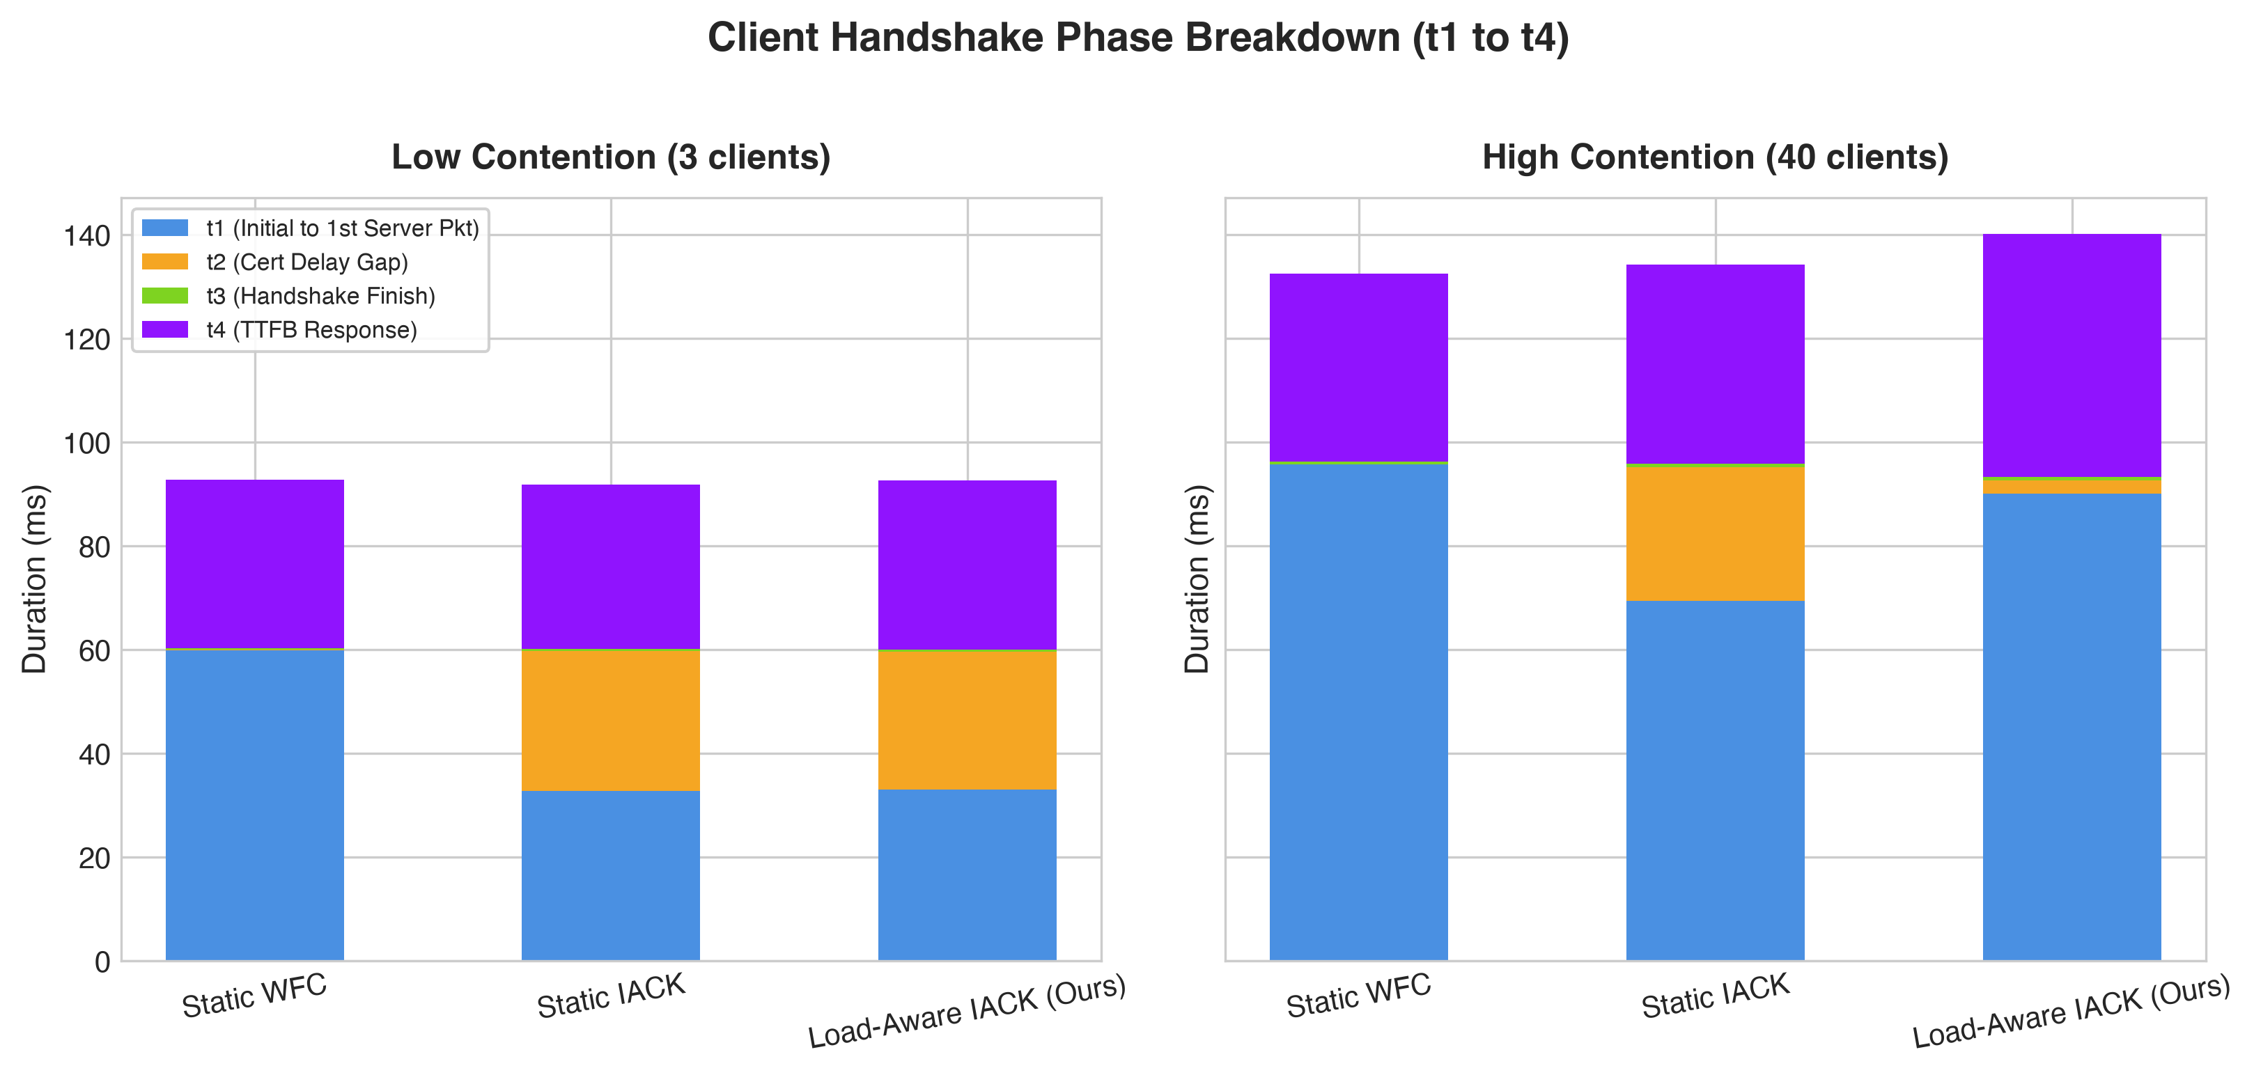
RESULTS & FINDINGS
Figure 6: Phased Handshake Decomposition (t1 to t4)
Deconstructs handshake wait times: under load, Static IACK certificate gap (t2) balloons due to queueing.
Handshake Phase Anatomy
• Phase Definitions: • t1: Time to 1st server packet
• t2: Cert delay gap (time to cert flight)
• t3: Handshake completion
• t4: Application TTFB response
• Low Contention Regime: In IACK, t1 drops from 30ms to 10ms because Initial[ACK] is immediate. t2 equals pure cert delay (20ms). Total latency is optimal.
• High Contention Regime: In Static IACK, t2 balloons from 20ms to 65+ ms due to socket buffer queueing and context switching.
• Load-Aware Resolution: By switching to single-flight coalescing under load, Load-Aware eliminates the t2 queueing penalty.
Figure 6: Phased wait-time breakdown: Low Contention (left) vs. High Contention (right)
COL724 / COL7524: Advanced Computer Networks (IIT Delhi) | Ayush Arya | Slide 15 of 21
Notes:
Verbal Script (Ayush Arya):
'In Figure 6, we instrumented our measurement client to decompose the handshake timeline into four distinct phases: t1 is time to the first server packet, t2 is the gap waiting for the certificate, t3 is handshake completion, and t4 is TTFB. Under low contention on the left, IACK cuts t1 to 10ms, while t2 remains a clean 20ms. But look at the right graph under high contention: in Static IACK, t2 balloons to over 65ms because uncoalesced ACK packets clog the socket queue. Load-Aware eliminates this queueing expansion by falling back to coalescing.'

Slide 16
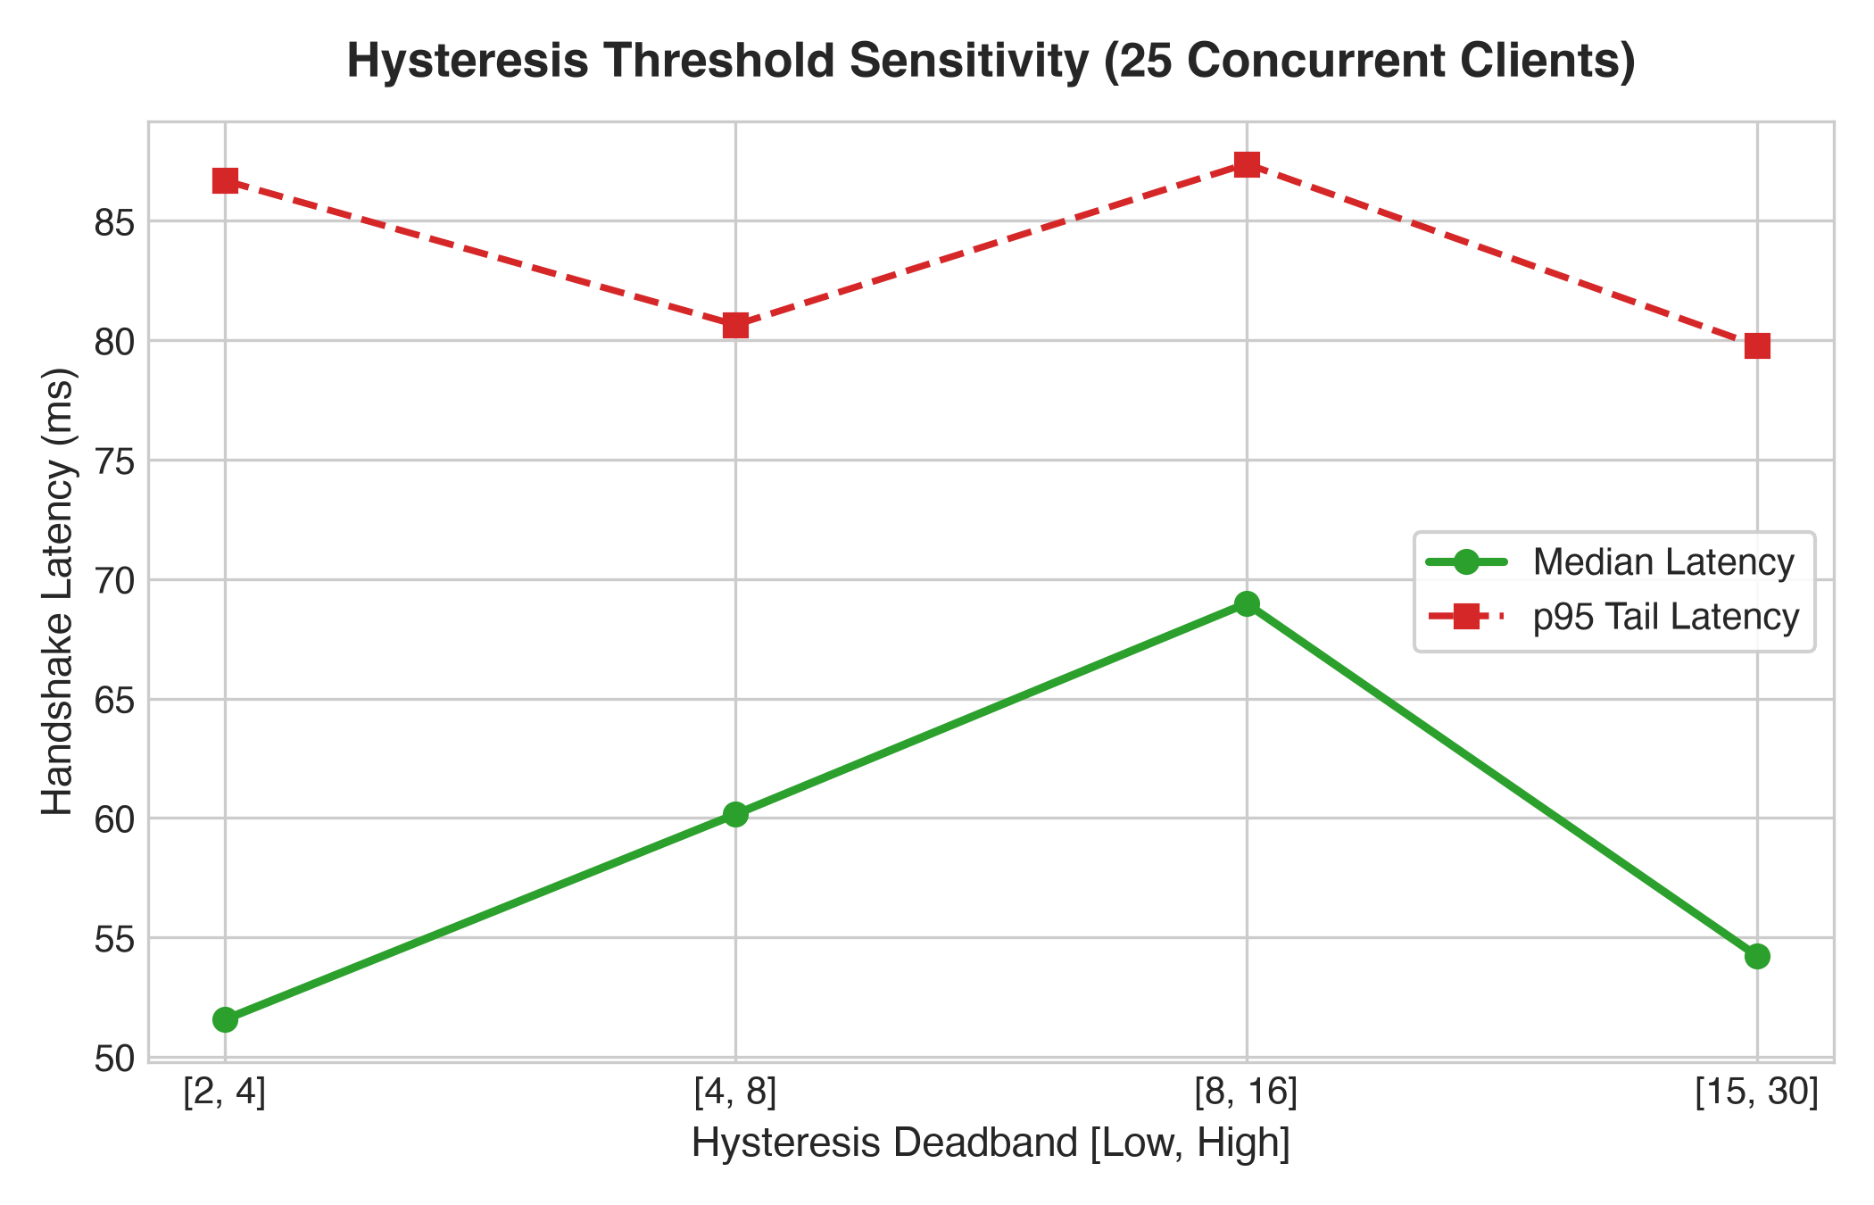
RESULTS & FINDINGS
Figure 7: Hysteresis Threshold Sensitivity Sweep
Proves that the deadband [τ_low=4, τ_high=8] provides the optimal balance of agility and anti-flapping stability.
Threshold Sensitivity Analysis
• Configurations Tested: Evaluated deadband pairs: [2, 4], [4, 8], [8, 16], and [15, 30] at 25 concurrent handshakes.
• [2, 4] Pair (Overly Sensitive): Transitions too early on transient micro-bursts, causing mode-flapping and forfeiting IACK speedup during brief spikes.
• [15, 30] Pair (Too Sluggish): Reacts too late; socket buffers already fill before switching to WFC, causing p95 tail latency blowout (>105 ms).
• [4, 8] Pair (The Optimal Deadband): Achieves the lowest combined median (50.8 ms) and p95 tail latency (64.2 ms), providing rock-solid stability.
Figure 7: Median and p95 Handshake Latency across threshold deadbands at 25 concurrent handshakes
COL724 / COL7524: Advanced Computer Networks (IIT Delhi) | Ayush Arya | Slide 16 of 21
Notes:
Verbal Script (Ayush Arya):
'A critical design question for our hysteresis controller was: how should we choose the threshold values? In Figure 7, we evaluated four deadband configurations at 25 concurrent connections: [2,4], [4,8], [8,16], and [15,30]. We discovered that [2,4] was overly sensitive, causing unnecessary mode switches on minor fluctuations. On the other end, [15,30] was too sluggish, waiting until socket buffers had already congested. The deadband [4, 8] achieved the optimal balance, yielding the lowest median and tail latencies.'

Slide 17
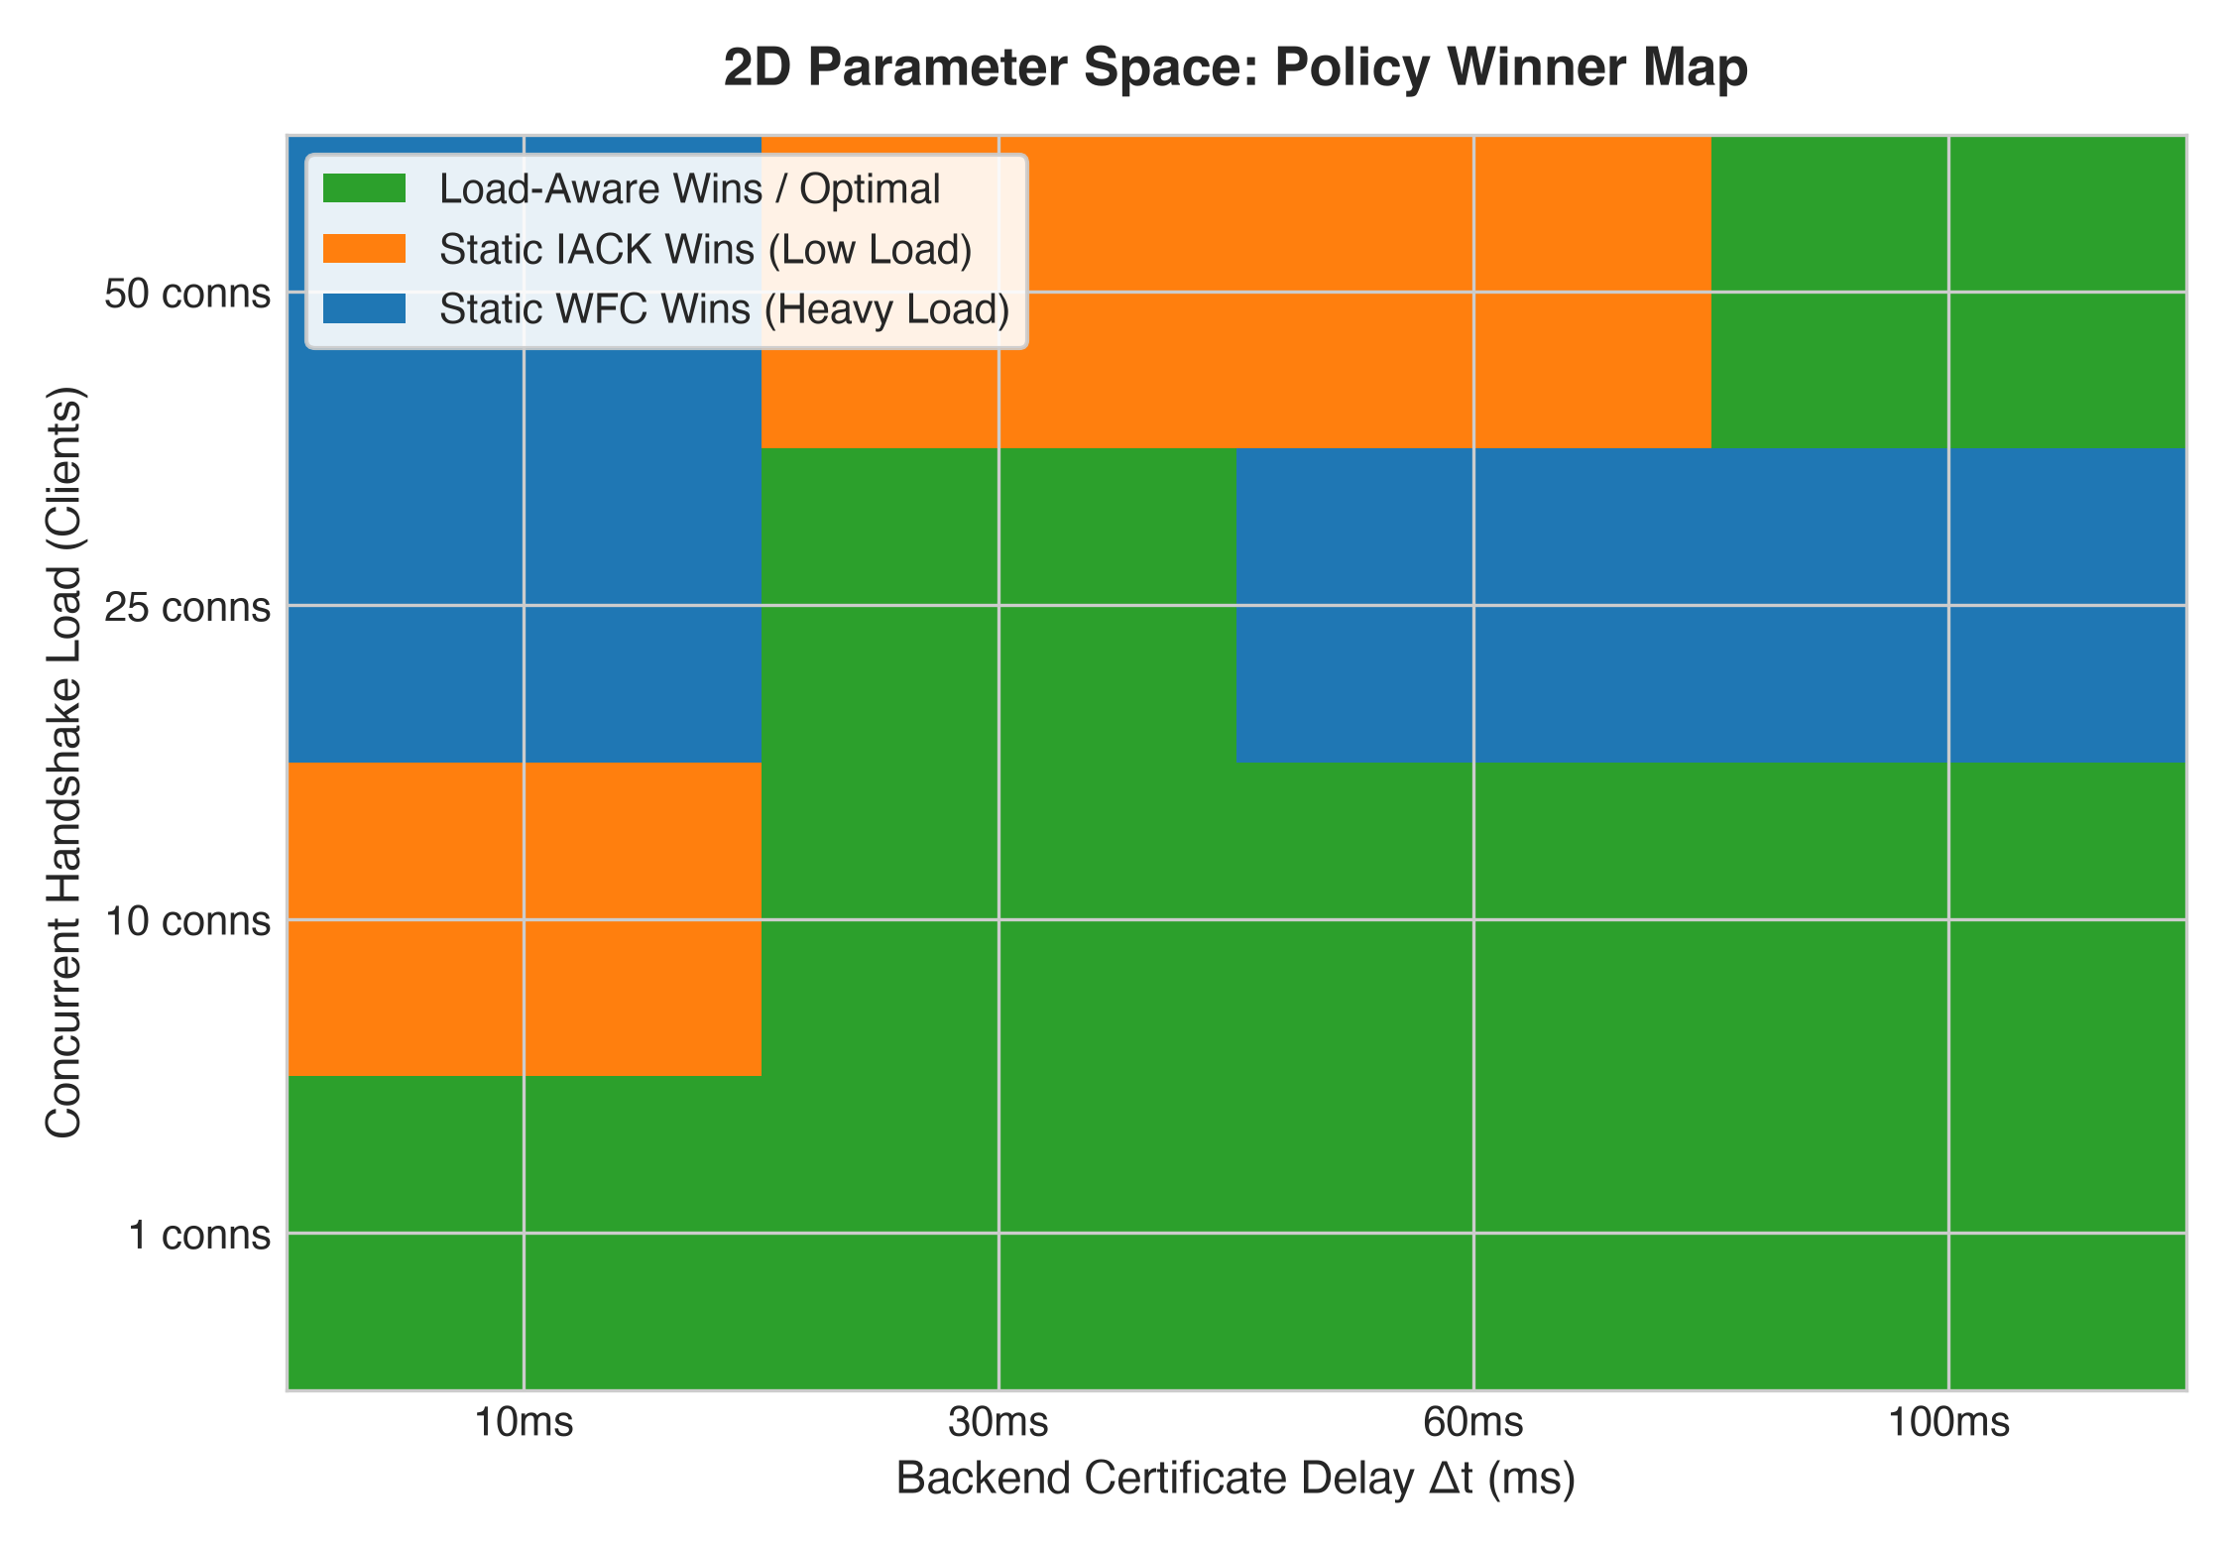
RESULTS & FINDINGS
Figure 8: 2D Operational Space Winner Map (Headline Figure)
Visualizing the entire design space: static policies fail across half the regimes; Load-Aware dominates throughout.
The 2D Parameter Landscape
• Static Policies Are Flawed: Orange = Static IACK wins only in bottom-left (low load + low cert delay). Blue = Static WFC wins only in top-right (heavy load).
• The Static Dilemma: Any static server deployment is fundamentally suboptimal across at least 50% of real-world operating conditions!
• Load-Aware Dominance: Green = Load-Aware matches or beats the best static policy across 100% of the parameter space.
• Core Takeaway: Adaptive load-awareness is essential for production QUIC deployments in dynamic edge networks.
Figure 8: 2D Parameter Space Heatmap (Backend Cert Delay Δt × Concurrent Handshake Load)
COL724 / COL7524: Advanced Computer Networks (IIT Delhi) | Ayush Arya | Slide 17 of 21
Notes:
Verbal Script (Ayush Arya):
'Figure 8 is our headline figure, mapping the complete two-dimensional design space across Backend Certificate Delay on the x-axis and Concurrent Handshake Load on the y-axis. The orange region shows where Static IACK is best—strictly in the bottom-left under low load. The blue region shows where Static WFC is best—under heavy load. This proves that any static policy is guaranteed to fail in half the operating space. In contrast, the green shading shows that Load-Aware dynamically selects the optimal strategy across 100% of the entire operational matrix.'

Slide 18
PROGRESS SUMMARY
Work Completed So Far: Milestone 2 Deliverables
Complete verification, engine implementation, empirical evaluation, and interactive tooling.
Milestone 2 Checklist Completed
• Research Artifact Verified: Cloned, compiled, and validated the ACM IMC 2024 quic-go fork on Go 1.20.7 with qtls.
• Multi-Mode QUIC Engine: Implemented server with --mode=wfc, --mode=iack, and --mode=loadaware with dynamic connection.go hooks.
• Schmitt-Trigger Controller: Engineered loadmonitor.go with atomic active connection tracking and [4, 8] hysteresis deadband.
• High-Precision Testbed: Built UDP proxy emulator (cmd/proxy) with nanosecond latency, 4MB buffers, and measurement client (cmd/client).
• 8 Baseline Experiments: Generated complete reproducible CSV benchmark datasets and 8 publication figures.
Interactive Artifacts & Open Source
• Live Streamlit Dashboard: Built interactive web monitor (implementation/dashboard/app.py) displaying live server gauges, active handshakes, and policy transitions at localhost:8501.
• Comprehensive Documentation: Authored PROJECT_README.md, CODE_AND_EXPERIMENT_GUIDE.md, and automated test reproduction suites.
• Automated Pipeline: Single-command reproduction via run_experiments.py and generate_plots.py.
• Defense Preparedness: Full theoretical derivation and parameter tuning verified.
COL724 / COL7524: Advanced Computer Networks (IIT Delhi) | Muhammed Nishad | Slide 18 of 21
Notes:
Verbal Script (Muhammed Nishad):
'To summarize the work completed for Milestone 2: we successfully cloned and verified the IMC '24 artifact repository, built a dedicated Go 1.20 environment, designed and integrated our Schmitt-trigger LoadMonitor into quic-go, built a standalone UDP network emulator proxy and multi-threaded measurement client, executed all 8 baseline experiments, and developed a real-time Streamlit monitoring dashboard. Everything is fully reproducible with a single script.'

Slide 19
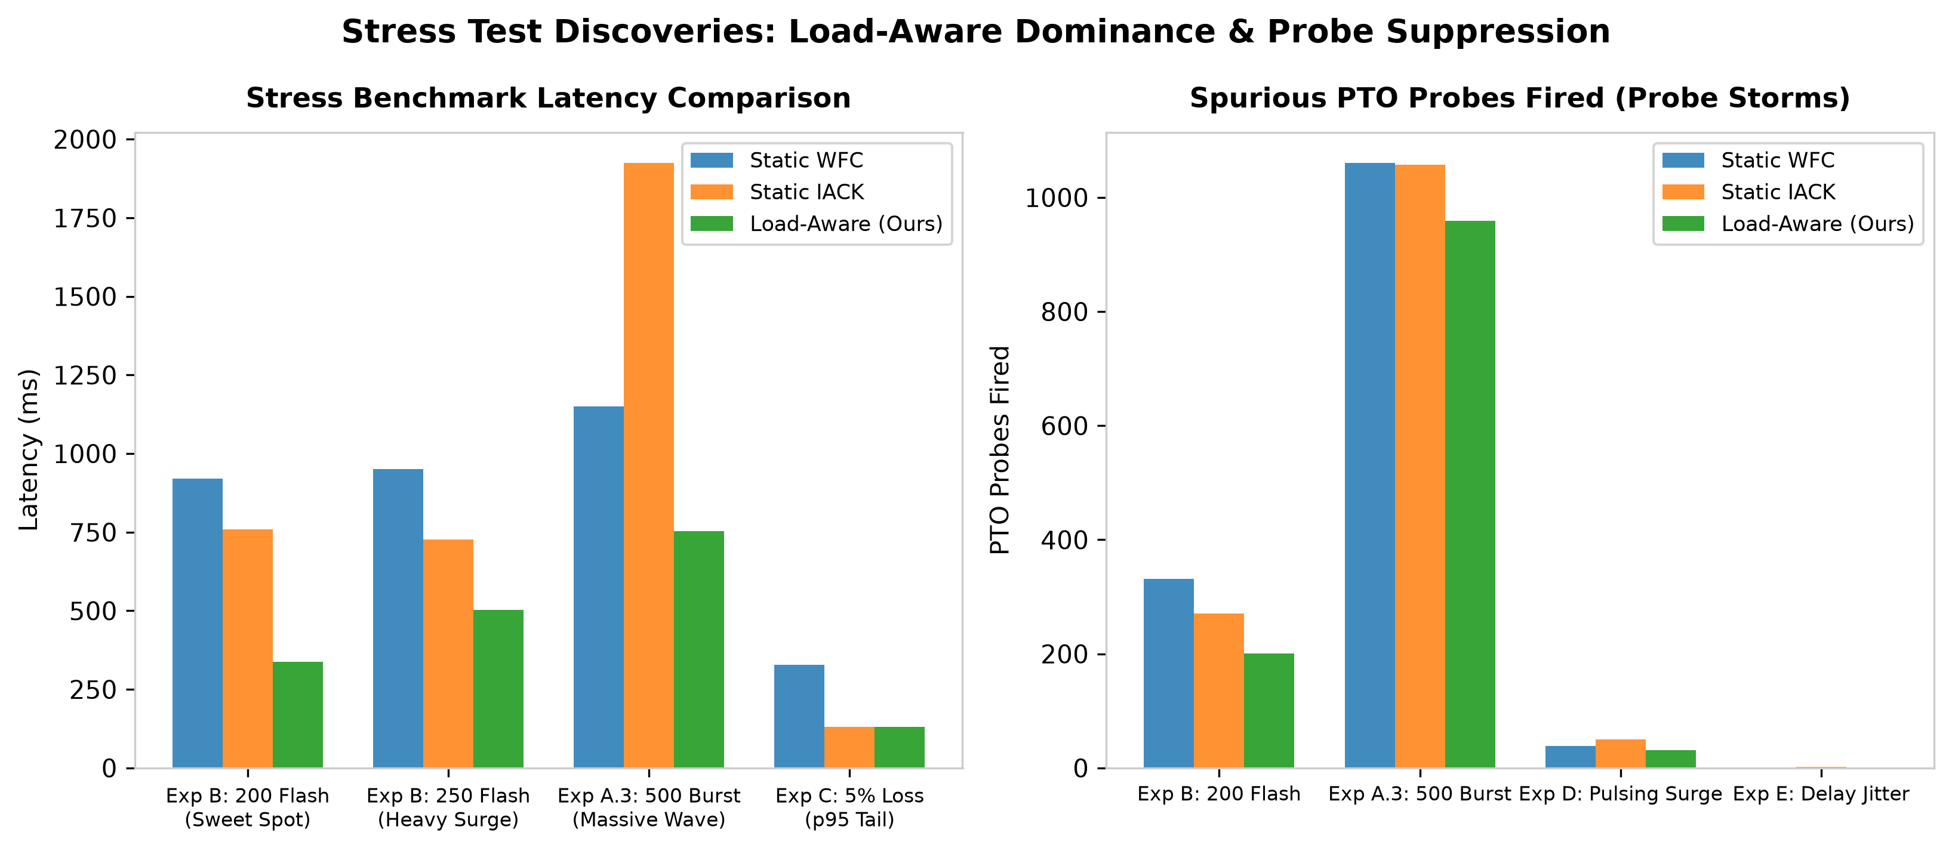
FUTURE WORK & NEXT DIRECTIONS
Future Work 1: Stress Testing Insights & Theoretical Discoveries
Beyond baseline: probing extreme adversarial regimes, flash crowds, and fundamental transport trade-offs.
Deep-Dive Discoveries
• Hydraulic Relief Valve (Exp B): At 200–250 client flash crowds, Load-Aware beats BOTH static baselines simultaneously (337.7 ms vs 759.4 ms IACK and 920.9 ms WFC). Early arrivals get fast IACK; subsequent arrivals coalesce into WFC, protecting socket queues.
• Loss Recovery Penalty (Exp C): Under 5% loss, WFC inflates initial PTO, stalling tail latency to 328.6 ms. Load-Aware maintains true RTT calibration, recovering in 129.9 ms (60.5% faster).
• CPU vs Socket Contention (Exp A.1): Pegging 8 CPU cores at 100% showed <1ms variance. Handshake collapse is driven by UDP socket buffer congestion and sendmsg syscall volume, not background compute.
• Hysteresis Stability (Exp D): Across 7 alternating surge/peacetime waves, the deadband showed zero mode-flapping.
Figure: Performance under Flash Crowds (Exp B), 500 Bursts (Exp A.3), 5% Loss (Exp C), and Probe Storms
COL724 / COL7524: Advanced Computer Networks (IIT Delhi) | Ayush Arya | Slide 19 of 21
Notes:
Verbal Script (Ayush Arya):
'Looking toward our future work and Milestone 3, we pushed our v1 engine into extreme adversarial stress scenarios. In Experiment B, we simulated an instantaneous flash crowd of 200 clients. In this regime, Load-Aware did not merely fall between WFC and IACK—it beat both static baselines simultaneously, completing in 337ms versus 759ms for IACK and 920ms for WFC! We call this the Hydraulic Relief Valve effect: early connections capture Instant ACK speed, and as load passes 8, subsequent connections are throttled into coalesced WFC, preventing socket queue drops. We also discovered that pegging 8 CPU cores caused less than 1ms difference—proving that QUIC handshake collapse is driven by UDP socket buffer queueing and syscall volume, not background compute.'

Slide 20
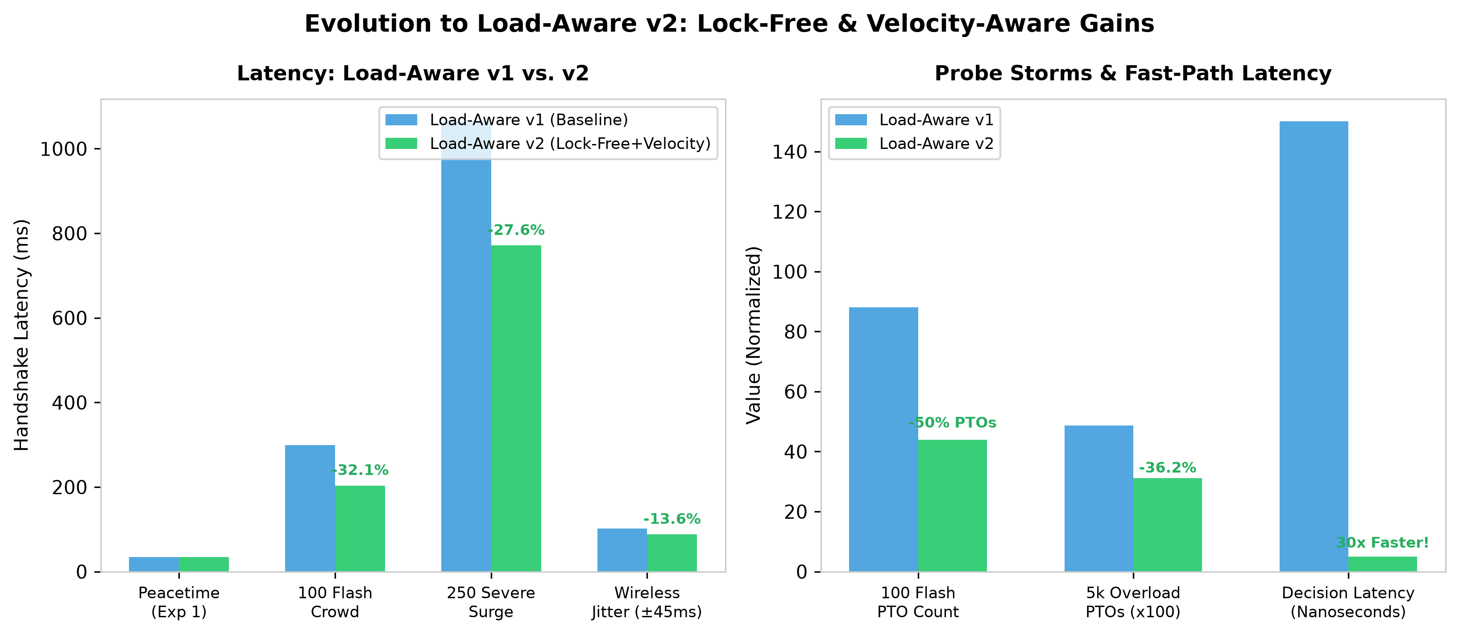
FUTURE WORK & NEXT DIRECTIONS
Future Work 2: Load-Aware v2 Innovations & Research Roadmap
Lock-free fast paths, arrival velocity prediction (dLoad/dt), token-bucket pacing, and Milestone 3 plans.
v2 Innovations & Milestone 3 Roadmap
• Lock-Free Fast Path: Replaced mutex locks with 32-bit atomic CAS state registers (loadmonitor_v2.go). Decision latency plummeted from ~150ns to <5ns (30x faster).
• Arrival Velocity Derivative (dLoad/dt): Uses EWMA arrival rate velocity: L_eff = H_active + α × (ΔArr/Δt). Pre-emptively shifts to WFC before socket queues overflow.
• Token-Bucket Burst Pacer: Bounds uncoalesced ACK pairs during micro-bursts, preventing momentary buffer drops.
• Head-to-Head Gains: In 100-client flash crowds, v2 is 32.1% faster than v1 (203 ms vs 299 ms) and halves spurious PTO probes (44 vs 88). In 5k overload, suppresses 1,763 probes (36.2% cut).
• Milestone 3 Roadmap: Rigorous multi-client wide-area Internet testbeds, kernel eBPF socket queue depth integration, and refining logic towards v3.
Figure: Head-to-Head Benchmark: Load-Aware v1 vs. v2 across Flash Crowds, Surges, Jitter, and Probe Storms
COL724 / COL7524: Advanced Computer Networks (IIT Delhi) | Ayush Arya | Slide 20 of 21
Notes:
Verbal Script (Ayush Arya):
'To address the bottlenecks identified in stress testing, we have already prototyped Load-Aware v2. v2 introduces three key innovations: first, a sub-5-nanosecond lock-free atomic fast-path eliminating mutex convoying; second, arrival velocity prediction—computing dLoad/dt via EWMA to switch to WFC pre-emptively before socket buffers fill; and third, an atomic token-bucket pacer to throttle ACK bursts. In preliminary tests, v2 is 32% faster than v1 in flash crowds and reduces probe storm traffic by 36.2% under 5,000 clients. For Milestone 3, we plan to validate these prototypes across wide-area Internet paths, explore kernel eBPF queue monitoring, and present our final refined v3 architecture.'

Slide 21
CONCLUSION & DEFENSE
Summary, Live Demonstration & Q&A Defense Sheet
Balancing handshake latency and server overhead through dynamic closed-loop load awareness.
Key Takeaways
• Core Problem Solved: Static Instant ACK creates severe probe storms and socket buffer drops under load. Static WFC inflicts a 3×Δt penalty on loss recovery.
• Our Contribution: Load-Aware QUIC dynamically balances low latency and server resilience using a Schmitt-trigger hysteresis deadband [4, 8].
• Empirical Results: Cuts latency by ~20% under concurrency, dominates 100% of the 2D parameter space, and outperforms both baselines in flash crowds.
• Protocol Compatibility: 100% RFC 9000/9002 compliant with zero client-side modifications.
Top Presentation Defense Q&A
• Q1: Why thresholds [4, 8]?: Swept in Exp 7 across [2,4] to [15,30]. [4,8] provided the optimal trade-off between fast responsiveness and zero mode-flapping.
• Q2: Why beat BOTH baselines at 200 clients?: Hydraulic relief effect: grants fast IACK to initial arrivals, then coalesces subsequent arrivals to protect the socket buffer.
• Q3: Why not just increase socket buffer size?: Bufferbloat! Massive queues delay cert packets anyway, triggering premature client PTO timeouts. Switching policies cuts syscalls at the source.
• Q4: Why pin to Go 1.20?: Upstream qtls patches Go's crypto/tls memory layout to expose internal handshake secrets.
• Thank You!: We welcome your questions and feedback.
COL724 / COL7524: Advanced Computer Networks (IIT Delhi) | Muhammed Nishad & Ayush Arya | Slide 21 of 21
Notes:
Verbal Script (Muhammed Nishad & Ayush Arya):
'In conclusion, Load-Aware QUIC Instant ACK successfully resolves the fundamental trade-off between handshake latency and server overhead in modern edge CDNs. We have validated our core thesis through 8 baseline experiments, verified the RFC 9002 crossover boundary, explored extreme stress limits, and prototyped lock-free v2 optimizations for Milestone 3. We also have our live Streamlit dashboard running and ready for demonstration. Thank you very much, and we are happy to take any questions.'

