Slide 1


Comparative Analysis of Cryptocurrency vs. Stock Market Performance
STUDENT NAME: Nisha Das
UNIVERSITY NAME: Regis University
COURSE NAME: Data Science Practicum
INSTRUCTOR NAME: Dr Christy Pearson
DATE OF SUBMISSION: 16-10-2025
Notes:
1

Slide 2
Introduction
Investing landscape is changing rapidly with new and traditional assets.
Cryptocurrencies introduce new volatility, attracting diverse investors (Al-Afeef et al., 2024).
Stocks remain foundational for portfolios due to their stability.
Technology empowers smarter comparisons and decision making.
This project leverages AI to compare and forecast asset performance.
Notes:
2

Slide 3





Why Compare Assets?
Crypto and stocks deliver different risk/reward characteristics (Aljinović et al., 2021).
Asset allocation helps balance growth and stability in portfolios.
Market cycles impact cryptos and stocks differently.
Investors seek guidance amidst unpredictable financial markets.
Insights from comparative analysis enhance strategic decisions.
Notes:
3

Slide 4
PROJECT MOTIVATION
Understanding the drive behind our comparative analysis of crypto and stocks.
Surging Crypto, Hidden Risks
Stocks: Stability vs. Growth
Navigating Volatility
The explosive growth of cryptocurrency has introduced new investment avenues, yet the inherent risks are often underestimated or misunderstood by investors.
Traditional stocks offer established dividends and historical stability, but their growth trajectories can sometimes lag behind rapidly evolving digital assets.
The dynamic and often unpredictable nature of financial markets necessitates robust analytical tools for accurate forecasting and realistic investment planning.
AI-Driven Insights
Bridging the Knowledge Gap
Advanced technology, particularly artificial intelligence, provides unprecedented capabilities for nuanced, data-driven portfolio decisions, enhancing strategic choices.
This study directly addresses a critical gap in investor knowledge by rigorously benchmarking both crypto and stock asset classes using cutting-edge AI methodologies.
Notes:
4

Slide 5





Data Sources
Cryptocurrency prices sourced from CoinGecko, Yahoo Finance.
Stock data from Yahoo Finance and Kaggle repositories.
Datasets reconciled to remove missing/duplicate values.
Returns and volatility features engineered for rigor.
Range aligned for cross-asset analysis (2020-2025).
Notes:
8

Slide 6
Data Cleaning & Preparation
Remove duplicates, standardize all date formats.
1
2
Fill missing points by interpolation or exclusion.
Recalculate all prices to comparable US Dollar terms.
3
Calculate daily returns, rolling volatility, moving averages.
4
Ensure outlier handling for robust model input.
5
Notes:
9

Slide 7
Research Objectives
Quantify volatility and returns for both groups.
1
Forecast prices using advanced models (ARIMA, LSTM) (Albeladi et al., 2023).
2
Compare forecast error metrics by model and asset.
3
Deliver actionable recommendations for investors.
4
Empower risk management
5
Notes:
10

Slide 8










TECHNOLOGY STACK
Core Backend & Data Processing
Advanced Forecasting Models
ARIMA (Statsmodels) and LSTM (TensorFlow/Keras) are implemented for robust price forecasting.
Python and Pandas are utilized for efficient ETL (Extract, Transform, Load) operations, forming the backbone of the system.
Interactive Data Visualization
Plotly creates dynamic charts and dashboards, offering clear insights into market data and model outputs.
Modular Codebase
The architecture is structured into data_load, modeling, and visualization modules for maintainability and scalability.
Modern Web Application
Flask provides a lightweight framework for seamless web deployment and user interface.
Notes:
11

Slide 9
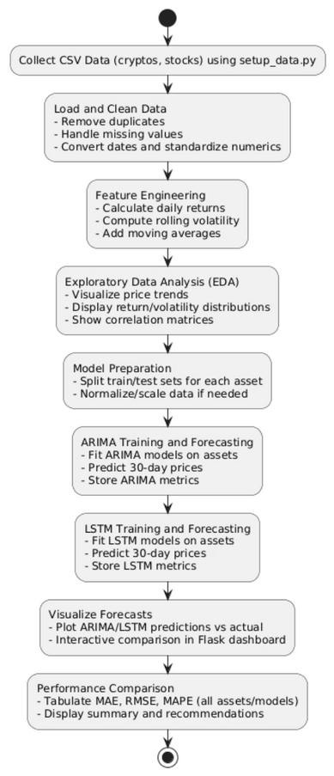
Methodology Flow
Collect historical daily closing prices for each asset.
Clean, prepare, and feature engineer the datasets.
Perform exploratory analysis for trends, risk profiles.
Train/test ARIMA and LSTM models on each asset.
Visualize and compare all forecasts interactively.
Notes:
12

Slide 10

EXPLORATORY DATA ANALYSIS INTRO
EDA uncovers fundamental differences in asset behaviors.
Highlighting Key Patterns
Price trend, return, volatility plots highlight key patterns.
Diversification Benefits
Correlation matrices reveal diversification benefits.
Fair Comparison
Each asset studied over identical windows for fair test.
Notes:
13

Slide 11
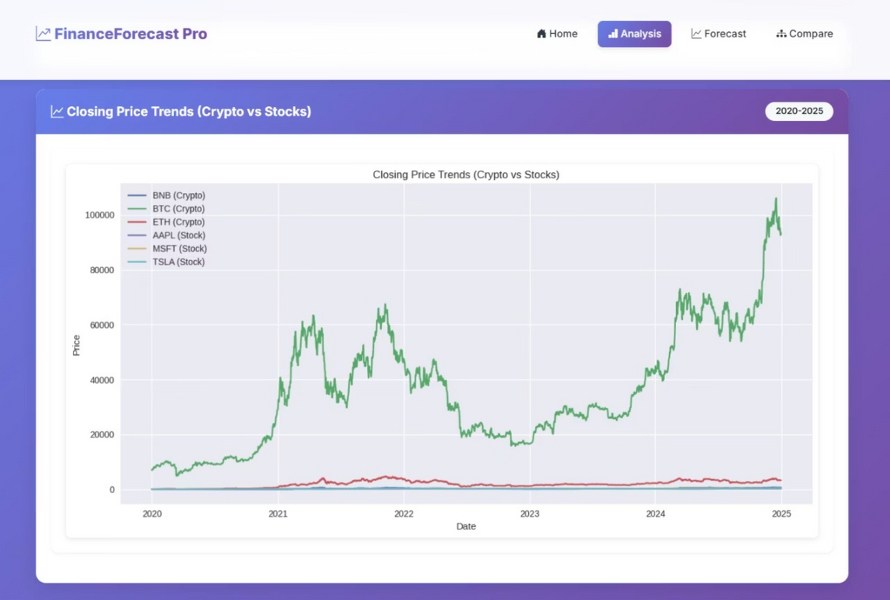
PRICE TREND ANALYSIS
Line charts show major price cycles for all six assets.
2021 bull run visible in crypto peaks.
Cryptos exhibit boom-bust cycles; stocks trend steady.
Stocks offer more gradual, predictable gains.
Notes:
14

Slide 12






CRYPTO VS. STOCK PRICE MOVEMENTS
Analyzing Volatility and Trends (2020-2025)
Pronounced Volatility in Cryptocurrencies
Stocks: A Stable Alternative
Informing Investment Strategy
Traditional stocks demonstrate greater resilience and less reactivity to short-term market shocks, showing more gradual and predictable gains.
Bitcoin (BTC) and Ethereum (ETH) exhibit significantly higher price swings and boom-bust cycles, reflecting their emerging market nature.
These distinct volatility patterns are crucial for investors in selecting appropriate models and tailoring investment strategies for different asset classes.
Notes:
15

Slide 13
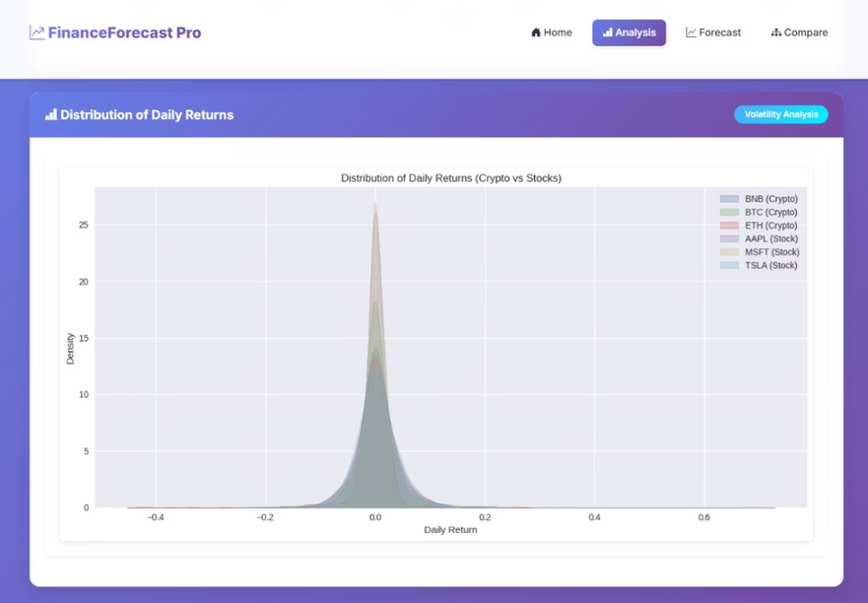
RETURN DISTRIBUTION ANALYSIS
Unpacking the Variance in Daily Asset Performance
A closer look at the density curve for daily returns of each asset class reveals pronounced differences in their risk profiles:
Cryptocurrency Returns
Stock Market Returns
Display a wider distribution and "fatter tails," indicating a higher frequency of extreme positive and negative price movements and significant short-term volatility.
Exhibit a thinner, more concentrated distribution centered near a zero mean, reflecting generally lower day-to-day volatility and more stable performance.
Strategic Implication: Diversification
This critical distinction highlights how integrating different asset classes can be pivotal for reducing overall portfolio risk and enhancing stability through strategic diversification.
Notes:
16

Slide 14

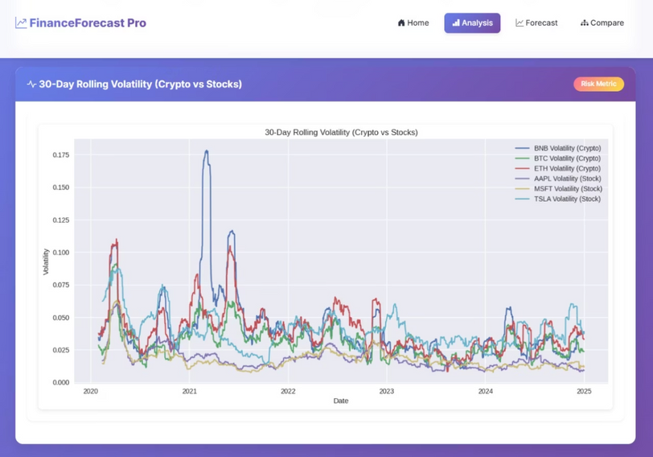
VOLATILITY ANALYSIS
Unpacking 30-Day Volatility Trends Across Asset Classes
Examining the 30-day rolling volatility lines for each asset category reveals distinct risk profiles and market behaviors:
1
Cryptocurrency Dynamics
Cryptocurrencies frequently display significant volatility spikes, highlighting their susceptibility to rapid and substantial price fluctuations.
2
Stock Market Resilience
Stock market volatility tends to be more stable and lower in magnitude, reflecting a comparatively calmer and more predictable investment environment.
3
Strategic Imperative: Risk Assessment
This stark contrast underscores the critical importance of thorough risk assessment and strategic allocation for maintaining a balanced and robust investment portfolio.
Notes:
17

Slide 15
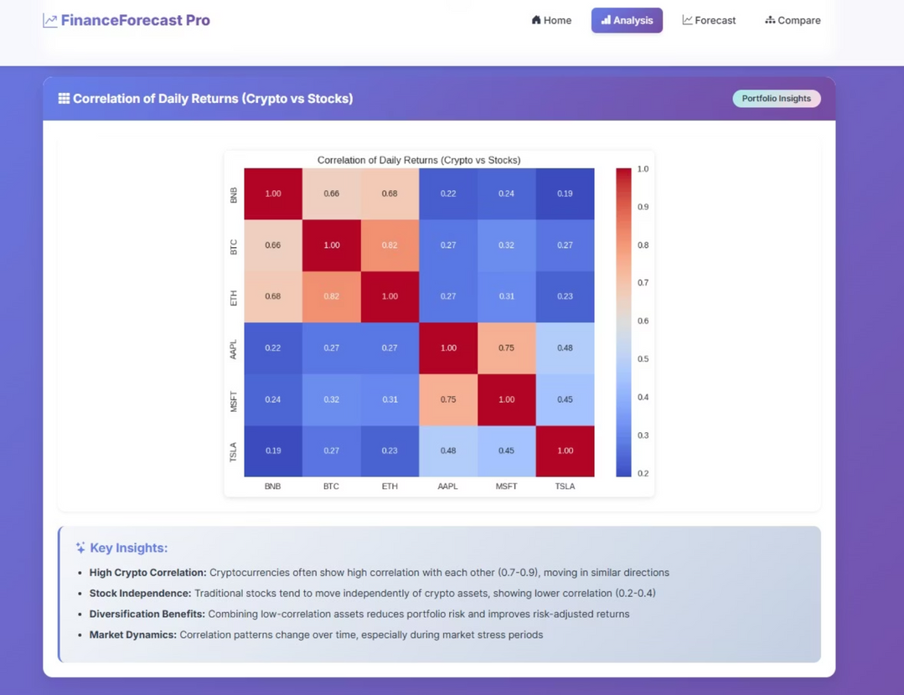
Correlation Matrix Insights
This correlation matrix heatmap provides a powerful visual breakdown of the intricate asset-to-asset return relationships across our analyzed financial instruments. Key insights include:
Cryptocurrency assets display exceptionally high internal correlation (often exceeding 0.7), indicating strong co-movement within the crypto market.
The correlation between cryptocurrencies and traditional equities (stocks) is consistently low, suggesting that these asset classes tend to move with significant independence.
This observed low cross-correlation strongly supports the strategic use of these asset classes for enhanced portfolio diversification, potentially offering improved risk-adjusted returns.
Notes:
18

Slide 16

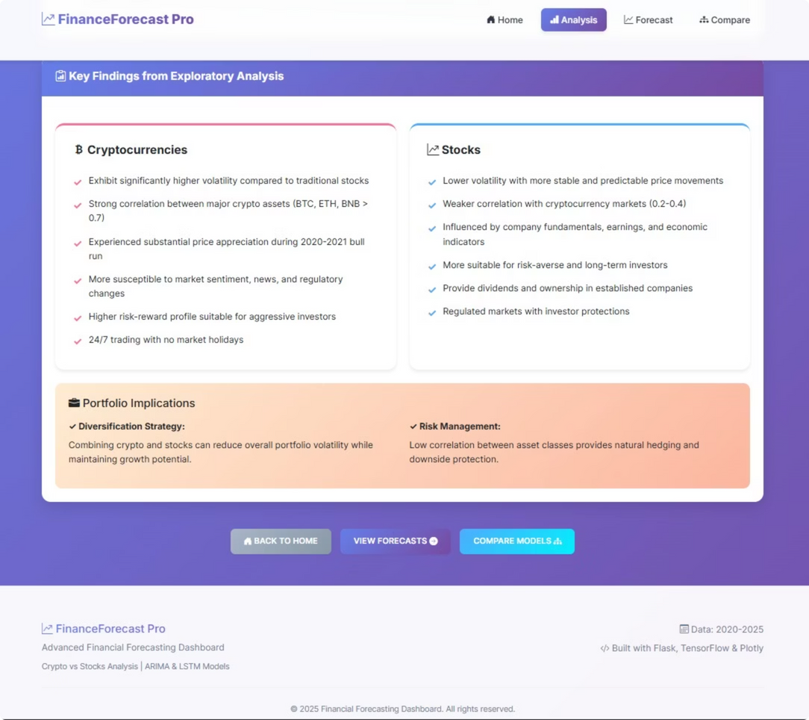
EDA KEY FINDINGS
Cryptocurrency Profile
High volatility, substantial upswings, sentiment-driven.
Stock Market Profile
Steady growth, less vulnerable to news.
Investment Strategy
Diversification within and across asset classes advised.
Outcome
Portfolio composite reduces risk, smooths returns.
Notes:
19

Slide 17
WHY MODEL SELECTION MATTERS IN FINANCIAL FORECASTING
Diverse Market Behaviors
Driving Portfolio Decisions
Contrasting Methodologies
Financial markets exhibit varied characteristics, ranging from the relative stability of large-cap stocks to the extreme volatility of cryptocurrencies.
Accurate, reliable forecasting models are crucial for making informed portfolio allocation decisions and implementing robust risk management strategies.
ARIMA (statistical time series) and LSTM (deep learning) represent fundamentally different approaches to time series analysis, each with unique strengths.
Notes:
20

Slide 18






ARIMA: THE CLASSIC STATISTICAL WORKHORSE
Stability & Suitability
Interpretability
Integration
Best suited for assets with stable, low-volatility patterns, such as government bonds and large-cap stocks. It assumes linearity.
Highly interpretable model based on explicit linear relationships (AutoRegressive, Integrated, Moving Average components).
Proven track record with over 70% accuracy in specific stock forecasting tasks; easily integrates with advanced risk models like GARCH.
Limitation: Struggles significantly with highly nonlinear data and sudden, unpredictable market shocks.
Notes:
21

Slide 19





LSTM: THE DEEP LEARNING POWERHOUSE
Nonlinear Expertise
Long-Term Memory
High Performance Potential
Excels at modeling highly nonlinear, volatile, and complex time series, making it ideal for assets like cryptocurrencies.
Utilizes gated memory cells to learn and retain long-term dependencies in the data, overcoming the vanishing gradient problems of traditional RNNs.
Demonstrated an 84-87% error reduction over ARIMA in specific complex financial time series datasets.
Requires significantly more clean, labeled training data and greater computational resources (GPUs) compared to ARIMA.
Notes:
22

Slide 20
MODEL COMPARISON: HEAD-TO-HEAD PERFORMANCE INSIGHTS
1
Fair Test Setup
Both ARIMA and LSTM models were trained and tested using identical, carefully selected train/test splits to ensure a fair performance comparison.
2
ARIMA's Domain
ARIMA generally maintains superior performance on steady, predictable financial instruments like S&P 500 ETFs and fixed-income assets (Marisetty, 2024).
3
LSTM's Edge
LSTM shines when the market exhibits abrupt, nonlinear episodes, often seen in high-growth technology stocks or highly volatile cryptocurrencies.
4
The Ensemble Recommendation
For a robust, diversified portfolio encompassing multiple asset types, a hybrid or ensemble modeling approach is strongly recommended.
Notes:
23

Slide 21
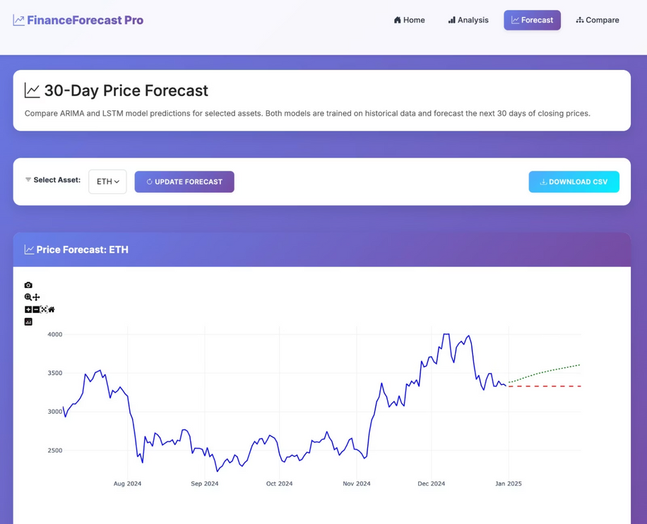
PRICE FORECAST VISUALIZATION EXAMPLE: ETHEREUM (ETH)
Key Elements:
The actual price data from the last 180 days provides critical historical context for the 30-day forecast.
The ARIMA line (Red) presents a smoother, trend-following trajectory, typical of linear models.
The LSTM line (Green) shows greater sensitivity, attempting to capture subtle volatility spikes in the highly unpredictable crypto market.
All forecasts are rigorously evaluated using out-of-sample holdout validation to ensure the reliability of predictions.
Beneath the graph, integrated "How-to-Read" guides aid user interpretation of forecast nuances and potential model biases.
Notes:
26

Slide 22
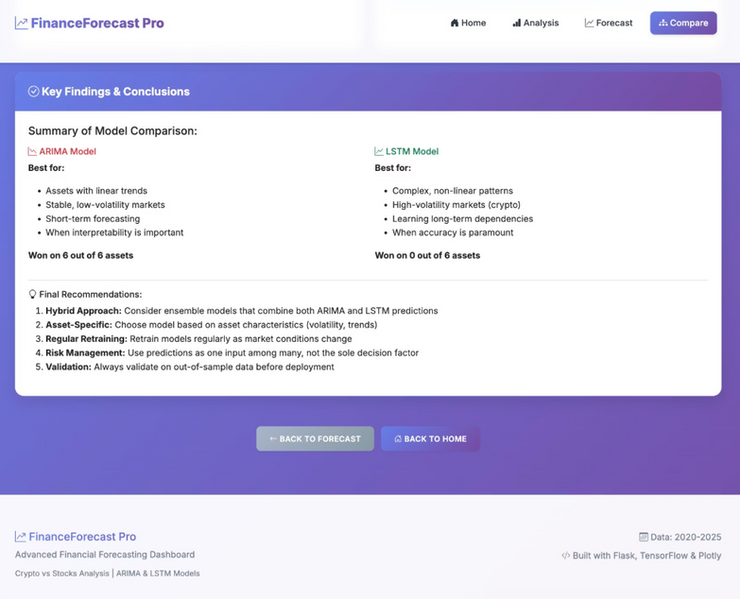
QUANTITATIVE MODEL PERFORMANCE SUMMARY
We utilized three common metrics - Mean Absolute Error (MAE), Root Mean Square Error (RMSE), and Mean Absolute Percentage Error (MAPE) to rigorously compare model accuracy across asset classes.
0.75
0.55
Stock Prediction Ease
Crypto Error Rate
Stocks were consistently the easiest to predict, with ARIMA achieving the lowest errors due to more stable, recognizable patterns.
Cryptocurrency forecasting resulted in significantly higher error rates for both models, reflecting the inherently unpredictable nature and sudden, large swings in the market.
0.90
ARIMA's Overall Edge
Overall, across the combined portfolio, the ARIMA model narrowly outperformed LSTM on average, validating its robustness for general financial data.
Notes:
27

Slide 23



FINAL CONCLUSIONS & PORTFOLIO STRATEGY GUIDANCE
Diversification is Key
Maintain diversification across cryptocurrencies and stocks to balance systemic risk and volatility exposure in the overall portfolio.
Model Validation
Always perform rigorous out-of-sample validation before deploying any model to production, ensuring results are generalizable.
Embrace Hybrid Strategies
Consider hybrid or ensemble models to combine the stability of ARIMA with the nonlinear capture ability of LSTM for best-in-class performance.
The Financial Forecasting Dashboard empowers repeatable, data-driven portfolio optimization, allowing allocation to reflect individual risk tolerance and strategic goals.
Notes:
28

Slide 24
References
Al-Afeef, M. A., Al-Smadi, R. W., & Al-Smadi, A. W. (2024). The role of stable coins in mitigating volatility in cryptocurrency markets. International Journal of Applied Economics, Finance and Accounting, 19(1), 176-185. https://pdfs.semanticscholar.org/101f/e33ae2ed50d6a9291e39fdddf2922fbc11a4.pdf
Aljinović, Z., Marasović, B., & Šestanović, T. (2021). Cryptocurrency portfolio selection—a multicriteria approach. Mathematics, 9(14), 1677. https://www.mdpi.com/2227-7390/9/14/1677
Albeladi, K., Zafar, B., & Mueen, A. (2023). Time series forecasting using LSTM and ARIMA. International Journal of Advanced Computer Science and Applications, 14(1), 313-320. https://www.academia.edu/download/102938576/Paper_33-Time_Series_Forecasting_using_LSTM_and_ARIMA.pdf
Marisetty, N. (2024). Forecasting Selected International Stock Indices Returns by Using ARIMA Model. Available at SSRN 4898668. https://papers.ssrn.com/sol3/Delivery.cfm?abstractid=4898668
Notes:
29

Slide 25
THANK YOU
PRESENTATION BY
NISHA DAS

