Slide 1
Reducing network energy consumption via sleeping and rate-adaptation
Nedevschi, Popa, Iannaccone, Ratnasamy, Wetherall
UC Berkeley, Intel Research, U of Washington
Presented by Nishad Gothoskar

Slide 2
Problem
Network Energy Consumption
Device
Router
Reoccurring themes
Utilization is low < 30%
Devices are built for worst case (peak)
High consumption even in idle state
We see this issues with
Processors, Mobile Devices, Mobile Networks
Energy dis-proportionality

Slide 3
Problem
Backbone of the Internet
Essential infrastructure
Networks are growing and expanding
Speed demands are increasing
Networks will become extremely power hungry
But, Energy costs and Environment concerns
Need to find a way to Energy optimize networks

Slide 4
Solution
Sleep
States
Performance
States
Somniloquy
SleepServer SleepProxy
(Computers)
DVFS
(Computers)
ACPI
(Computers)

Slide 5
Solution
E=p_{a}T_{a} + p_{i}T_{i}
Sleep
States
Performance
States
Find state
p_{s}
With
p_{i} > p_{s}
Reduce
p_{a} and p_{i}
and increase
T_{a}

Slide 6
Method
Assume certain network hardware exists
With these dynamic states
Sleep
Performance
Very different from our previous papers
Use models / simulations of networks
Write algorithms
Analyze and evaluate how this network hardware would improve energy usage in that model
* Criticism *

Slide 7
Models
Record the network traces
ns2 – packet-level simulator
Intel and Abilene
Router Netflow records per minute
Very realistically be able to model with precision the network traffic and information flow

Slide 8
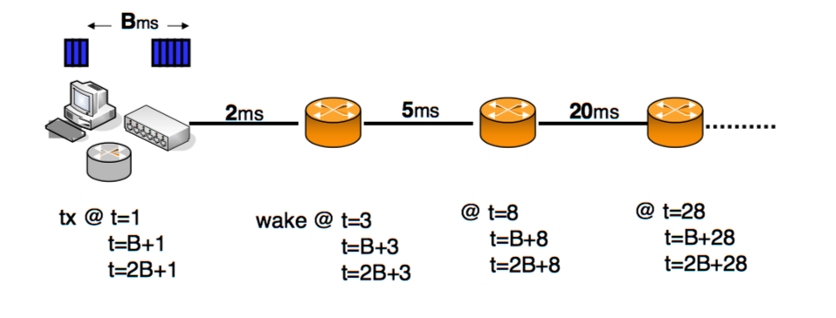
Sleep
Benefit comes from p_{sleep}
Must consider δ which is the transition period
Takes advantage of timer-driven sleep to coordinate a buffer interval of Bms

Slide 9
Sleep (2)
Called the Buffer and Burst strategy
Many times the delay is the downside
This strategy ensures upper bound of B
Developed two algorithms
Optimal B&B
Perfectly coordinated
Forgets delta
Practical B&B
Takes into account delta
More realistic and alike to something we could implement

Slide 10
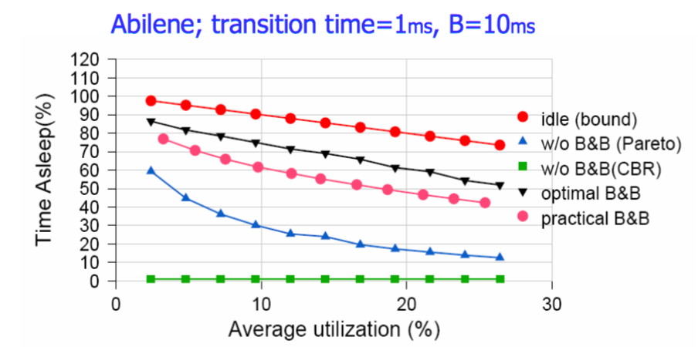
Data

Slide 11
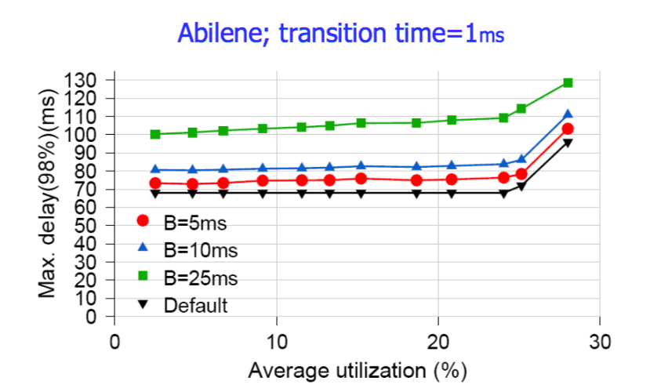
Data

Slide 12
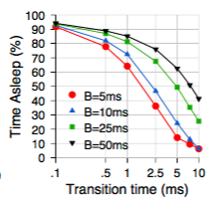
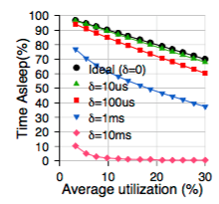
Data

Slide 13
Data Analysis
Savings vs. performance
Balanced metric
Savings – (sleep time→energy) compare prac to opt
Performance – (delay) compare prac to none
Drop bits
Usefulness highly dependent on parameters
In general, low utilization and B=5ms → 60% sleep
Delta is essential → design hardware with low delta

Slide 14
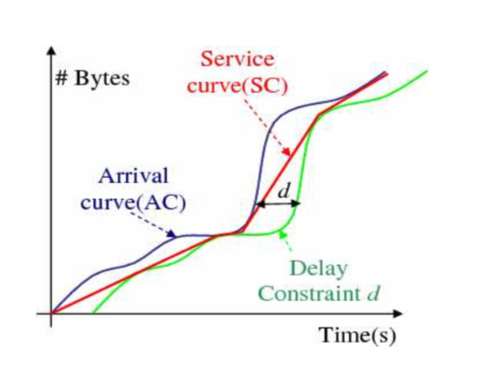
Rate Adaption
Different performance rates r₁, r₂, r₃, r₄…
Must consider δ which is the transition period
r₁,

Slide 15
Rate Adaption
Optimization problem
Because Energy ~ Transmission rate
r₁,

Slide 16
Rate Adaption (2)
The practical algorithm
Takes discrete values
Online
Same data analysis as previous part involving the Savings vs. Performance between prac and opt

Slide 17
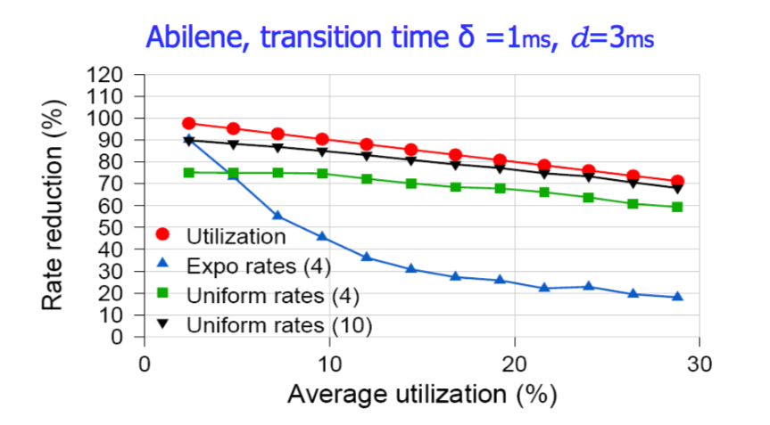
Data

Slide 18
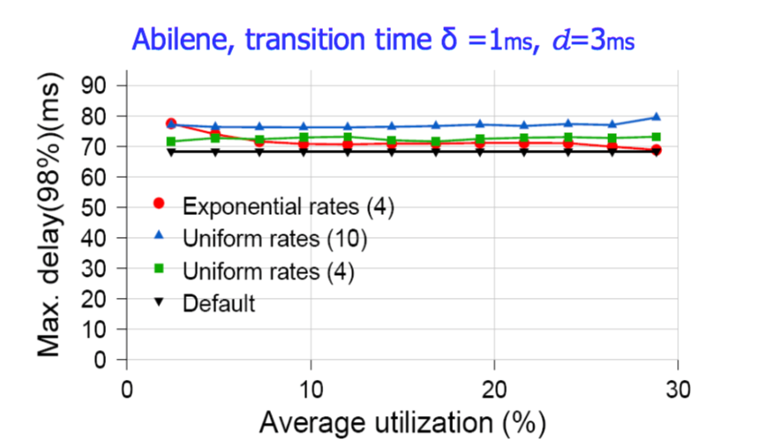
Data

Slide 19
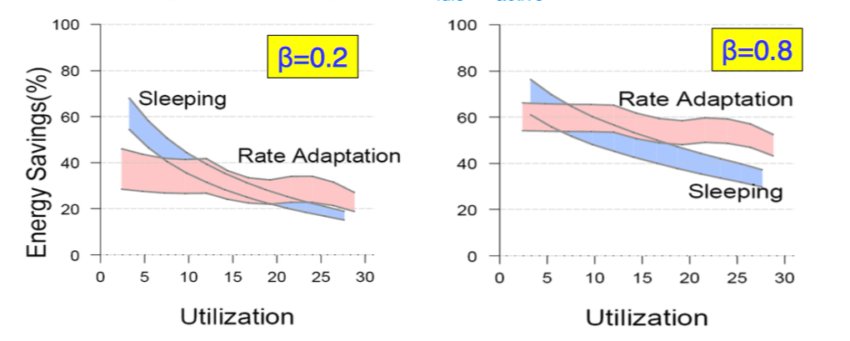
Results
Results are dependent on the power consumption in each of the states and the ratios between them

Slide 20
Conclusion
Lets address the big problem
NO implementation ALL simulations
This research provides the basis of how to develop new network hardware

