Slide 1
Lending Club Case Study
By: Nishadh Shrestha

Slide 2
About this case study
Lending Club is a financial services company that offer peer-to-peer lending services. When the company receives a loan application, the company has to make a decision for loan approval based on the applicant’s profile.
In this case study we analyse the data that contains historical information about loan applicants from lending club and look closely at whether they defaulted or not.
The aim is to study features in the data set identify patterns which indicate if a person is likely to default. These finding may then be used for taking actions such as denying the loan, reducing the amount of loan, lending (to risky applicants) at a higher interest rate, etc.
In this case study, we will Exploratory Data Analysis to explore and acquire insights out of the provided loan data.

Slide 3
Exploratory Data Analysis Process
There are four major parts of this study:
Data Understanding
Data Cleaning
Data Analysis
Recommendations

Slide 4
Data Understanding
There are 39717 rows and 111 columns in this dataset
This seems like high-dimensional dataset and might have one or more features that aren't important for this analysis
First impression is that this dataset might by somewhat noisy (like null values) and will need cleaning up

Slide 5
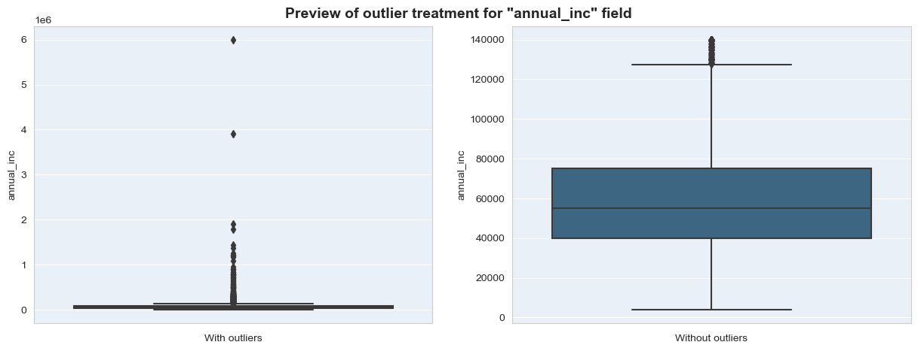
Data Cleaning
These 55 columns seems to contain only null values and they were dropped
Some other columns like loan behaviour data, unique id and fixed value columns were also removed
Data types of each columns were corrected
Outliers for numerical columns were removed by using the IQR method

Slide 6
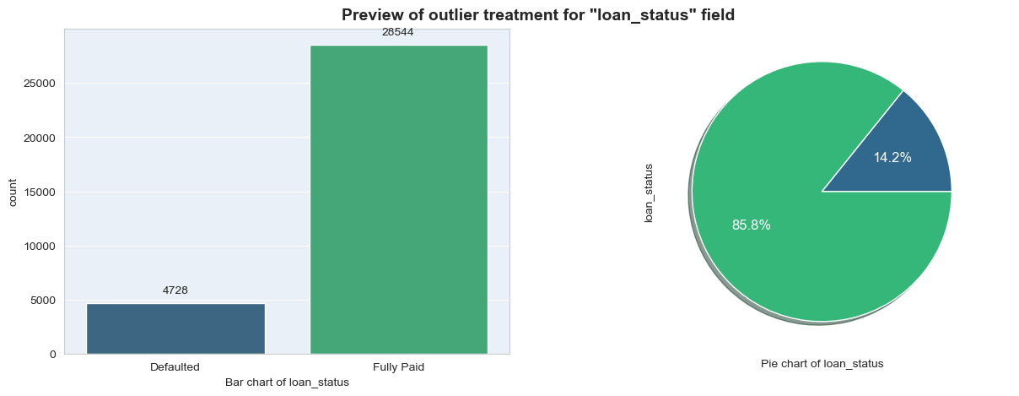
Data Analysis - Univariate
Univariate Analysis
Univariate Analysis was performed on several single fields to gain insights about individual variables in the data
Significantly more loans are fully paid when compared to defaulted loans

Slide 7
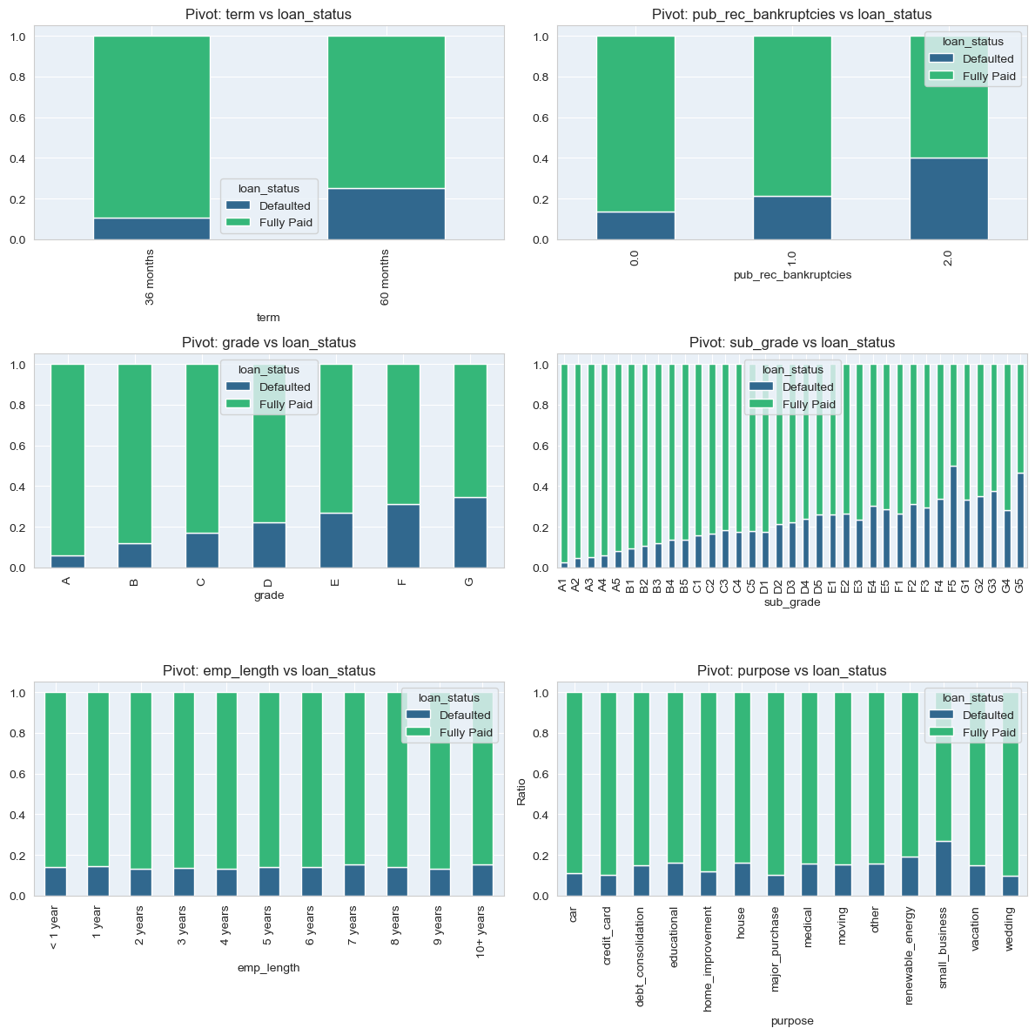
Observations from Univariate Analysis
Defaults rate is higher for 60 month term loan
Defaults rate is higher for borrowers with public bankruptcy records
Defaults rate is higher for lower grade loans
Default rate is slightly higher for small business loans

Slide 8
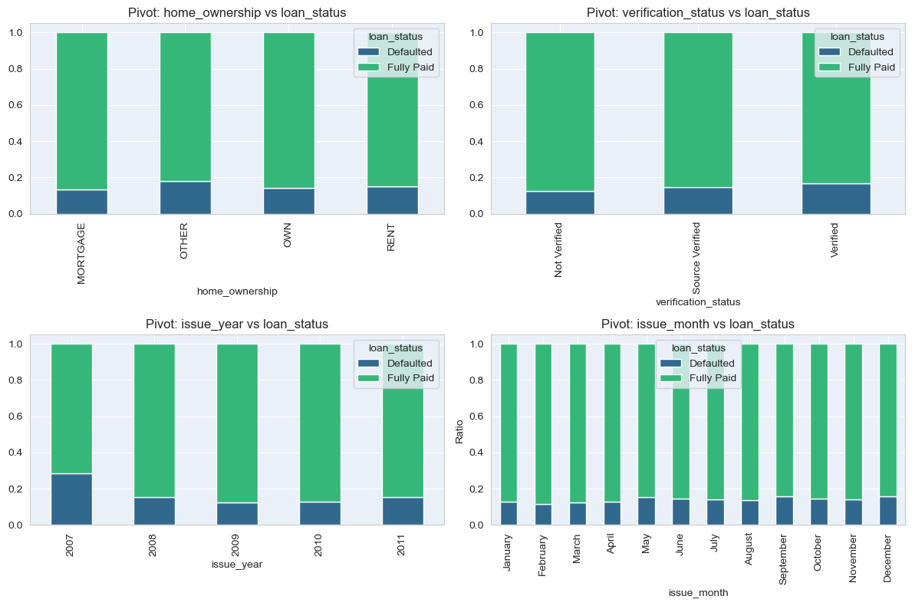
Univariate Analysis – Part 1
Default rate is higher in year 2007

Slide 9
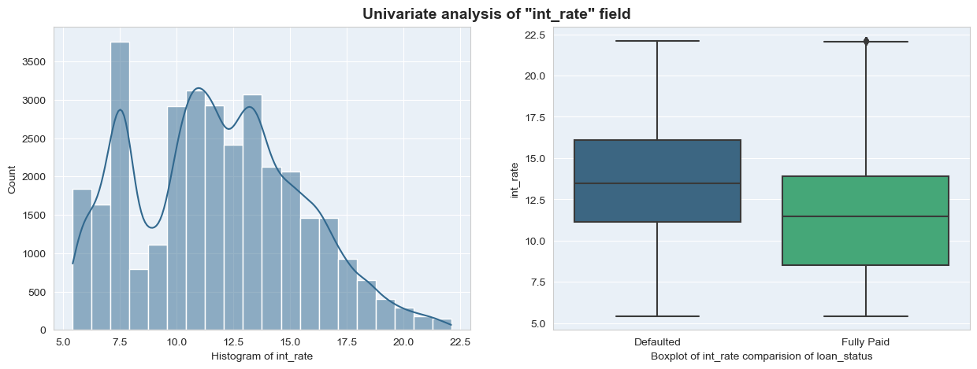
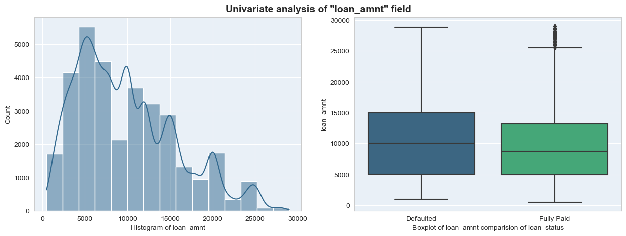
Univariate Analysis – Part 2
Loan defaults rate is higher with higher interest rates
Loan defaults rate is higher with higher loan amount

Slide 10
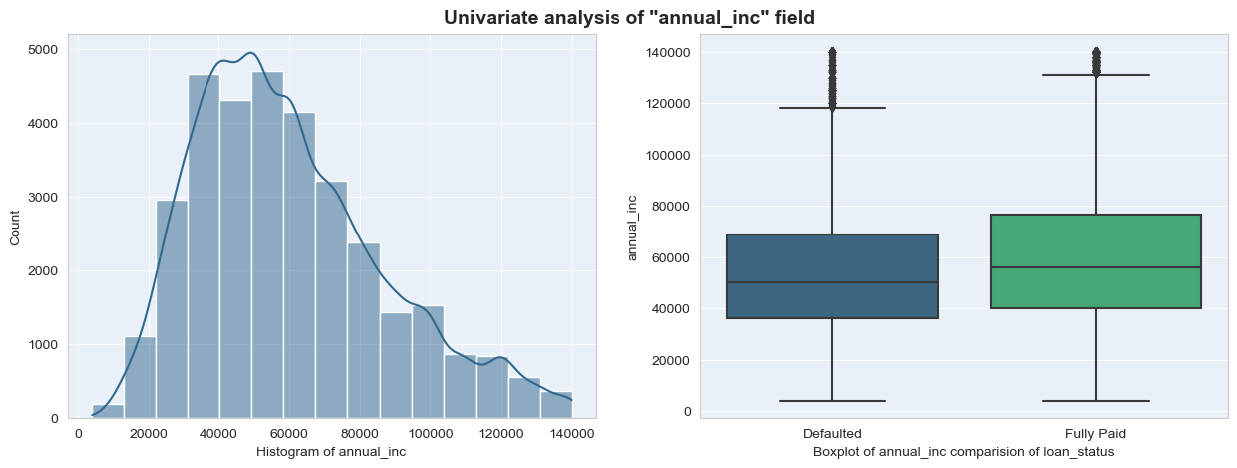
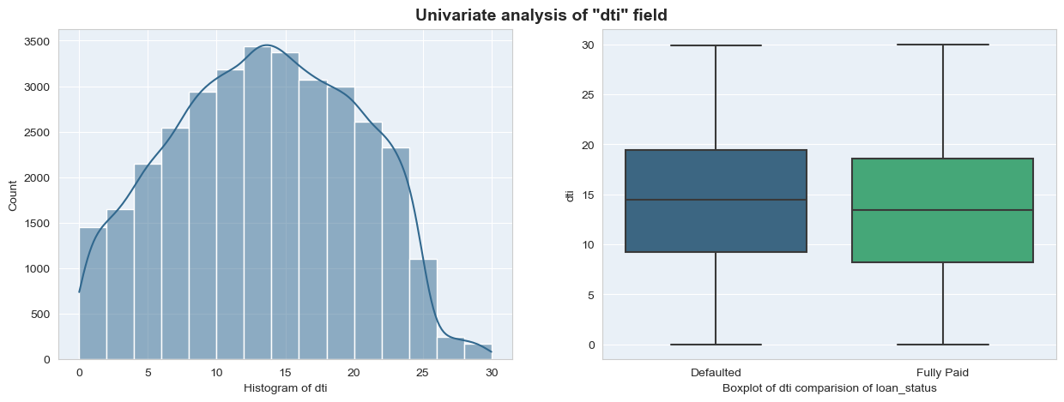
Univariate Analysis – Part 3
Loan defaults rate is lower with higher annual income
Loan defaults rate is higher with higher debt to income ratio

Slide 11
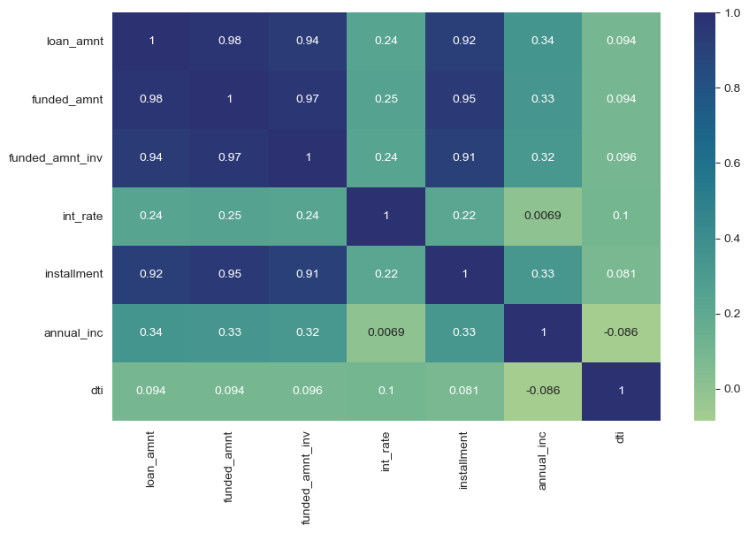
Bivariate Analysis – Part 1
Loan amount, Funded amount, Funded amount invested, and Installment are highly correlated.

Slide 12
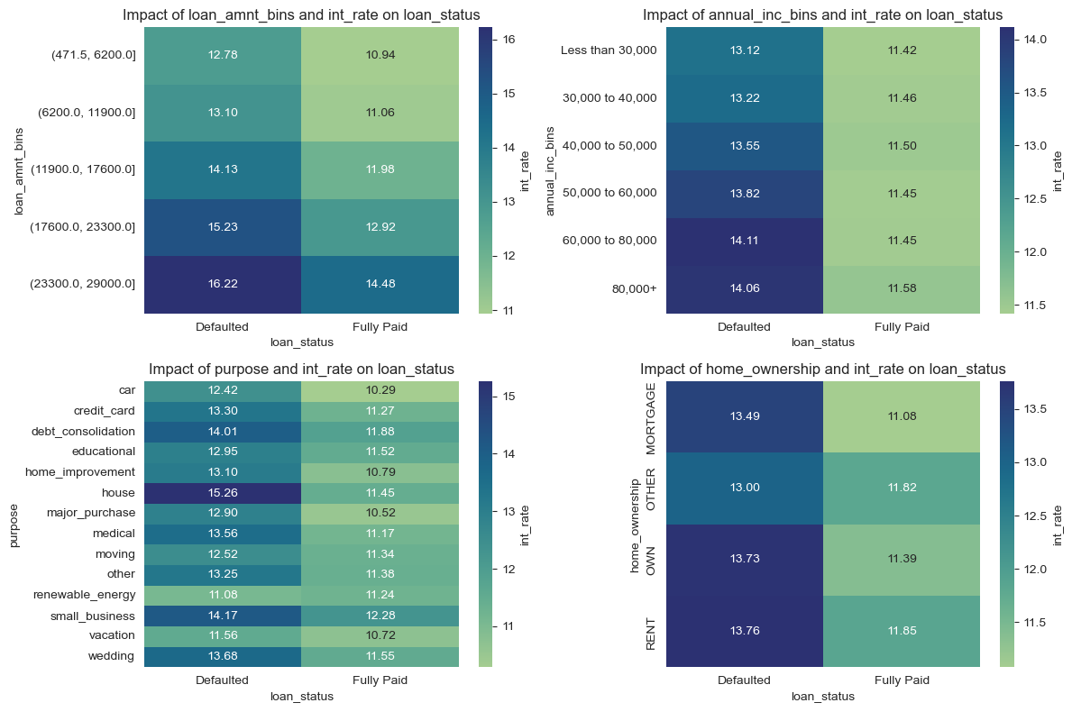
Bivariate Analysis – Part 2
Higher interest rate indicates higher loan defaults across most range of other variables

Slide 13
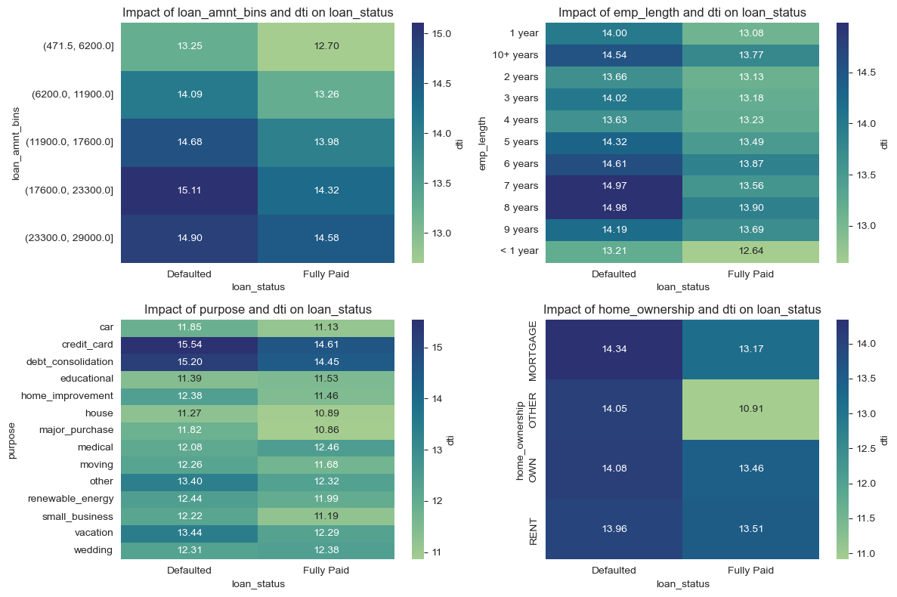
Multivariate Analysis – Part 2
Higher Debt to Income ratio indicates higher loan default rates across most range of other variables

Slide 14
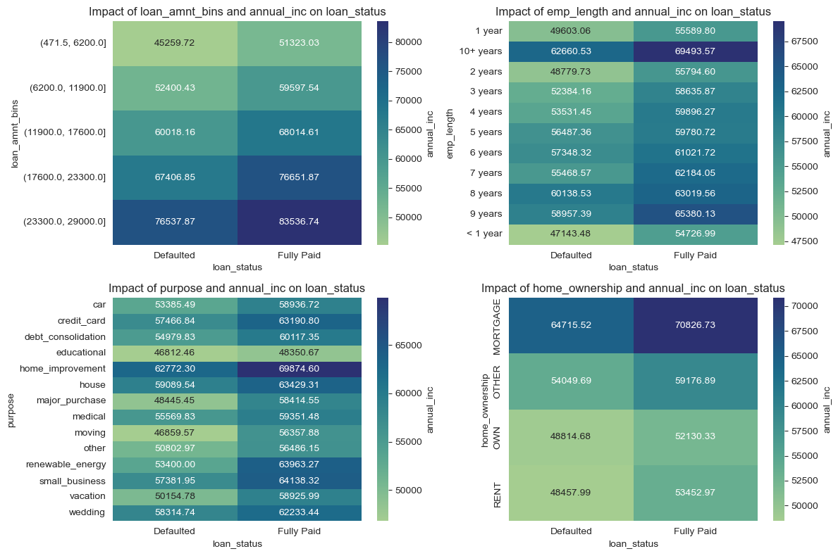
Bivariate Analysis – Part 3
Higher Annual Income indicates lower loan default rates across most range of other variables

Slide 15
Recommendation
The key factors that drive higher loan default rates include the following.
Borrower has low salary
Loan amount is high
Interest rate is high
60 months term instead of 30 months term
Lower Grade loans
Loan type of Small Business
Borrower has been bankrupt before
Higher Debt to Income ratio

