Slide 1
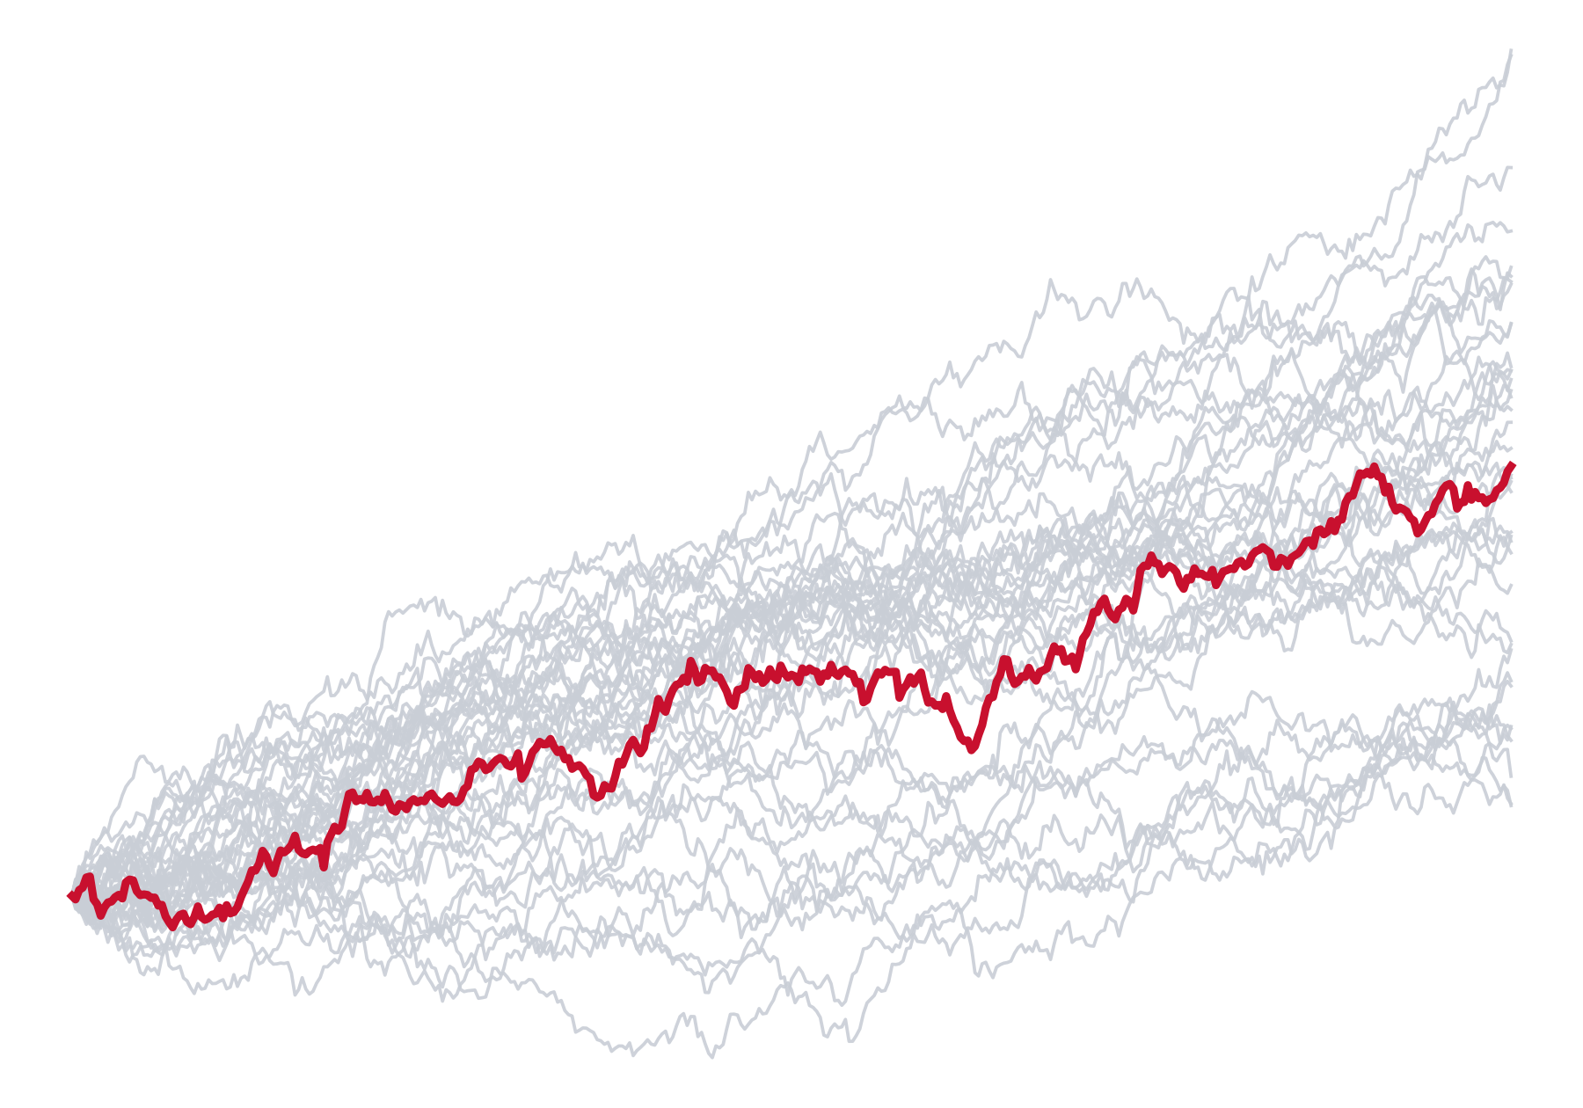
Neural SDEs
Differentiating through stochastic dynamics
Nishad Wajge
CMSC 838B · University of Maryland · Fall 2026
Notes:
[0:00 – 0:20]
PLAN: 25:00 total = 20:00 talk + 5:00 discussion. If behind at slide 7 or 19, skip them.
CHECKPOINTS: slide 9 by 6:00 · slide 14 by 12:15 · slide 20 by 18:30 · discussion by 20:00.
Appendix (A1–A10) is not presented; jump there only if asked.
• Hi, I'm Nishad. Today: neural SDEs, and how to take gradients through randomness.
• One running example the whole way: when does an avocado go bad?

Slide 2
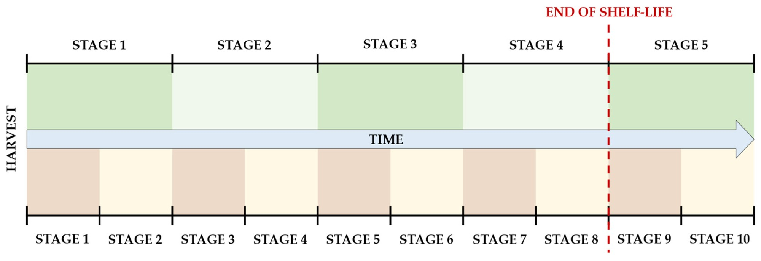
Xavier et al. (2024): Daily Images of 478 Avocados
RUNNING EXAMPLE
Group | Storage | n | Stage 1→5 (fit)
T10 | 10 °C, 85% RH | 192 | 17.6 d
T20 | 20 °C, 85% RH | 143 | 8.5 d
Tamb | 15.8–21.7 °C, RH not logged | 143 | 7.7 d
Fig. 2 (cropped): 5- vs. 10-stage index; end of shelf life = entry to stage 5. Xavier, Rodrigues & Silva, Foods 13:1150 (2024), CC BY 3.0.
Images | Labels | Split
14,722 (2 sides × daily) | 5-stage index; 10-stage refinement | 70/15/15 by fruit
Shelf life: τ = first day at stage 5
Stage-1→5 durations computed from the paper's Table 4 slopes (4 × |α|).
Three storage regimes, daily images, ordinal labels: an irregularly observed latent process.
Notes:
[0:20 – 1:10]
• Data: Xavier, Rodrigues and Silva, Foods 2024, open access. 478 Hass avocados photographed daily on both sides until overripe.
• Three groups: 10 °C, 20 °C (both 85% humidity), and room temperature, which drifted between 15.8 and 21.7 °C with humidity not logged.
• Labels: a 5-stage ripening index, refined to 10 stages. End of shelf life is reaching stage 5 (stage 9 on the 10-stage scale).
• Last column: from their fitted slopes, going from stage 1 to 5 takes ~17.6 days at 10 °C, ~8.5 at 20 °C.
• Splits are by fruit, so no avocado appears in both train and test.
IF ASKED — why is the 10-stage index there? Finer resolution; the paper reports it's less accurate exactly (≈60%) but ≈93% within one stage.
IF ASKED — license? The paper is CC BY 3.0; figures are reused with attribution. The dataset is on Mendeley Data (doi:10.17632/3xd9n945v8).

Slide 3
Their Pipeline: Classify, Then Map to Days Left
RUNNING EXAMPLE
Photo x
CNN (AlexNet / ResNet-18)
Stage ŝ ∈ {1,…,5}
Days Left = α_g (ŝ − 5)
Stage accuracy (test, by picture)
Shelf-life MAE (days, 5-stage)
Network | 5-stage exact | ±1 | 10-stage exact | ±1
AlexNet | 76.9% | 99.4% | 57.4% | 92.6%
ResNet-18 | 78.4% | 99.7% | 60.8% | 93.3%
Group | true stage | predicted
T10 | 1.70 | 1.82
T20 | 0.73 | 0.75
Tamb | 0.53 | 0.54
All | 0.99 | 1.04
Tables 3 and 6, Xavier, Rodrigues & Silva, Foods 13:1150 (2024). 'Predicted' = by sample.
A strong per-image classifier; shelf life is a deterministic read-out of the current stage.
Notes:
[1:10 – 2:00]
• Their method: a CNN with transfer learning classifies the stage from one photo; a per-group linear regression turns the stage into days left.
• Left: ~78% exact on 5 stages, >99% within one stage. 10 stages: ~60% exact, ~93% within one.
• Right: mean absolute error in shelf life. Even with the TRUE stage label ('true stage' column), error is 1.7 days at 10 °C. So most of the error isn't the classifier; it's the stage → days map.
IF ASKED — the abstract says 88.8%? That's accuracy on the best side of each fruit; the table shows per-picture averages.
IF ASKED — what's 'by sample'? Each fruit has two photos (sides); 'by sample' uses the better/combined side, which improves accuracy because one side can have marks.

Slide 4
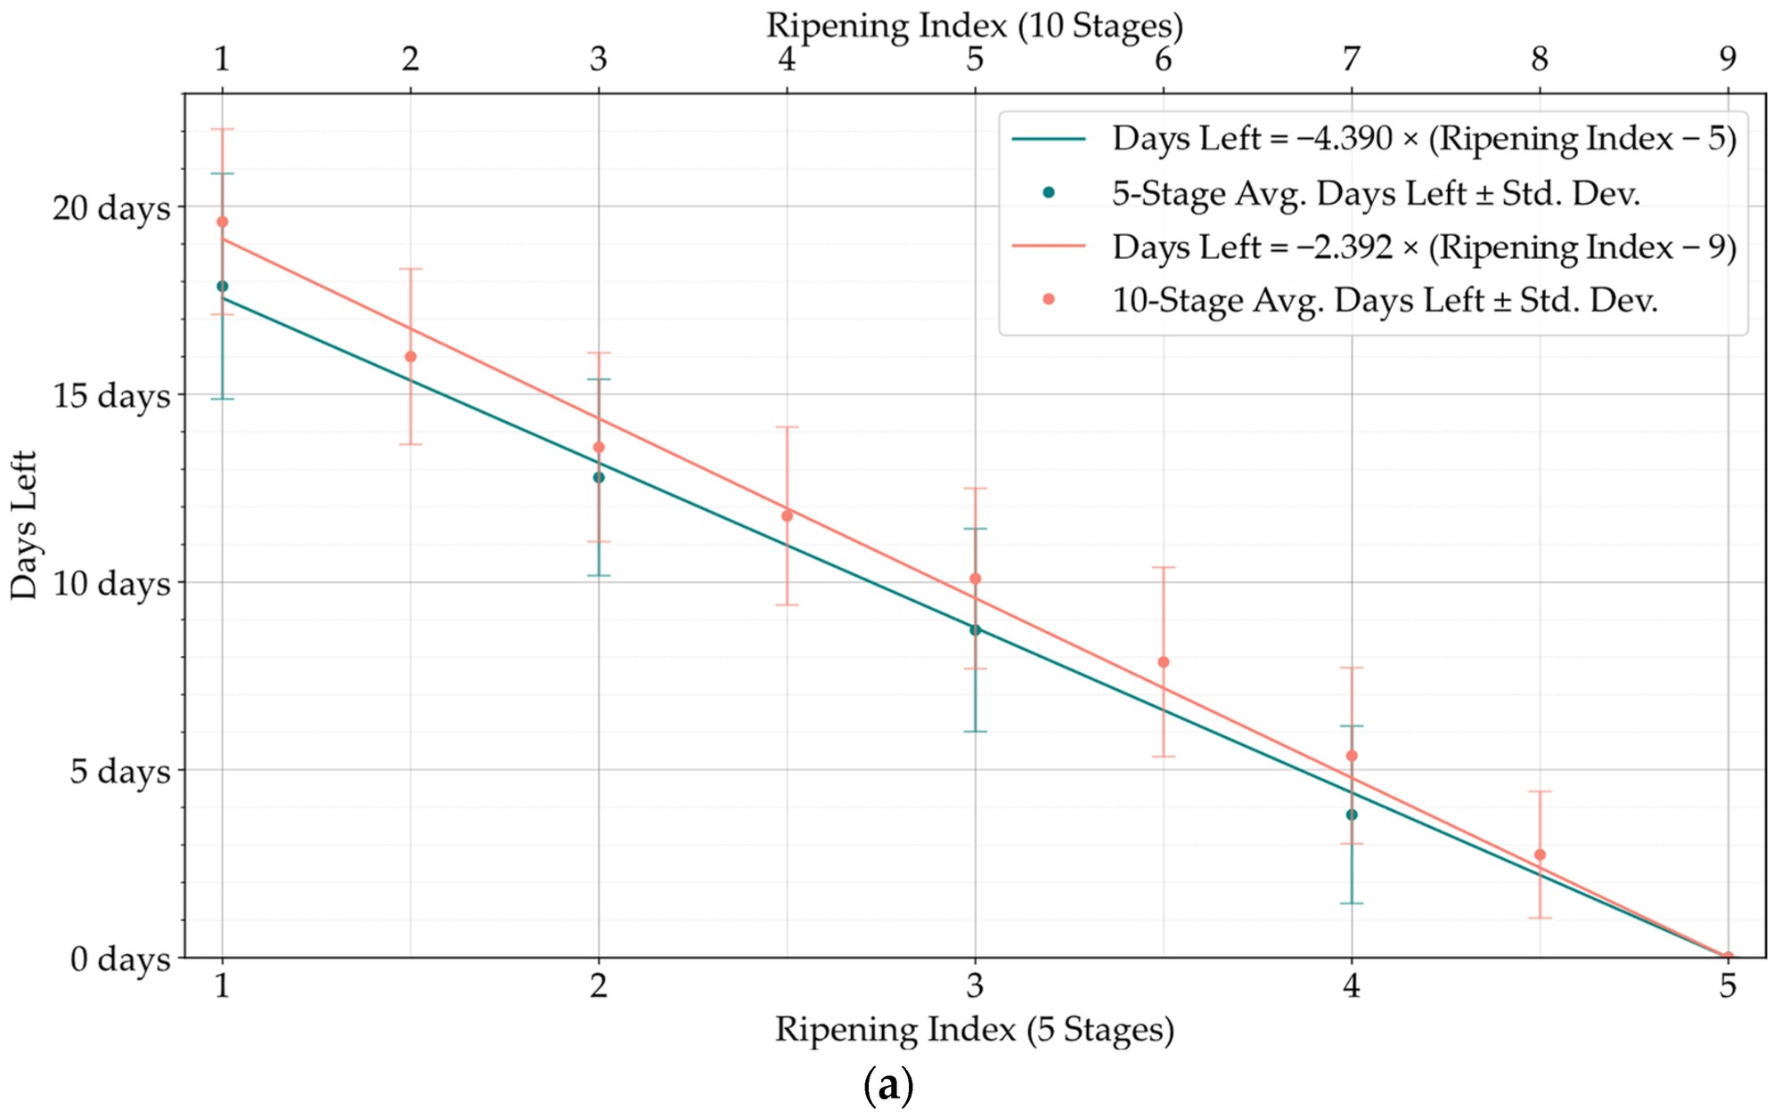
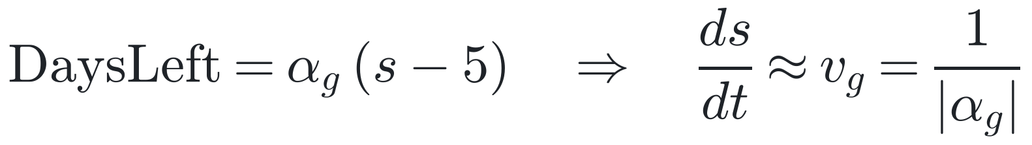
Their Shelf-Life Model, Read as a Constant-Drift ODE
RUNNING EXAMPLE
Group | α (d / stage) | v = 1/|α| | R²
T10 | −4.390 | 0.228 | 0.953
T20 | −2.116 | 0.473 | 0.963
Tamb | −1.929 | 0.518 | 0.959
α: Table 4 of the paper. v in stages / day (derived).
Missing: dW, memory of past images, uncertainty in τ.
Fig. 6a (T10, cropped from Fig. 6): mean ± sd days left per stage. Xavier, Rodrigues & Silva, Foods 13:1150 (2024), CC BY 3.0.
Regression line = drift; error bars = the spread it leaves out.
Notes:
[2:00 – 2:50]
• Their linear regression, Days Left = α(stage − 5), can be read as a constant-velocity ODE in stage: ds/dt ≈ v with v = 1/|α|.
• Rates: 0.23 stages/day at 10 °C, 0.47 at 20 °C, 0.52 at room temperature. 20 °C ripens ~2× faster than 10 °C, as the paper reports.
• Left plot (their Fig. 6a, T10): the error bars are standard deviations of days left at each stage, often ±2–3 days. A deterministic ODE can't represent that spread; a diffusion term can.
IF ASKED — is that inversion exact? No: regressing days on stage and inverting isn't the same as regressing stage on days (slopes differ by a factor R², ~4% here); stage is ordinal; and their fit is pinned at stage 5. Close enough to read off rates.
IF ASKED — R² ≈ 0.96 looks great; why change it? R² measures fit of the mean; the decision (sell/discount by Friday) needs the distribution around the mean, which R² doesn't capture.

Slide 5
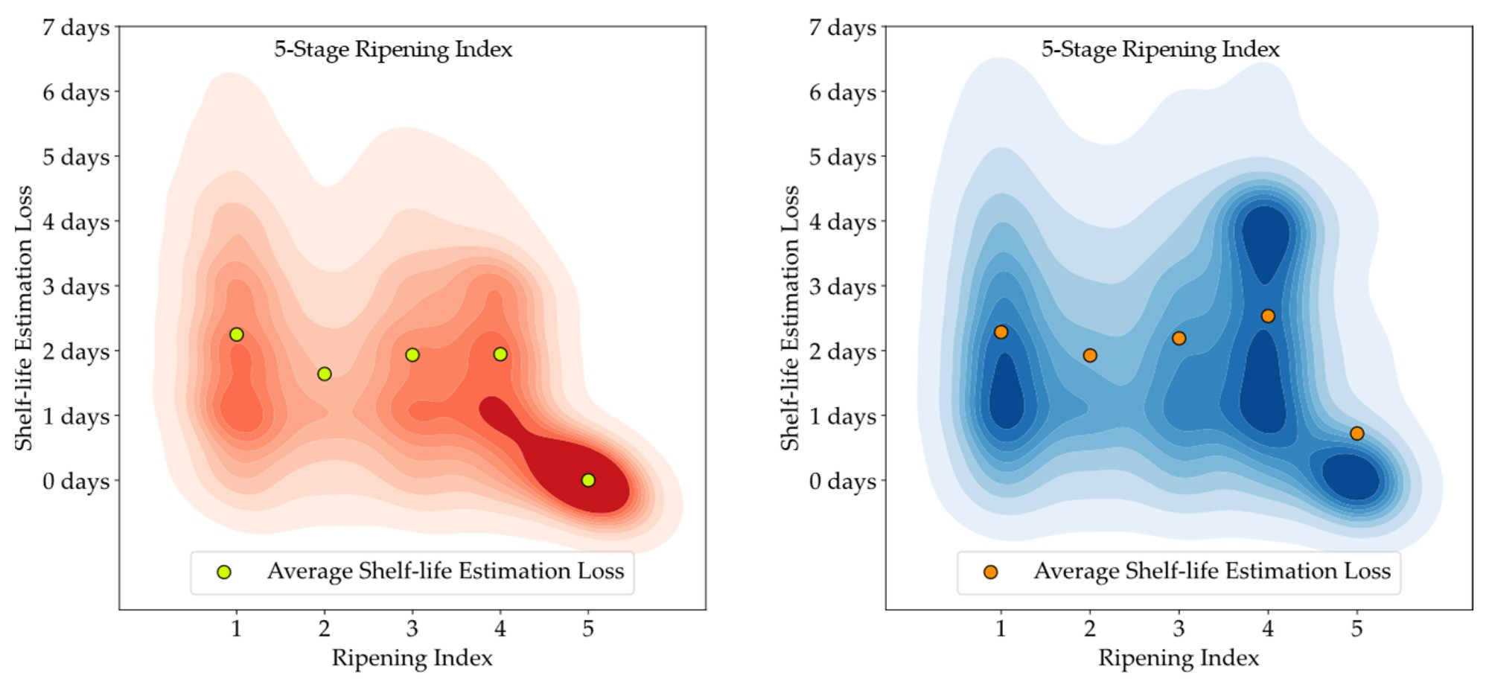
A Point Estimate Hides Days of Spread
RUNNING EXAMPLE
Group | |α| (d) | floor |α|/4 | MAE | share
T10 | 4.39 | 1.10 | 1.70 | 65%
T20 | 2.12 | 0.53 | 0.73 | 72%
Tamb | 1.93 | 0.48 | 0.53 | 91%
MAE in days, attributed labels (Table 6). Floor: uniform position within a stage.
Errors reach ~6 days at stages 1–4 (T10).
Fig. 11 (T10, cropped): shelf-life error vs. ripening index; left attributed labels, right predicted. Xavier, Rodrigues & Silva, Foods 13:1150 (2024), CC BY 3.0.
Quantization explains most error; the excess peaks at 10 °C, the longest horizon.
Notes:
[2:50 – 3:45]
• Fig. 11, 10 °C group: shelf-life error by stage. Left human labels, right model predictions.
• Average error ≈ 2 days at stages 1–4, tails to ~6 days.
• Part is unavoidable: one label can't tell day 1 of a stage from day 4. That floor, |α|/4, is 65% of the error at 10 °C, 91% at room temperature.
• The rest is what a model must represent as a distribution. It's largest at 10 °C, the longest horizon.
IF ASKED — couldn't this just be label noise? Partly: the 'attributed' labels are human. Separating diffusion (sd ∝ √horizon) from fruit-to-fruit rate variation (sd ∝ horizon) needs the per-stage sds in Fig. 6.
IF ASKED — why |α|/4? The MAE of a uniform distribution of width w about its center is w/4.
IF ASKED — why zero at stage 5? Days left is 0 by definition once the fruit is in stage 5.

Slide 6
What a Better Model Needs
RUNNING EXAMPLE
Requirement | Per-image CNN (paper) | Sequence model | Latent ODE | Latent SDE
Use all past images | — | ✓ | ✓ | ✓
Irregular / missing days | — | partial | ✓ | ✓
Distribution over τ | — | partial | partial | ✓
Temperature-structured rate | partial | — | ✓ | ✓
Within-fruit noise (sd ∝ √h) | — | — | — | ✓
Continuous time + intrinsic noise + structured drift → latent neural SDE.
Notes:
[3:45 – 4:20]
• The paper's model uses one image and outputs a point. Rows: what we want.
• A sequence model gets partway. A latent ODE handles irregular time, but has no noise that keeps arriving.
• Latent SDE: all five by construction; its diffusion adds variance that grows like √h along the way.
IF ASKED — can't a latent ODE spread? Yes, via an uncertain initial state or per-fruit rate (sd ∝ horizon), but that collapses as images accumulate.
IF ASKED — 'partial' for the paper on temperature: they fit a separate slope per storage group; that's temperature-dependent but not a function of temperature (can't interpolate to 15 °C).

Slide 7
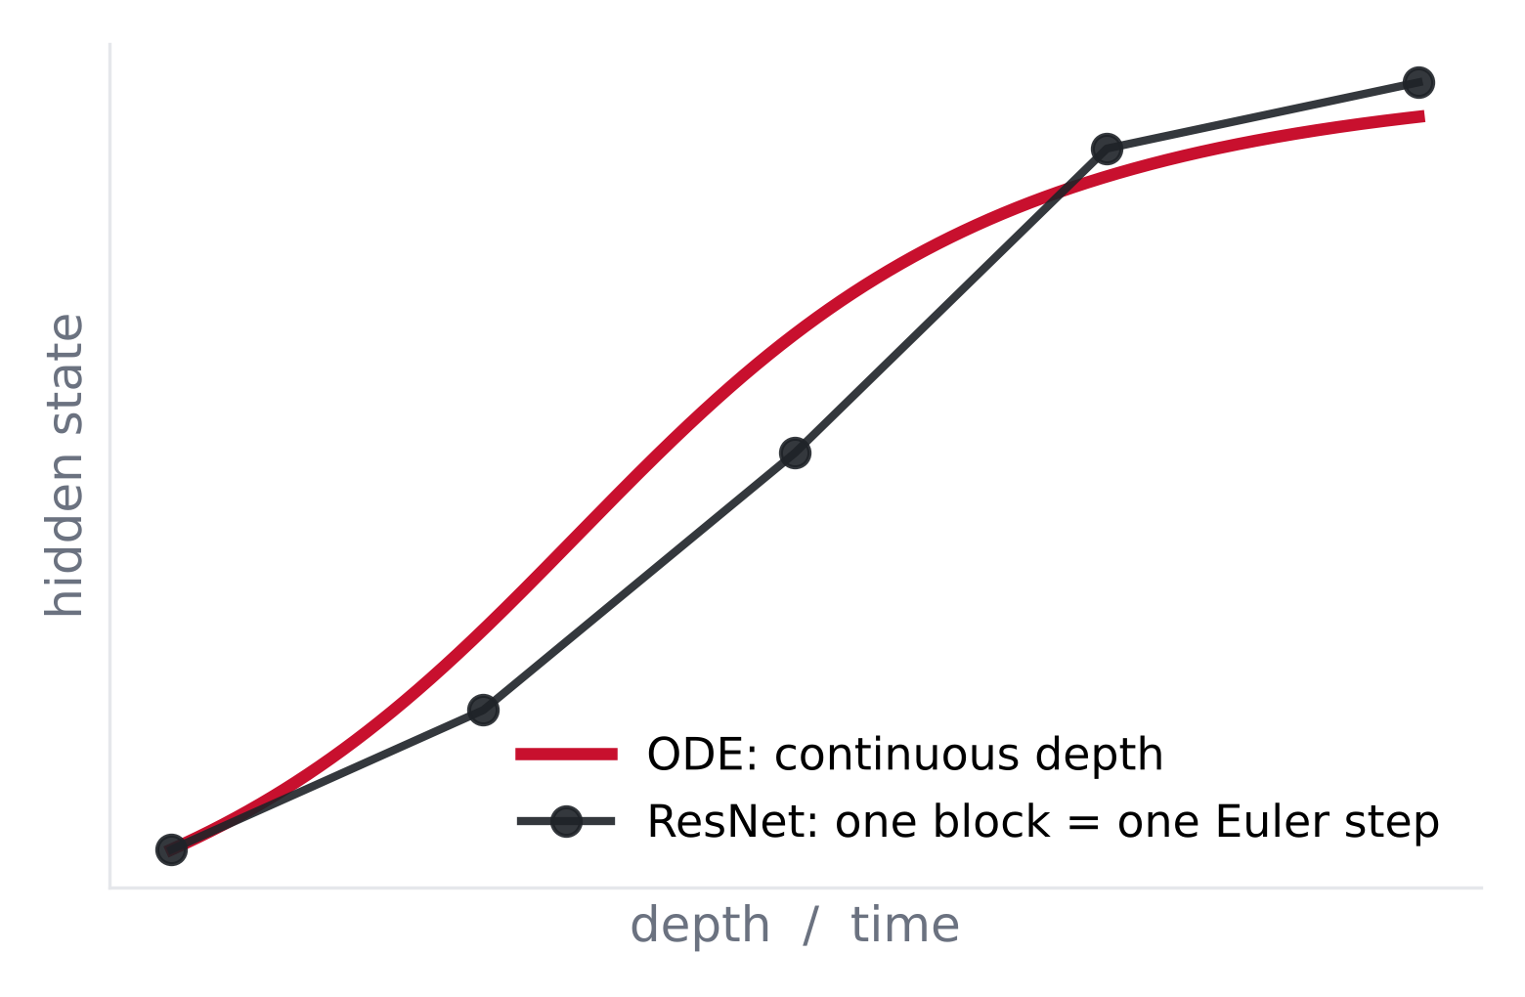
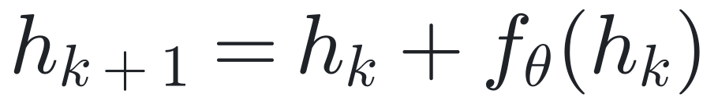
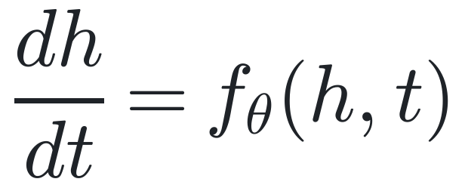
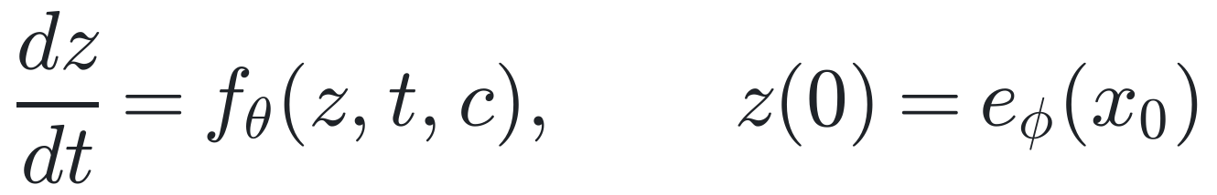
Neural ODEs: Continuous-Depth Dynamics
PART 1 · DIFFERENTIATING SOLVERS
residual block
Δt → 0
neural ODE
latent version (paper = special case f = v_g)
ResNet = explicit Euler; a neural ODE delegates stepping to the solver.
Notes:
[4:20 – 5:00] — SKIP-IF-SHORT (most of the room knows this).
• Residual block h + f(h) = one explicit Euler step. Δt → 0 gives dh/dt = f_θ(h, t); the solver chooses the steps.
• Bottom: in the avocado setting, z(0) is an encoding of the first photo, f evolves it under storage condition c. The paper's model is the special case f = constant rate v_g in stage space.
IF ASKED — costs? Each forward pass is a solve; adaptive solvers' step counts (NFE) tend to grow during training.

Slide 8
Three Ways to Differentiate a Solver
PART 1 · DIFFERENTIATING SOLVERS
Method | Memory (N steps) | Extra compute | Gradient | Diffrax
Backprop through steps | O(N) | ≈ 1 backward pass | exact (discrete) | RecursiveCheckpointAdjoint(checkpoints=N)
Binomial checkpointing | O(log N) | O(N log N) | exact (discrete) | RecursiveCheckpointAdjoint()
Continuous adjoint | O(1) in N | backward solve (2d + p) | approximate | BacksolveAdjoint()
d = state dim, p = #params. Rows 1–2: discretize-then-differentiate. Row 3: differentiate-then-discretize.
Memory, compute and gradient exactness trade off; no method wins all three.
Notes:
[5:00 – 5:55]
• Row 1: treat the solver as code and backprop. Exact gradient of the computed solution; stores every step.
• Row 2: Griewank's binomial checkpointing (revolve): O(log N) checkpoints, O(N log N) recomputation, still exact.
• Row 3: derive the continuous gradient as a backward ODE (next slide) and solve it. Memory independent of N, but the backward re-solve doesn't retrace the forward discrete path, so the gradient is approximate.
IF ASKED — 2d + p? Backward state = z (d), adjoint a (d), running parameter gradient (p).

Slide 9
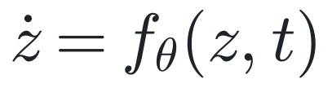
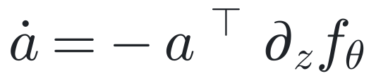
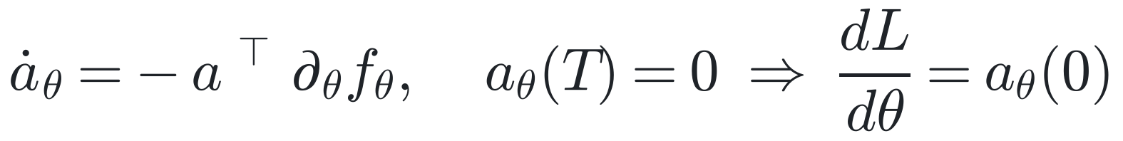
The Adjoint Method
PART 1 · DIFFERENTIATING SOLVERS
backward from T → 0 (derivation: A1)
0
T
state
forward: z(T); store nothing
adjoint a = ∂L/∂z(t)
backward: (z, a, a_θ) jointly
parameter gradient
Term | Primitive
aᵀ ∂f/∂z | VJP of f in z
aᵀ ∂f/∂θ | VJP of f in θ
a(T) = ∂L/∂z(T)
Reverse-mode AD in continuous time: one VJP per solver stage.
Notes:
[5:55 – 7:25] — core slide.
• a(t) = ∂L/∂z(t): sensitivity of the loss to the state at time t. Linear ODE backward from a(T) = ∂L/∂z(T).
• a_θ starts at 0 at T; its value at 0 is dL/dθ.
• z is re-integrated backward rather than stored: source of O(1) memory and of the approximation.
• Both terms are vector–Jacobian products: one reverse-mode call of f per solver stage (Lecture 4's primitive). Never form the Jacobian.
IF ASKED — derivation? Appendix A1 (Lagrange multiplier on ż = f, integrate by parts).
IF ASKED — relation to Pontryagin? a is the costate; the adjoint ODE is the costate equation.

Slide 10
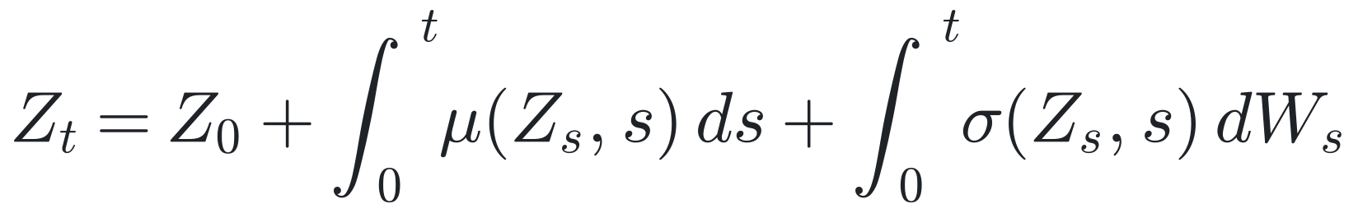
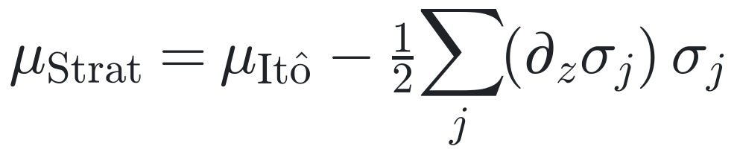
Itô Calculus: What You Need
PART 2 · STOCHASTIC DYNAMICS
SDE (integral form)
Brownian increments
Itô's lemma
Itô → Stratonovich drift
Scheme | Calculus | Strong | Weak
Euler–Maruyama | Itô | ½ | 1
Milstein | Itô / Strat. | 1 | 1
Reversible Heun | Strat. | ½ | —
Full table: A7
Itô for modeling; Stratonovich for gradients (ordinary chain rule).
Notes:
[7:25 – 8:55]
• An SDE is shorthand for the integral equation; the dW integral is Itô (left endpoint).
• Increments are independent N(0, Δt); (dW)² = dt is why stochastic calculus differs.
• Itô's lemma: the extra ½ f″ σ² dt term. Example: d log S picks up −½σ².
• Stratonovich (midpoint) obeys the ordinary chain rule; the drift changes by −½ Σ_j (∂σ_j/∂z) σ_j. Zero when σ doesn't depend on z.
• Orders: Euler–Maruyama strong ½ (paths), weak 1 (expectations).
IF ASKED — strong vs weak? Strong: E|Z_T − Ẑ_T|. Weak: |E f(Z_T) − E f(Ẑ_T)|. Probabilities like P(τ ≤ t*) need weak; pathwise gradients care about strong.
IF ASKED — which does Euler converge to? Euler–Maruyama → Itô; Heun / midpoint → Stratonovich.

Slide 11
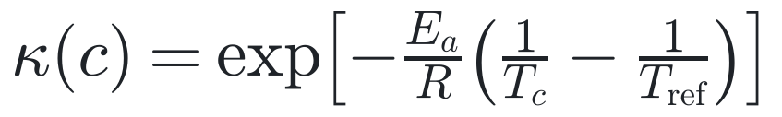
A Latent Neural SDE for Ripening
PART 2 · STOCHASTIC DYNAMICS
images x(t_k)
encoder e_φ
latent SDE Z_t
ordinal head
τ
irregular t_k
CNN / ViT
storage c
stages 1–5
first passage
dynamics
observation model
target
Paper | Here
ŝ from one image | filtered Z_t from all images
Days Left = α_g(ŝ − 5) | P(τ ≤ t* | images up to day k, c)
Drift = rate (physics prior × network); diffusion = fruit-to-fruit variability; τ = first passage.
Notes:
[8:55 – 10:15]
• Encode each photo; Z_t evolves as an SDE between photos; an ordinal head maps Z to stage probabilities; shelf life τ is when the ripeness score crosses the stage-4/5 cut.
• Drift: Arrhenius factor κ(c) times a neural rate. E_a activation energy, R gas constant, T in kelvin. Diffusion σ_θ: variability across fruit and storage.
• Ordinal head: cumulative-logit model, P(y ≤ k) = sigmoid(c_k − q(Z)), cut points c_k ordered. b = c_4 defines 'end of shelf life'.
• Bottom: what changes vs the paper. They classify one image and map to a point; we filter all images and output a probability.
IF ASKED — how do you compute P(τ ≤ t*)? Monte Carlo from the filtered posterior at the last photo; count crossings, with a Brownian-bridge correction between steps (A6).
IF ASKED — should σ scale with temperature? If temperature speeds up the whole biological clock, σ ∝ √κ. Slide 13 tests exactly this against the paper's numbers.

Slide 12
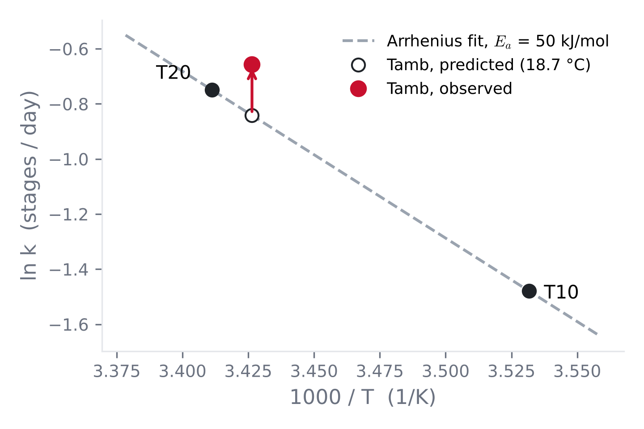
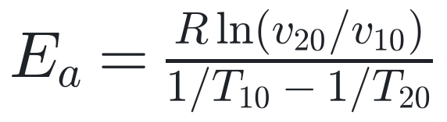
Fitting the Drift Prior to the Paper's Rates
PART 2 · CALIBRATING THE PRIOR
Quantity | Value
Q₁₀ = v₂₀ / v₁₀ | 2.07
Eₐ | 50.4 kJ/mol
Tamb, predicted (18.7 °C) | 2.32 d / stage
Tamb, observed | 1.93 d / stage
Temperature implied | 21.3 °C
Rates from the paper's Table 4; fit is ours (A5).
Two temperatures pin Eₐ; ambient ripens 20% faster than Arrhenius predicts → learned residual.
Notes:
[10:15 – 11:10]
• Using their per-group slopes: rates 0.228 (10 °C) and 0.473 (20 °C) stages/day. Q10 ≈ 2.07, so Eₐ ≈ 50 kJ/mol, a plausible enzymatic value.
• Predict room temperature (mean 18.7 °C): 2.32 days per stage. Observed: 1.93. Ambient fruit ripened ~20% faster than temperature alone explains; you'd need 21.3 °C, near the top of the recorded range.
• Likely culprits: humidity wasn't controlled in Tamb, and temperature fluctuated. Point: a physics prior gets you most of the way; a learned residual absorbs what it misses. That's why the drift is κ(c) × network.
IF ASKED — is two points enough to fit Arrhenius? It determines Eₐ exactly but gives no check of the functional form; that's why I treat it as a prior, not a law.
IF ASKED — could temperature fluctuation explain it? Rate is convex in T, but with sd 1.2 °C the Jensen effect is under 1%. Not enough for 20%.

Slide 13
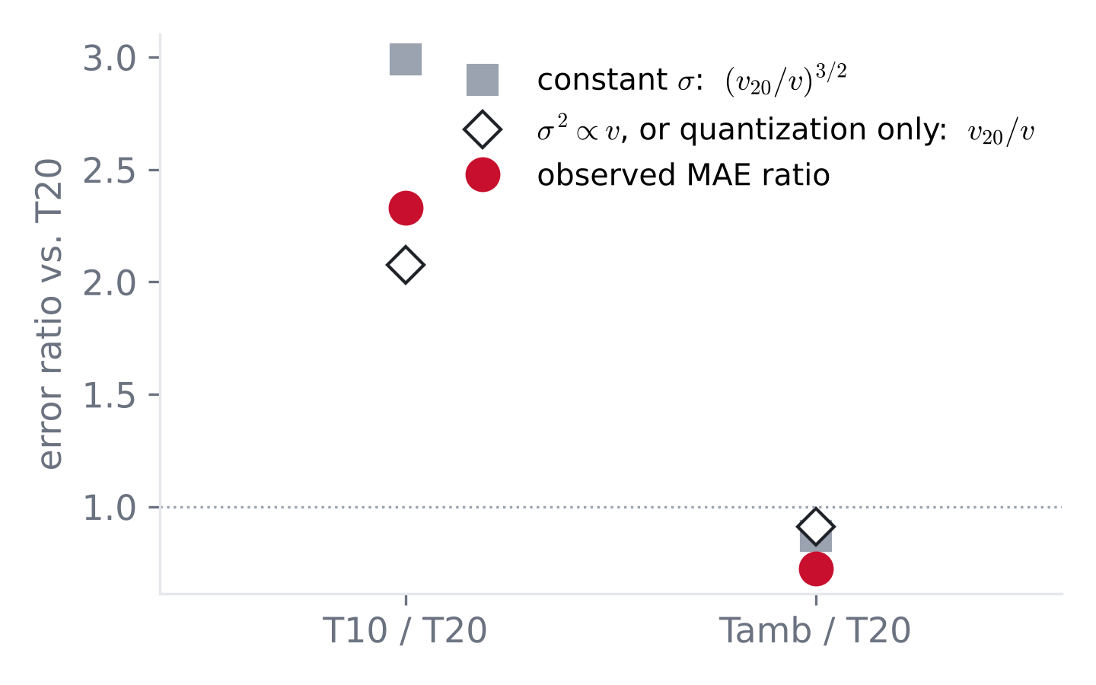
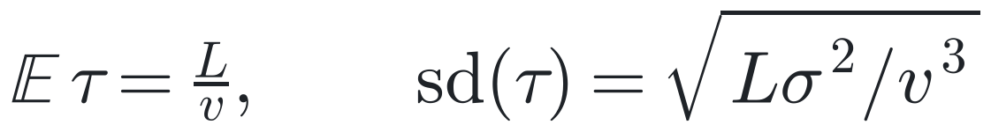
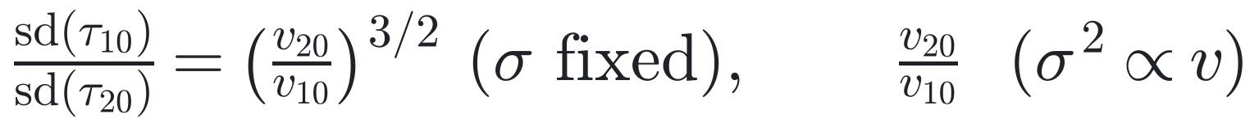
Do the Paper's Errors Have a Drift–Diffusion Shape?
PART 2 · A QUICK TEST
first passage of drifted Brownian motion (A4)
Ratio | σ fixed | σ² ∝ v | quant. only | observed
T10 / T20 | 2.99 | 2.07 | 2.07 | 2.33
Tamb / T20 | 0.87 | 0.91 | 0.91 | 0.73
Observed = MAE ratios with attributed labels (paper, Table 6).
Observed 2.33 > 2.07 from quantization alone: extra spread at 10 °C.
Notes:
[11:10 – 12:15]
• Back-of-envelope: stage drifts at rate v with noise σ. Time to cover distance L is inverse Gaussian: mean L/v, sd √(Lσ²/v³).
• If σ is the same at all temperatures, the T10/T20 error ratio is (v₂₀/v₁₀)^{3/2} ≈ 3.0. If temperature speeds up the whole clock (σ² ∝ v), it's v₂₀/v₁₀ ≈ 2.1.
• Careful: quantization alone also gives 2.07.
• Observed: 2.33. Above quantization, so extra spread at 10 °C. Three numbers can't pin σ(T); it's a shape check, not a fit.
IF ASKED — Tamb is lower than every prediction? Consistent with Tamb being a different regime (uncontrolled humidity, fluctuating temperature), as slide 12 showed.
IF ASKED — why MAE ∝ sd? For a fixed distribution shape, MAE is a constant multiple of sd (0.8 for Gaussian). That assumes small CV; under fixed σ the inverse-Gaussian CV differs 1.44× between T10 and T20, so treat the ratios as rough.
IF ASKED — caveats? MAE of a stage-based estimate, not the sd of τ, and labels are human. Derivation in A4.

Slide 14
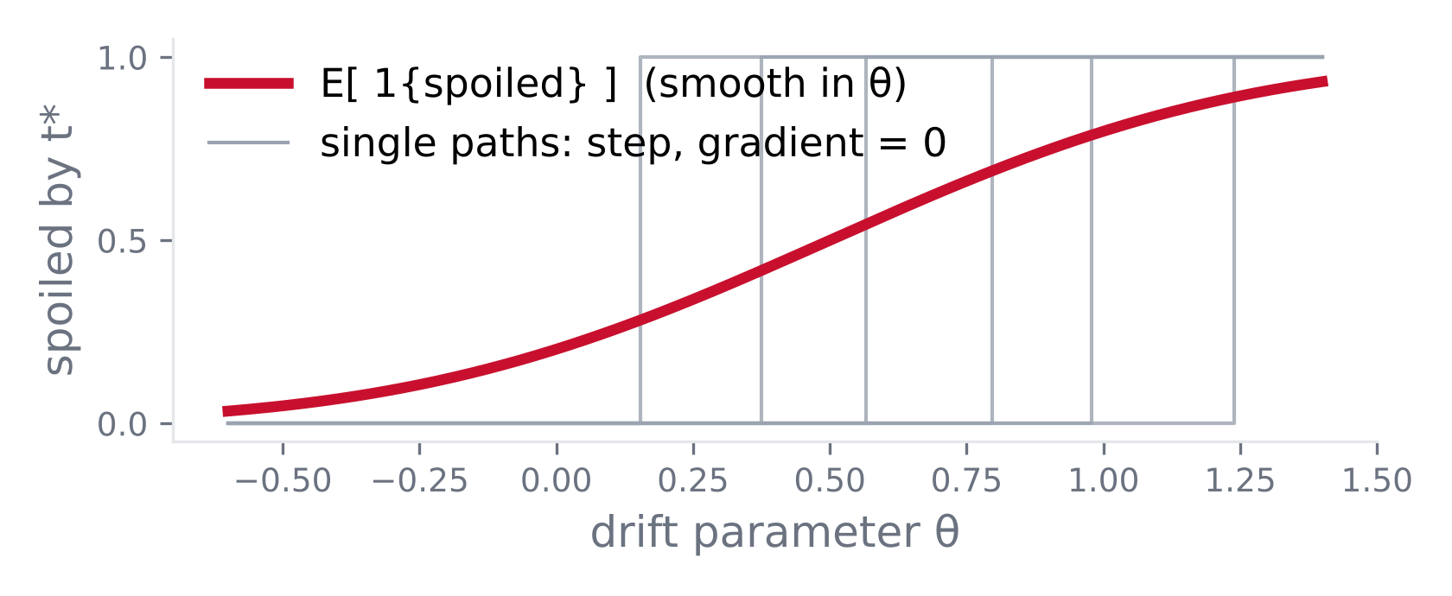
Pathwise vs. Score-Function Gradients
PART 3 · GRADIENTS THROUGH NOISE
pathwise (reparameterization)
score function (likelihood ratio)
Estimator for P(τ ≤ t*) | Bias | Variance | Notes
Pathwise on 1{τ ≤ t*} | total (∇ = 0) | — | fails
Sigmoid surrogate (ε) | O(ε) | ↑ as ε → 0 | needs ε schedule
Brownian-bridge crossing | low | low | smooth per step (A6)
Score function (Girsanov) | none | high | drift params only
Our target, P(τ ≤ t*), is discontinuous pathwise: the reparameterized gradient is zero.
Notes:
[12:15 – 13:45]
• Pathwise: Z_T as a deterministic function of θ and fixed noise W; differentiate inside E. VAE reparameterization trick. Low variance; needs f differentiable.
• Score function: E[f ∇ log p_θ]; any f, high variance.
• Plot: for each fixed noise path, 'spoiled by t*' is a step in θ, derivative zero almost everywhere. The expectation (red) has nonzero slope. Pathwise returns 0: a biased gradient, not a noisy one.
• Table: four estimators. Brownian-bridge crossing probability is the one I'd use: smooth in the endpoints, low variance, exact for frozen coefficients within a step.
IF ASKED — Girsanov ratio? For drift parameters: ∇_θ log p = ∫ (∂_θ(σ⁻¹μ))ᵀ dW. Parameters in σ change quadratic variation → path measures mutually singular in continuous time; on a grid the EM density exists but its estimator's variance blows up as Δt → 0.
IF ASKED — finance analogue? Digital and barrier options: same problem; same fixes (smoothing, likelihood-ratio Greeks, bridge corrections). Mohamed et al. JMLR 2020 for the ML view.

Slide 15
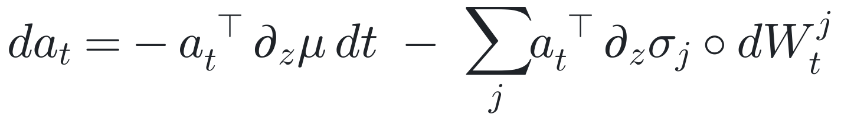
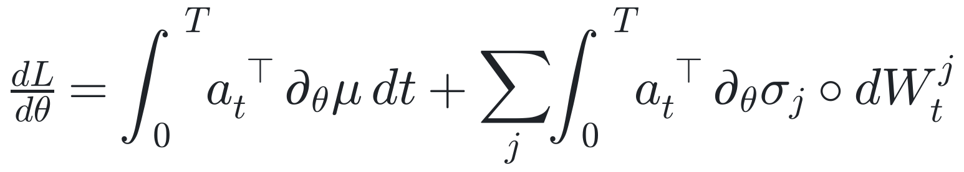
The Stochastic Adjoint
PART 3 · GRADIENTS THROUGH NOISE
backward from T, Stratonovich (∘), same W; μ = Stratonovich drift
Li, Wong, Chen & Duvenaud, AISTATS 2020. Why Stratonovich: A2.
Requirement | Solution | Cost
Same W forward and backward | virtual Brownian tree / Brownian Interval | O(1) memory, O(log 1/ε) per query
Chain rule must hold | Stratonovich form (convert Itô drift) | —
Exact gradients | reversible Heun + matching discrete adjoint (torchsde) | exact up to round-off
ODE adjoint + a noise term driven by the replayed Brownian path.
Notes:
[13:45 – 15:05]
• Compare slide 9: one extra term per noise channel, aᵀ ∂σ_j/∂z ∘ dW^j.
• Requirement 1: the backward pass must see the same noise. A virtual Brownian tree regenerates W(s) from a seed (A6).
• Requirement 2: Stratonovich form, so the ordinary chain rule holds. Convert an Itô model's drift first, or the gradients are wrong.
• Exact version: reversible Heun with its matching discrete adjoint (Kidger 2021, torchsde). Diffrax's BacksolveAdjoint is approximate.
IF ASKED — conversion formula? μ̃ = μ − ½ Σ_j (∂σ_j/∂z) σ_j. Zero when σ doesn't depend on z.
IF ASKED — why is reversible Heun exact? It's algebraically reversible, so the backward pass recovers the forward states to round-off; pair it with the discrete adjoint of that scheme.
IF ASKED — Itô directly? Possible, but the backward-in-time Itô SDE needs extra correction terms.

Slide 16
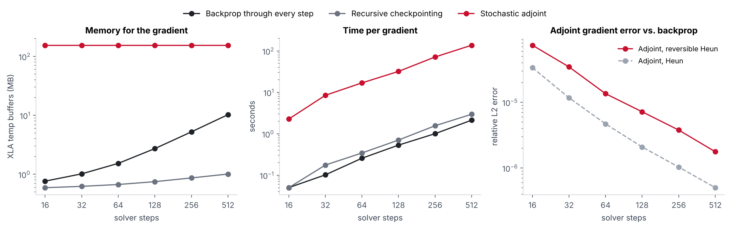
Three Ways to Get the Gradient, Measured
PART 3 · MEASURED
512 steps | Memory | Time / grad | Gradient
Backprop | 10.3 MB | 2.1 s | exact
Checkpointing | 1.0 MB | 3.0 s | exact
Adjoint | 154 MB | 137 s | rel. err 1.8e-6
16-dim neural SDE, 32 paths, reversible Heun, CPU. github.com/nishadw/neural-sde. Setup: A8.
In Diffrax, checkpointing beats the adjoint on memory, time and exactness at this scale.
Notes:
[15:05 – 15:45]
DEMO: no time in the talk. If someone asks during discussion, play assets/demo.mp4 (52 s).
• Memory (log scale): backprop linear in steps, checkpointing ~log, adjoint flat but ~150 MB. The method needs only 2d + p ≈ 110 KB; the rest is a Diffrax/XLA implementation constant growing with params and noise channels (A8).
• Time: adjoint ~60× slower.
• Error: adjoint vs backprop falls ~1/steps: discretization error of optimize-then-discretize. Plain Heun slightly better than reversible Heun here: reversibility alone doesn't make the continuous adjoint exact.
• Matches Diffrax's own recommendation: use checkpointing.
IF ASKED — why so large? Most likely per-noise-channel parameter cotangents materialized (512 × 12.7k × 8 B ≈ 52 MB, plus temporaries); measured scaling is consistent, not profiled buffer by buffer.

Slide 17
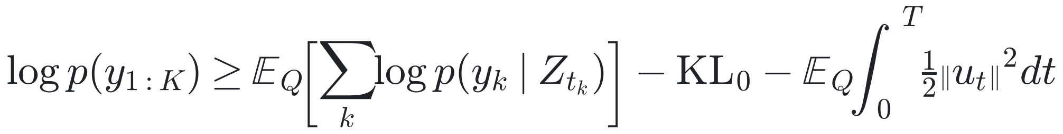
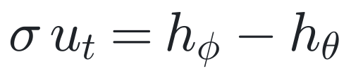
Latent-SDE ELBO on the Avocado Data
PART 4 · TRAINING
prior (forecast)
ELBO term | Avocado data
y_k | stage label of image k
t_k | photo day (irregular)
c | T10 / T20 / Tamb
shared σ | else KL = ∞
posterior (filter, sees images)
objective
Li et al. 2020. KL derivation: A3.
Girsanov: path-space KL = running cost ∫½‖u‖²dt, integrated with the state.
Notes:
[15:45 – 17:05]
• Latent SDE (Li et al. 2020): a VAE whose latent is a path.
• Prior: our ripening SDE given only storage. Posterior: same σ, drift also sees the images (e.g., a GRU run backward over encoded photos gives a context per time).
• ELBO: expected log-likelihood of observed stage labels at photo times − KL of initial state − KL between the SDEs.
• Girsanov: path KL = E ∫ ½‖u‖² dt with σu = h_φ − h_θ. Append it as one extra state; each solve gives a Monte Carlo estimate.
• Gradients of all of it flow through the solver: slides 8–16.
IF ASKED — why shared σ? Girsanov changes drift only; different σσᵀ ⇒ different quadratic variation ⇒ mutually singular measures ⇒ KL = ∞.
IF ASKED — forecasting? After the last photo, switch to the prior and sample forward for P(τ ≤ t*).

Slide 18
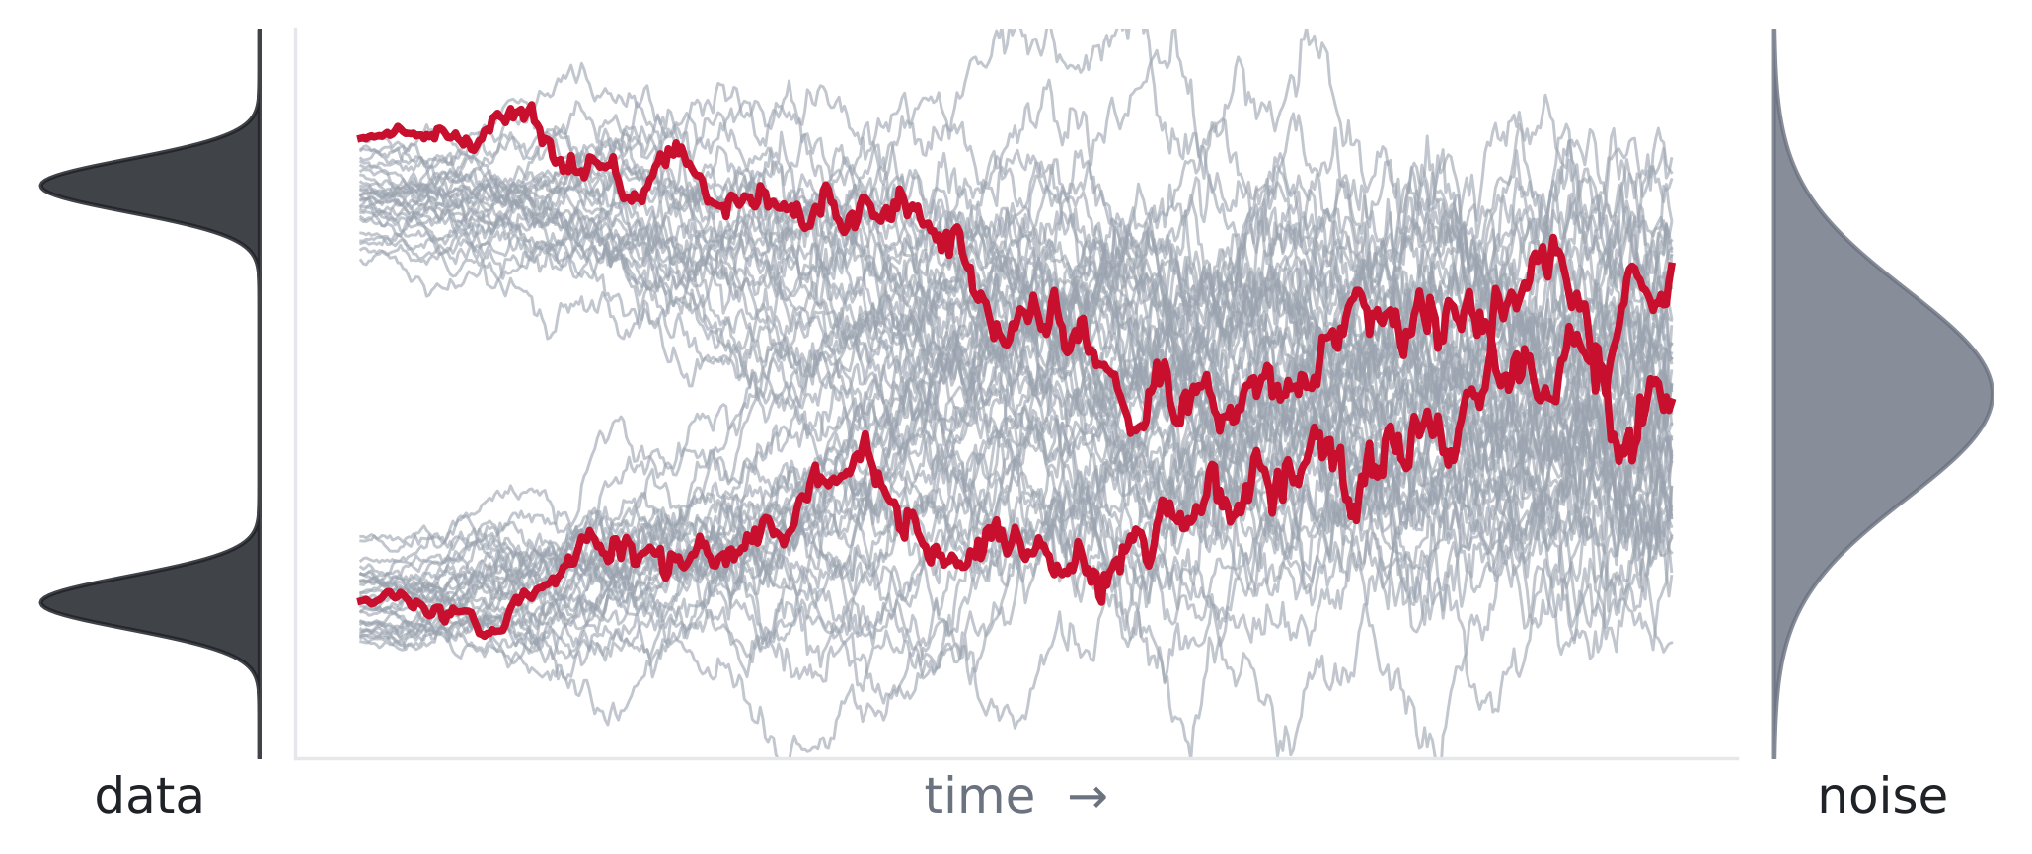
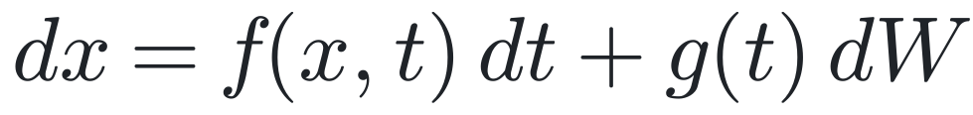
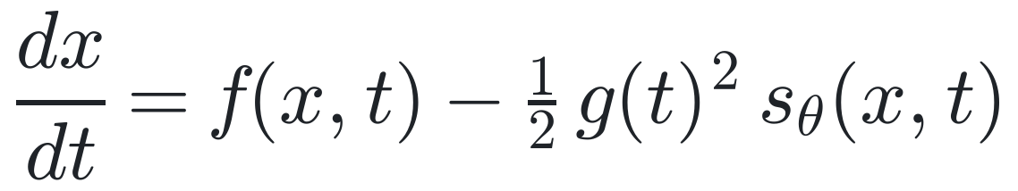
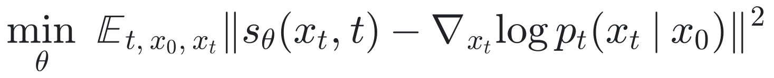
Diffusion Models Are Neural SDEs
PART 4 · CONNECTION
forward (fixed)
reverse (learned score)
probability-flow ODE
denoising score matching
 | Latent SDE (avocado) | Diffusion model
learns | μ, σ | score only
training | backprop through solver | simulation-free
Diffusion = neural SDE with fixed σ, trained simulation-free; ours learns σ and backprops through the solver.
Notes:
[17:05 – 18:00]
• Song et al. 2021: a fixed forward SDE turns data into noise. Reversing it needs the score ∇ log p_t; learn it as s_θ. The reverse SDE is a neural SDE.
• Probability-flow ODE: same marginals, deterministic sampling.
• Training is simulation-free: p(x_t | x_0) is Gaussian in closed form. No solver, no adjoint.
• Contrast: our avocado model learns the dynamics, so it must backprop through the solve.
IF ASKED — who showed the reversal? Anderson (1982).
IF ASKED — flow matching? Trains the probability-flow ODE's velocity directly; π0 robot policies use it.
IF ASKED — likelihoods? Change of variables along the ODE, with a Hutchinson trace estimator.

Slide 19
Same Structure Elsewhere
BEYOND PRODUCE
Domain | Latent state | Neural SDE role | Reference
Weather | atmosphere | diffusion sampling of ensembles | Price et al., Nature 2025 (GenCast)
Robotics | action trajectory | reverse diffusion / flow matching | Chi et al. 2023; Black et al. 2024
Quant finance | price, volatility | calibrated market models | Gierjatowicz 2022; Cohen 2021
Clinical | patient state | irregular vitals (ODE/CDE family) | Rubanova 2019; Kidger 2020
Generative models | image / audio | score-based sampling | Song et al. 2021
Wherever decisions depend on the distribution over trajectories.
Notes:
[18:00 – 18:30] — SKIP-IF-SHORT.
• Same pattern as the avocado: hidden state, randomness, sparse observations, decisions on the distribution of futures.
• My repo also has the finance case: a neural local-vol SDE calibrated to a Heston smile by backprop through Monte Carlo (0.31 vol pts RMSE vs 4.21 flat).

Slide 20
Open Problems
LIMITS
Issue | Symptom | Evidence / mitigation
Adjoint error | backward re-solve ≠ forward path | ANODE (2019); 1e-4–1e-6 here
Stiffness | NFE grows during training | kinetic / Jacobian regularization (Finlay 2020)
Discontinuous targets | ∇ 1{τ ≤ t*} = 0 pathwise | bridge crossing, surrogate, score function
Identifiability | drift ↔ diffusion trade-off; latent reparam. | ordinal head anchors q; synthetic recovery test
Visual confounds | lighting, marks, wind rub look like ripening | paper: per-sample > per-picture accuracy
Uncontrolled covariates | Tamb 20% faster than Arrhenius | condition on humidity if logged
O(1) memory is real; exact, unbiased, identifiable gradients each cost extra.
Notes:
[18:30 – 19:30] — analysis portion.
• Adjoint: not the gradient of what the forward solver computed. ANODE showed it can be badly wrong; 1e-4 to 1e-6 here.
• Stiffness: learned dynamics stiffen and solvers slow down; regularize kinetic energy or Jacobian norms.
• Our target is discontinuous: naive pathwise training gives zero gradient.
• Identifiability: fast drift + small noise can mimic slow drift + big noise. Test on synthetic data with a known SDE.
• Paper-specific: surface marks look like ripening, and ambient storage doesn't follow temperature.
IF ASKED — latent reparameterization? Any invertible map of the latent space leaves the likelihood unchanged; the ordinal head anchors the ripeness direction.

Slide 21
Takeaways
SUMMARY
Avocados: drift explains the mean; the spread needs diffusion.
Gradients: checkpointing is exact and cheap; the adjoint's O(1) memory costs accuracy.
Targets: first-passage losses need bridge, surrogate, or score-function gradients.
Training: latent-SDE ELBO; the path KL comes from Girsanov.
Notes:
[19:30 – 20:00]
• Four things to remember. Read each line once; don't add new material.
• Then: 'Let's open it up. Three questions to start.'

Slide 22
Questions for the Room
DISCUSSION
1
Which estimator for P(τ ≤ t*): surrogate, bridge crossing, or score function?
2
Does σ depend on temperature? How would you test it on this data?
3
Which simulator from this course would you make stochastic? What happens to gradients?
Code, benchmarks, slides: github.com/nishadw/neural-sde
Notes:
[20:00 – 25:00] — hard stop at 25:00.
~1:30 per question, then close.
• Q1: bias vs variance. Bridge crossing: exact per step for frozen coefficients, low variance. Score function: unbiased, noisy, drift params only. Sigmoid: needs ε annealing.
• Q2: fit the latent SDE with σ_θ(c) free per group, compare to σ ∝ √κ(c) by held-out likelihood; or estimate per-group variance of daily stage increments directly from the label sequences.
• Q3 (Prof. Lin's lectures): stochastic forcing adds Monte Carlo variance and needs same-noise replay; for contact-rich systems noise can smooth the loss landscape (randomized smoothing).
• Close at 25:00: 'Thanks. Code and slides are on GitHub.' Appendix is for questions only.

Slide 23
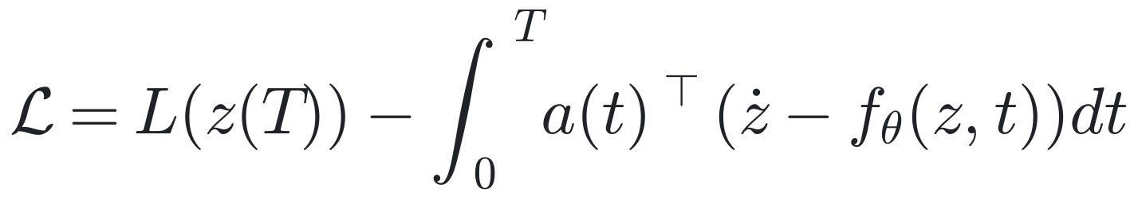
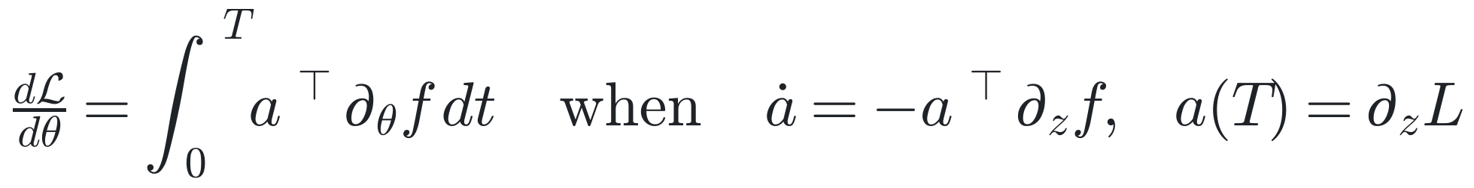
Derivation: ODE Adjoint
APPENDIX · A1 · NOT PRESENTED
1. Lagrangian with multiplier a(t) on ż = f
2. Differentiate in θ; integrate aᵀ (d/dt)(∂z/∂θ) by parts
∂z/∂θ terms: [ ∂L/∂z(T) − a(T) ]·∂z(T)/∂θ + ∫ (ȧ + aᵀ ∂f/∂z)·∂z/∂θ dt + a(0)ᵀ ∂z(0)/∂θ
3. Set both brackets to zero
Add a(0)ᵀ ∂z(0)/∂θ if the initial state depends on θ (e.g., z(0) = e_φ(x₀)).
Choose a(t) to cancel every ∂z/∂θ term; what remains is dL/dθ.
Notes:
Appendix A1. Since ż − f = 0 on solutions, adding ∫aᵀ(ż − f)dt leaves L unchanged for any a. Integrate by parts to move d/dt off ∂z/∂θ; choose a to kill those terms.

Slide 24
Why Stratonovich for the Stochastic Adjoint
APPENDIX · A2 · NOT PRESENTED
 | Itô | Stratonovich
integral evaluated at | left endpoint | midpoint
martingale property | yes | no
chain rule | Itô's lemma (+½ f″σ² dt) | ordinary
time reversal | extra correction terms | same form
drift conversion | μ | μ − ½ Σⱼ (∂σⱼ/∂z) σⱼ
Stratonovich obeys the ordinary chain rule, so the ODE adjoint carries over.
Notes:
Appendix A2. Rough-path view: σ ∘ dW behaves like an input signal; the ODE adjoint (A1) applies with one extra term per noise channel.

Slide 25
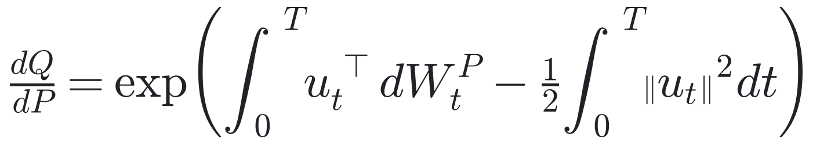
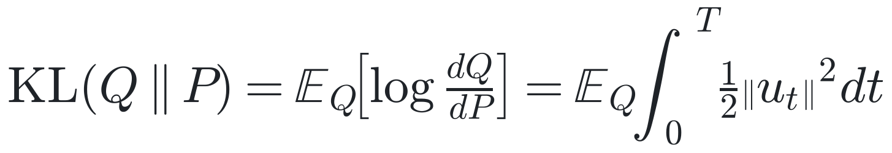
Derivation: Path-Space KL via Girsanov
APPENDIX · A3 · NOT PRESENTED
Girsanov (σu = h_φ − h_θ)
Under Q: W^P = W^Q + ∫u dt; the Itô integral has zero mean
Conditions: same σσᵀ; Novikov: E_P exp(½∫‖u‖²dt) < ∞.
In code: append dℓ = ½‖u‖² dt to the state; ℓ_T is a one-sample estimate.
Same σσᵀ, different drift: log dQ/dP = stochastic integral + running cost.
Notes:
Appendix A3. Different σσᵀ ⇒ different quadratic variation ⇒ mutually singular measures ⇒ KL = ∞.

Slide 26
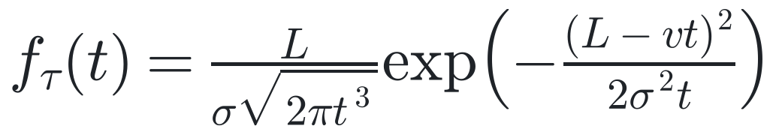
Derivation: First-Passage Ratios (Slide 13)
APPENDIX · A4 · NOT PRESENTED
density of τ for X = vt + σW, barrier at L > 0
⇒ E τ = L / v, Var τ = L σ² / v³ (inverse Gaussian, mean L/v, shape L²/σ²)
ratios between storage groups at equal distance L
Rates (Table 4): v₁₀ = 0.228, v₂₀ = 0.473, v_amb = 0.518 stages/day.
Assumes MAE ∝ sd (small CV). Quantization also predicts v₂₀/v₁₀.
Labeling noise ignored.
Inverse-Gaussian first passage gives sd(τ) ∝ √(Lσ²/v³).
Notes:
Appendix A4. Derivation via the Laplace transform of the hitting time of Brownian motion with drift, or via Wald's identities: E τ = L/v; Var τ = Lσ²/v³.

Slide 27
Arrhenius Fit (Slide 12)
APPENDIX · A5 · NOT PRESENTED
Step | Expression | Value
rates | v = 1 / |α| | 0.228, 0.473, 0.518 d⁻¹
Q₁₀ | v₂₀ / v₁₀ | 2.07
Eₐ | R ln Q₁₀ / (1/283.15 − 1/293.15) | 50.4 kJ/mol
v_amb predicted | v₂₀ exp[−Eₐ/R (1/291.85 − 1/293.15)] | 0.431 d⁻¹ (2.32 d/stage)
v_amb observed | 1 / 1.929 | 0.518 d⁻¹ (1.93 d/stage)
T implied | solve Arrhenius for v = 0.518 | 21.3 °C
Jensen (sd 1.2 °C) | ½ (Eₐ/RT²)² σ_T² | < 1% effect
Eₐ from two rates; prediction at the ambient mean; implied temperature.
Notes:
Appendix A5. All inputs from the paper's Table 4 and storage description; computations are mine.

Slide 28
Brownian Bridges: Replay and Crossings
APPENDIX · A6 · NOT PRESENTED
virtual Brownian tree: recursive bisection from a seed
crossing probability within a step (σ_q = local vol of q, frozen)
P(τ ≤ t*) ≈ 1 − Π_k (1 − p_k), with p_k = 1 if an endpoint ≥ b.
σ_q² = ‖∇q(Z_k)ᵀ σ_θ(Z_k)‖². Drift cancels after conditioning on endpoints.
One conditional Gaussian regenerates W and gives a smooth crossing probability.
Notes:
Appendix A6. Standard Brownian-bridge (continuity) correction from barrier-option pricing; removes discrete-monitoring bias for the frozen-coefficient interpolant; solver weak error remains.

Slide 29
SDE Solvers
APPENDIX · A7 · NOT PRESENTED
Solver | Converges to | Strong order | Weak order | Notes
Euler–Maruyama | Itô | ½ (1 additive) | 1 | default
Milstein | Itô / Strat. | 1 | 1 | needs ∂σ; commutative noise if d > 1
Heun | Stratonovich | ½ (general) | — | predictor–corrector
Reversible Heun | Stratonovich | ½ (general) | — | algebraically reversible
SRA1 / ShARK | Stratonovich | 1.5 (additive only) | — | state-independent σ
Kloeden & Platen (1992); Kidger et al. (2021); Diffrax docs.
Match solver to your calculus, and order to the quantity you need.
Notes:
Appendix A7. '—' = not claimed here.

Slide 30
Benchmark Setup (Slide 16)
APPENDIX · A8 · NOT PRESENTED
Item | Setting
Model | 16-dim state; drift + diagonal-diffusion MLPs, width 64, depth 2 (12.7k params)
Batch | 32 paths as one 512-dim SDE, diagonal noise
Solver | reversible Heun; virtual Brownian tree tol 1/4096; float64; 2-core CPU
Memory | XLA compiled temp buffers
Adjoint memory scaling | 256 → 1,024 channels: 62 → 438 MB; 4k → 42k params: 95 → 389 MB
Method's own state | 2d + p ≈ 110 KB → rest is implementation constant
Trend robust; absolute numbers depend on hardware and size.
Notes:
Appendix A8. Scripts: experiments/adjoint_tradeoffs.py, adjoint_memory_scaling.py.

Slide 31
Evaluation Protocol (If Asked)
APPENDIX · A9 · NOT PRESENTED
Shelf-life metric | Xavier et al. (CNN + linear) | What a latent SDE reports
MAE, T10 / T20 / Tamb (days) | 1.82 / 0.75 / 0.54 | median of τ
MAE, all (days) | 1.04 | median of τ
CRPS of τ, all (days) | 1.04 (= MAE for a point) | full predictive distribution
80% interval coverage | n/a (no interval) | should be ≈ 80%
Baseline: Table 6 (5-stage, by sample), Xavier, Rodrigues & Silva, Foods 13:1150 (2024).
Same by-fruit split; CRPS and coverage reward a calibrated distribution.
Notes:
Appendix A9. How the model would be scored against the paper; no new experiments are claimed.
• Keep the paper's 70/15/15 by-fruit split; refit α on training fruit only.
• CRPS(F, y) = ∫ (F(t) − 1{y ≤ t})² dt; equals absolute error for a point forecast; proper scoring rule.
• Baseline caveats: unclear whether Table 6 is test-only; 'by sample' keeps the better of two sides.

Slide 32
References and Figure Credits
APPENDIX · A10 · NOT PRESENTED
Xavier, Rodrigues & Silva. Shelf-life management and ripening assessment of 'Hass' avocado using deep learning. Foods 13(8):1150, 2024. doi:10.3390/foods13081150. CC BY 3.0 (Figs. 1, 2, 6a, 11; Tables 3, 4, 6).
'Hass' Avocado Ripening Photographic Dataset. Mendeley Data, 2024. doi:10.17632/3xd9n945v8.
Chen et al. Neural ODEs. NeurIPS 2018.
Li, Wong, Chen, Duvenaud. Scalable Gradients for SDEs. AISTATS 2020.
Kidger, Foster, Li, Lyons. Efficient and Accurate Gradients for Neural SDEs. NeurIPS 2021.
Kidger. On Neural Differential Equations. PhD thesis, 2022.
Mohamed et al. Monte Carlo Gradient Estimation in ML. JMLR 2020.
Gholami, Keutzer, Biros. ANODE. IJCAI 2019.
Finlay et al. How to Train Your Neural ODE. ICML 2020.
Song et al. Score-Based Generative Modeling through SDEs. ICLR 2021.
Kloeden & Platen. Numerical Solution of SDEs. 1992.
Särkkä & Solin. Applied SDEs. CUP 2019.
Griewank & Walther. Revolve. ACM TOMS 2000.
Rubanova et al. 2019; Kidger et al. 2020 (CDEs); Price et al. 2025; Chi et al. 2023; Black et al. 2024; Gierjatowicz et al. 2022.
Notes:
Appendix A10.

