Slide 1
OBJECT ORIENTED PROGRAMMING
C#
By,
NISHA PAUL

Slide 2
Overview
Constructors
Encapsulation
Polymorphism
Summary

Slide 3
Constructors
Special method of the class which gets automatically invoked whenever an instance of the class is created
It is used to assign initial values to the data members of the same class
The constructor of a class must have the same name as the class name in which it resides.
A class can have any number of constructors.
A constructor can not be abstract, final, and Synchronized.
A constructor doesn’t have any return type.

Slide 4
Constructors
Constructors are usually public. Since they are provided to create objects.
Constructors can also be declared as private or protected. In such cases:
Objects of that class cannot be created.
Class cannot be used as a base class for inheritance.
Types of Constructors:
Default Constructors
Parameterized Constructor
Copy Constructor
Private Constructor
Static Constructor

Slide 5
Parameterized Constructors
Eg:
class Car
{
public string model;
public Car(string modelName) // Create a class constructor // with a parameter
{ model = modelName; }
static void Main(string[] args)
{ Car Ford = new Car("Mustang");
Console.WriteLine(Ford.model);
}
}
// Outputs "Mustang"
A constructor having at least one parameter is called a parameterized constructor. It can initialize each instance of the class to different values.

Slide 6
ENCAPSULATION
Defined as the wrapping up of data and information under a single unit.
As the data in a class is hidden from other classes, it is also known as data-hiding.
Since, the variables or data of a class are hidden, it can be accessed only through any member function of its class in which they are declared.

Slide 7
Encapsulation
Can be achieved by:
Declaring all the variables/ fields in the class as private.
Provide public set and get methods, through Properties, to access and update the value of a private variable.
Eg:
class Person {
private string name; // field
public string Name // property
{ get { return name; } // get method
set { name = value; } // set method } }

Slide 8
Polymorphism
Concept in object-oriented programming (OOP) that allows methods, properties, or operators to take multiple forms.
The term "polymorphism" means "many forms“.
It enables a single interface to be used for different data types by improving code flexibility and reusability.
Polymorphism is achieved through method overloading and method overriding.

Slide 9
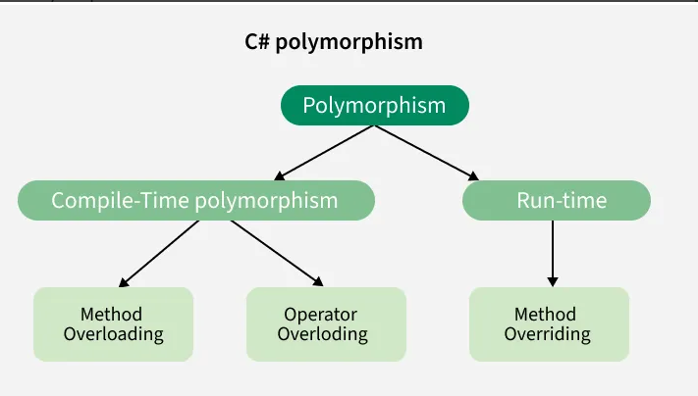
Polymorphism

Slide 10
Compile-Time Polymorphism
Also called static polymorphism.
Implemented using method overloading. It allows a class to have multiple methods with the same name but different signatures (parameter lists).
It can be differentiated, based perform:
Changing the number of Parameters
Changing data types of the parameters.
Changing the Order of the parameters.

Slide 11
Method Overloading
Ability to redefine a method in more than one form.
Overloaded methods are differentiated based on the number and type of the parameters passed as arguments to the methods.
We can not define more than one method with the same name, Order and the type of the arguments. It would be a compiler error.

Slide 12
Runtime Polymorphism/Dynamic Polymorphism
Achieved by method overriding.
Method overriding occurs when a subclass provides a specific implementation for a method that is already defined in the superclass or base class.
The method in the subclass must have the same signature as the method in the base class.
By overriding a method, the subclass can modify the behaviour of the inherited method. It allows a derived class to provide a specific implementation of a method that is already defined in its base class.
Virtual Method: The base class method must be declared as virtual to allow overriding.
Override Keyword: The derived class method must use the override keyword to provide a new implementation.

Slide 13
Method Overriding
Method overriding is possible only in derived classes.
A method is overridden in the derived class when it is inherited from the base class.
A non-virtual or static method cannot be overridden.
Both the overridden method and the virtual method must have the same access level modifier

Slide 14
SUMMARY
Object-Oriented Programming, commonly known as OOPs, is a technique, not a technology which provides some principles for developing applications or software. The fundamental idea behind OOP is to combine data and the methods that operate on that data into a single unit. The four pillars of OOP—encapsulation, inheritance, polymorphism, and abstraction—are used to implement the object oriented model.

Slide 15
THANK YOU

