Slide 1
HTML
by,
Nisha Paul

Slide 2




Agenda
What is HTML
HTML Document Structure
HTML Elements

Slide 3



What is HTML?
H – Hyper
T – Text
M - Markup
L - Language

Slide 4
What is HTML?
Basic structure
How to display the text
Links
Images
Other forms of multimedia

Slide 5
Tags, Attributes, Elements
TAGS
Essential building blocks that define the structure and content of a webpage.
Opening tag- beginning of an element
Closing tag – end of an element
Usually enclosed in angle brackets.
Example:
<html> content…. </html>

Slide 6
Tags, Attributes, Elements
Elements
It is the complete structure, including the opening tag, content (if any), and the closing tag (if applicable).
Example:
<html> content…. </html>
Element

Slide 7
Elements
In HTML there are two types of elements
Container element
One that requires starting as well as ending tags.
Empty element
That requires just a starting tag, not an ending tag.

Slide 8
Container Elements
This type of HTML Elements requires pair tags i.e. a starting as well as an ending tag
Example:
<HTML>--------</HTML>
<HEAD>---------</HEAD>
<BODY>---------</BODY>
<B>--------------</B>

Slide 9
Empty Elements
This type of Element require just a starting tag and not an ending tag. Examples:
<BR>
<hr>
<IMG>
<LINK>

Slide 10
Tags, Attributes, Elements
Attributes
Additional information about HTML elements.
Used within the opening tag of an HTML element
Used to configure and adjust the element’s behavior, appearance, or functionality in a variety of ways.
Each attribute has a name and a value.
Syntax:
<tagname attribute_name = “attribute_value”> content… </tagname>
Example:
<p align=“center”> Hello </p>

Slide 11
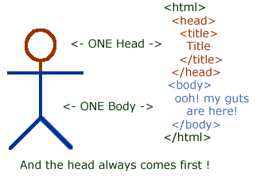
HTML Document structure
HTML Made Up of:
Tags
Elements
Attributes
Extension .html or .htm
O/p -> Web Browser
Root element of an
HTML document:
<HTML> …</HTML>

Slide 12
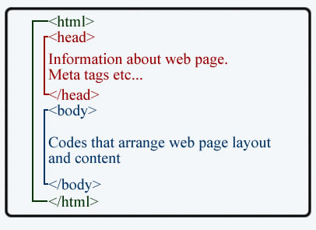
HEAD Tag <Head>...</Head>
Meta-information about the HTML document:
Title
Links to stylesheets.
Elements within the head aren’t visible on
the front end of a webpage.
Typical elements inside the <head> include:
<title>
<meta>
<link>
<style>
<script>

Slide 13
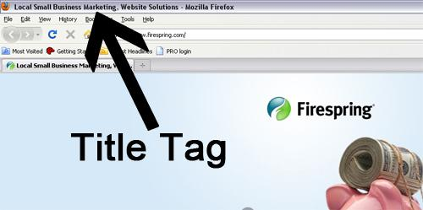
TITLE Tag <title>…</title>
Contains document title
Title specified inside the
<TITLE> tag appears on the
browsers’ title bar.

Slide 14
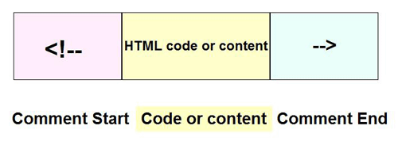
HTML Comments
The comment tag is used to insert comments in the source code.
Used to explain your code
Comments are not displayed in the browsers.
HTML comments start with "<!--" and end with "-->".

Slide 15
BODY Tag <body>…</body>
Encloses all the tag attributes and information to be displayed on the web page.
Opening below the closing </HEAD> tag
Closing above the </HTML> tag
Eg: <html>
<head></head>
<body></body>
</html>

Slide 16
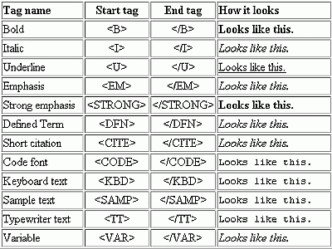
HTML Text

Slide 17
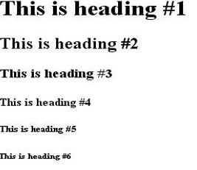
Heading Tag
Used to define a title or subtitle of sections on web page.
HTML heading tags <h1> to <h6> create headings that range from the main heading to the smallest subheading.
Eg: <html>
<head></head>
<body>
<h1>This is heading #1</h1>
.
.
.
<h6>This is heading #6</h6>
</body>
</html>

Slide 18
Paragraph Tag
The <p> tag is used to define paragraphs of text.
Syntax: <p> content </p>
Attribute of <P> tag is align

Slide 19
Break Lines <br> Tag
To simply end one line and jump to the next use line break or <br>
Example
Hello ! <br>Welcome to my web page I hope you like it <br> I’m a aitrich student this is my first attempt
Output
Hello!
Welcome to my web page I hope you like it
I’m an aitrich student this is my first attempt

Slide 20
HTML Links
HTML Links, also known as hyperlinks
Defined by the <a> tag in HTML, which stands for “anchor.
Used to navigate between web pages, different sites, documents, or sections within the same page.
Attributes include: href, title, and target

Slide 21
HTML Images
<img> tag is used to embed an image in web pages by linking them.
Attributes: src, width, height, and alt
Src : is used to specify the location of the image file.
Alt : is used to specify the alternative text of the image.
Does not require a closing tag.

Slide 22
HTML Font Tag
<font> tag is used to create an attractive and readable web page.
The font tag is used to change the color, size, and style of a text.
Attributes: size, color, type(face attribute)
Example: <font size=”3”> my font size</font>
<font size=”7” color =”red”> check the fond</font>

Slide 23
Horizontal Rules <hr> Tag
Used to separate section of your document visually,
The main attributes of HR tag is size,width,noshade,color

Slide 24


Summary
HTML is the universal markup language for the Web.
HTML lets you format text, add graphics, create links, input forms, frames and tables, etc., and save it all in a text file that any browser can read and display.

Slide 25

Thank you

