Slide 1
JAVASCRIPT INTRODUCTION TO DOM

Slide 2
Overview
Document Object Model
DOM structure
API’s
Events
Summary

Slide 3
DOM (Document Object Model)
A W3C (World Wide Web Consortium) standard.
Defines a standard for accessing documents.
Platform and language-neutral interface that allows us to create, change, or remove elements from the document.
Can add events to these elements to make our page more dynamic.
The W3C DOM standard is separated into 3 different parts:
Core DOM - standard model for all document types
XML DOM - standard model for XML documents
HTML DOM - standard model for HTML documents

Slide 4
HTML DOM
HTML DOM is a standard object model and programming interface for HTML. It defines:
The HTML elements as objects
The properties of all HTML elements
The methods to access all HTML elements
The events for all HTML elements
The DOM views an HTML document as a tree of nodes. A node represents an HTML element.
When a web page is loaded, the browser creates a Document Object Model of the page.

Slide 5
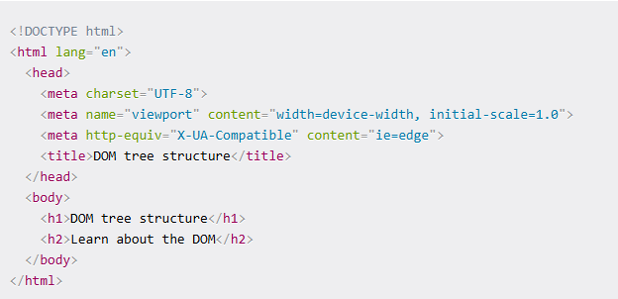
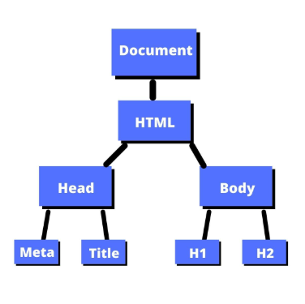
DOM Tree Structure

Slide 6
The DOM Programming Interface
The HTML DOM can be accessed with JavaScript (and with other programming languages).
The programming interface is the properties and methods of each object.
A property is a value that you can get or set (like changing the content of an HTML element).
A method is an action you can perform (like add or deleting an HTML element).
Eg:
<html><body> <p id="demo"></p> <script> document.getElementById("demo").innerHTML = "Hello World!"; // getElemetById - property
//innerHTML - method </script> </body></html>

Slide 7
Finding HTML Elements
COMMON API’S
Method | Description
document.getElementById(id) | Find an element by element id
document.getElementsByTagName(name) | Find elements by tag name
document.getElementsByClassName(name) | Find elements by class name

Slide 8
Examples…
var element = document.getElementById("myElementId");
var elements = document.getElementsByClassName("myClassName");
var elements = document.getElementsByTagName("div");
Eg: <html><body>
<p id="para">This is a paragraph to be changed on button click</p>
<button onclick=“change()">Change First Paragraph</button>
<script>
function change() {
document.getElementById("para").innerText = "Changed first paragraph";
}</script></body></html>

Slide 9
Changing HTML Elements
COMMON API’S
Property | Description
element.innerHTML = new html content | Change the inner HTML of an element
element.attribute = new value | Change the attribute value of an HTML element
element.style.property = new style | Change the style of an HTML element
Method | Description
element.setAttribute(attribute, value) | Change the attribute value of an HTML element

Slide 10
Example..
<html><body>
<img id="image" src="s.png" alt="First Pic" width="400">
<button onclick="change()">Change Image</button>
<script>
function change() {
let i = document.getElementById("image");
i.src = "s1.png";
i.alt = "Changed pic";
i.width = "350";
} </script></body></html>
function change() {
let i = document.getElementById("image");
i.setAttribute("src", "s1.png");
i.setAttribute("alt", "Changed pic");
i.setAttribute("width", "350");
}

Slide 11
Adding and Deleting Elements
COMMON API’S
Method | Description
document.createElement(element) | Create an HTML element
document.removeChild(element) | Remove an HTML element
document.appendChild(element) | Add an HTML element
document.replaceChild(new, old) | Replace an HTML element
document.write(text) | Write into the HTML output stream

Slide 12
Example..
Syntax: parentNode.replaceChild(newChild, oldChild); //example for replace child
<html><body>
<p id="para">This is a paragrapgh to be changed</p>
<button onclick="change()">Replace</button>
<script>
function change() {
let parentNode = document.body;
let oldChild = document.getElementById("para");
let newChild = document.createElement("p");
newChild.textContent = "This is the changed text";
parentNode.replaceChild(newChild, oldChild); } </script></body></html>

Slide 13
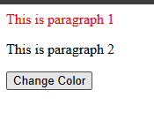
COMMON API’S
querySelector()- returns the first element within the document that matches the specified css or group of selectors. If no matches are found, null is returned.
Eg: <html><body>
<p>This is paragraph 1</p>
<p>This is paragraph 2</p>
<button onclick="change()">Change Color</button>
<script>
function change() {
document.querySelector("p").style.color = "red"; } </script></body></html>

Slide 14
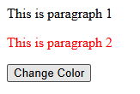
COMMON API’S
querySelectorAll() –Returns a static node list representing a list of the documents elements that match the specified group of selectors.
Eg: <html><body>
<p>This is paragraph 1</p>
<p>This is paragraph 2</p>
<button onclick="change()">Change Color</button>
<script>
function change() {
let para = document.querySelectorAll("p");
para[1].style.color = "red";
} </script></body></html>

Slide 15
EVENTS
A JavaScript can be executed when an event occurs, like when a user clicks on an HTML element.
Examples of HTML events:
When a user clicks the mouse
When a web page has loaded
When an image has been loaded
When the mouse moves over an element
When an input field is changed
When an HTML form is submitted
When a user strokes a key
To execute code when a user clicks on an element, add JavaScript code to an HTML event attribute:

Slide 16
Example for Events
Eg: <html><body>
<img id="image" src="i.jpg" width="100px" height="100px" onmouseover="change()" onmouseout="change_again()" />
<script>
function change() {
document.getElementById("image").src = "image.jpg";} // one form of accessing the src of img
function change_again() {
let i = document.getElementById("image"); //another way of accessing src of img
i.src = "i.jpg";}
</script></body></html>

Slide 17
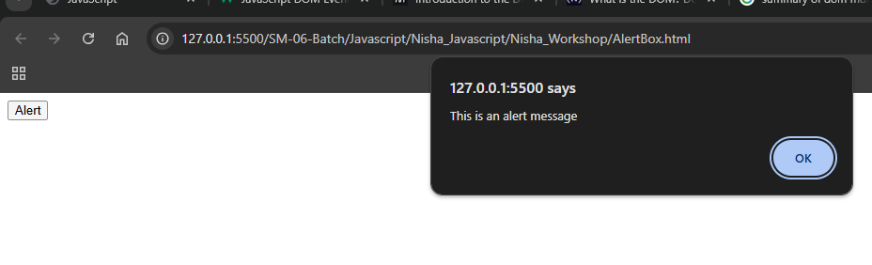
Example for Events
Eg: <html><body>
<button onclick="msg()">Alert</button>
<script>
function msg() {
alert("This is an alert message");
}
</script></body> </html>

Slide 18
SUMMARY
DOM offers web developers the ability to create dynamic and interactive content for user interactions. When the user clicks a button or submits a form, page content can be dynamically updated using the JavaScript DOM. This forms the basis of modern websites and applications.

Slide 19
THANK YOU

