Slide 1
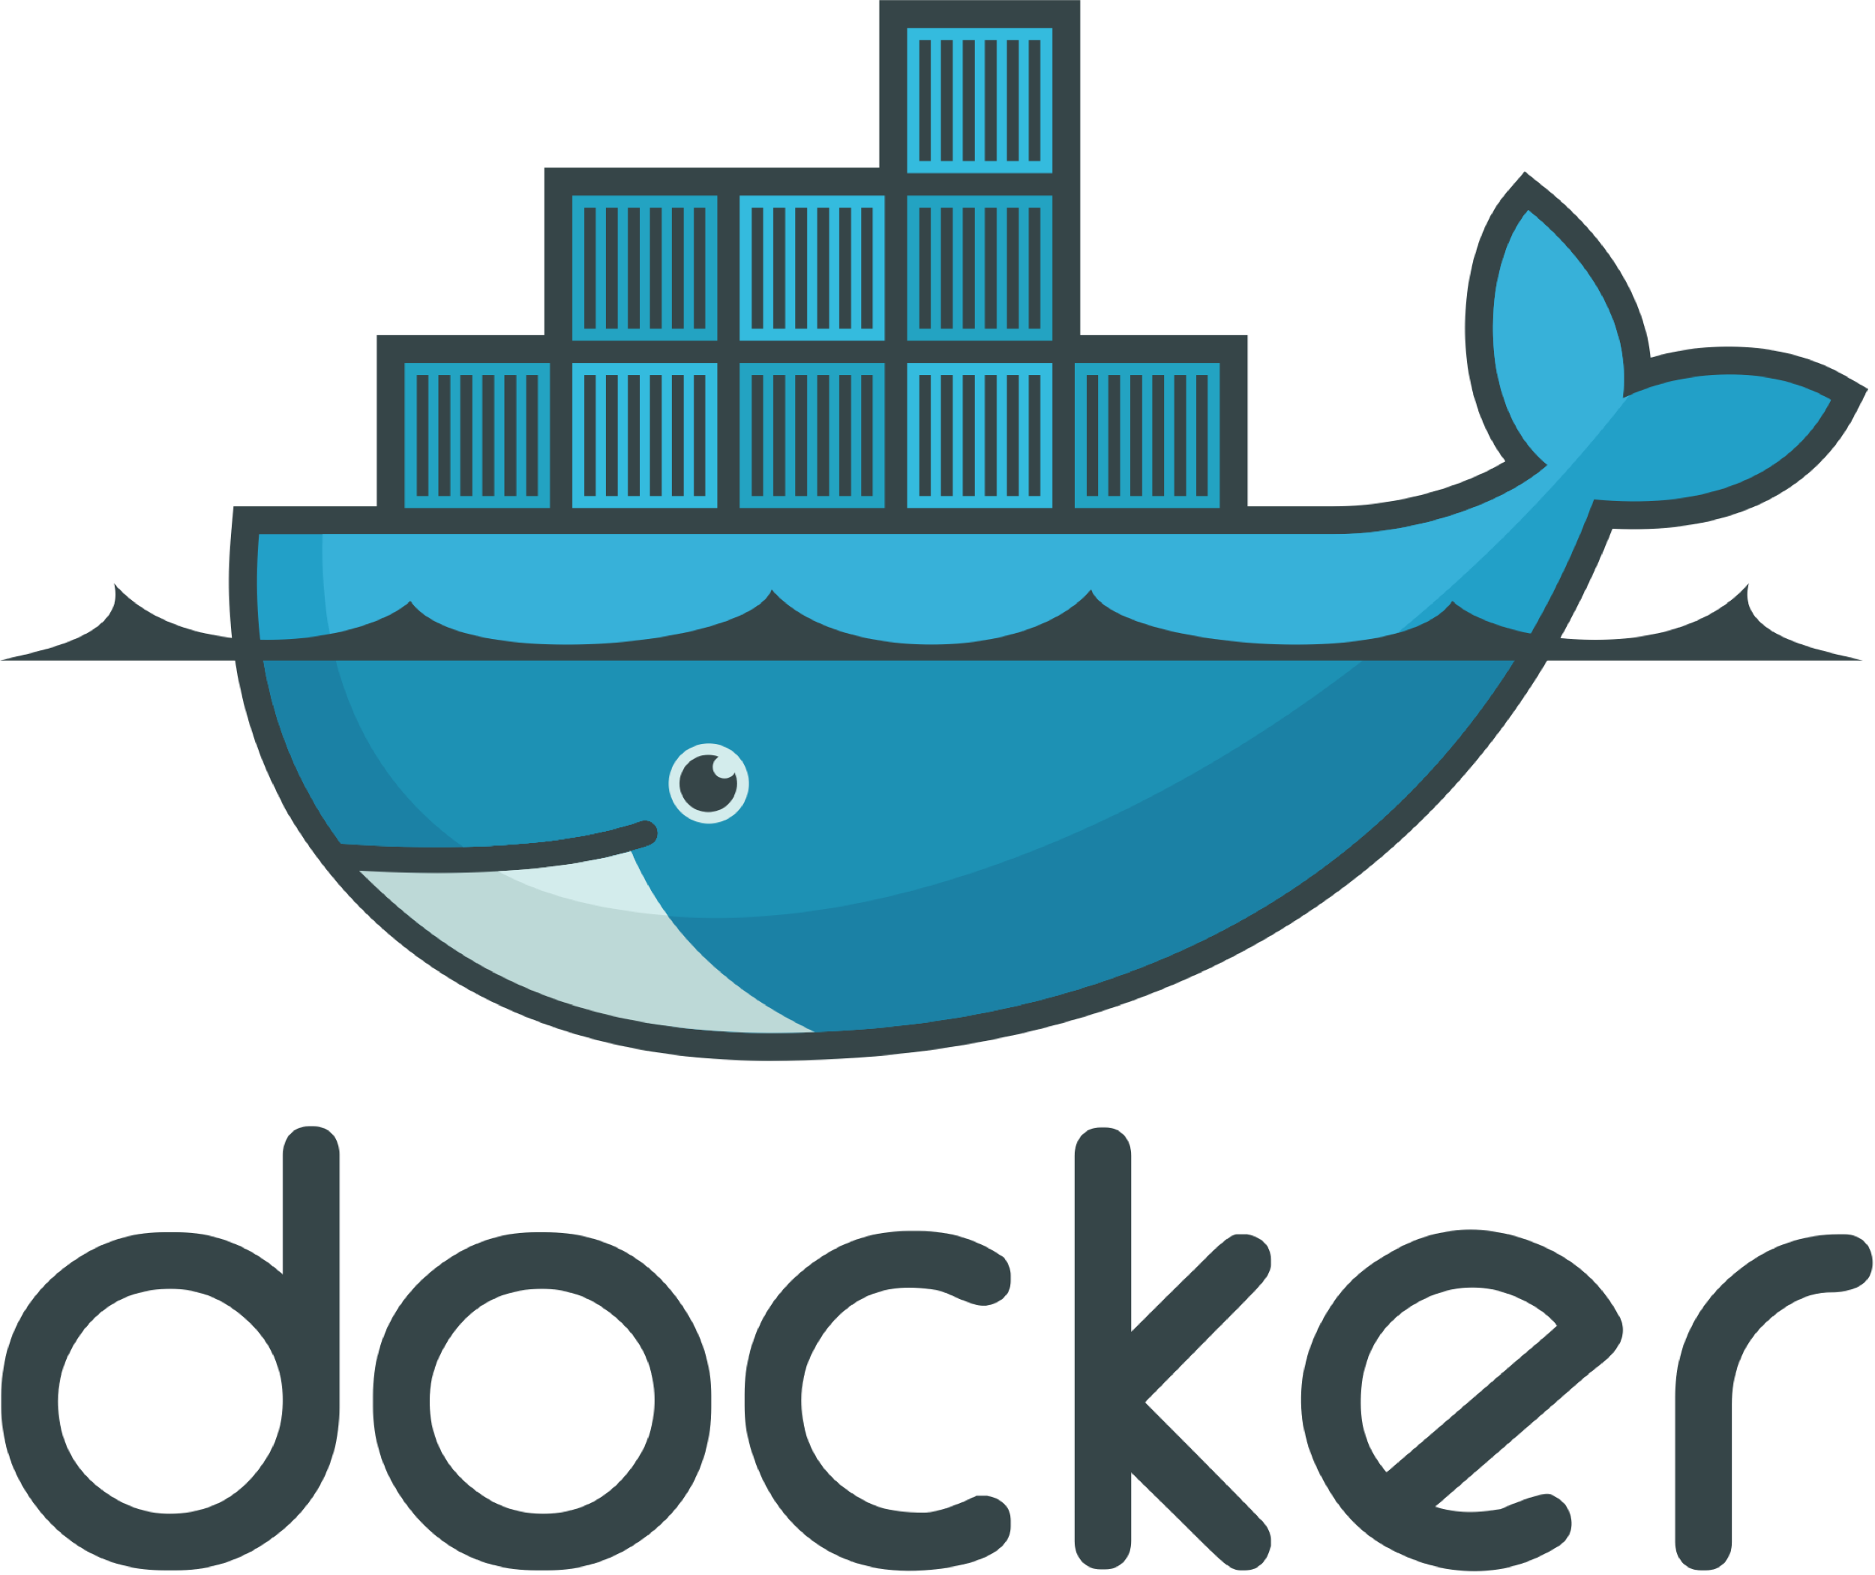

WHC Container Workshop Helsinki June 2019
Iovana Pavlovici @iovanap Nisha Lad @nlad95 Maddie Patrichi @maddie_patrichi Erno Venäläinen @venalainene
Notes:
Welcome
Great to see such a good turn out
Introduce the speakers, names, where we work
1

Slide 2
@iovanap @nlad95 @maddie_patrichi @venalainene
Poll
Who has heard about Containers, Docker & Orchestration?
Who has played around and used Containers & Orchestration tools?
Who is using these tools for real in industry?
What got you interested in this workshop?
Who is using Mac OS, Ubuntu, Windows, anything else?

Slide 3
The Growth of the Tech Industry:
@iovanap @nlad95 @maddie_patrichi @venalainene
Large demand in software
Pressure for companies and organizations to sell & deliver innovative products
Significant change in how software is developed and deployed into production
Software design divided into smaller pieces
Notes:
Recently the growth of technology has been immense
And has created an immense demand on software in many industries
Pressures for companies and organisations to be innovation and standardisation
This has changed how software is developed and deployed into production
As software systems become more complicated, this complication has driven software to be divided into smaller pieces, known as microservices.
1

Slide 4
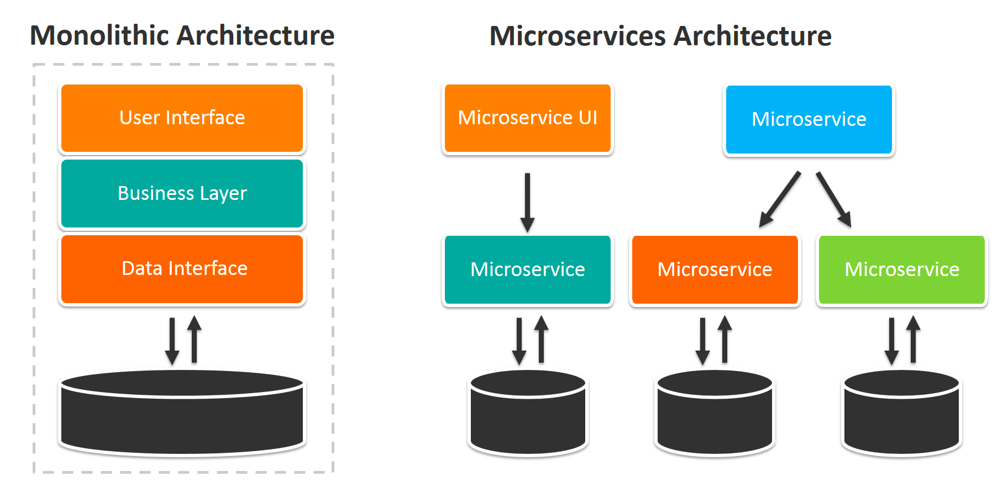
@iovanap @nlad95 @maddie_patrichi @venalainene
Microservices:
Notes:
What is microservice architecture?
Microservice architecture is where your software is intrinsically designed as small modular processes.
It is is a method of developing software applications as a suite of independently deployable, small, modular services in which each service runs a unique process.
This means that applications can be deployed and managed dynamically. This ensures agile development in creating and deploying apps, and increase in ease and efficiency for developers.
1

Slide 5
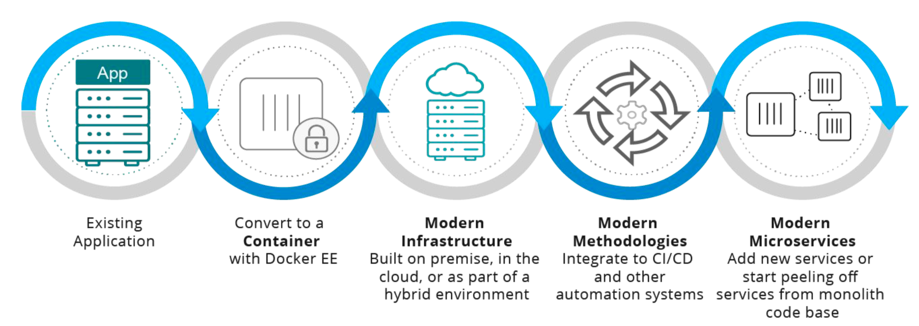
@iovanap @nlad95 @maddie_patrichi @venalainene
Microservices:
Notes:
It also keeps environmental consistency – your application will run the same on a laptop as it does in the cloud.
This links to agile practices such as Continuous Integration & Continuous Delivery, and is useful when using automation platforms such as Hudson or Jenkins which are also open source!
<number>

Slide 6
@iovanap @nlad95 @maddie_patrichi @venalainene
Containers
Containers keep logically distinct pieces of software separate.
They can be built, deployed, maintained, managed and scaled on their own.
Docker is the dominant leader
Containers running across a distributed network
Kubernetes used for Container Orchestration
Notes:
- The microservices architecture promotes the division of a service into a collection of sub-services. There are clear benefits in keeping logically distinct software modules separate. You can develop, deploy, scale, and maintain each sub-service without affecting other parts of the system.
- Containers are used to encapsulate these distinct sub-services and Kubernetes allows us to decide how these containers run and interact with each other - It is safe to say that Docker is the dominant leader in both technology and an adoption of containers.
- And the DockerHub repository has defined a dominant way of hosting versions of a container between developers.
- What happens if you have a bunch of containers running different applications across a distributed network and you want to create and deploy more of them?
- Docker can be scaled up at production and this can be done by a process known as 'Container Orchestration'. The De Facto standard for container orchestration is Kubernetes.
Kubernetes is a container cluster management system, used for deploying a large number of containers across a distributed network.
It was designed by Google to be an Open Source tool and is very DevOps focused, so it’s good for agile development methodologies. (We will learn more about Kubernetes later!)
- However, one thing to note is that if your application has a lot of low-level system calls or needs hardware access, then Docker isn’t the platform for you.
So not everything is suited to use a container environment. Containers really comes into its element when you have a microservice-based system.
If you look at the Docker community, one of the reasons why it's had such success over the six years is that the community is so active and willing to share knowledge.
Just like today, with all of you attending this workshop!
With that in mind, over the next few hours, we're going to do our bit to share knowledge on containers.
<number>

Slide 7
@iovanap @nlad95 @maddie_patrichi @venalainene
Agenda
Orchestration Workshop:
Intro to Orchestration
Kubernetes Theory & Architecture
Minikube examples
Container Theory:
Container Architecture
Why are containers useful?
Terminology
Docker Security & troubleshooting
Container Workshops:
Hello World with Busybox
Static sites & Dockerizing web app
Dockerizing your Node App
Notes:
Throughout this workshop we're going to take you through Docker containers, the architecture behind how they work and how they fit into the computing stack
We'll also take you through some hands-on tutorials and introduce you to container orchestration at the end!
<number>

Slide 8
@iovanap @nlad95 @maddie_patrichi @venalainene
Container Theory
Allows developers to easily automate the deployment of their software application
Packages an application with all of its dependencies into a standardized unit for software development
Source code
Libraries
Binary files
Other dependencies
Don’t get OS specific compilation errors
Lightweight on the kernel
Secure & isolated
Notes:
Containers are an open-source project
Allows developers to easily automate the deployment of their software applications by providing an additional layer of abstraction from the Operating System.
One such example of containers is Docker.
Key benefits of Docker containers is that it allows users to package an application with all of its dependencies into a standardized unit for software development.
Unlike virtual machines, containers do not have the high overhead and hence enable more efficient usage of the underlying system and resources.
Essentially Docker allows you to wrap up a piece of software in a complete filesystem alongside all dependencies that the application needs in order to run;
for example the code, the system libraries, the runtime environment, any binaries, anything you can install on a server, and docker allows you to wrap this all up into what is known as a software container.
- This means that it guarantees the application will run the exact same regardless of the underlying infrastructure and is independent of the underlying OS.
- So you don’t get any OS specific compilation problems or runtime errors when running the application.
Docker containers are:
Standard: Docker created the industry standard for containers, so they could be portable anywhere
Lightweight: Containers share the machine’s OS system kernel and therefore do not require an OS per application, driving higher server efficiencies and reducing server and licensing costs
Secure: Applications are safer in containers and Docker provides the strongest default isolation capabilities in the industry
And Docker is really simple to use! Throughout this workshop we will be working through containerizing an application to run on a Docker container & setting up the neccessary infrastructure for this!
<number>

Slide 9
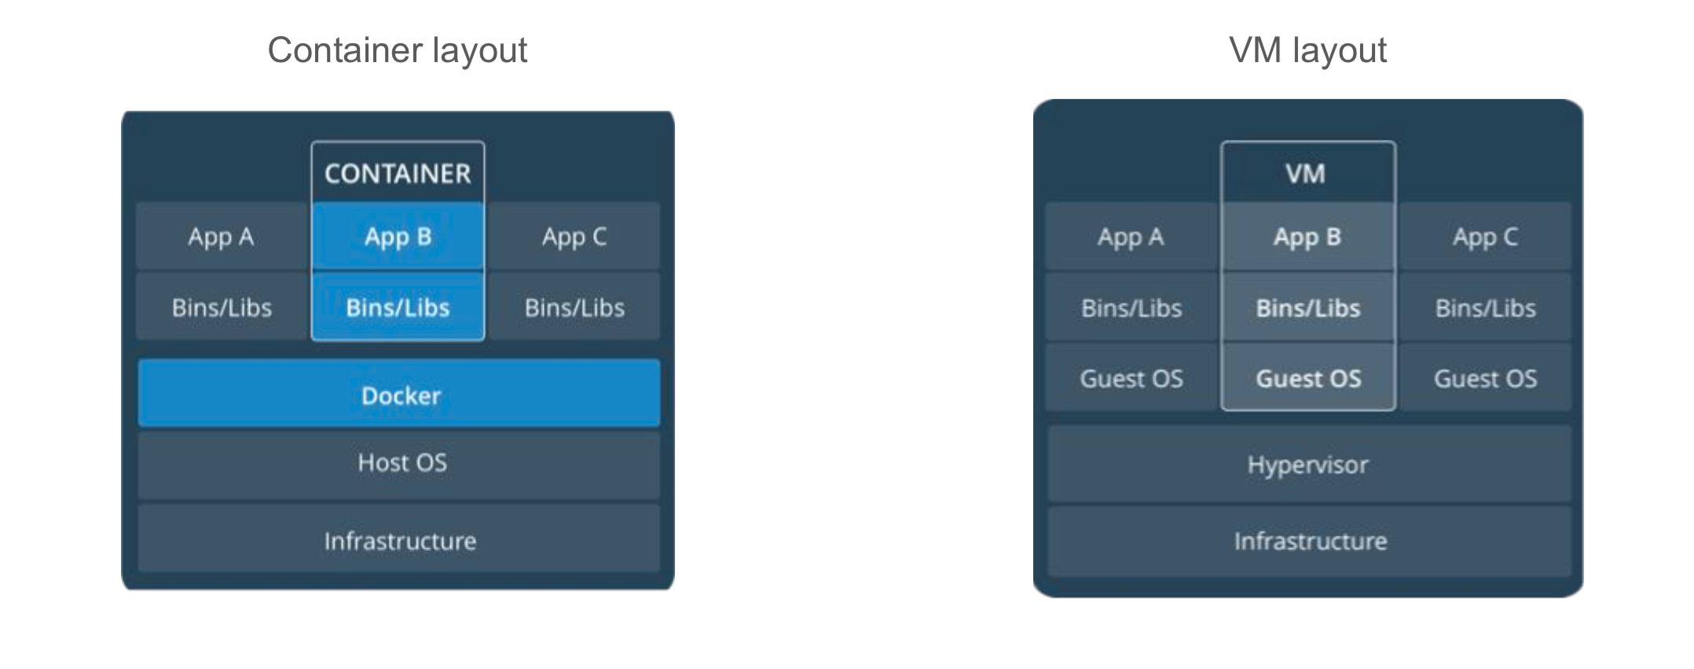
@iovanap @nlad95 @maddie_patrichi @venalainene
VMs vs Containers
Notes:
- Many companies in industry currently use VMs to run applications inside a guest Operating System, which runs on virtual hardware powered by the server’s host OS.
VMs are great at providing full process isolation for applications:
But the computational overhead spent virtualizing hardware for a guest OS to use is substantial.
- Containers take a different approach: by leveraging the low-level mechanics of the host operating system, at a fraction of the computing power.
- For example, take a look at the image below:
- In the VM world, each VM includes the application, the necessary binaries & libraries and an entire operating system, which can amount to tens of GBs.
- This type of architecture is not very portable and relies heavily on the underlying OS.
However, Containers are not tied to any specific infrastructure.
Docker containers allow developers to wrap up all software dependencies into the container such that the application is independent of the host OS.
Containers run an isolated process in userspace on the host OS and share the kernel with other containers.
- Containers can run on any computer, infrastructure and the cloud.
Containers offer a logical packaging mechanism in which applications can be abstracted from the environment in which they actually run.
This gives developers the ability to create predictable environments that are isolated from rest of the applications and can be run anywhere.
<number>

Slide 10
@iovanap @nlad95 @maddie_patrichi @venalainene
Why use Containers?
Notes:
- Companies like Google, Facebook, Netflix and Salesforce leverage containers to make large engineering teams more productive and to improve utilization of compute resources.
Some of the key uses of containers are:
Development:
Developing & building applications across many different host 0Ss and infrastructure
Building out CI/CD pipelines:
Encouraging a more productive & agile developer environment in the DevOps industry
Consistent container image moveing through the pipeline
Preventing "it worked in dev" syndrome
Application Modernization & Portability:
Used highly when moving application from on-prem to the cloud
In organizations that adopt Docker, deployments tend to increase steadily in scale long after the initial rollout. Deployments are also growing faster than they have in the past—the average size of a 10-month-old Docker deployment has increased 75% since last year.
Some businesses you may have heard of that have evolved from monolithic infrastructure to microservices in order to handle large volumes of data more effciently include Netflix, SoundCloud, Amazon & Twitter.
<number>

Slide 11
@iovanap @nlad95 @maddie_patrichi @venalainene
How Netflix uses containers:
Notes:
How Netflix Handles Microservices:
Netflix started out with a monolithic infrastructure, where all engineers contributed to one single codebase, which would be deployed into production once a week
This meant that trying to debug a problem was difficult and there was lack of agility in their development cycle as each component was heavily interconnected
As they started to become more popular, handling of network traffic and diagnosing issues became harder
They started to move away from this structure and into a more modular microservice structure in order to allow for ease in scalability and automation
<number>

Slide 12
@iovanap @nlad95 @maddie_patrichi @venalainene
Let’s get started!
Environment setup & prerequisites
https://github.com/nishalad95/WHCHelsinkiWorkshop/blob/master/Workshops/ContainerWorkshop1/EnvironmentSetUp.md
Notes:
<number>

Slide 13
@iovanap @nlad95 @maddie_patrichi @venalainene
Orchestration & Devops
Notes:
What is orchestration and what is this thing called Kubernetes? “Kubernetes is an open-source system for automating deployment, scaling and management of containerised applications.” The previous definition is vague and might initially be quite confusing. We are going to talk about Kubernetes in terms of what it does and why it came to be in the first place. We will then use it and see how it can be useful for ourselves. At the end of the orchestration section we will return to the definition to see if we can understand it further.
Kubernetes Adoption Since container orchestration is a new domain, the technologies involved are still evolving. Because of its maturity, Kubernetes has the backing of nearly every major cloud provider through the Cloud Native Computing Foundation, also known as the CNCF. CNCF is dedicated to making cloud native computing universal and sustainable. It focuses on setting the industry standards. It is responsible for mediating the interaction between cloud platforms and Kubernetes. It was formed in 2015 to promote containers and to foster an open-source community. Its founding members include Google, RedHat, Docker, and others. Just as containerisation has changed how software is developed and packaged, container orchestration is changing how containers are deployed and managed. Kubernetes evolved from Google's decade of experience with containers, and it was due to their internal need for autonomous container management that container orchestration came to be. The success of Kubernetes can be partly attributed to its open source nature. The project has grown through the CNCF and the public community into what it is today. Kubernetes has gained the trust and commitment of its users largely by avoiding vendor lock-in. This allows users to easily switch vendors while still enjoying the same service.
Use Cases Most companies are going to see fluctuations in the traffic they receive. Imagine a pizza company that's open 24/7. The pizza restaurant is paying a flat rate for a fixed amount of traffic. One busy Sunday the whole country is staying home to watch a sports event, such as ice hockey, and everyone is trying to order pizza. As more people use their website, the slower it becomes, until it can't deal with any more requests. Customers get angry, leave bad reviews, and the restaurant loses out on sales and reputation. Instead of paying for a fixed amount of traffic, the pizza restaurant decides to use Kubernetes. As demand grows, they spin up more containers to cope with the usage, and when demand drops the containers are spun down. They can now cope with variations in traffic while only paying for the traffic they are experiencing. Using Kubernetes also allows them to reduce the cost of their day to day service, as the number of sales is lower throughout the day compared to their lunch, and evening sales.

Slide 14
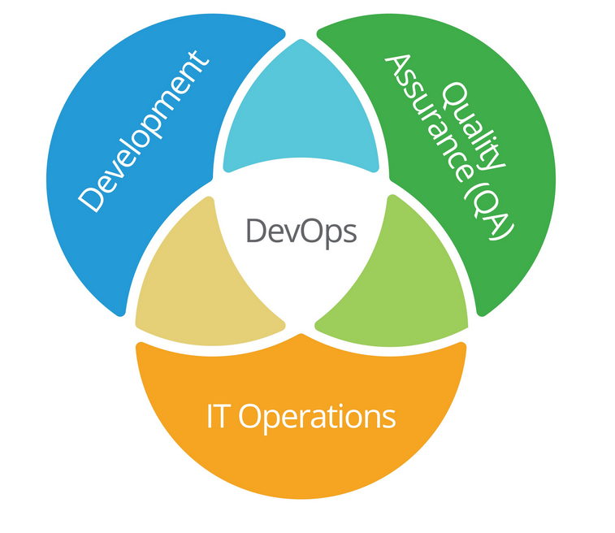
Devops
Notes:
#### The traditional approach Previously, most companies separated their software teams into developers, testers, system administrators, and so on. Lack of communication and division of knowledge would often result in a slow down of the delivery of a project. Suppose a developer added a new feature, they would then have to send it to the testing team for review. After the review, the application would be built, and then finally, another team would pick it up to deploy the feature and roll it back in the case of an error. This approach is time consuming and prone to error due to lack of understanding of the project as a whole. #### A new approach The Devops culture instead advocates for software developers to be involved in the entire delivery process. The main advantage of this approach is reducing the time it takes from the inception of the software to its delivery. The separation between teams is reduced, as both developers and administrators share the same tools and are expected to know how to: - Write and test the code for each component - Build the entire project - Secure it - Deploy it - Maintain it - Monitor it Both Devops and Agile concentrate on automation and continuous integration and delivery. Continuous integration and delivery is a software engineering approach in which the features of a product are incrementally developed, tested, and deployed. The advantage of this is that the time it takes to integrate and test large features is reduced as the features are broken down more granularly. A secondary advantage is that quality assurance is being done often, resulting in early feedback, and therefore improves customer satisfaction. With the advent of Kubernetes, practicing a Devops methodology has become a lot easier. Developers can write, test, roll out, and roll back features if necessary, all in one day.

Slide 15
@iovanap @nlad95 @maddie_patrichi @venalainene
Kubernetes Primitives

Slide 16
@iovanap @nlad95 @maddie_patrichi @venalainene
Kubernetes Primitives

Slide 17
@iovanap @nlad95 @maddie_patrichi @venalainene
Kubernetes Primitives

Slide 18
Thank You!
Notes:
<number>

