Slide 1
AXA Depression dataset exercise
Nishal Chandarana

Slide 2
Dataset basics
413768 rows
Target variable: “History of mental illness”
30.4% = Yes
Mixture of categorical and numerical variables

Slide 3
EDA
Variables that seem to be correlated with mental illness outcome:
Education
Employment status*
Dietary habits
Sleep
Income*

Slide 4
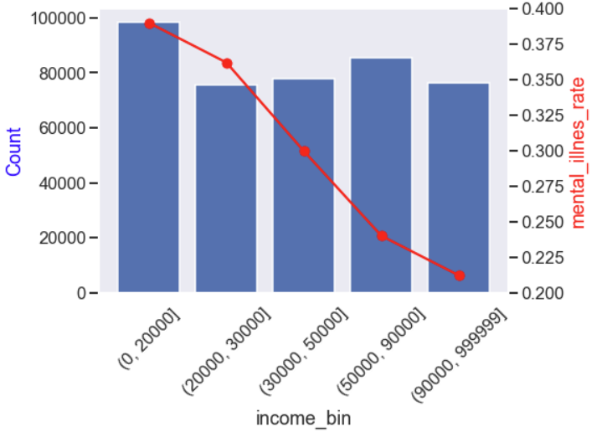
EDA – income

Slide 5
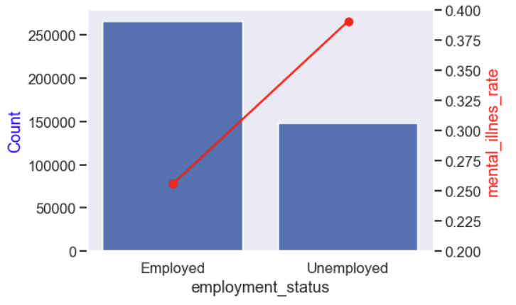
EDA - employment

Slide 6
Random forests
PROS
Flexible algorithm, capable of identifying non linear effects
Handles multiple data types
Can achieve high predictive power
CONS
Relatively long processing time
Needs optimisation / parameter tuning
Difficult to interpret and make causal links

Slide 7

Model performance
Prediction threshold 0.3
56% accuracy in test set
Only 30% precision in mental_illness = “yes” group – can adjust threshold to increase precision at the expense of recall

Slide 8
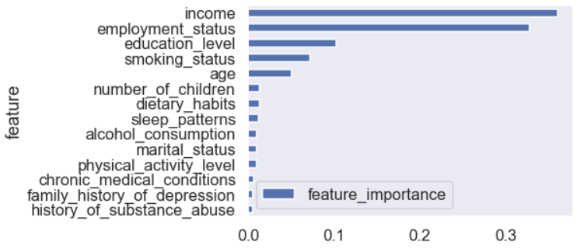
Feature importance
Income, employment, education, smoking and age highly predictive
Remaining variables of low importance

Slide 9
Conclusions + limitations
Random forests algorithm can predict history of mental health outcome with 56% accuracy, though with low precision when predicting “Yes” to mental illness
Model primarily uses income, employment_status, smoking and education to make predictions – these variables appear to have the strongest link to history of mental illness in the data
Further work
Can further optimise algorithm to maximise performance
Tune and select variables, removing highly correlated or low importance variables to simplify model
Explore more sophisticated algorithms, or simpler ones that allow more interpretation (logistic regression)

