Slide 1





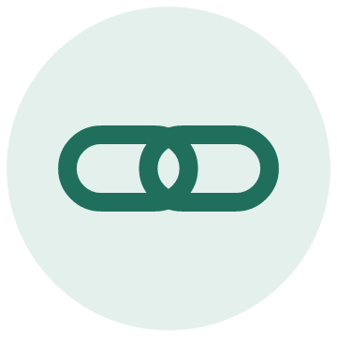
PHASE 2
Phase 1 builds the record. Phase 2 puts it to work.
Every phase has a reason
PHASE 1 · THIS PROTOTYPE
Recommend only
PHASE 2 · AFTER THE GATE
Earned, one step at a time
Recommend only
The AI recommends with citations. The nurse confirms.
THE GATE
Evals on real, labeled cases
A compliance review for anything the member sees
The member sees where the request stands
Fed by the decision record from phase 1. Patient Access API, January 2027.
No more pend loops
A missing detail is found at once, as one question.
Learn from outcomes
Denial and appeal results feed back into the rules and the evals.
One service at a time
Planned, then pilot, then live.
More services
Onboard the next ones, ranked by Humana's request history.
In every phase, a person decides. The AI never denies and never approves on its own.
Phase 1 is what you have seen. The AI recommends with citations and the nurse confirms. It removes the pend and builds the decision record.
Phase 2 has a gate: evals on real labeled cases, and a compliance review for anything the member sees.
First: the member sees where the request stands. The decision record from phase 1 feeds it.
Second: learn from outcomes. Denial and appeal results feed back into the rules and the evals.
Third: more services, ranked by Humana's own request history.
In every phase, a person decides. The AI never denies and never approves on its own.
Phase 2 is a plan, not built. Each step waits for its gate.
Notes:
One slide. One click per step. Finish your talking point, then click.
Click 1: Phase one is what you have just seen. The AI recommends, with citations, and the nurse confirms. It removes the pend. A missing detail is found at the start, as one precise question, not after a loop. I add services one at a time, planned, then pilot, then live. And it builds something that matters for what comes next: a trusted record of every decision, with its evidence.
Click 2: Phase two has a gate. I do not build the next layer on a record I have not tested. First, evals on real, labeled cases, not made-up ones. Second, a compliance review for anything the member sees. Until the gate opens, nothing in phase two goes live.
Click 3: First, the member. In friction six, the member waits with no view. I did not build it first, because a status is only as good as the record behind it. The decision record that phase one creates is exactly what the member view reads. And from January 2027, plans must offer a Patient Access API with prior authorization information, so this is on the way regardless.
Click 4: Second, learn from outcomes. When a denial is appealed and overturned, I want to know whether the packet already had the answer. That result feeds back into the rules and the evals. That is the full version of right-first-time.
Click 5: Third, more services. I onboard them one at a time, ranked by Humana's own history of prior authorization requests: volume, pends and reversals by procedure code. The process is the one you saw: policy, codes, service, pilot, live.
Click 6: And in every phase a person decides. The AI never denies, and it never approves on its own. A nurse confirms every recommendation. Only a medical director denies, and writes the reason.

