Slide 1

PROFESSIONAL MASTERS IN INFORMATION AND CYBER SECURITY (PMICS)
CSE 810: PROJECT ON CYBER SECURITY
INCEPTION STAGE · SEPTEMBER 2026
RedGrid
Dependency-Constrained UCB Exploration for Autonomous Penetration Testing
PRESENTED BY
Name | Class Roll | Reg No
Nishan Paul | 50028 | H-55
Md Rakibur Rahman | 50040 | H-49
SUPERVISOR
Dr. Md. Abdur Razzaque
Professor and Chair
Department of Computer Science and Engineering
University of Dhaka

Slide 2
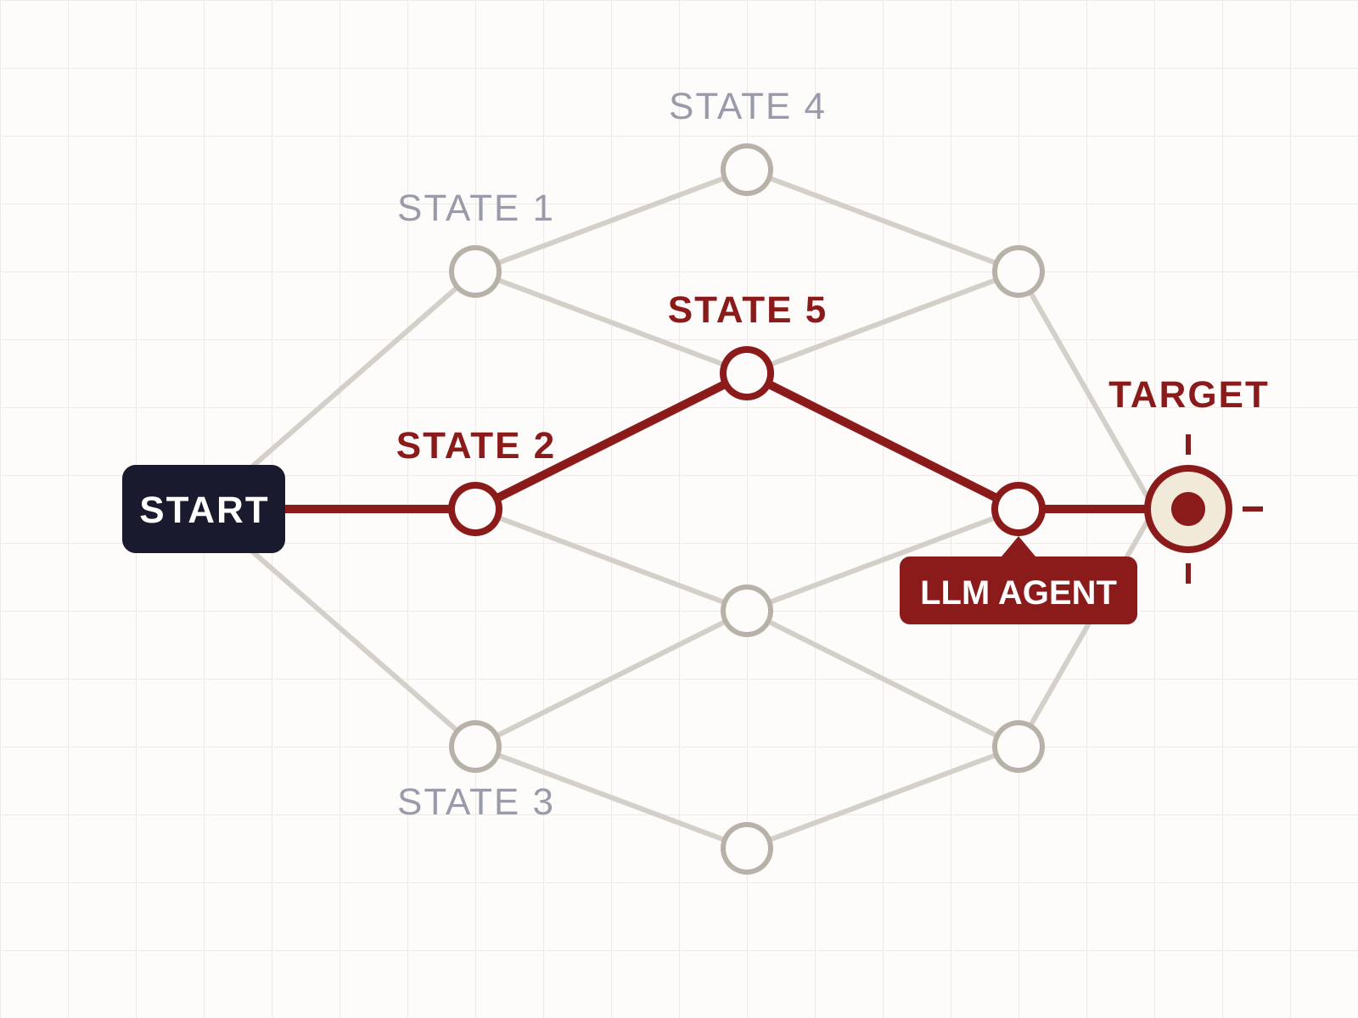
Why This Matters
PROJECT MOTIVATION
“Attackers move fast. Defenders move slow. Automated testers don’t move at all.”
Security vulnerabilities are found daily in web apps, APIs, and networks. Human pen testers are scarce and expensive. Automated scanners use fixed rule-sets — they cannot reason, adapt, or chain exploits.
The question:
Can an LLM agent carry out penetration testing autonomously — without step-by-step human direction?
ATTACK SURFACE EXPLORATION
02 / 21

Slide 3
Literature We Surveyed
A
AGENT SYSTEMS
8 PAPERS
B
BENCHMARKS
2 PAPERS
01
AutoHack
GPT-4 successfully exploits real web vulnerabilities
CVE-Bench
40 critical web CVEs with oracle-backed evaluation
Fang et al., 2024
Zhu et al., 2025
02
OneDay
GPT-4 exploits one-day CVEs at 87% success with description
PentestEval
Stage-level breakdown of pipeline failure modes
Fang et al., 2024
Yang et al., 2025
03
HPTSA
Hierarchical multi-agent system for zero-day CVEs
S
SURVEYS
1 PAPER
Zhu et al., 2024
04
PentestGPT
Context loss is the dominant failure in long sessions
Wang 2025
General survey of LLM-based agent architectures
Deng et al., 2024
Wang et al., 2025
05
VulnBot
Role-specialised multi-agent dispatch architecture
Kong et al., 2025
06
CHECKMATE
Classical planning integrated with LLM agent execution
Wang et al., 2025
KEY TAKEAWAY
07
Incalmo
Multi-host orchestration across Active Directory
8 Agent Systems · 2 Benchmarks · 1 Survey
Singer et al., 2025
Benchmarks serve as the primary source for failure-mode analysis and motivate the research gap.
08
PrediQL
Schema-aware LLM fuzzer for GraphQL APIs
Liu et al., 2025
03 / 21

Slide 4
What the Literature Agrees On
"Architecture, not model scale, is the dominant variable."
CONSISTENT ACROSS
VulnBot
PentestGPT
CHECKMATE
Incalmo
HPTSA
Fang 2024
Unstructured ReAct + GPT-4 | Structured Pipeline + GPT-4o-mini
✗ Depth-first tunnel vision | ✓ Broad, structured exploration
✗ Context loss in long sessions | ✓ Scoped per-invocation context
✗ No failure recovery | ✓ Retry / adapt / escalate loops
✗ Implicit planning only | ✓ Explicit dependency modeling
Synthesised from 6 independent papers | September 2026 Review
04 / 21

Slide 5
Failure Mode 1 — Insufficient Exploration
Exploration Failure Rate by Agent
CVE-BENCH · 40 CRITICAL WEB CVEs · CVSS 9.0+
50% threshold
Even the best agent exploits only 13% (one-day) or 10% (zero-day).
T-Agent (0-day)
80.0%
AutoGPT (0-day)
72.5%
The dominant failure is not reasoning quality — it is breadth of search. Agents commit early to a narrow attack path and never revisit.
Cy-Agent (0-day)
67.5%
T-Agent (1-day)
55.0%
Range: 37.5% – 80% exploration failure rates across all agents tested.
AutoGPT (1-day)
45.0%
Root cause: Not a smarter-model problem — it's a search problem.
Cy-Agent (1-day)
37.5%
Source: CVE-Bench (Zhu et al., 2025), Table 5
05 / 21

Slide 6
Failure Mode 2 — The Dependency-Reasoning Gap
PENTESTEVAL GT INJECTION ABLATION — TASK SCORE
0.80
Largest single-stage gain
+0.14 ★
PENTESTEVAL · 12 REAL-WORLD SCENARIOS · 346 TASKS
0.60
+0.03
Attack Decision-Making (ADM) is the single weakest stage — Spearman ρ = 0.25.
+0.19
0.40
Ground-truth ADM injection adds +0.14 on top of already-perfect weakness discovery. No existing system closes this gap.
Baseline (0.31)
0.20
0.25
+0.14
0.00
ADM SPEARMAN ρ
GT ADM GAIN
SMP Baseline
+ GT Weakness
Gathering
+ GT Weakness
Filtering
+ GT Attack
Decision-Making
Source: PentestEval (Yang et al., 2025)
06 / 21

Slide 7
The Gap No System Has Closed
Wide Exploration
Dependency Reasoning
HPTSA
VulnBot
T-Agent
AutoGPT
CHECKMATE
PentestEval SMP
UNEXPLORED TERRITORY
✓ Finds many candidate weaknesses
THE
COMPOUND
GAP
✓ Explicit prerequisite modeling
✗ No prerequisite / dependency model
✗ Requires pre-enumerated weakness sets
✗ Flat task dispatch
✗ Does not scale to open-ended discovery
No system combines open-ended exploration with dynamic dependency-aware planning.
RedGrid investigates this exact combination.
07 / 21

Slide 8
Prior System Comparison
FOUR DIMENSIONS THAT MATTER MOST · PRELIMINARY 11-PAPER REVIEW
SYSTEM | ARCHITECTURE | DEPENDENCY MODELING | CROSS-SESSION MEMORY | BENCHMARK
Fang et al. 2024 | Single agent (ReAct) | ✗ None | ✗ None | 15 CVEs
HPTSA | Hierarchical planner + tasks | ✗ Flat dispatch | ✗ None | 14 zero-day CVEs
PentestGPT | Split reasoning / parsing | ~ Implicit (LLM only) | ✗ None | HTB / VulnHub
VulnBot | Multi-agent, role-specialised | ✗ Flat dispatch | ✗ None | HTB-style
CHECKMATE | Agent + classical planner | ✓ Explicit, pre-enumerated | ✗ None | Curated only
Incalmo | Multi-host orchestration | ~ Partial (host/cred) | ✗ None | MHBench (40)
PrediQL | LLM-guided fuzzer | ~ Schema-derived | ✗ None | 6 GraphQL APIs
RedGrid (proposed) | 4-layer multi-agent | ✓ Dynamic VDG | ✓ 3-tier memory | Web + GraphQL + Multi-host
PRELIMINARY READING — 11-PAPER FOCUSED REVIEW, SEPTEMBER 2026
08 / 21

Slide 9
Research Gap
THE IDENTIFIED GAP
“The reviewed literature does not contain a system that combines:
(1) broad, open-ended exploration of an unfamiliar attack surface,
(2) with an explicit, dynamically constructed dependency model,
(3) evaluated across more than one benchmarked attack-surface family.”
Exploration Gap
Planning Gap
Coverage Gap
37 – 80%
0.25
1
EXPLORATION FAILURE RATE
ADM SPEARMAN ρ
ATTACK SURFACE PER SYSTEM
CVE-Bench: insufficient exploration is the dominant failure mode
PentestEval: ADM is the weakest stage across all pipelines
Every prior system evaluated on exactly one surface only
This is the gap RedGrid is designed to investigate.
09 / 21

Slide 10
Introducing RedGrid
Dependency-Constrained UCB Exploration for Autonomous Penetration Testing
SQLi
VDG
STATE
ELIGIBLE
Model vulnerabilities as a graph with prerequisite edges, not a flat list.
UCB
3.42
UCB
Auth Bypass
RCE
Guide exploration with Upper Confidence Bound over the dependency-constrained frontier.
STATE
NEXT ►
STATE
BLOCKED
UCB
4.17 ★
UCB
—
↑
Memory
XSS
Agent targets highest UCB
Retain and reuse strategies across missions.
STATE
ELIGIBLE
UCB
2.81
Vulnerability Dependency Graph (VDG) — conceptual sketch
10 / 21

Slide 11
Research Objectives
FIVE WORKING GOALS AT INCEPTION STAGE
VDG Formalization
Investigate whether a prerequisite-edge graph improves agent exploration over a flat priority list
1
Dual-Layer World Model
Separate confirmed facts from inferred hypotheses for independent ablation
2
Multi-Layer Orchestration
Design a four-layer agent hierarchy matching the strongest surveyed systems
3
Cross-Mission Memory
Determine whether strategy reuse offers measurable benefit vs. negative-transfer risk
4
Benchmark-Grounded Evaluation
Evaluate on oracle-backed benchmarks across 3+ attack surfaces
5
NOTE These reflect the research direction at inception stage. Scope will evolve with implementation.
11 / 21

Slide 12
Expected Contributions
ⓘ THE FOLLOWING SLIDES ARE HIGH-LEVEL SKETCHES — IMPLEMENTATION HAS NOT STARTED.
C1 — PRIMARY
C2 — SUPPORTING
C3 — METHODOLOGICAL
Smarter Exploration
Learning Across Missions
Consistent Evaluation
“Can modeling vulnerabilities as a graph — with explicit prerequisites — help an agent explore more intelligently?”
“Can an agent carry forward what it learned in past engagements to perform better on similar targets?”
“Can a single architecture be tested fairly across web, GraphQL, and multi-host surfaces using standardized oracles?”
DISCLAIMER
These are research questions. Answers come from experiments — not this report.
12 / 21

Slide 13
RedGrid — The Core Idea
EXPLORE
GUIDE
LEARN
Explore Broadly
Dependency Graph
Remember and Reuse
GUIDED BY
FEEDS INTO
Search the full attack surface. Don't commit to one path early.
Model which vulnerabilities depend on which. Pick the smartest next step.
Carry forward what worked across past missions.
RedGrid asks whether connecting
EXPLORATION
+
DEPENDENCY REASONING
+
MEMORY
make autonomous penetration testing meaningfully better?
13 / 21

Slide 14
Architecture — A Rough Sketch
WORLD MODEL
Confirmed facts vs. attack hypotheses — kept strictly separate.
Mission Planner
Takes in the target. Starts the scan. Stays in control.
1
Decision-Maker
Decides what to attack next — using the dependency graph.
2
Specialist Agents
Web, GraphQL, Network — each focused on one attack type.
3
Execute and Validate
Runs the attack. Checks if it worked.
4
MEMORY
Remembers strategies and failures. Reuses what worked.
RedGrid
14 / 21

Slide 15
How RedGrid Will Work
1
Recon
2
Plan
Scan the target. Build a picture of what’s there.
Decide what to attack next — using the dependency graph.
VDG drives the loop
4
Learn
3
Attack
Did it work? Update the graph. Store the lesson. Repeat.
Send in a specialist agent. Run the attempt.
01
Clean Slate per Attempt
02
Facts vs. Guesses
Each attack attempt runs with fresh context — no leftover noise from previous steps.
What the agent confirmed is kept strictly separate from what it infers.
15 / 21

Slide 16
Evaluation — Three Attack Surfaces
01. WEB APPLICATIONS
02. GRAPHQL APIs
03. MULTI-HOST NETWORKS
CVE-Bench
PrediQL
MHBench
40 real critical CVEs
6 real GraphQL APIs
40 multi-host environments
“Can the agent find and exploit web vulnerabilities without a hint?”
“Can the agent abuse API schemas and find injection points?”
“Can the agent move laterally across hosts and escalate privileges?”
We only test on attack surfaces that already have a published, oracle-backed benchmark.
No custom benchmarks.
16 / 21

Slide 17
Project Timeline
6-MONTH PROJECT · SEPTEMBER 2026 — FEBRUARY 2027
SEP 05, 2026
NOV 21, 2026
FEB 20, 2027
Inception Stage
Mid Defense
Final Defense
10:00 – 10:15
09:00 – 15:00
09:00 – 15:00
Phase: Literature and Architecture
Phase: Core Framework Implementation
Phase: Full Evaluation and Writeup
Literature review compiled
System architecture designed
Evaluation strategy locked
VDG mechanism integration
Autonomous agentic loop execution
Initial target environment testing
Empirical benchmark testing
Comparative performance analysis
Final project submission
17 / 21

Slide 18
Challenges We Are Aware Of
ANTICIPATED BOTTLENECKS AND PROACTIVE MITIGATION
CRITICAL RISK
Inferring Dependencies Is Hard
HIGH RISK
Sandbox vs. Real World
MEDIUM RISK
Memory Could Backfire
LOW RISK
Tuning Is Tricky
Building the prerequisite graph using an LLM instead of human annotation will be noisy. We must measure this gap.
What works perfectly on a controlled benchmark may fail on a real-world target. We will test both environments.
A strategy that succeeds against software version 1 might backfire against version 2. A safety mechanism is key.
The system has parameters to adjust. Final results must be robust, and not depend on one perfect setup.
18 / 21

Slide 19
Where We Are
COMING NEXT
01
Build the prototype
02
Early experiments to test the ideas
FOUNDATION SECURED
Synthesized 11 key VAPT papers
03
Full benchmark evaluation (web, GraphQL, multi-host)
Identified 2 quantified failure modes
Formalized the research gap
04
Refine based on what we find
Proposed 3 research directions
Sketched the architecture approach
05
Write the thesis
Submitted inception report
The architectural blueprint is ready. Awaiting greenlight for implementation.
DISCUSSION POINT
Given the ambitious scope of VDG + dependency-aware exploration, should we pursue the full architecture, or constrain the scope to a specific subsystem before implementation?
19 / 21

Slide 20
RedGrid
Thank You
FLOOR OPEN FOR QUESTIONS
Nishan Paul and Md Rakibur Rahman
UNIVERSITY OF DHAKA
PROFESSIONAL MASTERS IN INFORMATION AND CYBER SECURITY (PMICS)
CSE 810: PROJECT ON CYBER SECURITY
20 / 21

Slide 21
Key References
Fang, R., Bindu, R., Gupta, A., Zhan, Q., & Kang, D. (2024). LLM agents can autonomously hack websites. arXiv:2402.06664. AutoHack
Liu, Z., et al. (2025). PrediQL: Automated testing of GraphQL APIs with LLMs. PrediQL
Fang, R., Bindu, R., Gupta, A., & Kang, D. (2024). LLM agents can autonomously exploit one-day vulnerabilities. arXiv:2404.08144. OneDay
Zhu, Y., et al. (2025). CVE-Bench: A Benchmark for AI Agents' Ability to Exploit Real-World Web Application Vulnerabilities. CVE-Bench
Yang, K., et al. (2025). PentestEval: Benchmarking LLM-based penetration testing. PentestEval
Zhu, Y., Kellermann, A., Gupta, A., Li, P., Fang, R., et al. (2024). Teams of LLM agents can exploit zero-day vulnerabilities. arXiv:2406.01637. HPTSA
Wang, L., Ma, C., Feng, X., et al. (2025). A Survey on Large Language Model based Autonomous Agents. AgentSurvey
Deng, G., et al. (2024). PentestGPT: Evaluating and Harnessing Large Language Models for Automated Penetration Testing. PentestGPT
Sheyner, O., et al. (2002). Automated generation and analysis of attack graphs. IEEE S&P. VDG
Kong, L., et al. (2025). VulnBot: Autonomous penetration testing for a multi-agent system. VulnBot
Auer, P., Cesa-Bianchi, N., & Fischer, P. (2002). Finite-time Analysis of the Multiarmed Bandit Problem. Machine Learning, 47(2-3). UCB
Wang, J., et al. (2025). Automated penetration testing with LLM agents and classical planning. CHECKMATE
Shinn, N., et al. (2023). Reflexion: Language agents with verbal reinforcement learning. NeurIPS. ADM
Singer, J., et al. (2025). Incalmo: An autonomous LLM-assisted system for red teaming. Incalmo
21 / 21

