Slide 1
Project for PMICS Credit Hour: 6 Duration: 1 semester

Slide 2
Meaning of Project
A project is a temporary undertaking with defined goals, a specific start and end, and a unique deliverable, such as a new product, service, or process.
A project is a planned set of activities designed to achieve specific goals within a fixed timeframe and resources.
In academics, a project means a practical application of knowledge where students investigate a problem, analyze it, and propose or implement solutions.
Examples of Projects: Research Project, Construction Project, Product Development, Software Implementation, Robotics design and development

Slide 3
Project Selection Methods
Relevance to cybersecurity field
Availability of resources & datasets
Feasibility within time
Personal interest + career goals
Example Topics:
Cloud Security & Incident Response
AI for Malware Detection
Phishing Email Classification
IoT Security

Slide 4
Responsibility
Supervisor- to evaluate and guide your work
Yourself- to stay focused and organized during your work
What is important?
Show you have legitimate project topic
Demonstrate a realistic and effective project plan
Reflect your understanding
Essential for Success- Planning is the key

Slide 5
Project Proposal
Literature review for the relevant topic
Prepare a project proposal and sent it to supervisor
Update/adjust the proposal based on supervisor comment
Specify and finalize scope of work and methodology
Work breakdown/Schedule for the project (timeline)
Strictly follow the timeline
Before start the project work, project proposal must be approved from supervisor with scope of work and methodology

Slide 6
Project Proposal (Planning & Design) report
Title & Abstract:
Clear, concise title related to Cybersecurity topics with 200–300 words abstract summarizing background, objective and scope
Introduction & Problem Statement
Define the cybersecurity challenge , 2. Research questions/objectives
Scope of the Project
Boundaries (what is included, excluded), 2. Academic + practical contribution
Literature Review
Summary of past studies & tools, Gaps/limitations in existing works
Proposed Methodology
Research design (experimental, case study, simulation), Data sources (datasets, logs, simulated attacks), Tools/technologies (Python, Wireshark, Splunk, ML models, etc.)
Expected Outcomes
Anticipated results (e.g., improved detection accuracy, secure design)
Timeline & Resources
Week-wise/Gantt chart plan, Hardware, software, datasets required
Proposal Report Length: 20–25 pages

Slide 7
Project Implementation and Report
General guideline based on reference document from DU
The report must be written in Latex
The plagiarism level must be below of range
AI detection or AI use limit must be below of range
Total report must be written by the student (may use AI for assistance but not preparing the entire report with AI tools)

Slide 8
Project Report
Front part
Title Page , certification, declaration, Abstract, Acknowledgement, Table of content, List of figure, List of Table → All are in a separate page → 8-15 pages
Body Part
Introduction → 6–8 pages
Feasibility Analysis → 8–12 pages
Proposed System Design and Architecture→ 8-10 pages
Results & Analysis → 8–10 pages
Conclusion → 3–5 pages
End Part
References → 3–5 pages
Appendix → as required
Publications (if any )
Project Report: 50–70 pages total

Slide 9
Title
Should be concise, descriptive, informative and catchy
Provides keywords for the classification and indexing
Title should contain
Topic
(What)
Population
(Who)
Context
Methodology
(How)
Wireless Network Sensor: Adaptive energy saving Smart Healthcare Monitoring to improve data accuracy for medical professional using AI based optimization techniques
Malware Detection: Adaptive Resource-Efficient Cybersecurity System to Enhance Threat Identification Accuracy for Security Analysts Using AI

Slide 10
Chapter 1:Introduction
1.1 Background and Context
Begin with a clear background that explains why your project matters. Provide a brief overview of the broader field in which your project fits and highlight key trends or developments. Summarize what is already known and describe the main issues or gaps your project intends to address. This sets the stage and shows that you understand the area you are working in.
1.2 Problem Statement
Describe the specific problem your project is designed to solve. Explain what is already understood about this problem and point out what is still missing or not working well. Make it clear why this gap needs attention.
1.3 Relevance and Importance
Explain why your project is worth doing. Show how it will provide useful insights, practical improvements, or new approaches. Highlight the value it brings to users, organizations, or the field in general.
1.4 Project Aim
State in one sentence what you intend to achieve. This should capture the overall purpose of the project—what you want to create, test, or demonstrate.
1.5 Project Objectives
List 4–5 specific, measurable scope you will take for your project. Use clear action verbs. For example: To design a prototype that… To implement a system that… To evaluate performance by… To compare results with existing methods…
1.6 Key Project Questions
Write the main questions your project will answer. These should guide your work and make clear what you are investigating or proving through the project.

Slide 11
Chapter 2: Literature Review
Make this section a focused, practical survey (from published paper and project) that shows how past and current work lead to your project.
Keep it concise, well-organized, and clearly tied to your project goals.
Short overview of the field and the main themes or approaches relevant to your project.
Identify gaps & contradictions
Show how your project fits into the field
* Use a matrix or table to map papers to methods, datasets, metrics, and limitations — this makes gaps obvious.
Be critical but fair: state what each study contributes and what it does not
Note: Use an excel sheet, read one paper and make some notes like relevance, key methods, dataset, algorithms, experimental setup

Slide 12
Chapter 2: Literature Review
Paper Name / Year | Reference (Example DOI or Source) | Methodology | Key Strengths | Identified Gap / Limitation | Notes / Relevance
Malware Detection Using Deep Learning (2019) | Kim & Park, IEEE Access, 2019 | CNN applied to raw executable bytes | High accuracy (97%) on benchmark dataset; end-to-end feature learning | Evaluated only on static datasets; limited real-world traffic tests | Shows potential of deep learning but needs live-network validation—aligns with our dynamic-analysis goal
Hybrid IDS with Machine Learning (2020) | Smith et al., Computers & Security, 2020 | Combines signature-based IDS with Random Forest classifier | Reduced false positives by 15% compared to Snort baseline | Requires frequent rule updates; performance drops on encrypted traffic | Good hybrid approach we can extend with adaptive retraining
Behavior-Based Ransomware Detection (2021) | Li & Zhao, Journal of Cybersecurity, 2021 | Monitors file-system activity patterns using Hidden Markov Models | Early detection of ransomware encryption start; lightweight | Tested only on Windows environment; small sample size | Suggests cross-platform feature set we can generalize
Ensemble Learning for Network Intrusion (2022) | Al-Farsi et al., Future Generation Computer Systems, 2022 | Stacking ensemble of SVM, RF, and Gradient Boosting | Excellent detection rate on NSL-KDD dataset; good scalability | Old dataset; may not reflect current attack vectors | Highlights need for more recent, diverse datasets
Adversarial Evasion of ML-Based IDS (2023) | Chen & Gupta, ACM CCS Workshop, 2023 | Generates adversarial network packets to fool ML detectors | Demonstrates weaknesses of popular ML models | Focuses on evasion attacks; no countermeasure tested | Underscores importance of robust, adversarial-resistant model design
Note: Use an excel sheet, read one paper and make some notes like relevance, key methods, dataset, algorithms, experimental setup

Slide 13
Chapter 3. Research Methodology
3.1 Research Design → Experimental / Descriptive / Analytical/System Model Prepare an application-based system model for explaining the proposed system. While preparing this section, keep in mind the problem statements that you have mentioned in chapter 1. 3.2 Dataset and Experimental design/System Requirements Explain the Datasets and experimental design/hardware and software requirements of your proposal (logs, datasets, simulations, journals, reports, benchmarks)
3.3 Methodology and Data Sources Describe the tools, procedures, participants and sources of the research. When, where and how will you collect, select and analyze data? (e.g., Python, Wireshark, Splunk, ML models)
3.4 Work Plan and Expected Outcomes (if appropriate) Place a flow chart and explain the working procedure of your proposed work. 3.5 Testing Environment (if appropriate) Explain the testing procedures of the proposed work.

Slide 14
Chapter 4: Results / Findings
Present outcomes of your research / implementation
Tables, graphs, screenshots, case study results
Compare with literature findings
Performance Analysis

Slide 15
Chapter 5. Conclusion
Primary Objective- This project addresses the critical challenge of [briefly restate your problem—e.g., detecting and mitigating evolving malware threats in real-time environments]. Our primary objectives are to design, implement, and evaluate an AI-driven malware detection system that is accurate, resource-efficient, and adaptable to emerging attack patterns.
Summarize key findings- To meet these objectives, we will apply [key methodologies—e.g., ensemble machine learning models, dynamic feature extraction, and continuous model retraining], supported by rigorous testing on both benchmark datasets and real-world network traffic.
Link back to objectives- The expected contributions are both practical and theoretical. Practically, the system can help organizations improve early threat identification and response, guiding better security policies and operational practices. Theoretically, our work will offer insights into scalable model architectures and adaptive optimization techniques that can inform future research on intelligent cybersecurity systems.
Contributions to cybersecurity field- We recognize potential challenges, such as the need for diverse, high-quality data, the risk of adversarial evasion, and computational constraints. These limitations will be managed through careful dataset curation, iterative testing, and resource-efficient model design.
Limitations + Future Work- In closing, this project not only tackles an urgent cybersecurity problem but also lays the groundwork for further research on adaptive, AI-based threat detection. By bridging current gaps in accuracy, scalability, and resilience, our findings aim to advance both professional practice and the broader field of cybersecurity research.
Notes:
Finish the project proposal by emphasizing why your proposed work is important and what it will contribute to practice or theory. Will your findings help improve a process, inform policy, or make a case for concrete change?
Will your work help strengthen a theory or model, challenge current assumptions?
Briefly restate the problem, summarize objectives, highlight key methodologies, outline expected contributions, acknowledge challenges and limitations, and end with a final thought emphasizing the significance of your project work.

Slide 16
Reference/ Bibliography
Examples (As required and relevant in a specific format IEEE)
[1] C. P. Pfleeger, S. L. Pfleeger, and J. Margulies, Security in Computing, 5th ed. Upper Saddle River, NJ, USA: Pearson, 2015.
[2] W. Stallings, Cryptography and Network Security: Principles and Practice, 8th ed. Boston, MA, USA: Pearson, 2023.
[3] M. Conti, A. Dehghantanha, K. Franke, and S. Watson, "Internet of Things security and forensics: Challenges and opportunities," Future Generation Computer Systems, vol. 78, pp. 544–546, Jan. 2018.
[4] K. Scarfone and P. Mell, "Guide to intrusion detection and prevention systems (IDPS)," NIST Special Publication, vol. 800-94, pp. 1–127, Feb. 2007.
[5] A. Shabtai, Y. Elovici, and L. Rokach, "A survey of data leakage detection and prevention solutions," in Proc. IEEE Symp. Security and Privacy Workshops (SPW), San Francisco, CA, USA, 2012, pp. 1–12.

Slide 17
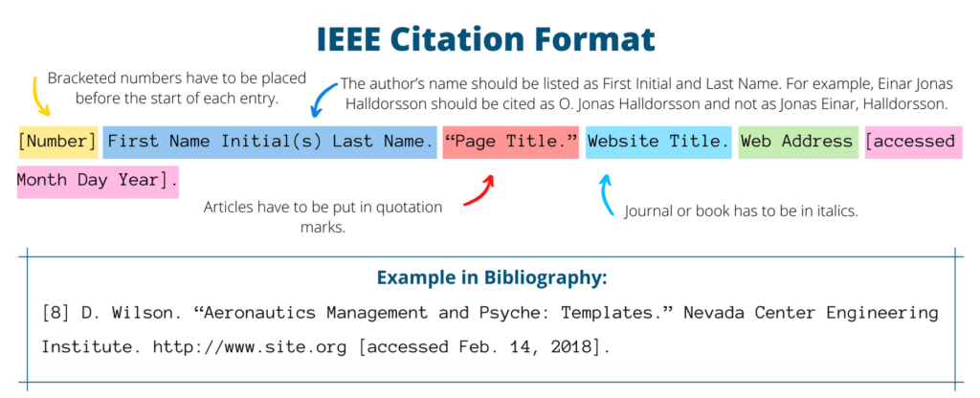
Reference/ Bibliography

Slide 18
Project Timeline
Week 1–2: Topic selection + proposal preparation
Week 3–5: Literature review for project proposal
Week 6–8: Define Scope, Methodology, design solution + data collection
Week 9–12: Experimentation & analysis
Week 13–14: Report writing
Week 15-17: Final submission + presentation

Slide 19
My own observation
Select a topics based on prior knowledge
Without prior knowledge will hinder the project completion and often leads to delays, extra learning curves, and heavier workloads.
Select implementable and justifiable project
Complete the scope defined at project proposal.
Just do it yourself (use AI tools or GPT for your assistance but not to complete your task with tools)

Slide 20
Q A

Slide 21


