Slide 1
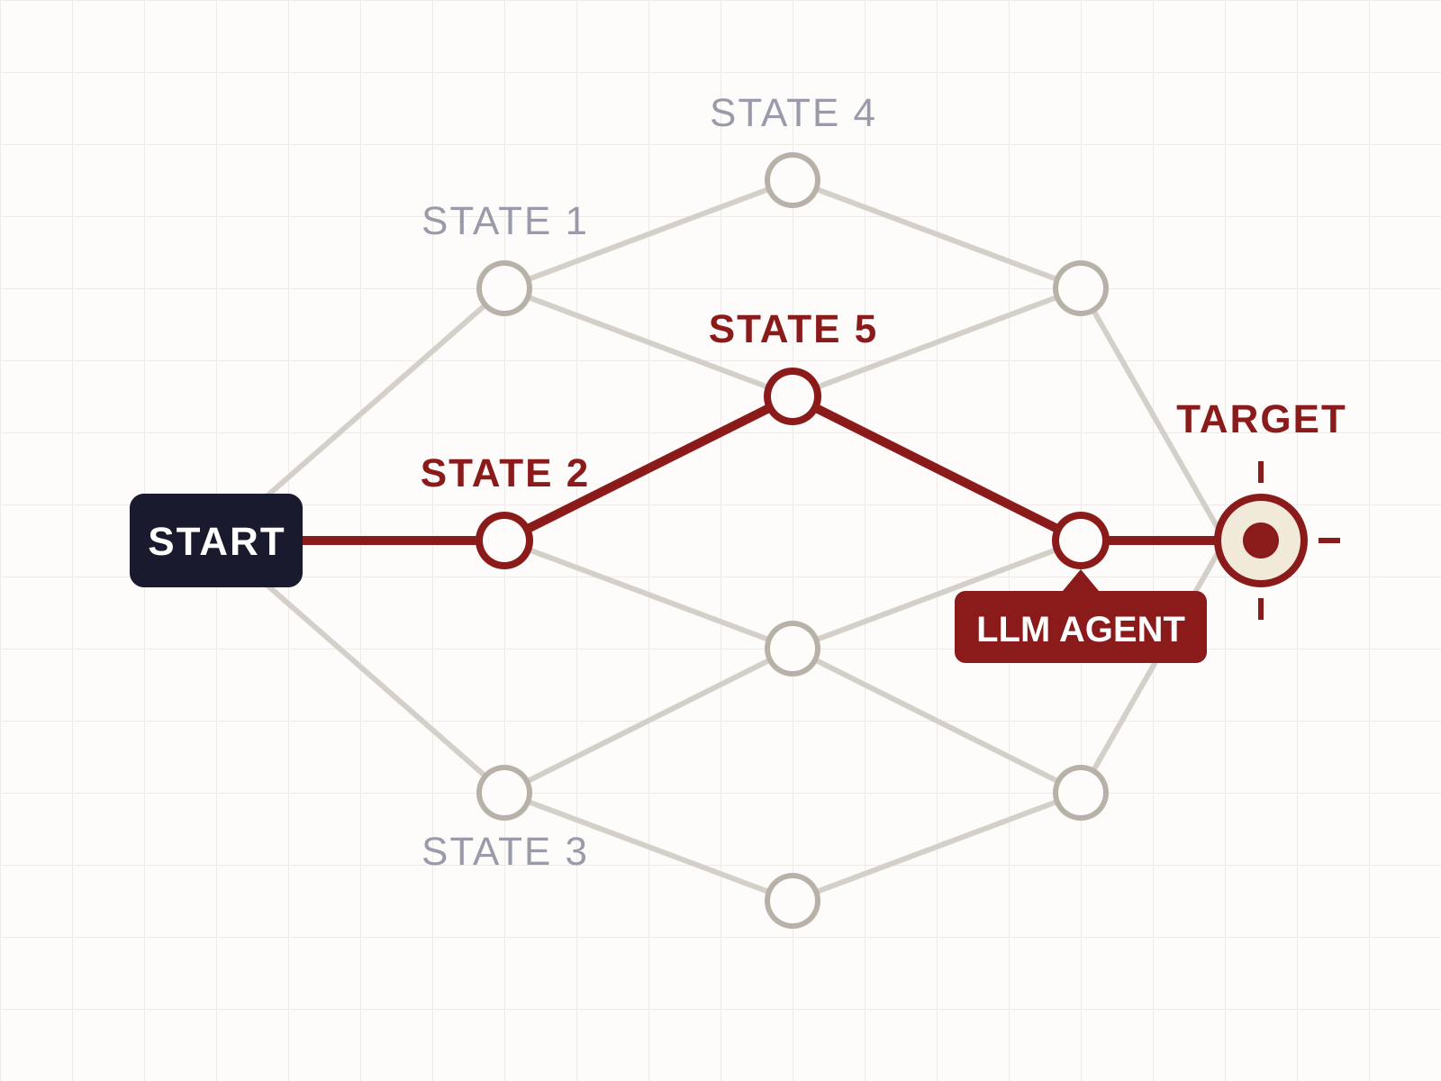
RedGrid
Why This Matters
PROJECT MOTIVATION
“Attackers move fast. Defenders move slow. Automated testers don’t move at all.”
Security vulnerabilities are found daily in web apps, APIs, and networks. Human pen testers are scarce and expensive. Automated scanners use fixed rule-sets — they cannot reason, adapt, or chain exploits.
The question:
Can an LLM agent carry out penetration testing autonomously — without step-by-step human direction?
ATTACK SURFACE EXPLORATION
02 / 20

