Slide 1
DataLex: Explainable SIEM Security Intelligence Using Generative Al
Group Members:
Abu Syeed Sajid Ahmed (H-26)
Arpita Paul (H-07)
Supervisors:
Abu Ahmed Ferdaus
Associate Professor, CSE, DU
&
Major (retd) Md Mehedi Hasan

Slide 2
SCOPES
01
02
03
04
05
06
07
08
01
Introduction
Problem Statement & Motivation
Proposed Solution
System Design
Tech Stack
Result Analysis
Competitor Analysis
Future Works

Slide 3
01
INTRODUCTION
02

Slide 4
INTRODUCTION
03
In the digital transformation age, cybersecurity has become a critical frontier.
Cyber threats have increased due to the exponential rise in digital infrastructures.

Slide 5
What is SIEM?
What is SIEM?
04
Security Information and Event Management (SIEM)
A system that collects, aggregates, and analyzes security logs.
Used for real-time monitoring and threat detection.
Helps security teams respond to incidents quickly.
Basically it’s an umbrella under which all logs are aggregated.
Ex. Splunk, Fortinet, IBM qRadar

Slide 6
PROBLEM STATEMENT
06
Cost is too high for many companies in Bangladesh
Lacks contextual understanding of interconnected security events
Overwhelming dependence on external cloud-based API services
Significant privacy risks from third-party data transmission
Inability to provide human-readable, actionable threat intelligence

Slide 7
02
PROBLEM STATEMENT
& MOTIVATION
05

Slide 8
MOTIVATION
Why We Introduced DataLex
07
Bridging the Gap:
Traditional SIEM lacks explainability and AI-driven automation.
Security analysts struggle with inefficient threat detection methods.
Cloud-based SIEMs create privacy concerns.
Initially the solution can work as Threat Intel as well to some extent.

Slide 9
03
PROPOSED SOLUTION
08

Slide 10
PROPOSED SOLUTION
09
Lower false positives and clear contextual understanding.
No dependency on external cloud-based services for AI processing.
Scalable, explainable, and adaptive security solutions.
Plug and Play (PnP) technology

Slide 11
Introducing DataLex
10
An AI-powered, offline, and explainable SIEM.
Uses LLAMA 3.0 and DeepSeek Qwen for intelligent analysis. Users can choose which model they want to use.
Privacy-preserving threat detection with zero external API reliance.
Through Chat interface, users can interact.

Slide 12
04
SYSTEM DESIGN
11

Slide 13
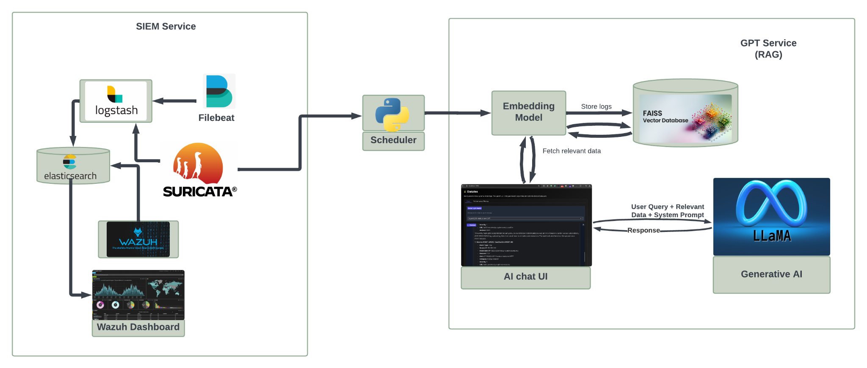
SYSTEM DESIGN
12

Slide 14
SYSTEM DESIGN
13
SIEM Service (Wazuh)
GPT Service (RAG)
Store Logs
Vector Database
(Faiss)
Logstash
Filebeat
Embedding
Model
Relevant Logs
Scheduler Service
(JSON)
User Query + Relevant Logs +
System Prompt
Elasticsearch
Transfer Logs (JSON)
Generative AI
(Llama3/Qwen)
Wazuh
Dashboard
Suricata
Agentic AI Chat Interface
Response

Slide 15
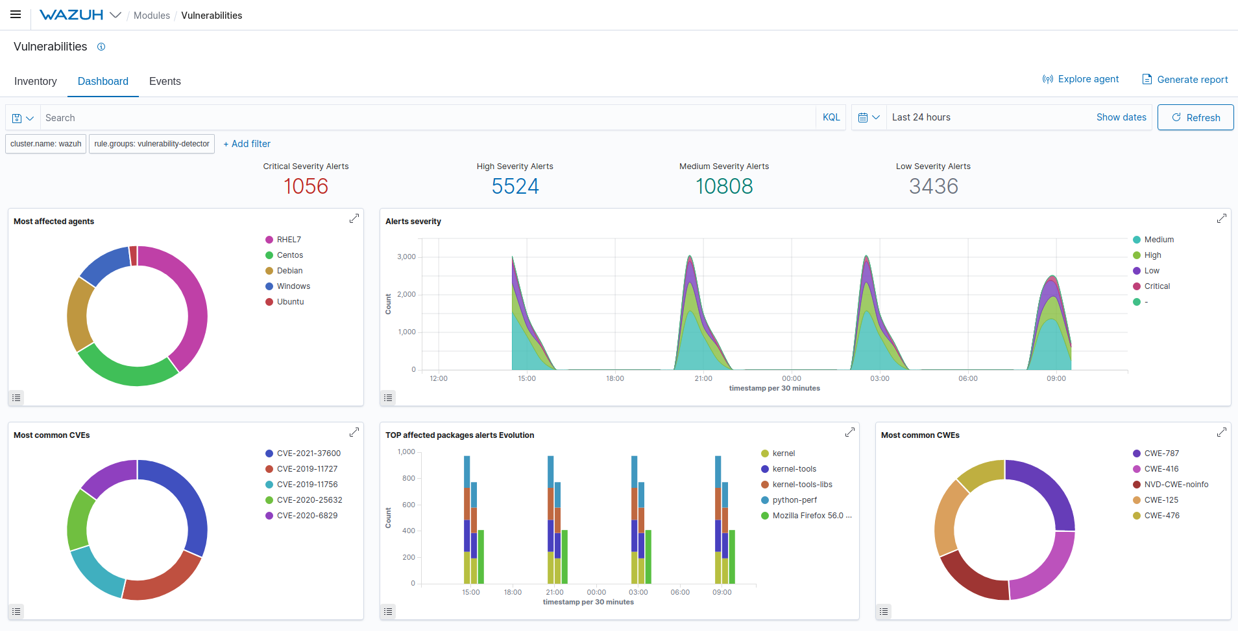
SYSTEM DESIGN
14
SIEM Service (Wazuh)
Logstash
Filebeat
Suricata
Elasticsearch
Wazuh
Dashboard

Slide 16
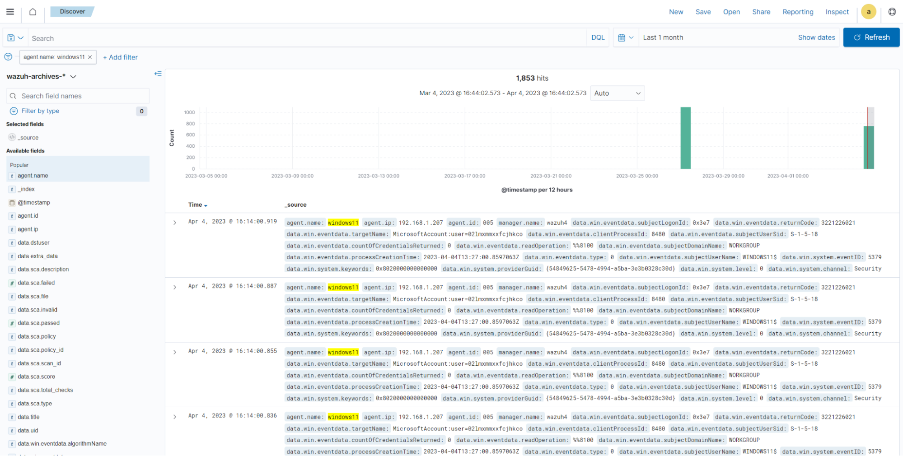
SYSTEM DESIGN
15
SIEM Service (Wazuh)
Logstash
Filebeat
Suricata
Elasticsearch
Wazuh
Dashboard

Slide 17
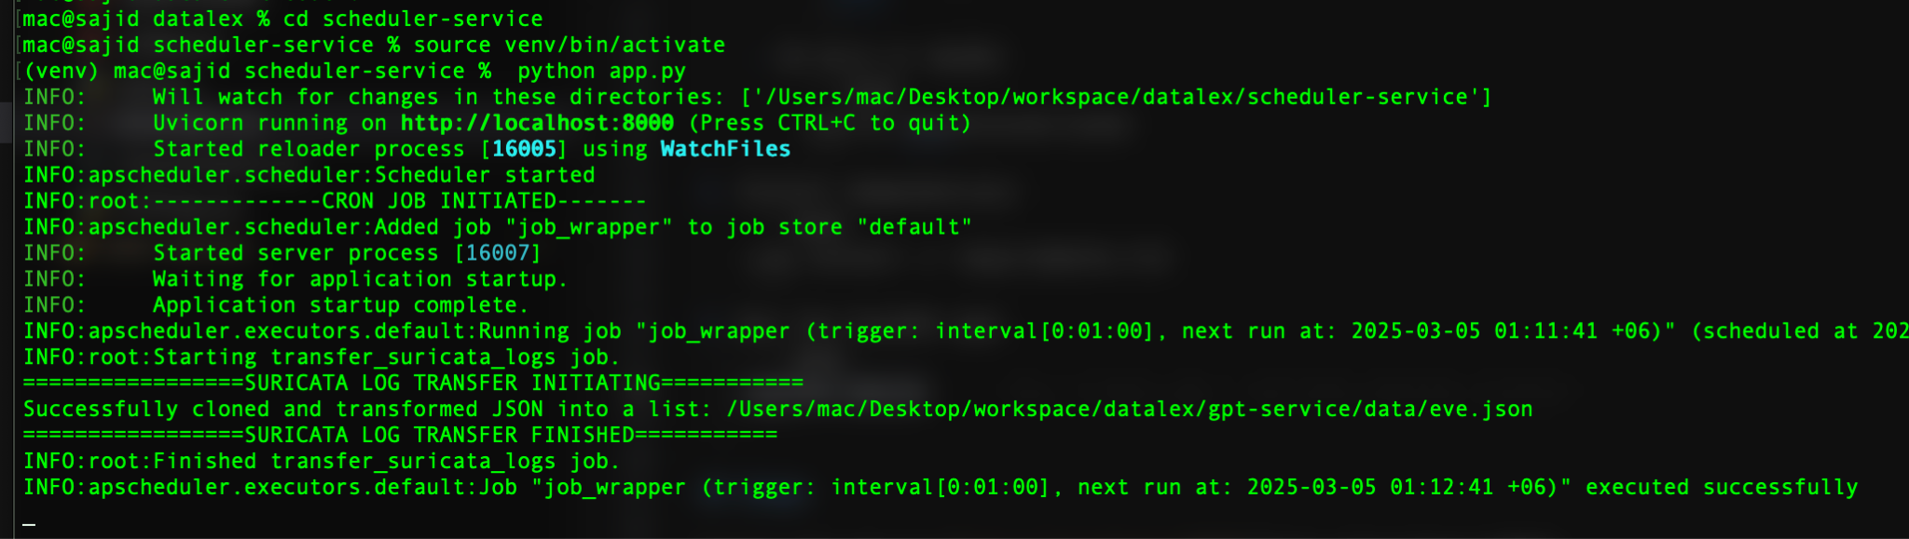
SYSTEM DESIGN
16
SIEM Service (Wazuh)
Logstash
Filebeat
Suricata
Elasticsearch
Scheduler Service
Wazuh
Dashboard

Slide 18
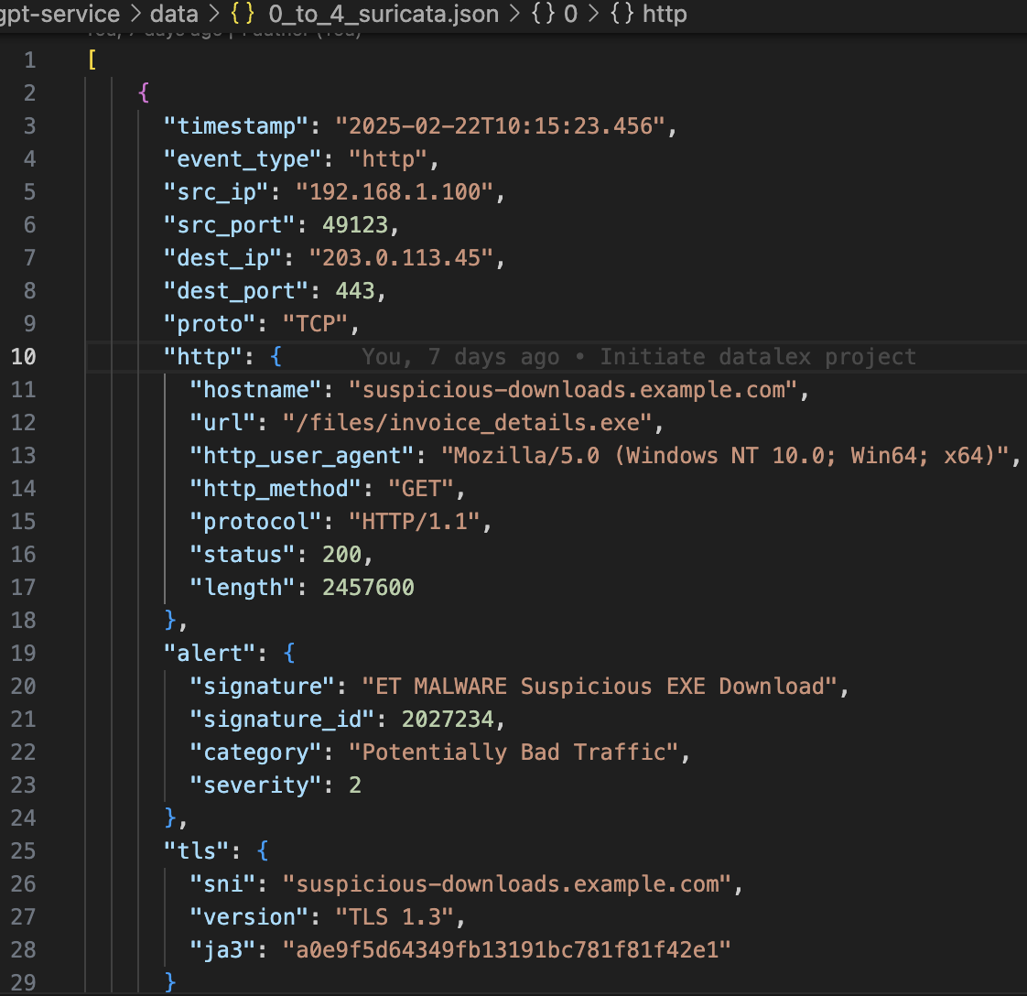
SYSTEM DESIGN
17
Suricata Logs
GPT Service (RAG)
Store Logs
Embedding
Model
Vector Database
(Faiss)
Scheduler Service
5 min interval

Slide 19
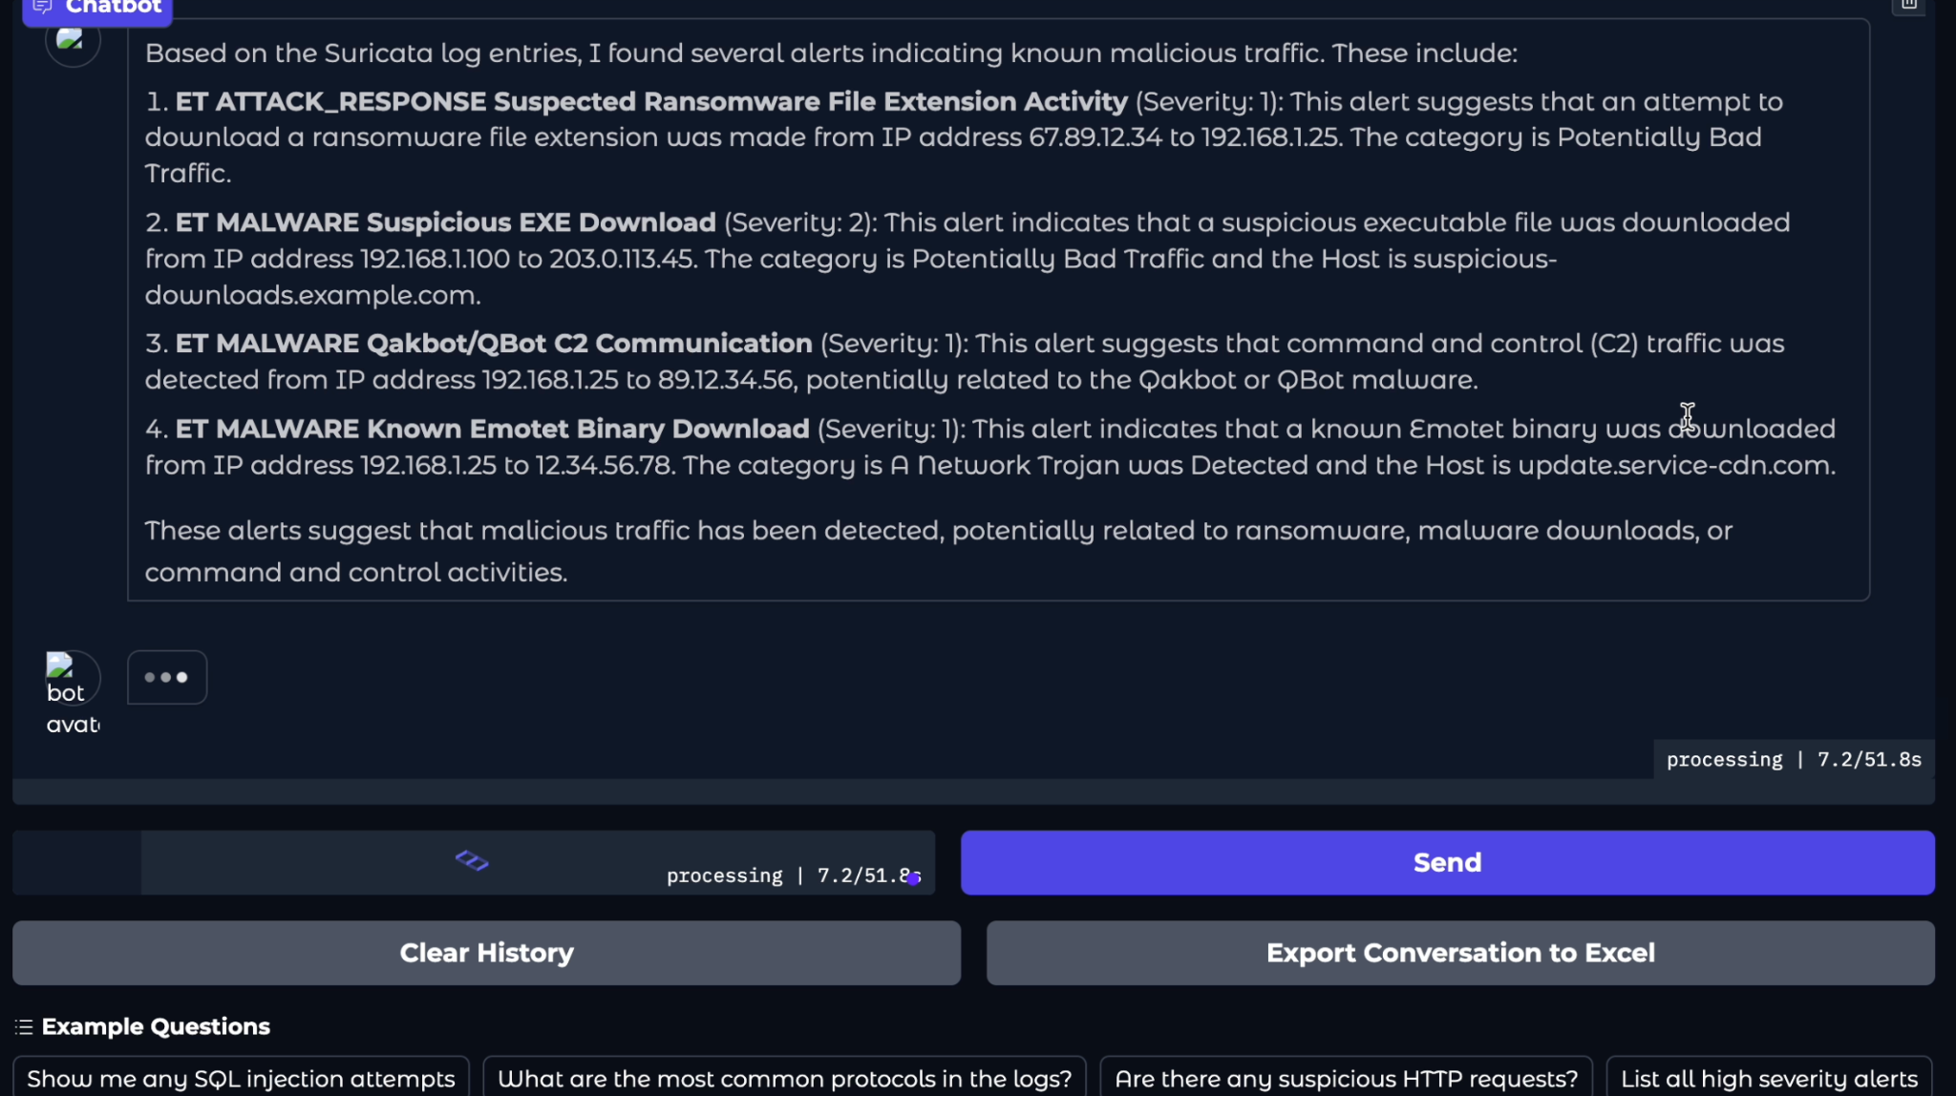
SYSTEM DESIGN
18
GPT Service (RAG)
Relevant Logs
Vector Database
(Faiss)
Embedding
Model
User Query + Relevant Logs +
System Prompt
Generative AI
(Llama3/Qwen)
Agentic AI Chat Interface
Response

Slide 20
05
TECH STACK
19

Slide 21
TECH STACK
20
Language/Framework: Python, FastAPI.
Log Management: Wazuh, Logstash, Filebeat Elasticsearch
Visualization: Wazuh Dashboard.
Intrusion Detection: Suricata.

Slide 22
TECH STACK
21
AI/ML: Ollama, LLAMA3/Qwen, FAISS, Gradio
Containerization: Docker for scalable and isolated service deployment
Threat Intelligence: Virus Total

Slide 23
06
RESULT ANALYSIS
22

Slide 24
RESULT ANALYSIS
23
Inference Time = Retrieval Latency + Generative AI response
Retrieval Latency = Required time to fetch logs from vector database
Memory Usage = Required memory for processing per query
User Query/Min = Number of query execution per minute
Human Labeling on conversation logs

Slide 25
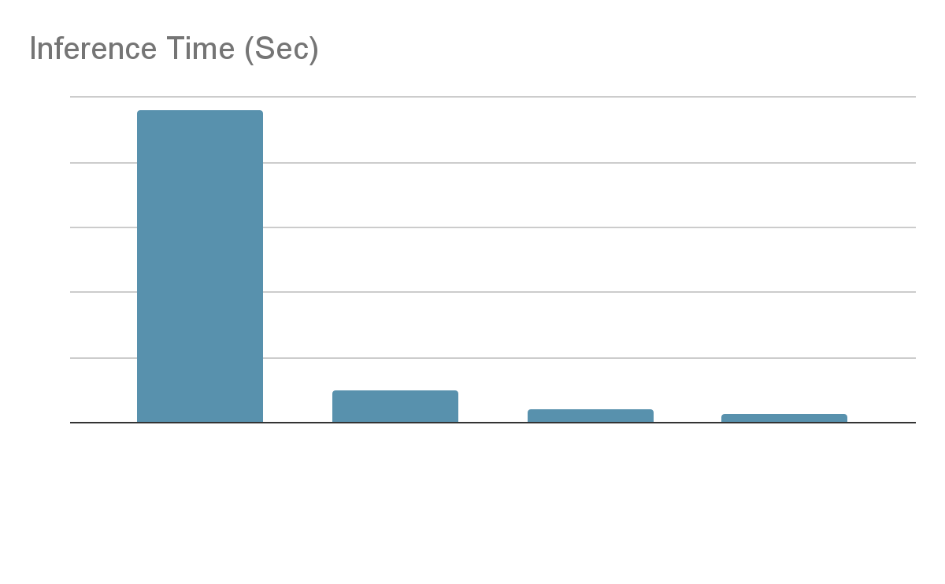
RESULT ANALYSIS
24

Slide 26
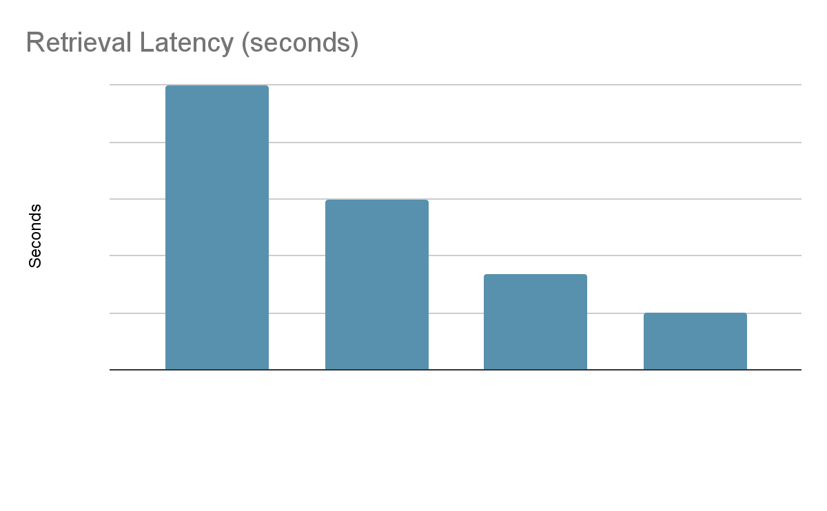
RESULT ANALYSIS
25

Slide 27
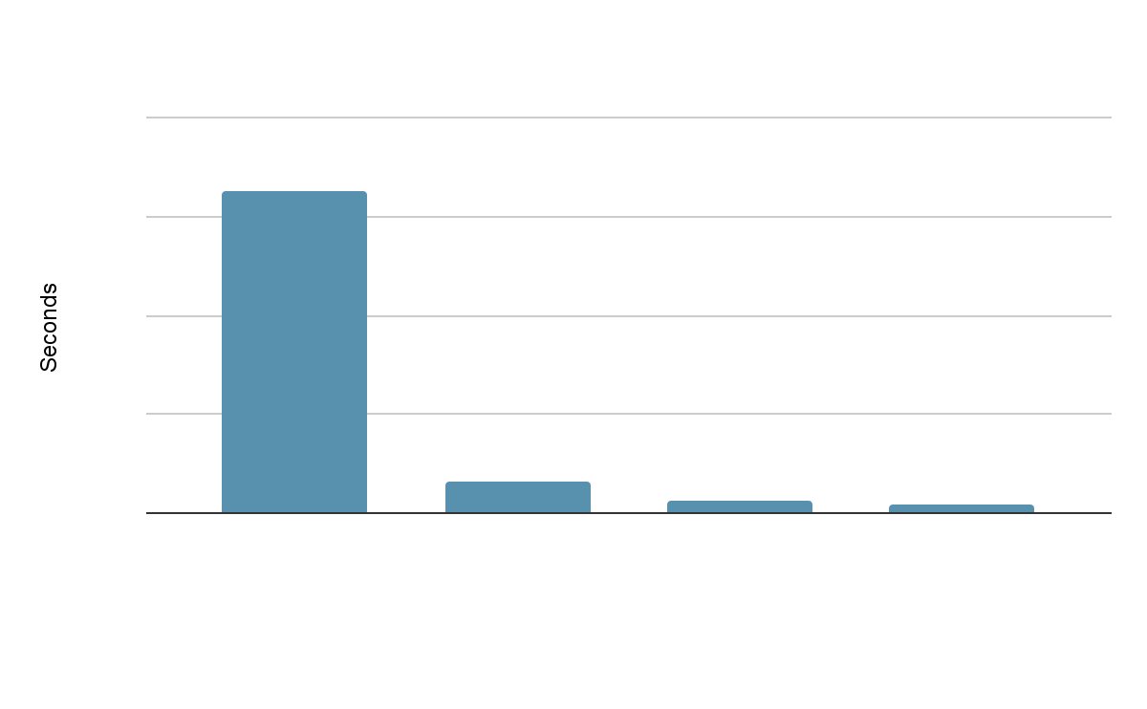
RESULT ANALYSIS
26

Slide 28
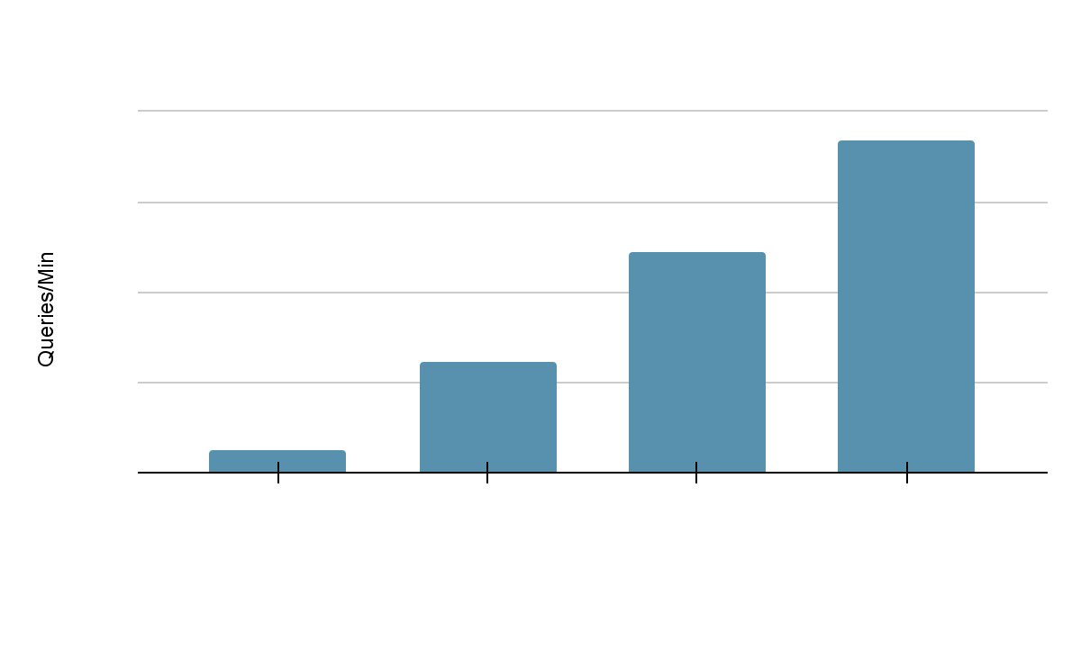
RESULT ANALYSIS
27

Slide 29
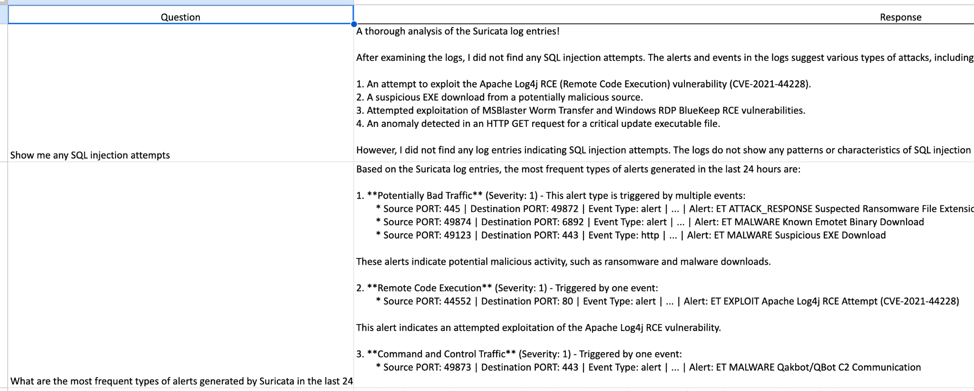
RESULT ANALYSIS
28
Conversation Logs

Slide 30
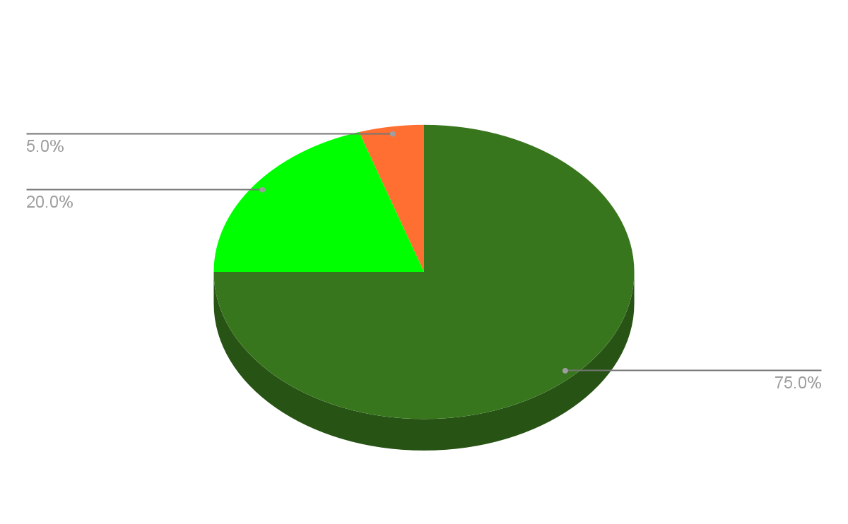
RESULT ANALYSIS
29

Slide 31
07
COMPETITOR ANALYSIS
30

Slide 32
COMPETITOR ANALYSIS
31
Feature | Datalex | Splunk | Fortinet
Offline AI Processing | ✅ | ❌ | ❌
More Control over AI | ✅ | ❌ | ❌
Support for Multiple AI models | ✅ | ❌ | ❌
Support for Bangla Language | ✅ | ❌ | ❌

Slide 33
08
FUTURE WORKS
32

Slide 34
FUTURE WORKS
33
Need more fine tune of RAG for better outputs.
Add support for custom knowledgebase.

Slide 35
Thanks!
Do you have any questions?

Slide 36
REFERENCE
AI Test Case: conversation_log_20250301_024007.xlsx
[GPU Requirement Guide for LLaMA3](https://apxml.com/posts/ultimate-system-requirements-llama-3-models)
[Building a LLaMA 3.2-11B-Based RAG System](https://www.e2enetworks.com/blog/building-a-llama-3-2-11b-based-rag-system-with-vision-model-integration)
[Wazuh Server Installation Guide](https://documentation.wazuh.com/current/installation-guide/wazuh-server/index.html)
[Elastic Stack Integration with Wazuh](https://documentation.wazuh.com/current/integrations-guide/elastic-stack/index.html)

