Slide 1
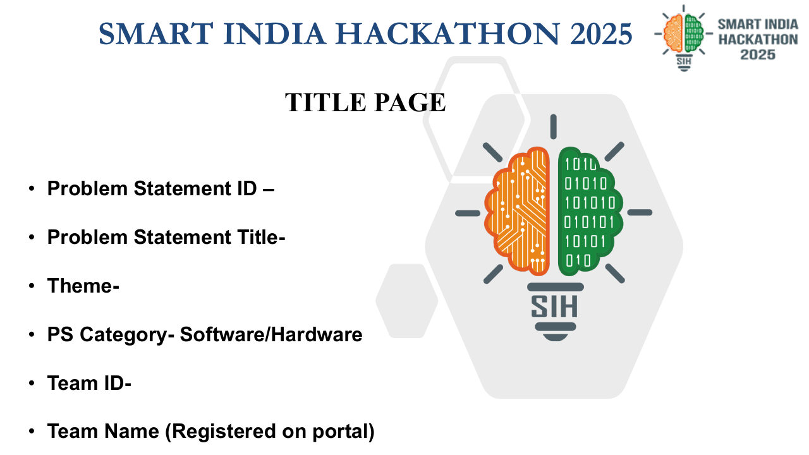
2026
2026
INTELLIGENT FREIGHT FORECASTING
FOR OPTIMIZED VESSEL CHARTERING
Bulk cargo procurement from overseas to the East Coast of India
Problem Statement ID
SIH26006
Theme
Transportation & Logistics*
PS Category
Software
Team ID
160555
Team Name
NUL POINTERS
PROJECT CODENAME
FREIGHT ORACLE
Notes:
Replace the four TO BE ADDED fields before submission.

Slide 2
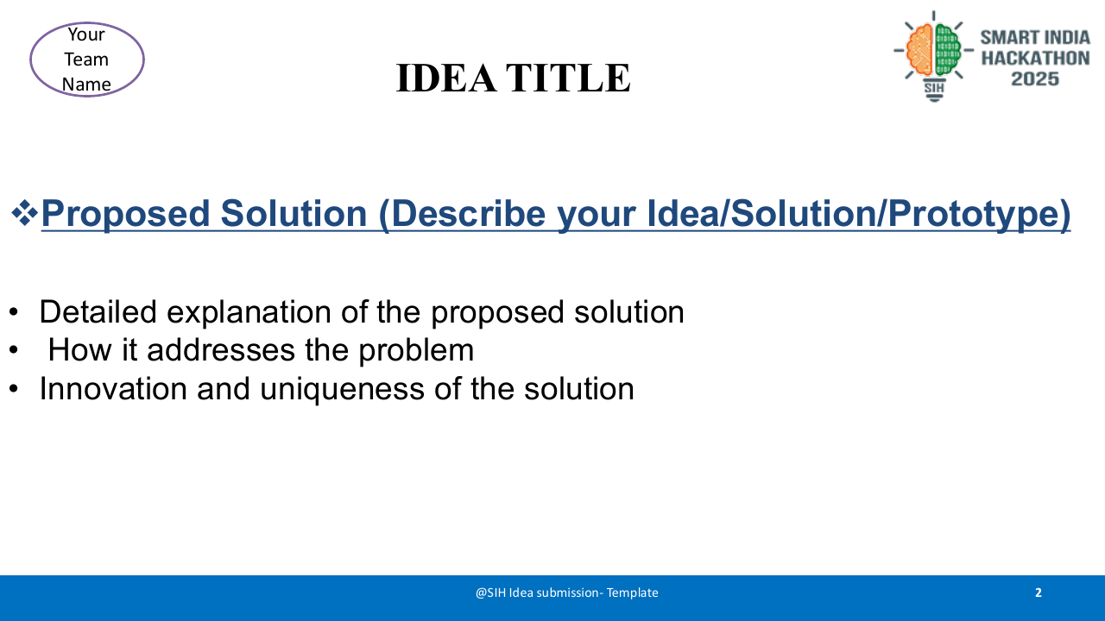
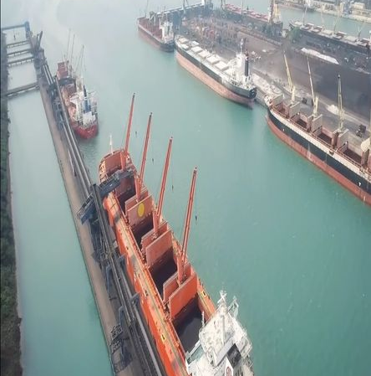
NUL POINTERS
INTELLIGENT FREIGHT FORECASTINGFOR OPTIMIZED VESSEL CHARTERING
2026
HOW THE SOLUTION ADDRESSES THE PROBLEM
ONE CLOSED-LOOP DECISION ENGINE
Turns fragmented market signals into a risk-aware charter recommendation—with the planner retaining final approval.
1 SENSE
2 FORECAST
3 OPTIMIZE
4 ACT + LEARN
AIS • rates • ports
weather • prices
P10 / P50 / P90
1–12 week horizon
vessel • laycan
route • cargo lot
rank • explain
approve • retrain
GAP → RESPONSE
OVERSEAS BULK → EAST COAST INDIA
Fragmented inputs
Unified signal layer
WHY IT IS NOVEL
Real-world chartering context
Uncertain freight timing
Probabilistic forecast bands
Forecast + procurement + charter optimization in one explainable feedback loop.
Siloed charter choices
Landed-cost optimizer
Visual: Paradip Port, Wikimedia Commons

Slide 3
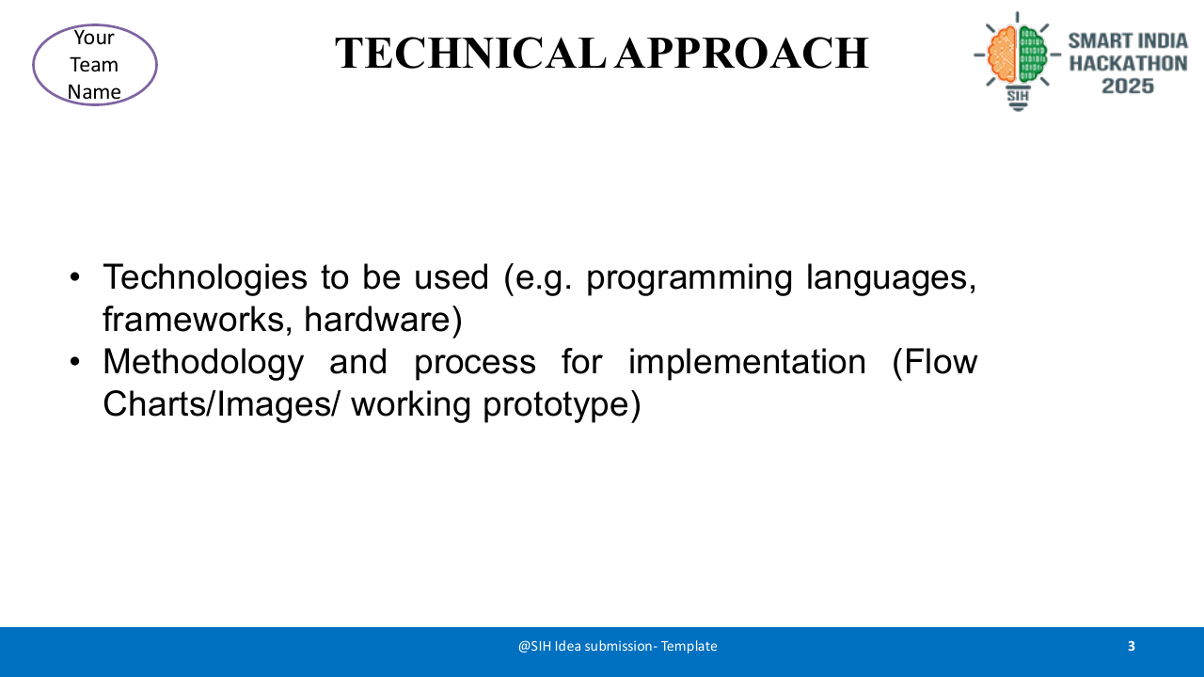
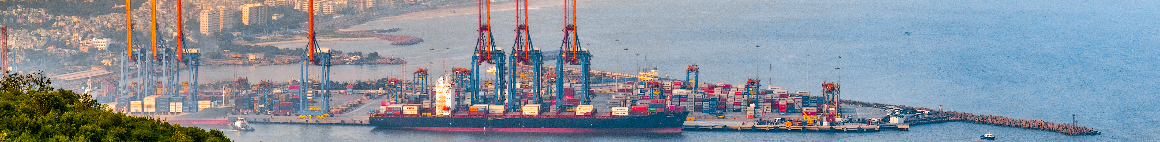
NUL POINTERS
TECHNICAL APPROACH
2026
METHODOLOGY | SIGNAL → FORECAST → OPTIMIZE → DECIDE → LEARN
01 DATA LAYER
02 FORECAST ENGINE
03 STOCHASTIC MILP
04 DECISION + LEARNING
AIS + fixtures
Port queues + weather
Commodity + FX + bunker
Procurement history
TFT + XGBoost ensemble
Walk-forward validation
P10 / P50 / P90
1–12 week horizon
Minimize landed cost + risk
Laycan • draft • vessel class
Route • cargo lot • stock cover
Ranked charter options
SHAP drivers + scenarios
Planner approval + audit trail
Actuals feed retraining
TECH STACK
Python • FastAPI • PyTorch • LightGBM • OR-Tools/Pyomo • PostgreSQL • React • Docker
MODEL / GITHUB LINK
Repository :: https://github.com/nishan1-singh/freight_oracle_v2/
Visual: Visakhapatnam Port panorama, Wikimedia Commons

Slide 4
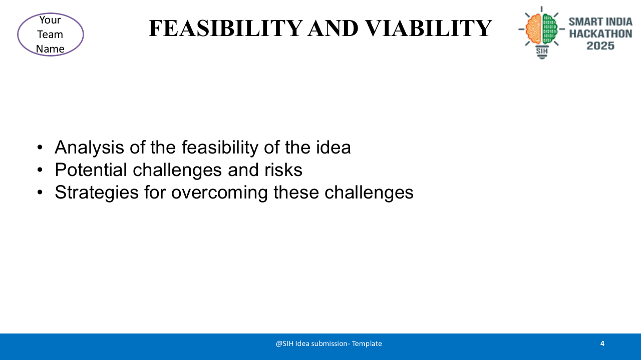
NUL POINTERS
FEASIBILITY AND VIABILITY
2026
36-HOUR BUILD PATH
0H
12H
24H
36H
DATA
BASELINE
OPTIMIZER
DEMO
schema + sample
forecast API
ranked options
dashboard + pitch
RISK HEATMAP
CONTROL PLAN
Impact →
D
Schema validation • imputation • source confidence • fallback baseline
Likelihood
D
A
V
V
Quantile forecasts • drift monitor • stress scenarios • frequent retraining
A
SHAP rationale • role access • audit log • planner approval retained
LOW
MED
HIGH
D Data gaps V Volatility A Adoption

Slide 5
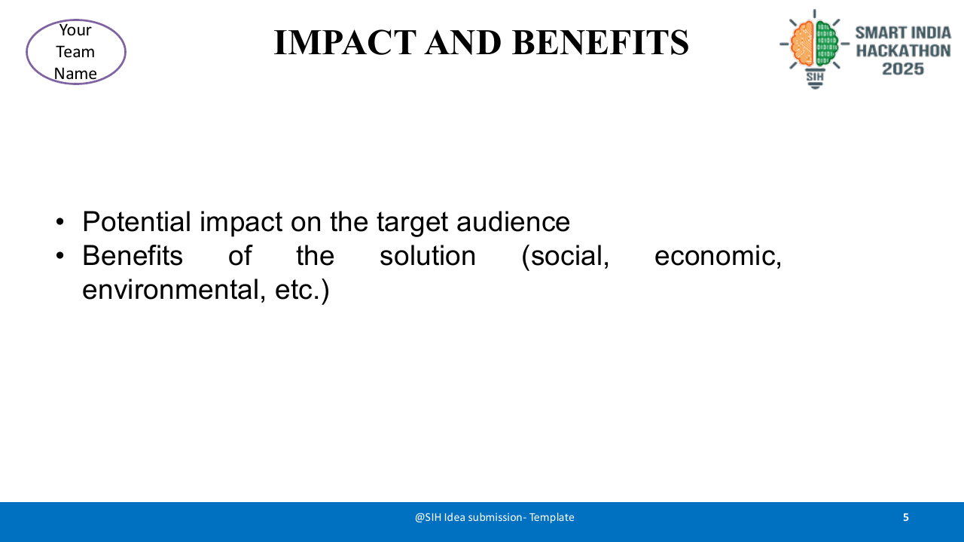
NUL POINTERS
IMPACT AND BENEFITS
2026
PILOT TARGETS — UPPER BOUND
Illustrative hypotheses; validate through historical back-tests and a shadow-mode pilot.
TARGET VALUE HYPOTHESIS
Freight 40% • Demurrage 25% • Forecast 20% • Emissions 15%
Illustrative share of expected pilot value—not measured results.
BENEFICIARIES
PROCUREMENT + FINANCE
CHARTERING + PORT TEAMS
SUPPLY RESILIENCE + LOWER EMISSIONS
Strategic outcome: proactive, risk-aware freight buying instead of reactive chartering.

Slide 6
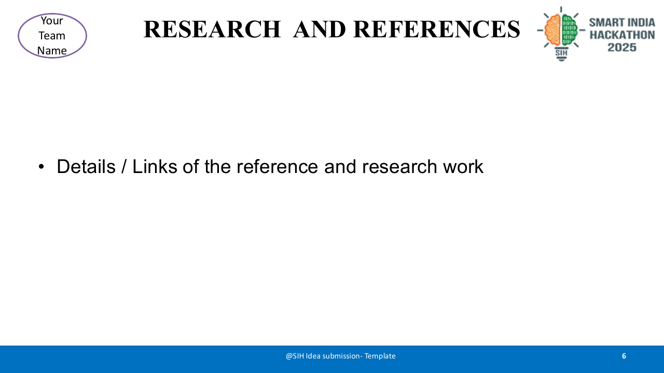
NUL POINTERS
RESEARCH AND REFERENCES
2026
RESEARCH BASIS
Authoritative market, port and weather sources + proven forecasting and optimization methods.
EVALUATION PLAN
KEY DATA & METHOD REFERENCES
1 UNCTAD — Review of Maritime Transport 2023, Ch. 2
unctad.org/system/files/official-document/rmt2023ch2_en.pdf
1 Walk-forward back-testing
Prevents future-data leakage.
2 Baltic Exchange — Dry bulk market information & indices
balticexchange.com/en/data-services/market-information0/dry-services.html
2 Practical baselines
Seasonal naïve • moving average • XGBoost.
3 Ministry of Ports — Monthly cargo traffic
shipmin.gov.in/en/transport-reseach/monthly-cargo-traffic-handled-major-ports
3 Decision-quality metrics
MAE / WAPE • pinball loss • cost regret.
4 World Bank — Commodity Markets “Pink Sheet”
worldbank.org/en/research/commodity-markets
4 Shadow-mode pilot
Compare recommendations with actual charter outcomes.
5 Open-Meteo / DWD — Marine Weather API
open-meteo.com/en/docs/marine-weather-api
METHODS | Temporal Fusion Transformers (arXiv:1912.09363) • Google OR-Tools
VISUAL CREDITS | Paradip Port.jpg and Cargo Ship and breakwaters.jpg — Wikimedia Commons

